Slide 1
NERC EMSWG Update
Wei Qiu, NERC EA
ERCOT TWG Conference Call
April 24, 2024

Slide 2
Hybrid meeting at WECC
Date/Time: June 4, 2p -5p MPT
Location: WECC
Communication Resilience
GridEx lessons learned
Routable RTU communications
6 Ghz
Theme/presentations for 2024 Monitoring and Situational Awareness Technical Conference

Slide 3
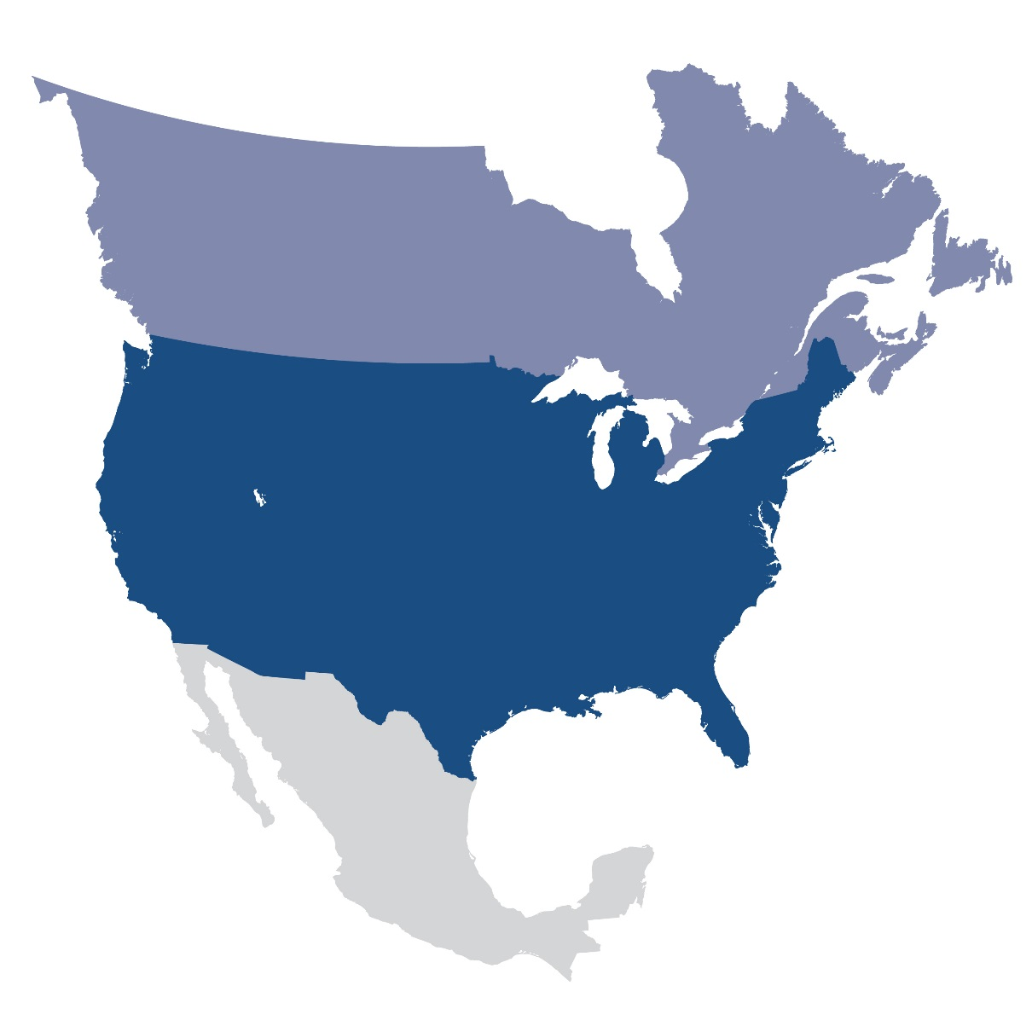
Questions and Answers
Contact Information:
wei.qiu@nerc.net

