Slide 1
RTC+B Task Force
Update
Matt Mereness
TWG Update
April 24, 2024

Slide 2
Outline
Program update: RTC+B Program Update from April Board T&S
Reminder of RTCBTF Review Cycle
Current Issues for RTCBTF
  Issue 3 - Framework for periodic analysis comparing RTC and the current ORDC design
  Issue 4 - Verifiable Cost Manual- Change for on-line hydro Resources per Key Principle 1.3(3)
  Issue 17 - RUC Capacity Short (TAC endorsement)
  Issue 18 - Review of the AS Demand Curves in the context of current policy
TAC Endorsement requested: Issue 17 RUC Capacity Short

Slide 3
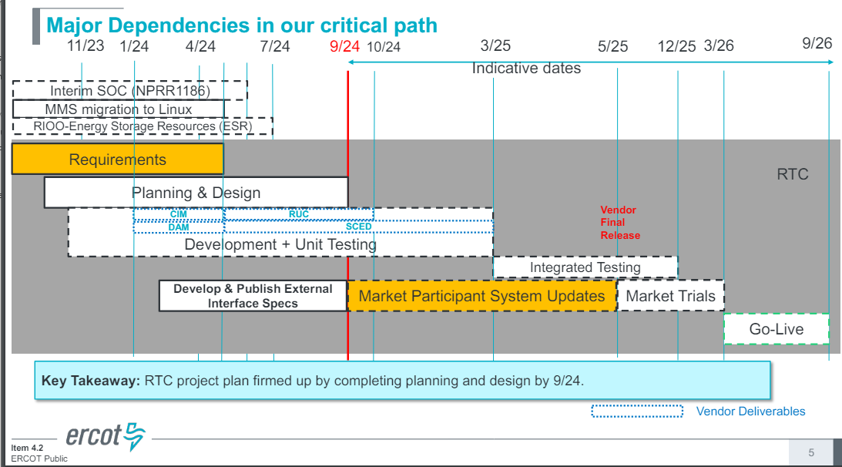
RTC+B Program Update
(excerpt from April Board T&S RTC Update)

Slide 4
Current Issues List
Link to current issues on today’s meeting page
Based on questions received, ERCOT proposes addition of:
  Issue #20- Review of the Energy and AS Offer Caps in the context of current policy
    Defer discussion to May RTCBTF meeting
- Moving up discussion of interface changes and market trial configuration
- Added discussion of Energy and AS Offer Caps per MP requests

Slide 5
Status of in-flight discussions for April RTCBTF
Issue 17 - RUC Capacity Short
  Third round of three discussions
    Feb 2024- Detailed whitepaper and examples to close gaps on addressing AS subtypes and State of Charge
    March 2024- More examples and Q&A
    April 2024- Walked through draft NPRR language to show how whitepaper would be converted to protocols, and Received TAC endorsement.
Issue 4 - Change for on-line hydro Resources mitigation per Key Principle 1.3(3))
  Second round of three discussions
    March 2024- Initial review of concept: Given that Hydro Resources operating in synchronous condenser mode are not dispatched by SCED, ERCOT proposes setting the Mitigated Offer Cap for all Hydro Resources to SWCAP.
    April 2024- Reviewed draft NPRR and verifiable cost language, and RTCBTF had no issues with moving concept forward for TAC endorsement.
Issue 3 - Framework for periodic analysis comparing RTC and the current ORDC design
  ERCOT staff walked through approach for RTC analysis
    Public RTC educational tool- based in MS excel for 5 generator case (available on April RTCBTF meeting page)
    Internal production scale simulator based in Python to perform “what-if” analysis (in progress)
    Based on capabilities and limitations, soliciting feedback from RTCBTF on framework and types of analysis or Operating Days to be evaluated.
Issue 18 - Review of the AS Demand Curves in the context of current policy
  Shams presentation on potential changes
  RTCBTF will discuss more at next meeting (reminder- ERCOT current plan is to implement approved protocols)

Slide 6
RTCBTF Next steps
May 8- Next RTCBTF
Limited series of RTC+B Technical Workshops (April-June 2024)
  Target audience, vendors and IT development/implementation staff (sent to RTCBTF and TWG)
    RTC+B Technical Workshop - April 18, 2024: 1:00 PM – 4:00 PM :
    Overview of ICCP Telemetry/EMS SCADA/AGC changes & ICCP Configurations for parallel testing.
    RTC+B Technical Workshop - May 6, 2024: 1:00 PM – 4:00 PM :
    Finalize approach on ICCP configuration approaches for parallel testing and transition.
    RTC+B Technical Workshop - May 15, 2024: 1:00 PM – 4:00 PM :
    Market Interfaces design specifications (submissions - External API/Market Manager, notifications, and reports)
    RTC+B Technical Workshop - June 6, 2024: 1:00 PM – 4:00 PM :
    Reserved for further discussions if needed and Q&A session.
  Based on the feedback from these workshops, ERCOT will finalize ICCP/Market Interface design specifications and publish draft versions to the ERCOT website.
  This engagement will help QSEs and their vendors start planning their RTC+B systems design and implementation early to align with ERCOT’s RTC+B project implementation timelines which is critical for ERCOT to deliver this project successfully and on time.
  Discussions and artifacts will be highlighted and shared at regular RTCBTF meetings.
Questions?

