Slide 1
NPRR1186 Update
Sreenivas Badri
April 24, 2024

Slide 2
NPRR1186 Status
Objective of this NPRR is to implement improvements prior to the RTC+B project for better ESR State of Charge Awareness, Accounting, and Monitoring.
NPRR Status
  On 1/18/2024, PUCT remanded this NPRR to the ERCOT Board.
  Suggested modifications to section 8.1
  ERCOT submitted comments to remove the revisions to Protocols Section 8.1
  ERCOT Board approved
  PUCT approved

Slide 3
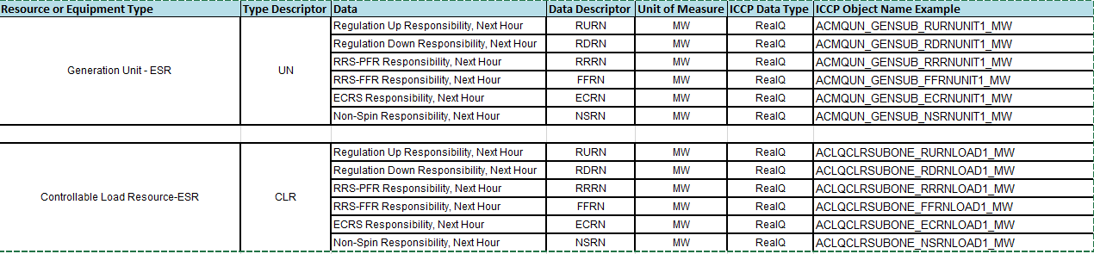
ERCOT System Changes
New ICCP Telemetry points for ESR additions

Slide 4
ERCOT System Changes
External Specs/xsd changes
  3 new fields are being added to COP submissions
    Max SOC
    Min SOC
    TargetBeginSOC
  Changes are backward compatible for Non-ESRs and ESRs
  Changes are in the ErcotTransactionTypes.xsd

Slide 5
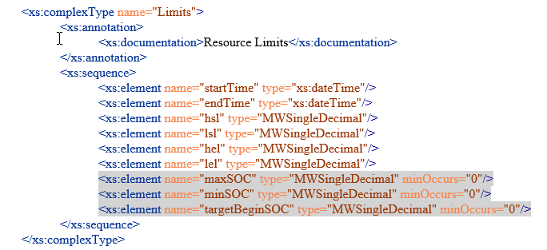
ERCOT System Changes
External Specification changes
  The gray highlighted elements below were added for this NPRR

Slide 6
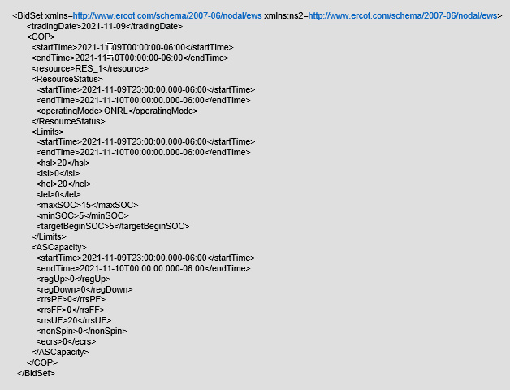
ERCOT System Changes
External Specification changes
  COP submission xml example with SOC changes

Slide 7
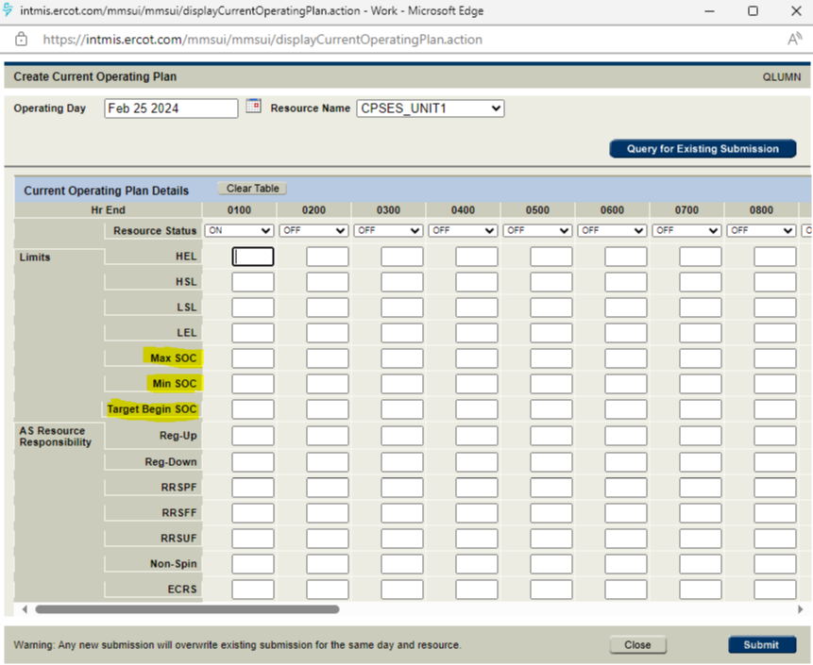
ERCOT System Changes
Market Manager UI changes
  COP Submission with SOC changes

Slide 8
Timelines
ICCP Handbook was updated with new telemetry changes. ICCP handbook can be found at below link
https://www.ercot.com/services/mdt/userguides
Draft version of External Specs (XSD) changes (EIP External Interfaces Specification v1.26) are available in ercot.com (https://www.ercot.com/services/mdt/xsds).
Release Timelines (subject to change based on PUCT decision)
  MOTE Testing to start from 05/20/2024
    Market Notice was sent on MOTE testing on 04/15/2024
    https://www.ercot.com/services/comm/mkt_notices/M-A041524-01
  Go live date - 06/27/2024

Slide 9
First Operating Day
Go Live 06/27/2024 afternoon around 3:45 PM
NPRR is effective immediately after go live as EMS start calculating ESRs updated HASL/LASL to be used in SCED dispatch.
06/27/2024 is considered as first Operating Day
ESR COPs submitted for Operation Day 06/27 and for future Operating Days before go live should be resubmitted after go live on 06/27.

