Slide 1
ERCOT Technology Working Group (TWG)
April 24, 2024

Slide 2
ERCOT TWG
WELCOME

Slide 3
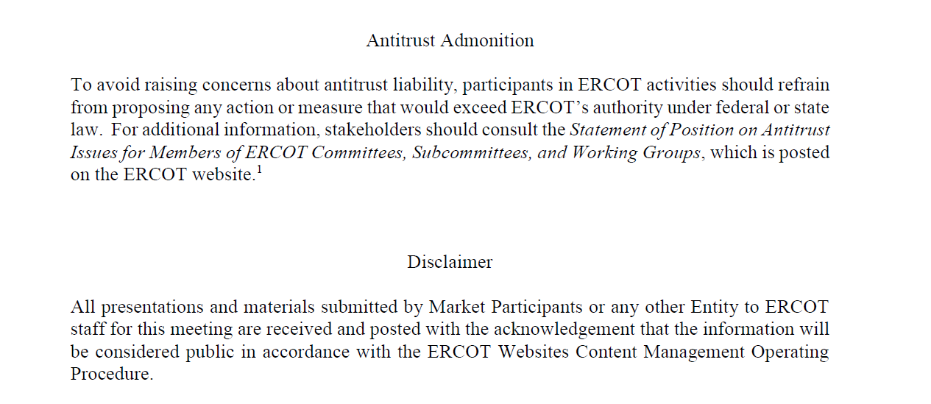
ERCOT TWG

Slide 4
ERCOT TWG Agenda
Item # | Item Description | Presenter | Start Time
1 | Antitrust admonition | Sreenivas Badri | 2:00 PM
2 | Vice Chair Selection | Sreenivas Badri | 2:05 PM
3 | NERC Update – EMSWG | Wei Qiu | 2:10 PM
4 | Project Updates | No Presentation – Information Only | 2:15 PM
5 | RTC+B Updates | Matt Mereness | 2:15 PM
6 | RTC+B Technical Workshops Updates | Sreenivas Badri | 2:25 PM
7 | NDCRC - Generating Unit Tests and Automatic Tracing | Nick Barbas | 2:35 PM
8 | NPRR1217 – Technical Discussion | Blake Holt (LCRA) | 2:50 PM
9 | Secure API Improvements Pilot and Roadmap | Brian Brandaw | 3:15 PM
10 | Other Projects/Initiatives status updates |  | 3:25 PM
 | NPRR1186 Updates | Sreenivas Badri/Nitika Mago
 | NPRR1149 Updates | Katherine Li
 | ERCOT MMS Migration to Linux – Go Live Updates | Katherine Li
 | SCR820 Update - Real-Time Operator Messaging Tool - POC Demo Tool Access to TOs | Sreenivas Badri
11 | Future Topics of Interest | Sreenivas Badri | 3:55 PM
12 | Adjourn | Sreenivas Badri | 4:00 PM

Slide 5
Vice Chair Selection
Vice Chair Nomination and Selection

Slide 6
NERC EMSWG Update
NERC EMSWG Update – Wei Qiu

Slide 7
Project Updates
Project Updates – No Presentation

Slide 8
RTC+B Updates
RTC+B Updates – Matt Mereness

Slide 9
RTC+B Technical Workshops Updates
RTC+B Technical Workshops Updates – Sreenivas Badri

Slide 10
NDCRC - Generating Unit Tests and Automatic Tracing
NDCRC - Generating Unit Tests and Automatic Tracing - Nick Barbas

Slide 11
Secure API Roadmap Updates
Secure API Improvements Pilot and Roadmap – Brian Brandaw

Slide 12
NPRR1217 – Technical Discussion
NPRR1217 – Technical Discussion on ERS and Load Resource XML Instructions – Blake Holt (from LCRA)

Slide 13
Other Projects/Initiatives Status Updates
NPRR1186 Updates – Sreenivas Badri/Nitika Mago
NPRR1149 Update – Katherine Li
ERCOT MMS Migration to Linux – Katherine Li
SCR820 Update - Real-Time Operator Messaging Tool - POC Demo Tool Access to TOs – Sreenivas Badri

Slide 14
ERCOT TWG – Open Forum
Future Topics of Interest
Topics and presentations from TWG members

Slide 15
ERCOT TWG
Thank You
You can reach me at
Sreenivas.Badri@ercot.com

