Slide 1
Potential Changes to CDR NPRR1219 Language
Pete Warnken
Resource Adequacy
Supply Analysis Working Group
April 19, 2024

Slide 2
Battery Energy Storage Design Duration Classes
Astrapé Consulting is developing a modeling approach to determine the Effective Load Carrying Capability (“reliability value”) of one MWh of energy
Given mixes of wind, solar, and battery storage resources—and based on the proportions of energy versus capacity shortages for loss-of-load events with a range of durations—ELCCs can be determined for different battery durations
With this approach, assigning battery storage units to duration classes can be avoided
If the energy ELCC approach works out, then ERCOT will submit NPRR comments modifying the language regarding battery storage ELCCs

Slide 3
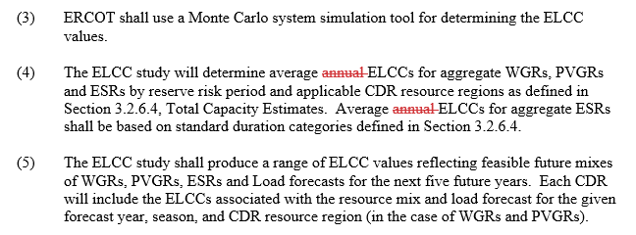
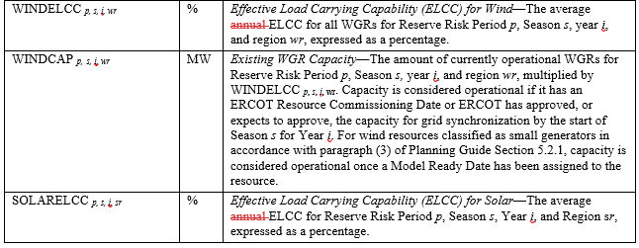
Clarification on Annual vs. Seasonal ELCC Language
NPRR language cites “average annual ELCCs” several times. This term was used because ELCC derivation involves annual estimation followed by seasonal calculations. A commenter thought that this was confusing given that the CDR will be based on seasonal ELCCs
To avoid confusion, ERCOT is proposing deleting “annual” from the NPRR language as shown below:

Slide 4
NPRR Implementation Timeline
ERCOT expects to implement all the proposed changes over the course of multiple CDR releases
If the Commission approves the NPRR by fall 2024, ERCOT would introduce the more modest and straightforward changes for the December 2024 CDR; the more consequential changes would be targeted for the May 2025 release and possibly the December 2025 release
ERCOT will keep SAWG apprised on the timeline for the specific changes once more clarity on time NPRR timeline

