Slide 1
RTC+B Technical Workshop
ERCOT Staff
April 18, 2024

Slide 2
RTC+B Technical Workshop
WELCOME
Meeting#1 - Overview of ICCP Telemetry/EMS SCADA/AGC changes & ICCP Configurations for parallel testing.

Slide 3
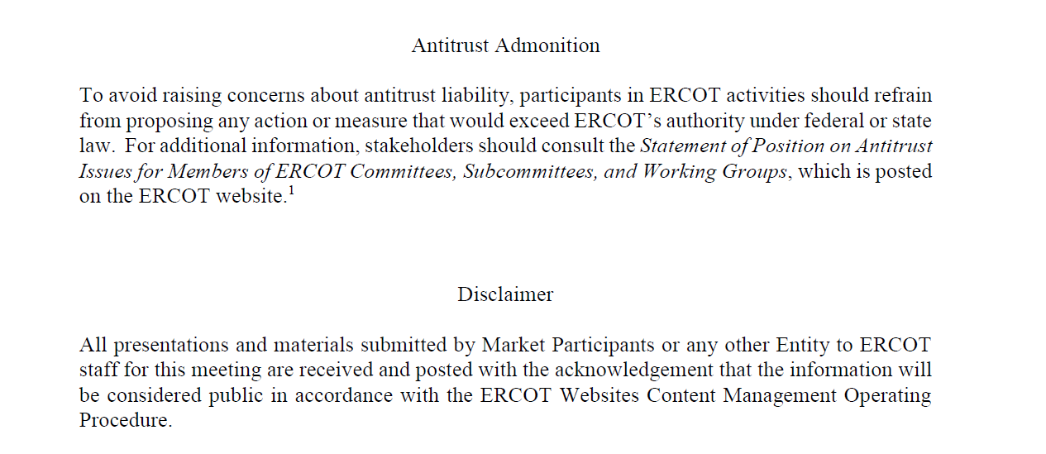
RTC+B Technical Workshop

Slide 4
Agenda
Item # | Item Description | Presenter | Start Time
1 | Antitrust admonition | Sreenivas Badri | 1:00 PM
2 | Introduction | Sreenivas Badri | 1:05 PM
3 | ERCOT Systems Changes Overview | Sruthi Hariharan | 1:10 PM
4 | RTC+B Real-Time Data flows | Tejaswi Potluri | 1:20 PM
5 | ERCOT LFC (AGC)/RLC Design Overview | Tejaswi Potluri | 1:35 PM
6 | RTC ICCP Telemetry changes | Tejaswi Potluri/Kevin McGarrahan | 1:50 PM
7 | Break | Break | 2:20 PM
9 | ICCP Configurations for Parallel Testing | Sreenivas Badri/Kevin McGarrahan | 2:30 PM
10 | Q&A Session |  | 3:20 PM
11 | Next Steps | Sreenivas Badri | 3:50 PM
12 | Adjourn | Sreenivas Badri | 4:00 PM

Slide 5
RTC+B Technical Workshops – Key Objectives
Key Objectives
  Help QSEs, and their vendors start planning their RTC+B systems design and implementation early to align with ERCOT’s RTC+B project implementation timelines which is critical for ERCOT to deliver this project successfully and on time.
  Based on the feedback from these workshops, ERCOT will finalize ICCP/Market Interface design specifications and publish draft versions to the ERCOT website.
RTC+B Technical Workshops Schedule
    RTC+B Technical Workshop - April 18, 2024: 1:00 PM – 4:00 PM :
    Overview of ICCP Telemetry/EMS SCADA/AGC changes & ICCP Configurations for parallel testing.
    RTC+B Technical Workshop - May 6, 2024: 1:00 PM – 4:00 PM :
    Finalize approach on ICCP configuration approaches for parallel testing and transition.
    RTC+B Technical Workshop - May 15, 2024: 1:00 PM – 4:00 PM :
    Market Interfaces design specifications (submissions - External API/Market Manager, notifications, and reports)
    RTC+B Technical Workshop - June 6, 2024: 1:00 PM – 4:00 PM :
    Reserved for further discussions if needed and Q&A session.

Slide 6
RTC+B Technical Workshops – Meeting #1
  Focus of today’s meeting
    Overview of Real-Time Data flows
    LFC/RLC design changes
    ICCP Telemetry points – Additions/Deletions
    Discuss options for ICCP system configurations to enable parallel testing
  Objective of today’s meeting
    Solicit feedback on ICCP configurations for parallel testing
  Out of Scope items from today meeting
    Market Interfaces (External Specs/XSD changes, API, Report Specs etc.)
    Market Trials readiness
    Closed Loop Testing and Cutover Plan

Slide 7
What is RTC+B+SOC?
RTC (NPRR1007-1013)
  Current Real-Time Market (RTM) finds most effective set of Resources for providing Energy (but not Ancillary Services).
  Real-Time Co-optimization would help find the most effective set of Resources for providing Energy & Ancillary Services.
  Brings Operational and Economic Benefits - $1.6B per year in energy cost reduction + more
Batteries – Single Model for Batteries (NPRR1014)
  Switching Batteries from the current “Combo Model” to a “Single Model” in ERCOT core systems.
  To implement “single-model” is to unify into single ESR
    Better Modeling and the ESR is represented as it is, as one Resource
    Single set of telemetry; “bid/offer curve” submittal; Performance Monitoring; and Settlements
State of Charge Management (NPRR1204)
  Accounting for SOC (MWh) in Reliability Unit Commitment (RUC) and Security-Constrained Economic Dispatch (SCED).

Slide 8
Overview of ERCOT System Changes
Resource Integration & Ongoing Operations (RIOO)
Network Model
Management
Registration
Settlement
& Billing
Credit Monitoring
Market Participant (MP)
EMS/GMS
ICCP
Energy Management System
MP
Scheduling & Trading systems
External Facing APIs
Market Management System
Enterprise Integration
Reports &
Dashboards
Outage Scheduler

Slide 9
RTC+B Project Tentative Schedule
11/23
1/24
4/24
7/24
9/24
10/24
3/25
5/25
12/25
3/26
9/26
Indicative dates
RIOO-Energy Storage Resources (ESR)
Requirements
RTC
Planning & Design
Development + Unit Testing
Vendor Final Release
CIM
RUC
DAM
SCED
Integrated Testing
Develop & Publish External
Interface Specs
Market Participant System Updates
Market Trials
Go-Live
Key Takeaway: RTC project plan firmed up by completing planning and design by 9/24
Vendor Deliverables

Slide 10
RTC+B Real-Time Data Flows

Slide 11
ERCOT RTC+B LFC (AGC) Design changes
Current LFC
Regulation instructions
1) QSE Portfolio
2) FRRS service
RTC+B LFC
Regulation instructions
1) Resource Specific
2) No concept of participation factors
3) FRRS service is removed
Basepoint instructions
Updated Desired Set Point
(UDSP:- 4-minute ramp to SCED Base Point + Regulation Instruction)
AS Deployments
QSE portfolio deployment for RRS-PFR, RRS-FFR,ECRS
AS Deployments
Resource specific deployment included in UDSP
Capacity Monitoring
Capacity calculations using
1) HASL/LASL
2) AS Responsibilities and Schedules
Capacity Monitoring
1) Capacity calculations using AS Capabilities
2) HASL/LASL are removed
3) Separate capacity calculations for ESRs
Basepoint instructions
Updated Desired Base Point (UDBP:- 4-minute ramp to SCED Base Point)

Slide 12
ERCOT RTC+B RLC Design changes
Current RLC
Dispatch Limit Calculation
Telemetry validations
RTC+B RLC
Dispatch Limit Calculation
HDL/LDL using Normal Up/down Ramp Rates
HASL/LASL are removed
Telemetry validations
SCADA data quality – use last good value for suspect or bad quality telemetry
Reasonability checks (ESRs are allowed to have negative telemetry)
AS Ramp capabilities validation against Qualification flags and Qualification MW
Resource status validity checks - Ensure resource status is valid and corresponds to the resource type (GR/LR)
SCADA data quality – use last good value for suspect or bad quality telemetry
Reasonability Checks
AS responsibility and schedule validation against Qualification flags and Qualification MW
Resource status validity checks – Ensure resource status is valid and corresponds to the resource type (GR/LR)
HDL/LDL using SCED Up/Down Ramp Rates
HASL/LASL calculations

Slide 13
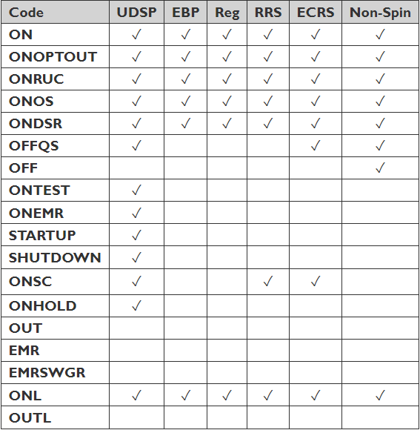
ERCOT RTC+B RLC Design changes
Resource Status (RST) codes are changing for all resources
Valid Resource Statuses for RTC+B

Slide 14
Dispatch limit calculations for SCED dispatchable resources
Generation Resources (GR)
Resource Status | Dispatch Limit Calculation
SHUTDOWN | HDL= MW - (NDRR* 5)
not SHUTDOWN | HDL= min(MW+ (NURR* 5), HSL)
STARTUP | LDL= MW+ (NURR* 5)
not STARTUP | LDL= max(MW- (NDRR* 5), LSL)
Energy Storage Resources (ESR)
Resource Status | Dispatch Limit Calculation
ONHOLD | HDL= 0 LDL= 0
ONTEST | HDL= max(min(MW, HSL), LSL) LDL= HDL
not {OUT, EMR, EMRSWGR, ONHOLD, ONTEST} | HDL= min(MW+ (NURR* 5), HSL) LDL=max(MW- (NDRR* 5), LSL)

Slide 15
Dispatch limit calculations for SCED dispatchable resources
Variable | Unit | Definition
HSL | MW | High Sustained Limit
LSL | MW | Low Sustained Limit
HDL | MW | High Dispatchable Limit
LDL | MW | Low Dispatchable Limit
MW | MW | Telemetered net generation of Resource
NURR | MW/min | Normal Up Ramp Rate
NDRR | MW/min | Normal Down Ramp Rate

Slide 16
Dispatch limit calculations for SCED dispatchable resources
Controllable Load Resources (CLR)
Dispatch Limit Calculation
HDL= min(LDMW+ (NDRR* 5), MPC)
LDL= max(LDMW- (NURR* 5), LPC)
Variable | Unit | Definition
MPC | MW | Maximum Power Consumption
LPC | MW | Low Power Consumption
HDL | MW | High Dispatchable Limit
LDL | MW | Low Dispatchable Limit
MW | MW | Telemetered net generation of Resource
NURR | MW/min | Normal Up Ramp Rate
NDRR | MW/min | Normal Down Ramp Rate

Slide 17
Updated Desired Setpoint (UDSP)
UDSP is the sum of a calculated MW value representing the expected MW output of a Resource ramping to a SCED Base Point and the Resource-specific Regulation Service instruction from ERCOT.
LFC shall send Resource-specific UDSP to QSEs every four seconds

Slide 18
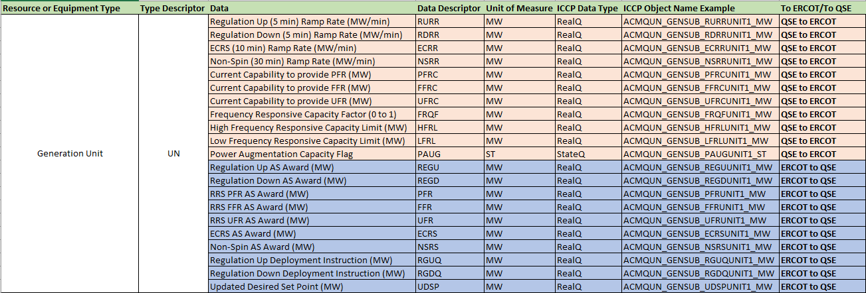
RTC Telemetry Changes - Additions
Generating Unit telemetry additions
  Physical Units Telemetry points like Gross MW, NetMW, AVR, PSS remain same
  Data Descriptor/Object Names subject to small changes as design is updated.

Slide 19
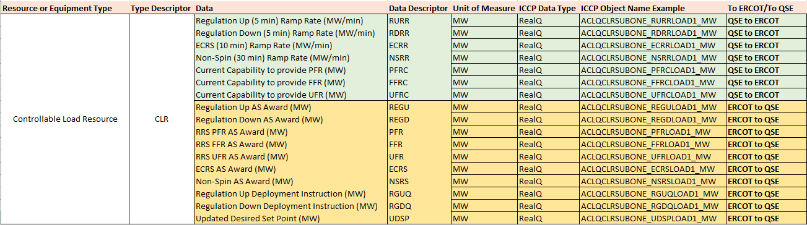
RTC Telemetry Changes - Additions
Controllable Load Resources telemetry additions
  Data Descriptor/Object Names subject to small changes as design is updated.

Slide 20
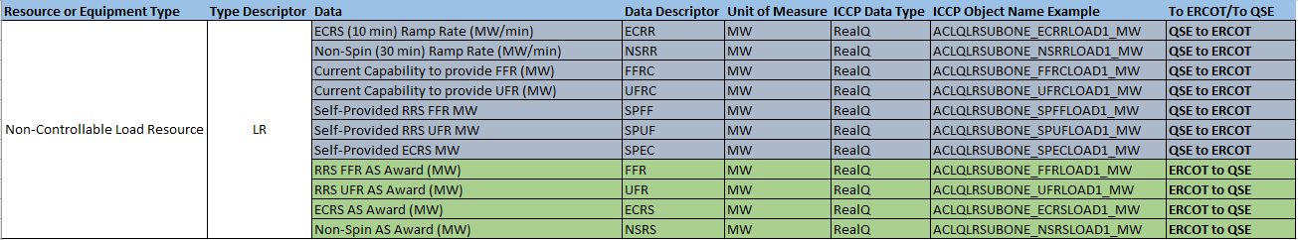
RTC Telemetry Changes - Additions
Non-Controllable Load Resources telemetry additions
  Data Descriptor/Object Names subject to small changes as design is updated

Slide 21
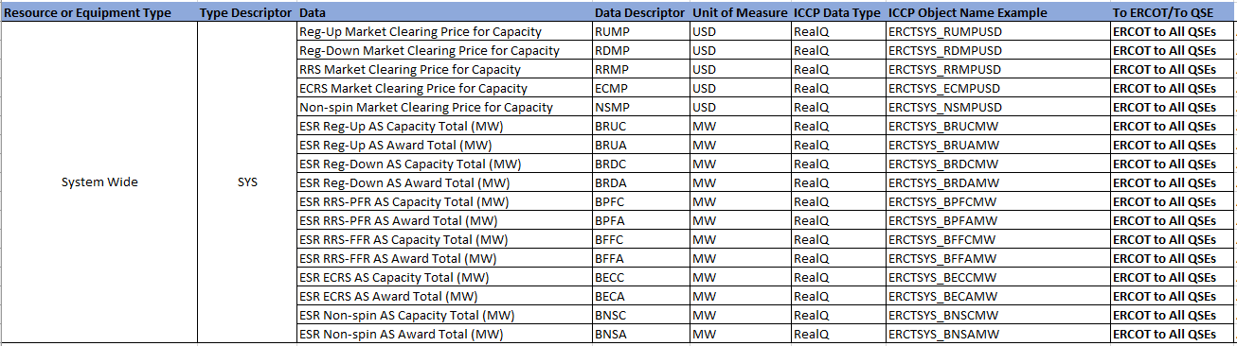
RTC Telemetry Changes - Additions
System Level telemetry additions
  Data Descriptor/Object Names subject to small changes as design is updated.

Slide 22
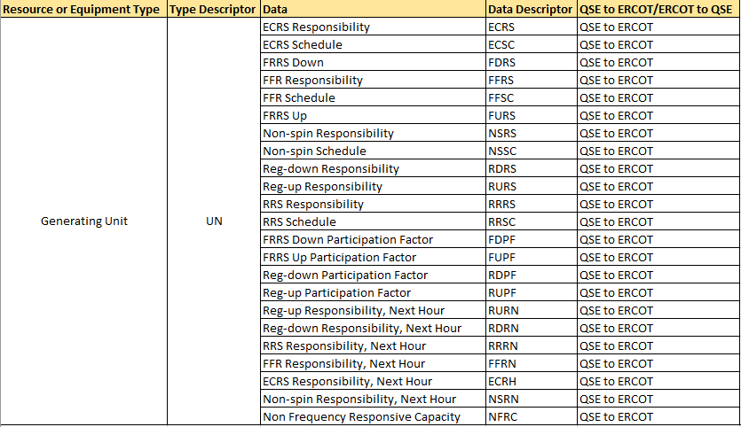
RTC Telemetry Changes - Deletions
Generating Units telemetry deletions
  Deletions happen post Go-Live

Slide 23
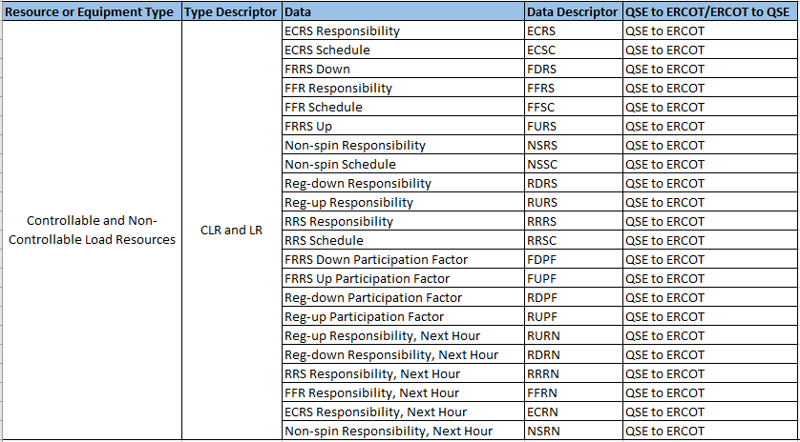
RTC Telemetry Changes - Deletions
Load Resources telemetry deletions
  Deletions happen post Go-Live

Slide 24
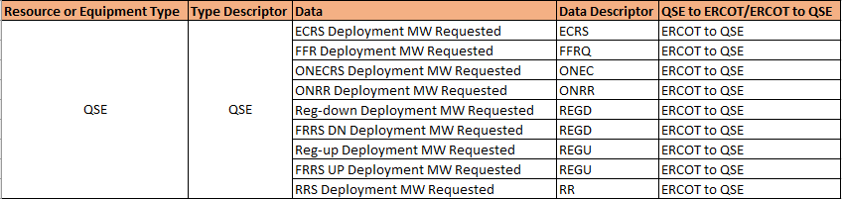
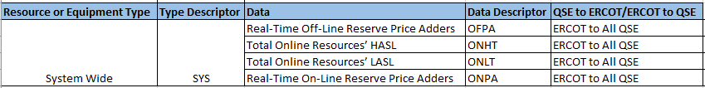
RTC Telemetry Changes - Deletions
QSE and System level telemetry deletions
  Deletions happen post Go-Live

Slide 25
RTC+B Technical Workshop
  10 Minutes Break

Slide 26
Model – Expected Changes
Single Model ESR Model changes
  RE to submit Single Model ESR data into RIOO after RIOO ESR project go live (current planned go live date is end of July)
  Model conversion tool to generate combo model from RIOO single model data until RTC+B project go live.
RTC+B ICCP Telemetry Model changes
  QSEs to Submit new ICCP telemetry points requests
  QSEs/ERCOT to maintain new ICCP telemetry points for current and new telemetry points through weekly model loads.

Slide 27
ICCP Telemetry Testing
Need to setup, test new ICCP telemetry points and maintain through weekly model loads to enable
  RTC+B telemetry points communication testing
  Parallel testing of RTC+B EMS/SCED Applications during Market Trials
  Prepare for Closed Loop Testing and Go live
Telemetry points check out and communication testing scheduled to start before Market Trials, continues until Closed Loop Testing & Go-Live
  Timelines will be finalized when final execution phase schedule in published Q3 this year.

Slide 28
ICCP Telemetry Configurations for Parallel Testing
ICCP system configurations – Two options
  Option 1 - Add RTC+B telemetry points to current production ICCP system
    Setup and test on Test ICCP system if possible before adding new telemetry points to current production ERCOT & QSE ICCP systems.
    Maintain the new telemetry points through weekly model loads for existing & new resources.
    Closed Loop Testing and Go live will be with current Production ICCP system.
    RTC+B EMS Applications (SE, RTCA, LFC, RLC etc.) will use RTC+B single model ESR CIM.
  Option 2 - Standup Parallel ICCP systems for RTC+B Project
    New ERCOT & QSE ICCP/EMS systems will have ONLY RTC+B Single Model Battery CIM.
    Does not include current telemetry points that will be deleted post go live.
    Maintain the new telemetry points through weekly model loads for existing & new resources.
    Closed Loop Testing and Go live will be with new ERCOT & QSE ICCP systems.

Slide 29
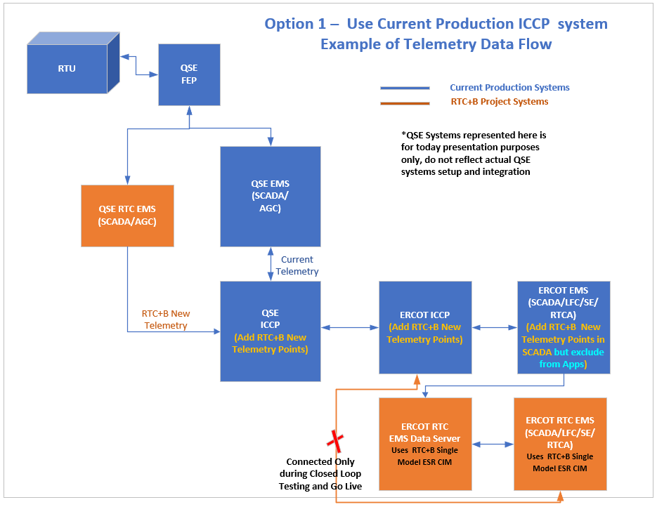
Option 1 – Example of Telemetry Data Flow

Slide 30
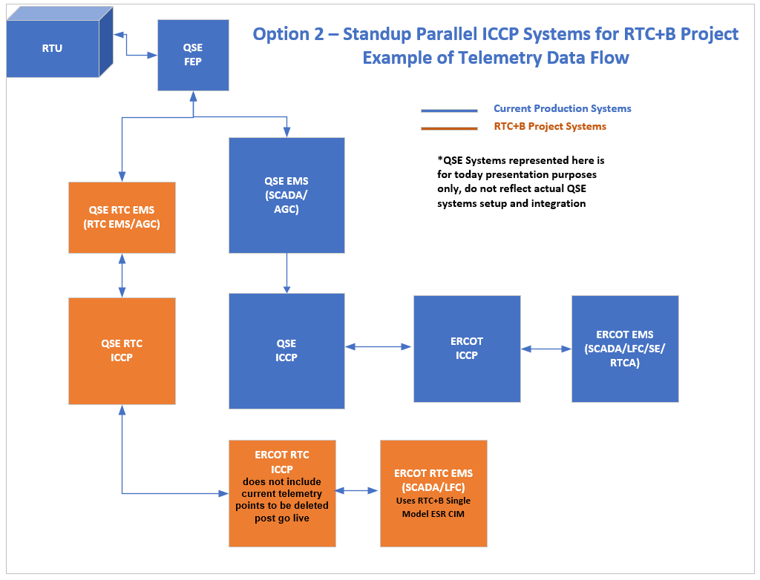
Option 2 – Example of Telemetry Data Flow

Slide 31
Single Model ESR Telemetry changes
ESR-GR telemetry points will be retained and ESR-CLR telemetry points will be removed.
Modified validation on Single Model ESR telemetry points
      LSL - can be negative
      HSL - can be negative
      Net MW - can be negative
      Gross MW - can be negative

Slide 32
Additional Telemetry Points – for Option 1
If Option 1 is selected,
  Following additional telemetry points will be added for ESRs
      Low Sustained Limit for Battery
        Example telemetry point name: LSLB
      High Sustained Limit for Battery
        Example: HSLB
      Net MW for Battery
        Example: MWB
      Gross MW for Battery
        Example: GMWB
  Additional telemetry point for resource status (example: RSTR) will be added for all resources
  Existing LSL/HSL/MW/GMW telemetry points for Single Model ESRs, and existing RST telemetry point for all resource can not be used during parallel testing.
  RTC+B EMS applications will use these new telemetry points data during closed loop testing instead of current LSL/HSL/MW/GMW/RST telemetry points.
  These additional telemetry points will be removed post go live and repurpose existing LSL/HSL/MW/GMW/RST telemetry points.

Slide 33
ICCP Configurations – Pros & Cons
Option 1 – Use Current Production ICCP System
  Pros
    Avoids maintenance and support of new ICCP system for ERCOT and QSEs
    Does not require ICCP Cutover for Closed Loop Testing Cutover and Cutback, and Go-Live – so less risky, and requires less coordination
    Minimizes ICCP/EMS down times during Closed Loop Testing and Go-Live.
    Requires maintenance of only one ICCP model for both current Production as well as RTC+B for weekly model loads
  Cons
    Current ICCP/SCADA Database size increase could impact system performance
    Could impact current production applications if new telemetry points impacts existing telemetry points, especially for ESRs

Slide 34
ICCP Configurations – Pros & Cons
Options 2 – Standup Parallel ICCP Systems for RTC+B Project
  Pros
    Cleaner demarcation between current Production and RTC+B systems -
    avoid cross-impacts and system performance issues.
    No post go-live telemetry clean-up required (e.g, LSLB, HSLB, RSTR)
  Cons
    Additional maintenance during testing period (several months) for QSEs and ERCOT to support new ICCP systems
    Requires significant additional coordination between ERCOT and QSEs for ICCP cutover and cutback during Closed Loop Testing and Go-Live
    ICCP/EMS down times could be longer during Closed Loop Testing and Go-Live.
    Requires maintenance of two ICCP models – current Production and RTC+B project
Requesting input on preferred approach

Slide 35

Q&A Session

Slide 36
Next Steps
Review ICCP telemetry points, ICCP system configurations for parallel testing.
Provide feedback on or before next RTC+B Technical workshop meeting on 05/06/2024.
    For any questions and feedback, contact me at Sreenivas.Badri@ercot.com

Slide 37
RTC+B Technical Workshop – Meeting #1
Thank You!!!

