Slide 1
ERCOT Updates
April 2024 NDSWG
Joel Koepke
4/16/2024

Slide 2
Topics
ERCOT Organizational Changes
Project Updates
Contingency Reviews
Double-Circuit (In Progress)
Manual (Upcoming)
Model Submission for Summer
Outage restrictions start on May 15th

Slide 3
Grid Coordination Organizational Changes - Before
Joel Koepke
Manager, Grid Coordination Support and Development
Rochie Guiyab
Manager, Network Modeling
Trish Miller
Supervisor, Network Model Coordination
Sujatha Kotamarty
Supervisor, Network Model Maintenance
Eric Meier
Supervisor, Network Model Administration
Agee Springer
Large Load Integration Manager
Bill Blevins
Director, Grid Coordination
Large Load Integration
Jay Teixeira
Manager, Resource Integration
Resource Integration

Slide 4
Grid Coordination Organizational Changes - After
Jay Teixeira
Joel Koepke
Manager, Grid Coordination Support and Development
Rochie Guiyab
Manager, Network Modeling
Trish Miller
Supervisor, Network Model Coordination
Sujatha Kotamarty
Supervisor, Network Model Maintenance
Eric Meier
Supervisor, Network Model Administration
Bill Blevins
Director, Grid Coordination
Agee Springer
Manager, Grid Interconnections
Resource Integration
Large Load Integration
Retired

Slide 5
Project Updates
Active/Upcoming Projects
Upgrade to NMMS RHEL Operating System
Upgrades the OS of additional NMMS systems
No changes in MAGE functionality
Upgrade to CIM16 + SCR813
Scope
Upgrades the NMMS database schema to CIM16
Upgrades XML models and incremental files to CIM16
Completing “Planning” phase
Determining key milestones, requirements, and schedule
“Execution” to officially start in late February
Completion in ~2 years (TBD)
Dates will be broadly communicated

Slide 6
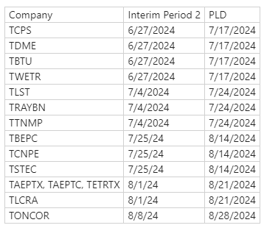
Contingency Reviews
Double-Circuit Contingency Review
Nearing completion
Manual Contingency Review
Kick-off emails starting in early June
Question
Should these reviews be done at the same time?
Proposed Submission Dates for Manual Contingency Review

Slide 7
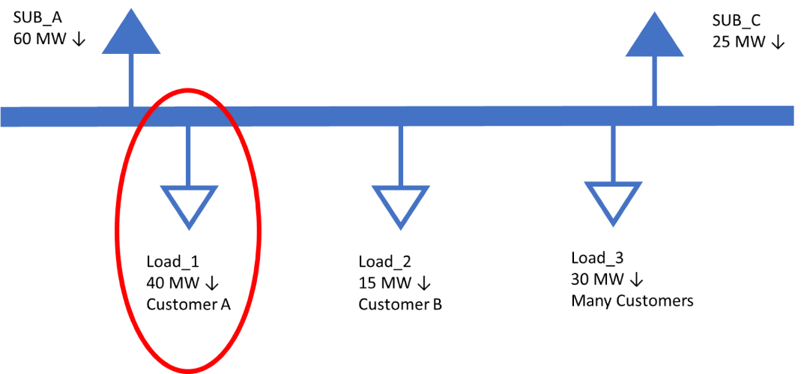
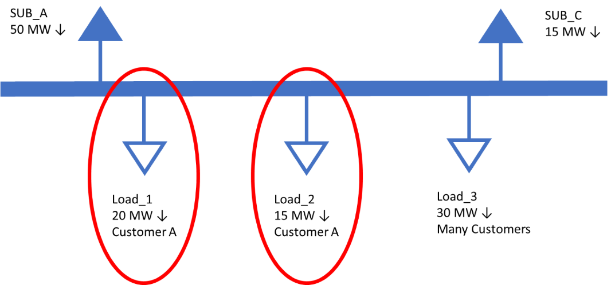
Upcoming NPRR – Identifying Loads With Large Customers
Goal
Increase situational awareness of large end-use customer load
Likely Proposed Change
Identify load(s) in the network operations model which serve a single end-use customer whose consumption is greater than 25MW
Provide an industry classification for that large end-use customer
(Not an exhaustive set of) Examples:
Single load point serving Customer A
Multiple load points at a substation serving Customer A

