Slide 1
Resource Integration Topics
Jenifer Fernandes
ERCOT
Resource Integration Working Group
April 16, 2024

Slide 2
Quarterly Stability Assessment (QSA)
Planning Guide 5.9
Next Deadline for QSA
If a GINR is not included in QSA, its Initial Synchronization date will be automatically delayed to the next quarter
All-Inclusive Generation Resource Initial Synchronization Date | Last Day for an IE to meet prerequisites as listed in paragraph (4) below | Completion of Quarterly Stability Assessment
Upcoming January, February, March | Prior August 1 | End of October
Upcoming April, May, June | Prior November 1 | End of January
Upcoming July, August, September | Prior February 1 | End of April
Upcoming October, November, December | Prior May 1 | End of July

Slide 3
Quarterly Stability Assessment (QSA)
Planning Guide 5.9, Quarterly Stability Assessment
Issue’s seen in previous QSA’s
  10 day comment period for FIS
    Needs to be complete before QSA deadline
    TSPs need to plan for it
  Dynamic/PSCAD Model Review
    Dependent on FIS Stability study
    Need to meet PG 6.9 15 to 30 days prior to QSA deadline
PSSE Model Quality Test Required
PSCAD Model Quality Test and Unit Model Validation required
TSAT Model Required – If PSSE model is UDM, then TSAT model should be UDM and should include MQT

Slide 4
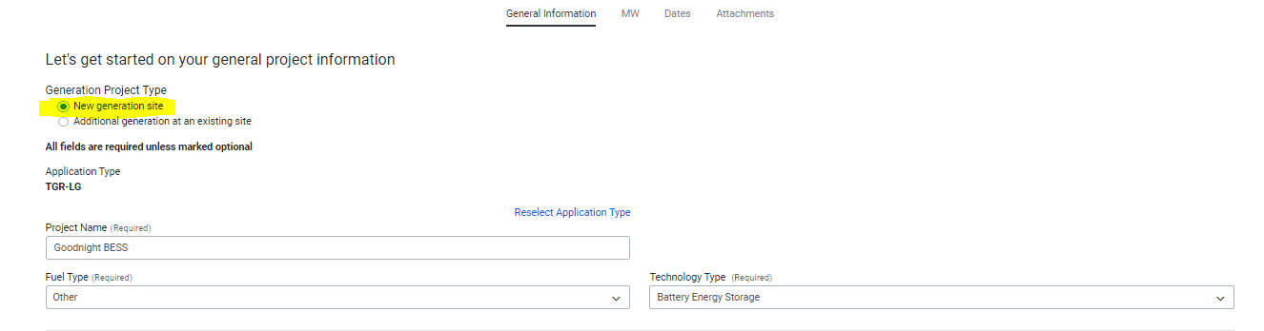
RIOO-IS: Duplicate Site Codes
New Generation Site: Adding a New Resource or ESR (co-located) still in the INR process

Slide 5
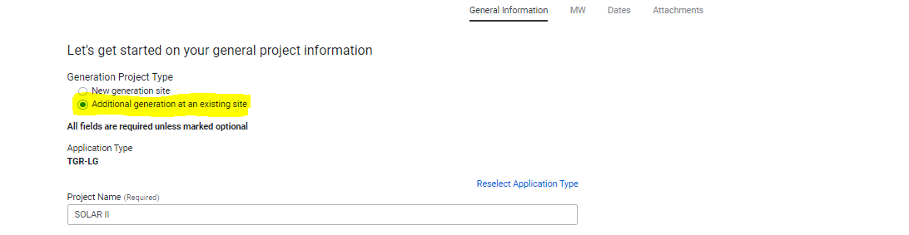
RIOO-IS: Duplicate Site Codes
Additional Generation at an existing site: Adding another INR to an existing site with the same technology type that is in the INR process e.g. Solar 1(100MW), Solar 2 (50 MW)

Slide 6
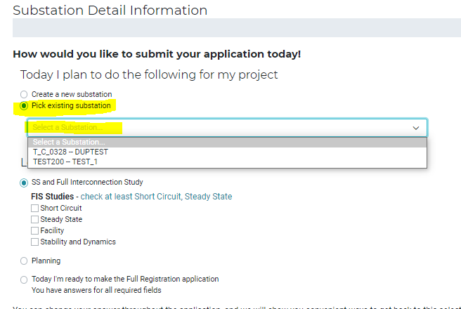
RIOO-IS: Duplicate Site Codes
Under Substation Details “Pick existing substation”. The drop down should bring up list of existing Site codes to select from.

Slide 7
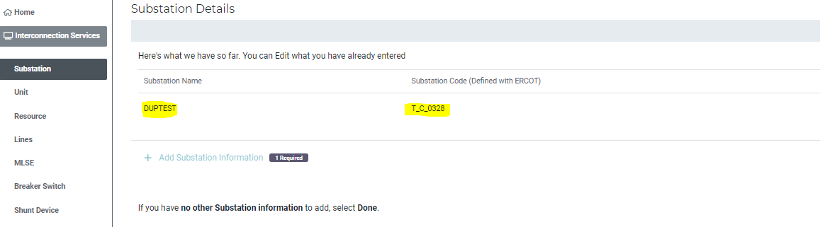
RIOO-IS: Duplicate Site Codes
Under substation Details the Site Code will auto populate

Slide 8
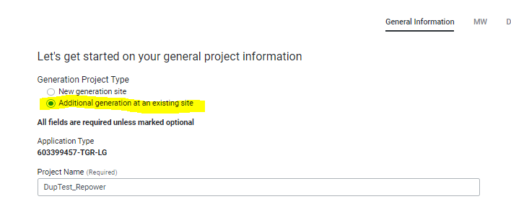
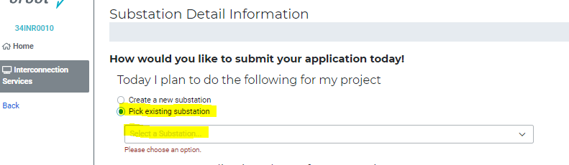
RIOO-IS: Repower
For repower start a new Interconnection Request as an RE
  Pick an existing substation

Slide 9
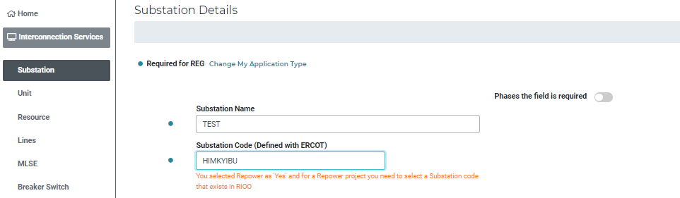
RIOO-IS: Repower
Verify the Substation Code is correct under Substation Details

Slide 10
Generator nameplate ratings
Generator ratings (MVA, MW, MVAR) submitted in RIOO-IS application “MW” and substation details (“Ratings and Design”) are the max capability of the unit at the generator terminals.
  Where “Generator terminals” in the ERCOT model typically means MV 34.5kV bus for IBRs and 13.8kV bus for conventional units.
The IE/RE is responsible to ensure that the correct MW is studied at each point (LV, MV, POIB) and that the resource can meet other ERCOT requirements (including ERCOT NP 3.15 for Voltage Support Service).

Slide 11
Reactive study
Reactive study scenarios which overload equipment will not qualify as meeting ERCOT NP 3.15 requirements for VSS (Voltage Support Service).
  For example, any study showing an overloaded transformer will need to either:
  -Decrease the total MVA flow which is causing the overload or
  -Based on OEM transformer specifications, revise the transformer rating.

Slide 12
Active RR’s
NPRR1212/PGRR114
  PGRR114 requires that before ERCOT approves Initial Energization for a project that will consume Load other than Wholesale Storage Load (WSL) and that is not behind a Non-Opt-In Entity (NOIE) tie meter, the Distribution Service Provider (DSP) must provide ERCOT with Electric Service Identifier(s) (ESI ID(s)). Ensuring that ESI ID(s) are provided before Initial Energization will avoid the creation of (Unaccounted for Energy) UFE for Initial Settlement.
PGRR112
  Dynamic Data Model and Full Interconnection Study (FIS) Deadline for Quarterly Stability Assessment – Approved at TAC for December 1st, 2024, implementation which affects February 1st, 2025, QSA.

Slide 13
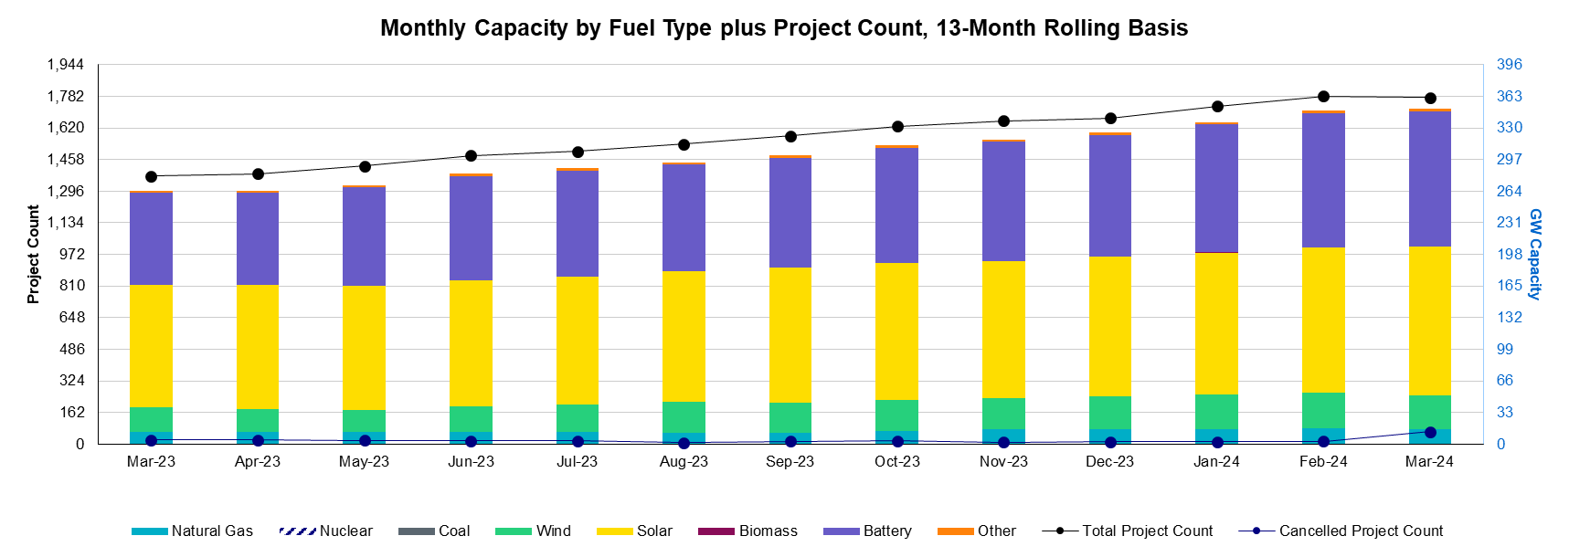
Generation Interconnection Requests
1,775 active generation interconnection requests totaling 346 GW as of March 31st, 2024
(Solar 155 GW, Wind 35 GW, Gas 15 GW, and Battery 141 GW)
(Excludes capacity associated with projects designated as Inactive per Planning Guide Section 5.7.6)

Slide 14
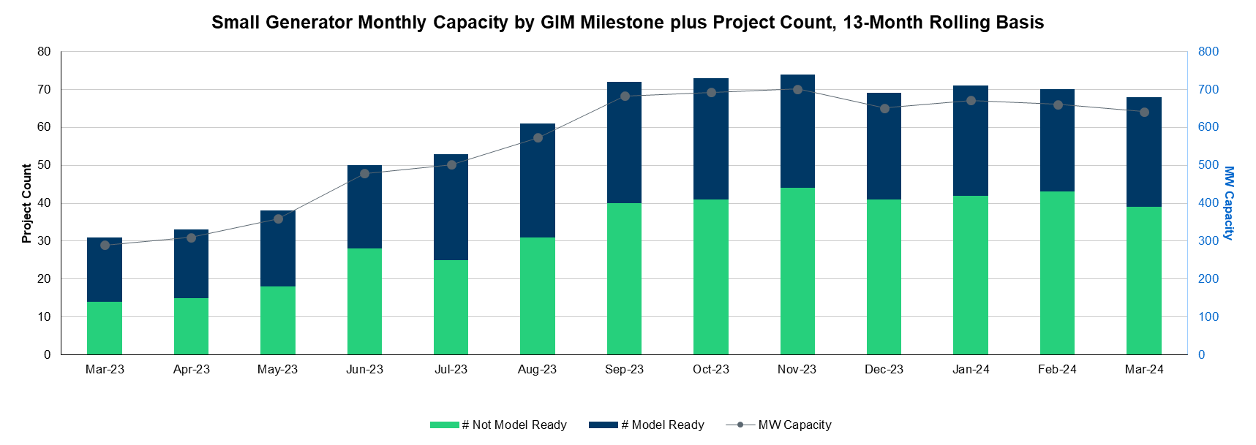
Generation Interconnection Requests
Small Gen- 39 projects Not Model Ready, 29 projects Model Ready

Slide 15
Other contact information
ResourceIntegrationDepartment@ercot.com is distribution list for Resource Integration department
Mailing List
  RESOURCE_INTEGRATION@LISTS.ERCOT.COM

Slide 16

Questions?
Thank you!

