Slide 1
ERCOT Planned Project Success Factor Analysis Update
Resource Adequacy
April 19, 2024

Slide 2
Assumptions for Success Rates and Development Cycle Analysis
Analysis based on queue data snapshot from 2/1/24
To account for the development cycle of generation projects, the success rate statistics in this analysis were limited to projects requested between 2002 and 2020 into the ERCOT queue
Successful projects are defined as a planned generation projects that have become operational resources (received Commercial Operations Approval or Synchronization Approval from ERCOT)
Due to Protocol confidentiality provisions, only those projects for which a Full Interconnection Study (FIS) has been requested are included in this dataset
Consistent with monthly Generator Interconnection Status Report (GIS)
These statistics do not account for delays to expected in-service dates (Projected Commercial Operations Dates)
Wind repowers, thermal upgrade projects were excluded from this dataset due to having different interconnection milestone requirements compared to new Generation Resource (GR) projects

Slide 3
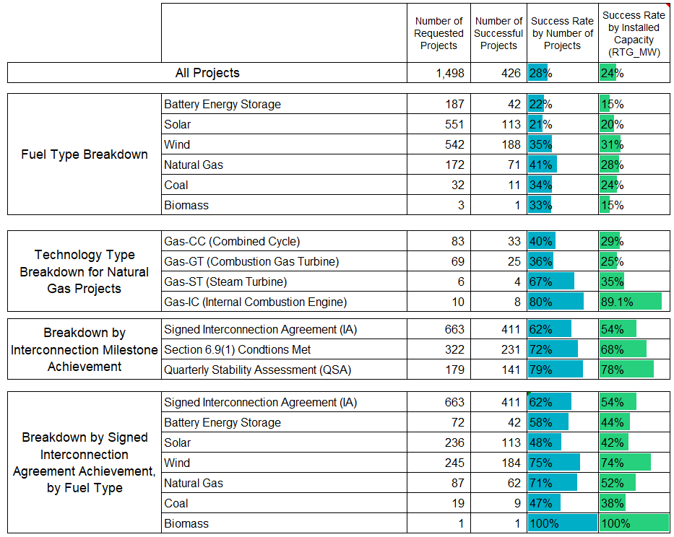
Success Rates of Planned Generation Projects in ERCOT queue
Key Takeaways:
28% of planned projects requested between 2002 and 2020 have been successful on a project count basis (24% on a capacity basis)
Very little change in success rates listed in April 2022 update
Includes larger sample size of successful storage and solar projects (42 and 113, respectively)

Slide 4
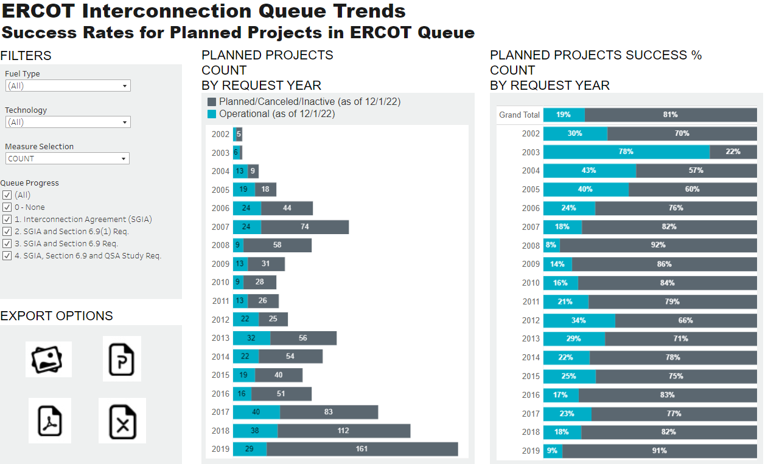
Interactive Tableau Dashboard – updated for recent data

Slide 5
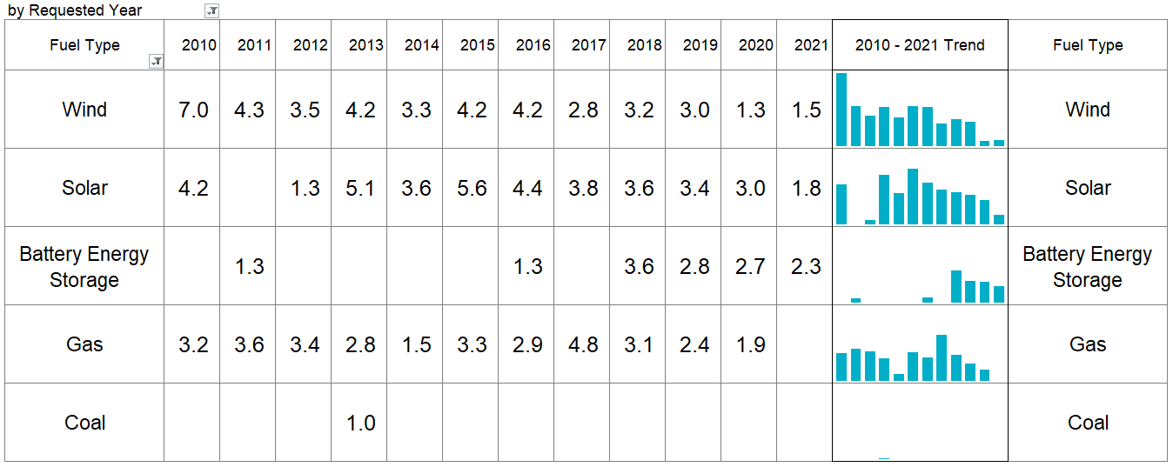
Development Cycle for Planned Projects: Average Duration in Years for Successful Projects (from Queue Request to ERCOT Commercial Operations or Synchronization Approval)
Notes:
There were several projects requested prior to 2014 that did not have recorded Commercial Operations or Synchronization Approval dates in queue database. Duration cycles for development for these projects could not be determined.
The Quarterly Stability Assessment (QSA) started in 2018 for planned projects.

Slide 6
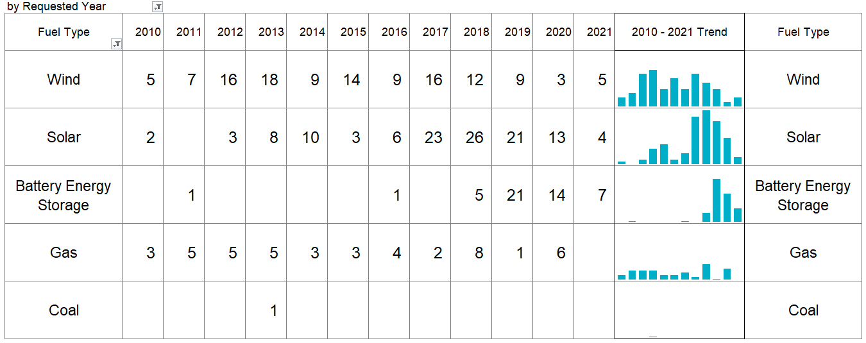
Development Cycle for Planned Projects: Number of successful projects (from Queue Request to ERCOT Commercial Operations or Synchronization Approval)
Notes:
There were several projects requested prior to 2014 that did not have recorded Commercial Operations or Synchronization Approval dates in queue database. Duration cycles for development for these projects could not be determined.
The Quarterly Stability Assessment (QSA) started in 2018 for planned projects.

Slide 7
Development Cycle for Planned Projects: Installed capacity (MW) of successful projects (from Queue Request to ERCOT Commercial Operations or Synchronization Approval)
Notes:
There were several projects requested prior to 2014 that did not have recorded Commercial Operations or Synchronization Approval dates in queue database. Duration cycles for development for these projects could not be determined.
The Quarterly Stability Assessment (QSA) started in 2018 for planned projects.

Slide 8
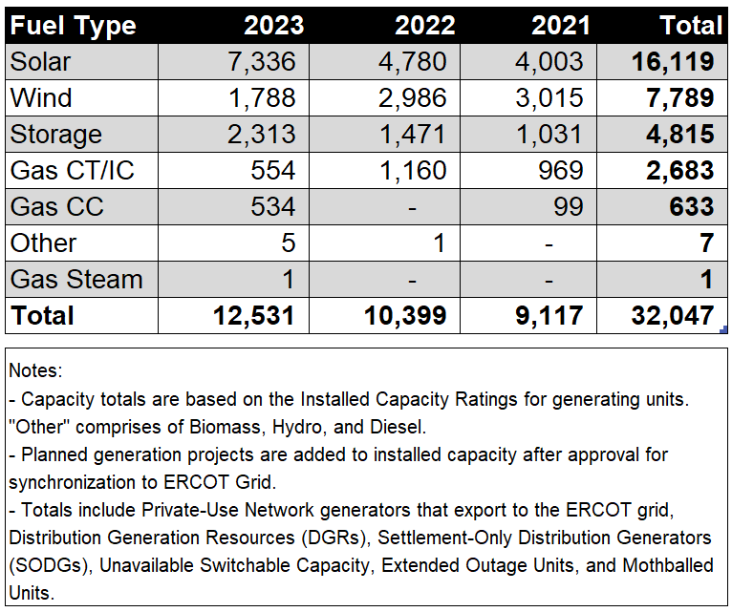
Planned Generation Projects that have Synchronized to ERCOT Grid in Last Three Years
Key Takeaways:
Solar leads with 16,119 MW total planned capacity, nearly doubling from 4,003 MW in 2021 to 7,336 MW in 2023
Wind follows at 7,789 MW total, remaining stable year-over-year
Gas project additions remained stable as well; year-over-year, averaging 1,000 MW of new additions

Slide 9
Retirements in Last Three Years (2021-2023)

Slide 10
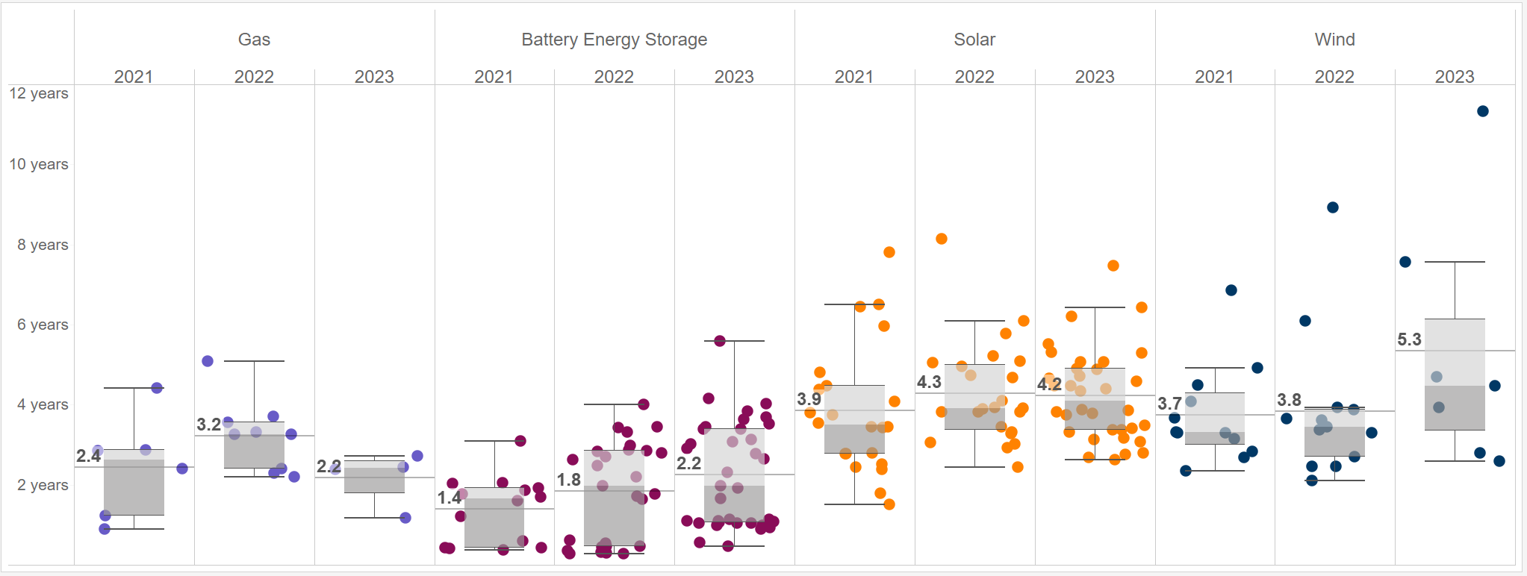
Development cycle based on recently approved operational units (from Queue Request to Synchronization Approval to ERCOT Grid)
Key Takeaway: Development timelines for recently approved units have been at historical average or slightly higher for the various types of planned projects.
Each dot represents a planned project

Slide 11
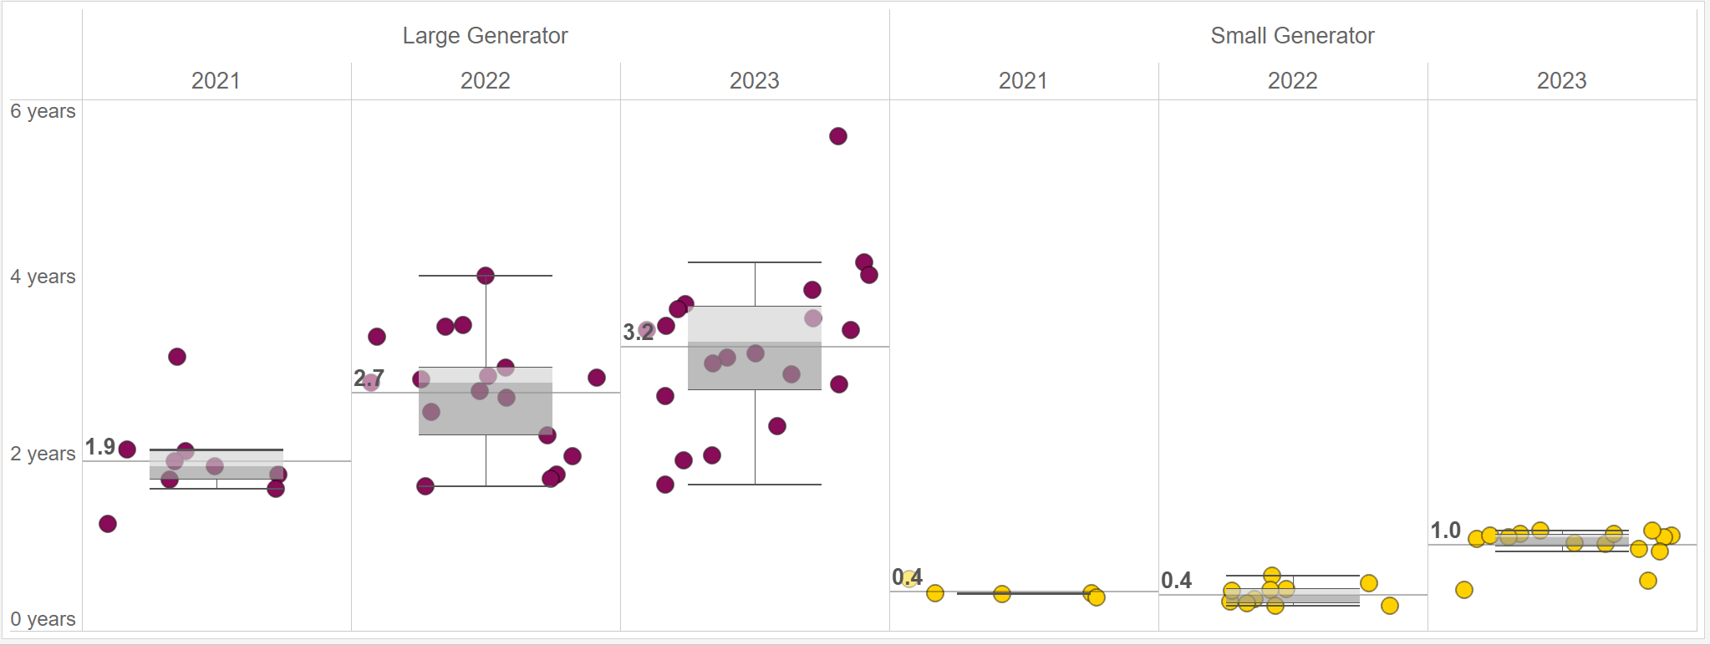
Development cycles for Small Generator Battery Energy Storage projects are much faster than Large Generator Battery Energy Storage projects (based on recently approved operational units from Queue Request to Synchronization Approval to ERCOT Grid)
Each dot represents a planned project

Slide 12
Wrap-up
Are there any other interconnection queue topics that would be useful for SAWG stakeholders?
If you have any questions on this analysis or requests for additional research, sent them to the following email address with the following subject line item (SAWG analysis request)
ResourceAdequacy@ercot.com

Slide 13
Appendix
Previous queue trends presentations at SAWG
August 2023
Queue Trends using GIS reports (since 2020)
Geolocation siting trends for new generation projects
April 2022
Planned Project Success Factor Analysis
Development cycle trends for planned projects
Delays to in-service dates of planned projects

Slide 14
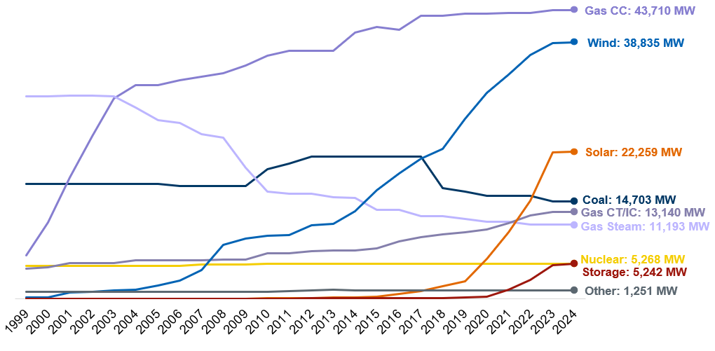
ERCOT Installed Net Generation Capacity Mix Trends (as of 2/1/24)
Notes:
as of 2/1/2024 (Includes Additions and Retirements)
- Capacity totals are based on the Installed Capacity Ratings for generating units. "Other" comprises of Biomass, Hydro, and Diesel.
- Planned generation projects are added to installed capacity after approval for synchronization to ERCOT Grid.
- Totals include Private-Use Network generators that export to the ERCOT grid, Distribution Generation Resources (DGRs), Settlement-Only Distribution Generators (SODGs), Unavailable Switchable Capacity, Extended Outage Units, and Mothballed Units.

