Slide 1
Analysis of Forward Adjustment Factors
Brenden Sager, Austin Energy, Chair
18 April 2024

Slide 2
Purpose
ERCOT Credit Estimate Aggregate Liability presentations included discussions on possible “gating” of forward adjustment factors
Max values could provide certainty around capital requirements during high price events
Minimum value could provide credit assurance when FAF “haircuts” invoice exposure at values < 1.0, especially after high pricing events
However, FAF’s below < 1 are the only protection against persistent high collateral requirements from lookbacks unaligned with pricing and invoices
To date, analysis focused on EAL/TPE in various scenarios versus aggregate invoice exposure
Need to consider collateral posting which also includes discretionary collateral and CRR locks – might be hard to back out these effects

Slide 3
FAF definition
Simplified formula: RFAF x Max 40-day RT invoice history
Analysis focuses on Real Time FAF’s since both RFAF and DFAF highly correlated (coefficient = 0.87)
RFAF more prominent in EAL calculation, applied to max value of Real Time daily history (lookback)
Fixing max/min values for FAF more straightforward implementation compared EAL adjustment proposals (which are not mutually exclusive)

Slide 4
FAF Data Summary
min | 0.01 | 2/7/2018
max | 10.61 | 4/9/2024
N | 2254

Slide 5
More Data Summary
FAF rising by roughly .073 per year
45% of data between 1.0 and 1.5; 31% below 1.0
Volatility increasing annually
Higher and more frequent pricing events in data midpoint starting in 2021
10 RFAF’s > 4.0 (98th percentile) before 2021 and 34 after
Uri had highest RFAF at 10.61

Slide 6
RFAF Percentiles and Max Value
FAF | obs > | N-tile | Wgt Avg > FAF level
2 | 117 | 0.90 | 4.215
2.5 | 45 | 0.95 | 5.425
3.25 | 11 | 0.97 | 5.819
5.25 | 4 | 0.99 | 8.119
CFSG members proposed including max value for RFAF to provide more certainty around maximum collateral requirements during pricing events
ERCOT uses percentile and distributional analytic methods for other operational needs in protocols
Above method uses a weighted average of values greater than FAF at observed n-tile
For instance, at 99th percentile only 21/2254 observations = RFAF of 5.25
Observation weighted average of the values > 5.25 = 8.119, only four obs > than this (max 10.61)

Slide 7
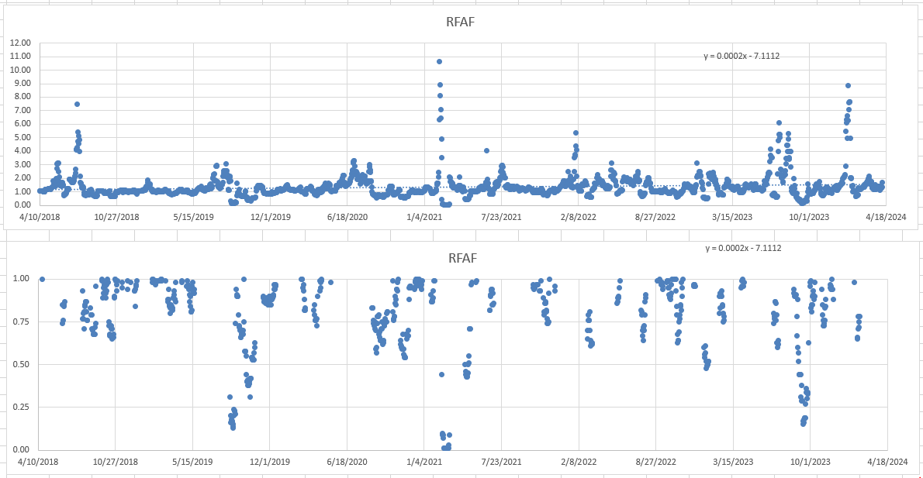
RFAF time series and periods where < 1.0

Slide 8
RFAF history and minimums
We observed that RFAF can fall below 1.0 and usually does so after a dramatic high price event, 31% of data < 1.0
As high prices roll off but settlement prices remain high, calculation may cause (unintended?) FAF of < 1.0
Given nature of calc this effectively haircuts the maximum invoice exposure, possibly below actual which is a risk to the market and undermines intent of methodology
Uri a particularly notable case where RFAF went from 10.61 to 0.44 in eight days then remained at 0.01 for several days thereafter

Slide 9
RFAF history and invoice history
Protocols propose a Look-back period for RTM seeking max invoice exposure for 40 days ensure there is enough collateral from CP to cover default and mass transition event
While FAF method calls more collateral when forwards rise against most recent SPP’s – lookbacks maintain elevated collateral levels well past an event (40 days posting max invoice vs 2-day event)
As shown below, FAF < 1.0 effectively adjusts down the lookback to a “reasonable” amount
Can we calibrate lookback/min FAF? … Max (current RTLE, FAF adjusted RTLE)
lrq | Days | Look-back period for RTM to find the maximum of RTLE or URTA for all QSEs represented by the Counter-Party if any of the QSEs represented by the Counter-Party represent either Load or generation.
lrq | Days | 40
Price | MW | Hours | Dollars | FAF | RTLE
$ 40 | 2500 | 16 | $ 1,600,000 | 1 | $ 1,600,000
$ 5,000 | 5000 | 16 | $ 400,000,000 | 0.01 | $ 4,000,000

Slide 10
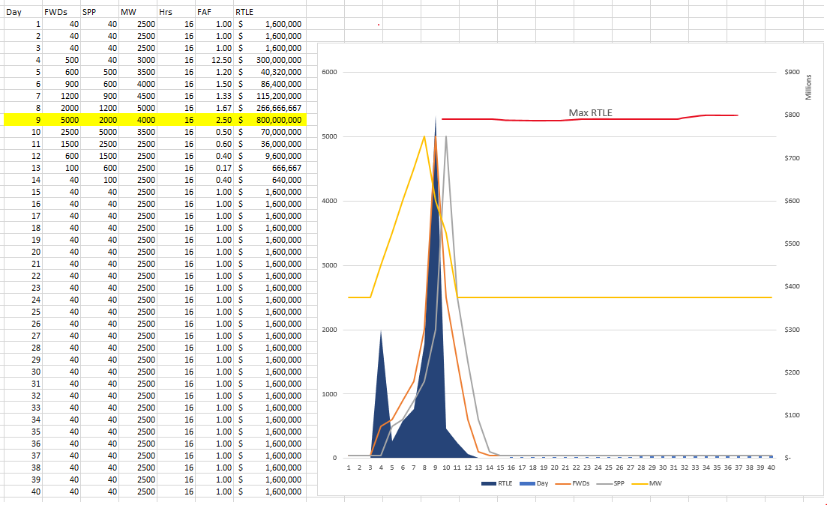

Slide 11
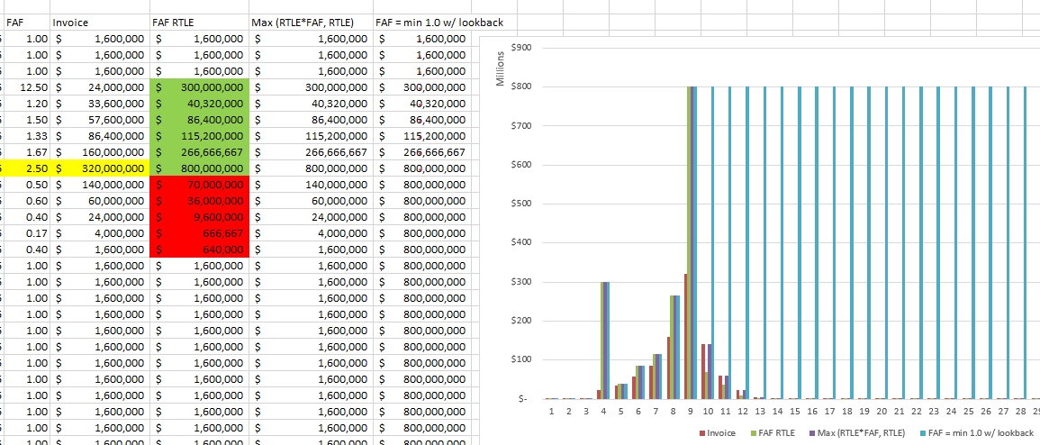

Slide 12
Conclusion
CFSG should consider max values of 8.5 for FAF’s
Would add clarity for short term collateral requirements
CFSG should consider a min value of FAF’s < 1 only if there are changes to the lookback value
If lookback not changed, then current method is preferable
Fixing max/min values for FAF and/or lookbacks more straightforward implementation compared complex EAL formula adjustment proposals (which are not mutually exclusive)

Slide 13
Questions?

