Slide 1
Monthly Review of Reliability Unit Commitment Market Impacts – March 2024
Wholesale Market Working Group
ERCOT Staff

Slide 2
RUC Resource-Hours
March 2024 | Total | Opt-Out | Non-Opt-Out
Instructed Resource-Hours
Total Count | 224.0 | - | 224.0
Effective Resource-Hours*
Total Count | 209.1 | - | 209.1
Average Megawatts (MW) for Effective Resource Hours
Average LSL | 164.5 | - | 164.5
Average LDL | 167.0 | - | 167.0
Average BP | 168.0 | - | 168.0
Average HSL | 404.2 | - | 404.2
* The difference between “Instructed” and “Effective” values is a result of Resources starting up, shutting down, receiving partial hour instructions, or otherwise not being dispatchable by SCED.

Slide 3
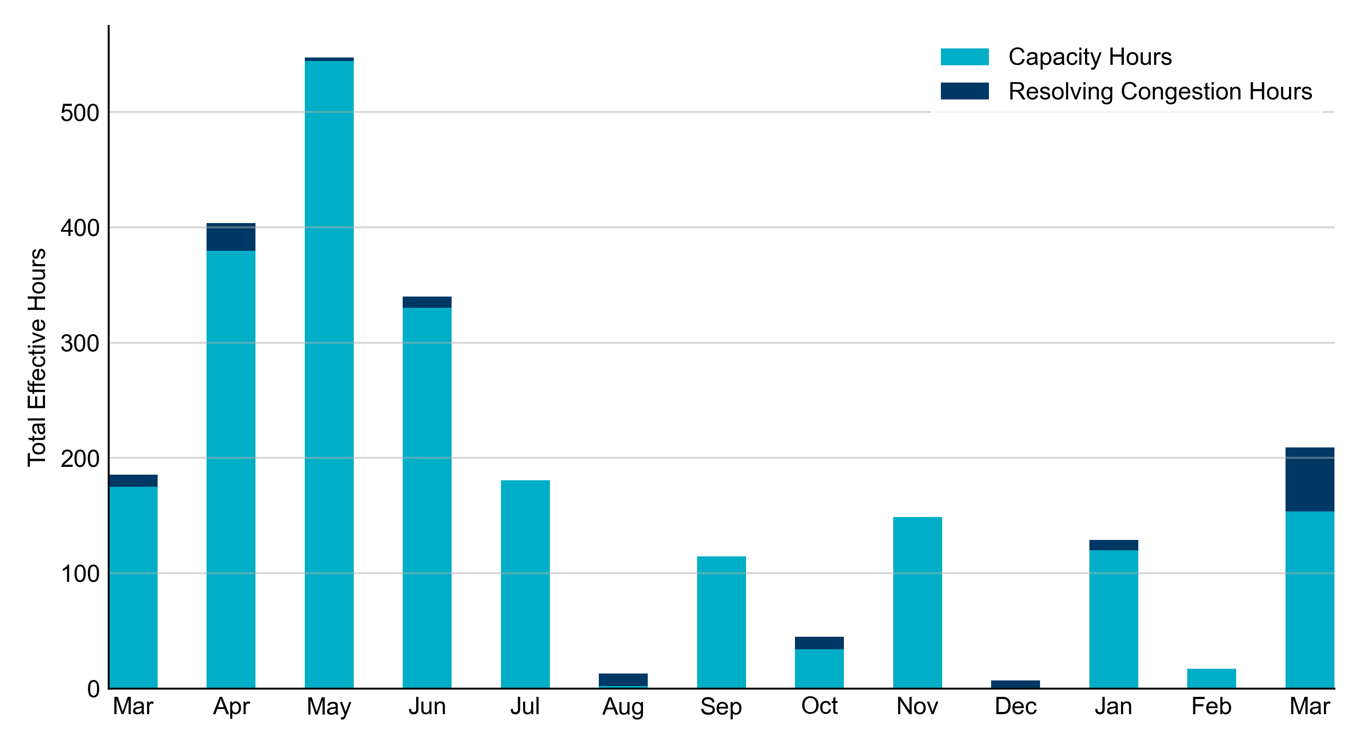
RUC Instruction Reasons: Last 13 Months
RUC in March 2024 was primarily to ensure sufficient capacity and to resolve congestion.

Slide 4
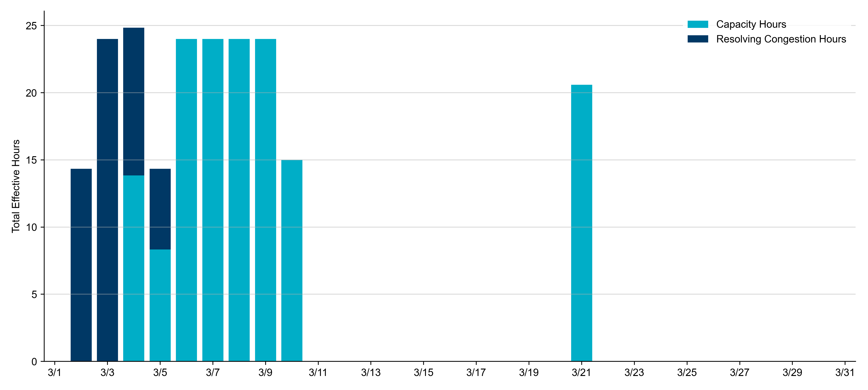
RUC Instruction Reasons in March 2024
209.1 RUC effective Resource-hours.
  153.8 hours (74%) for capacity.
  55.3 hours (26%) for resolving congestion.

Slide 5
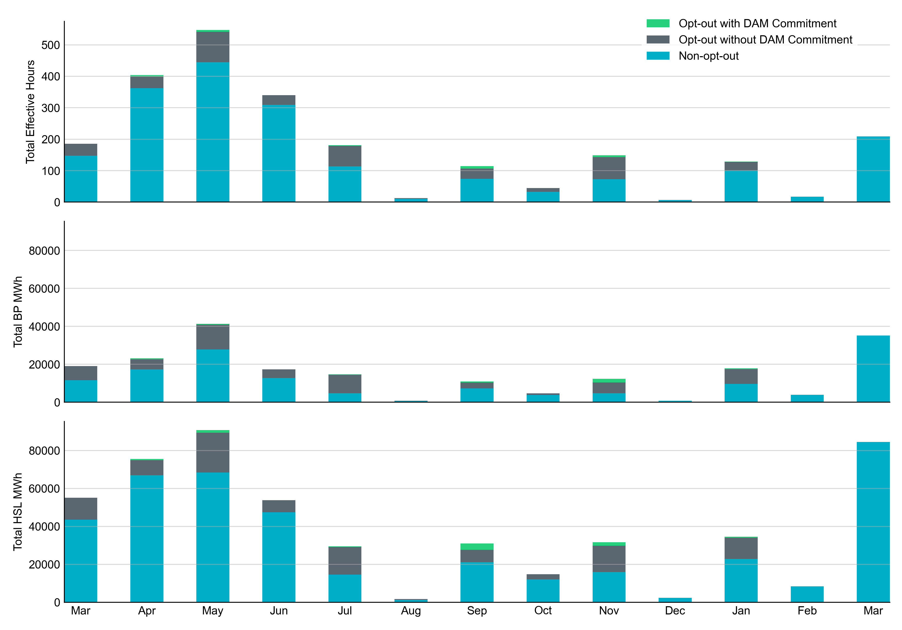
Non-opt-out and Opt-out Totals: Last 13 Months
March 2024 had a total of 209.1 non-opt-out effective Resource-hours, which was 100% of the effective Resource-hours for the month. There were no opt-out effective Resource-hours.

Slide 6
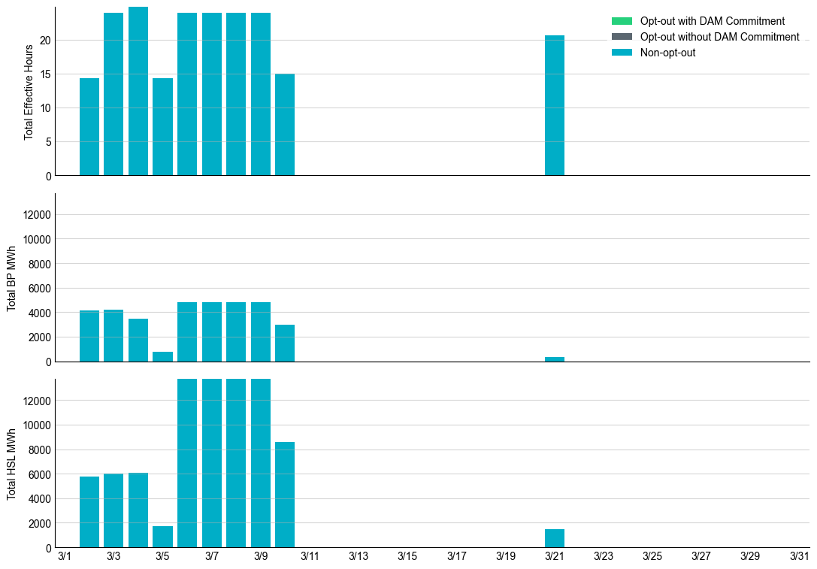
Non-opt-out and Opt-out Totals: March 2024

Slide 7
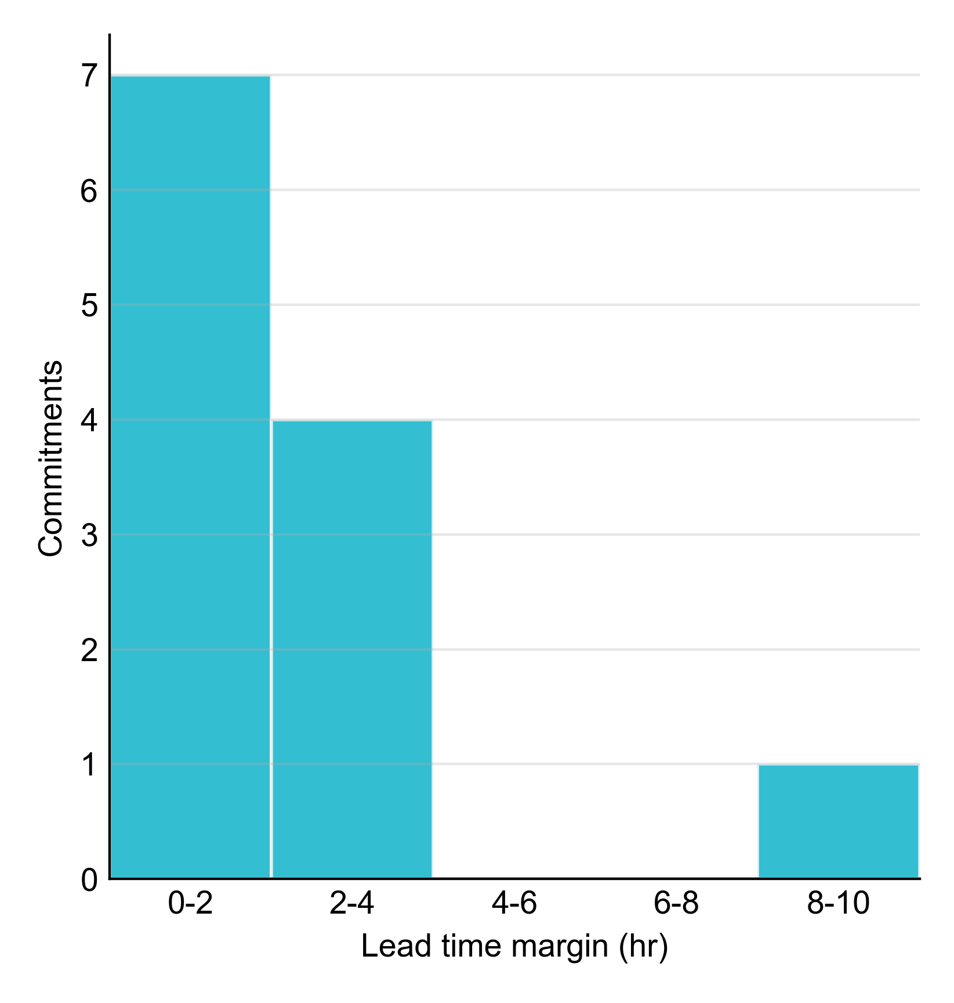
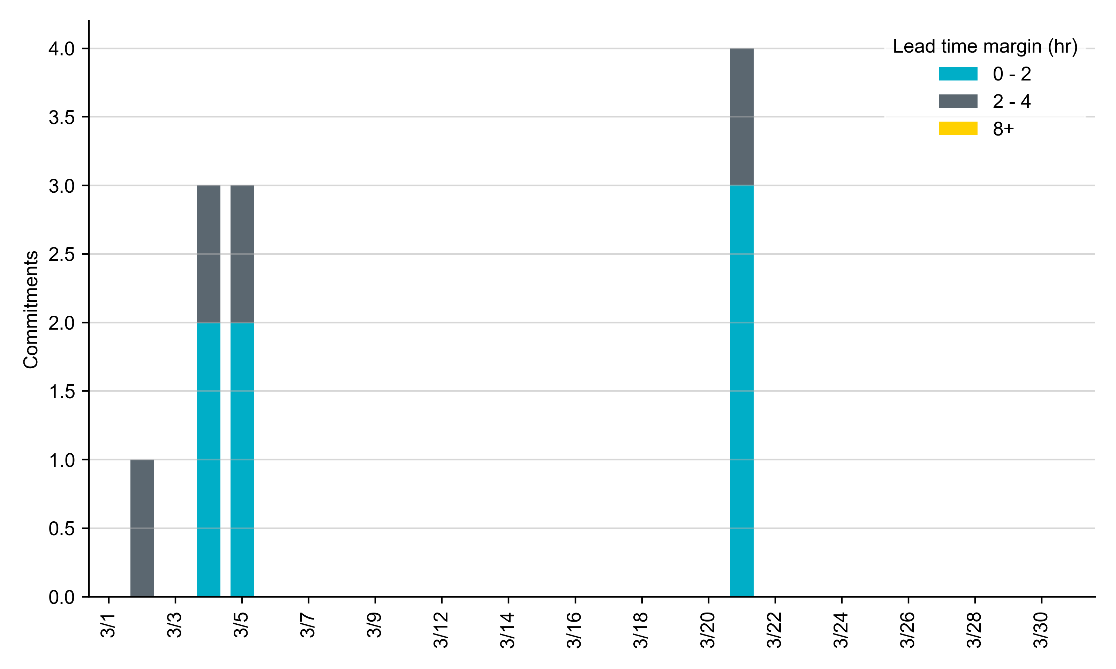
RUC Lead Time Margin: March 2024
Most RUC commitment windows had a lead time margin at or below 4 hours.
Lead time refers to the length of time between a RUC instruction and the start of the commitment window.
Lead time margin is the difference between lead time and the Resource’s startup time.
In cases where a Resource is committed for multiple back-to-back time blocks, lead time margin is calculated from the first instruction.

Slide 8
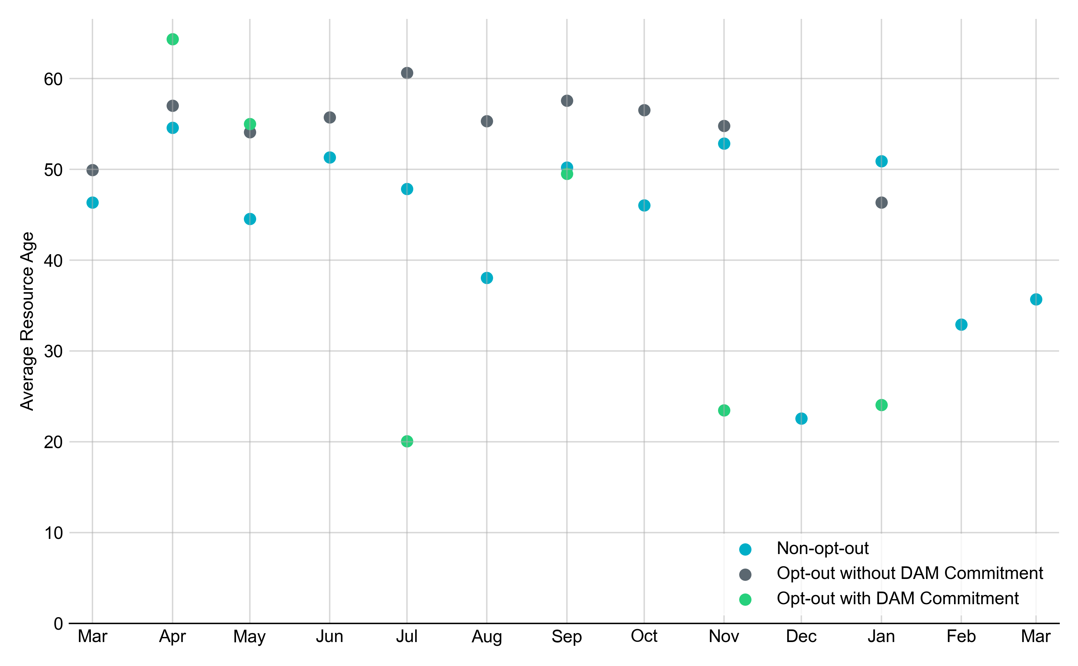
Average Resource Age: Last 13 Months
In March 2024, the average age of RUC-committed Resources was 35.7 years for non-opt-out Resource-hours. There were no opt-out Resource-hours with or without DAM Commitments.
Note: For Resource configurations with multiple physical generators, the age of the oldest generator is used.

Slide 9
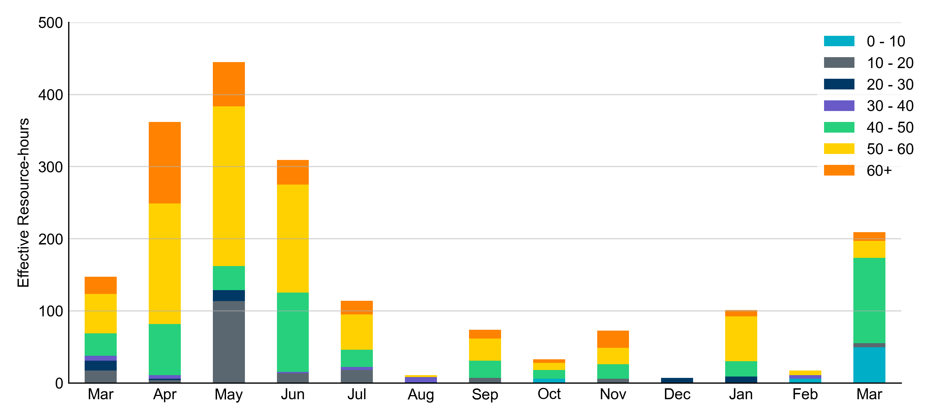
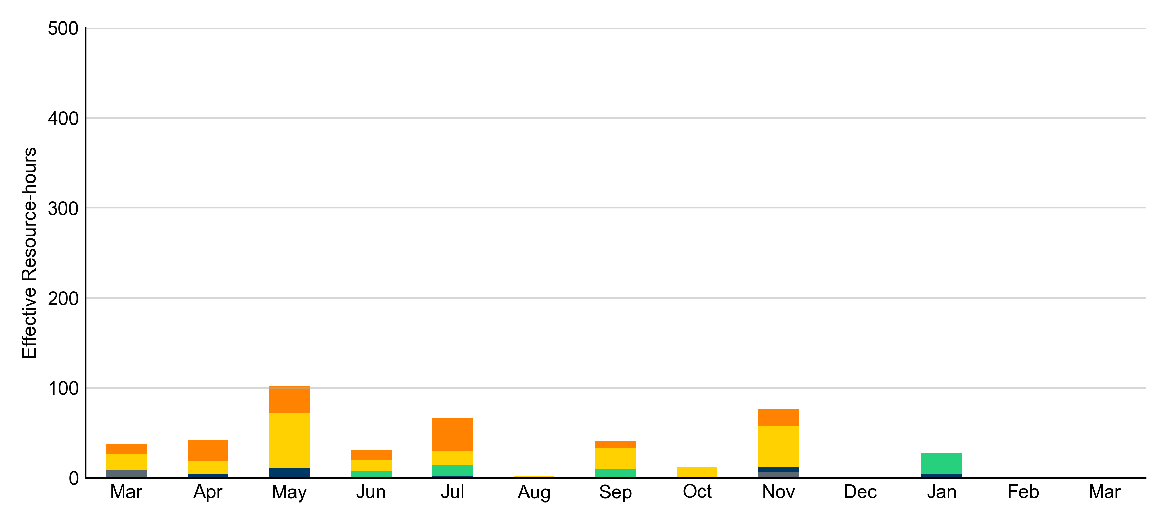
Age Category: Last 13 Months
Most RUC-committed Resources in March 2024 were older than 40 years.
Non-opt-out
Opt-out

Slide 10
RUC-Instructed Resource Dispatch above LDL
March 2024
There were 3.4 effective Resource-hours in which Resources that did not successfully opt out were dispatched above their LDL in March 2024.
  For 3.3 of these Resource-hours, the LMP for the RUC-instructed Resource was above the RUC offer floor.
  For 0.1 of these Resource-hours, the LMP for the RUC-instructed Resource was below the RUC offer floor.
    For all 0.1 Resource-hours, the RUC-instructed Resource was mitigated.
Additionally, there were no Exceptional Fuel Cost submissions for any RUC-committed Resources in March 2024.

Slide 11
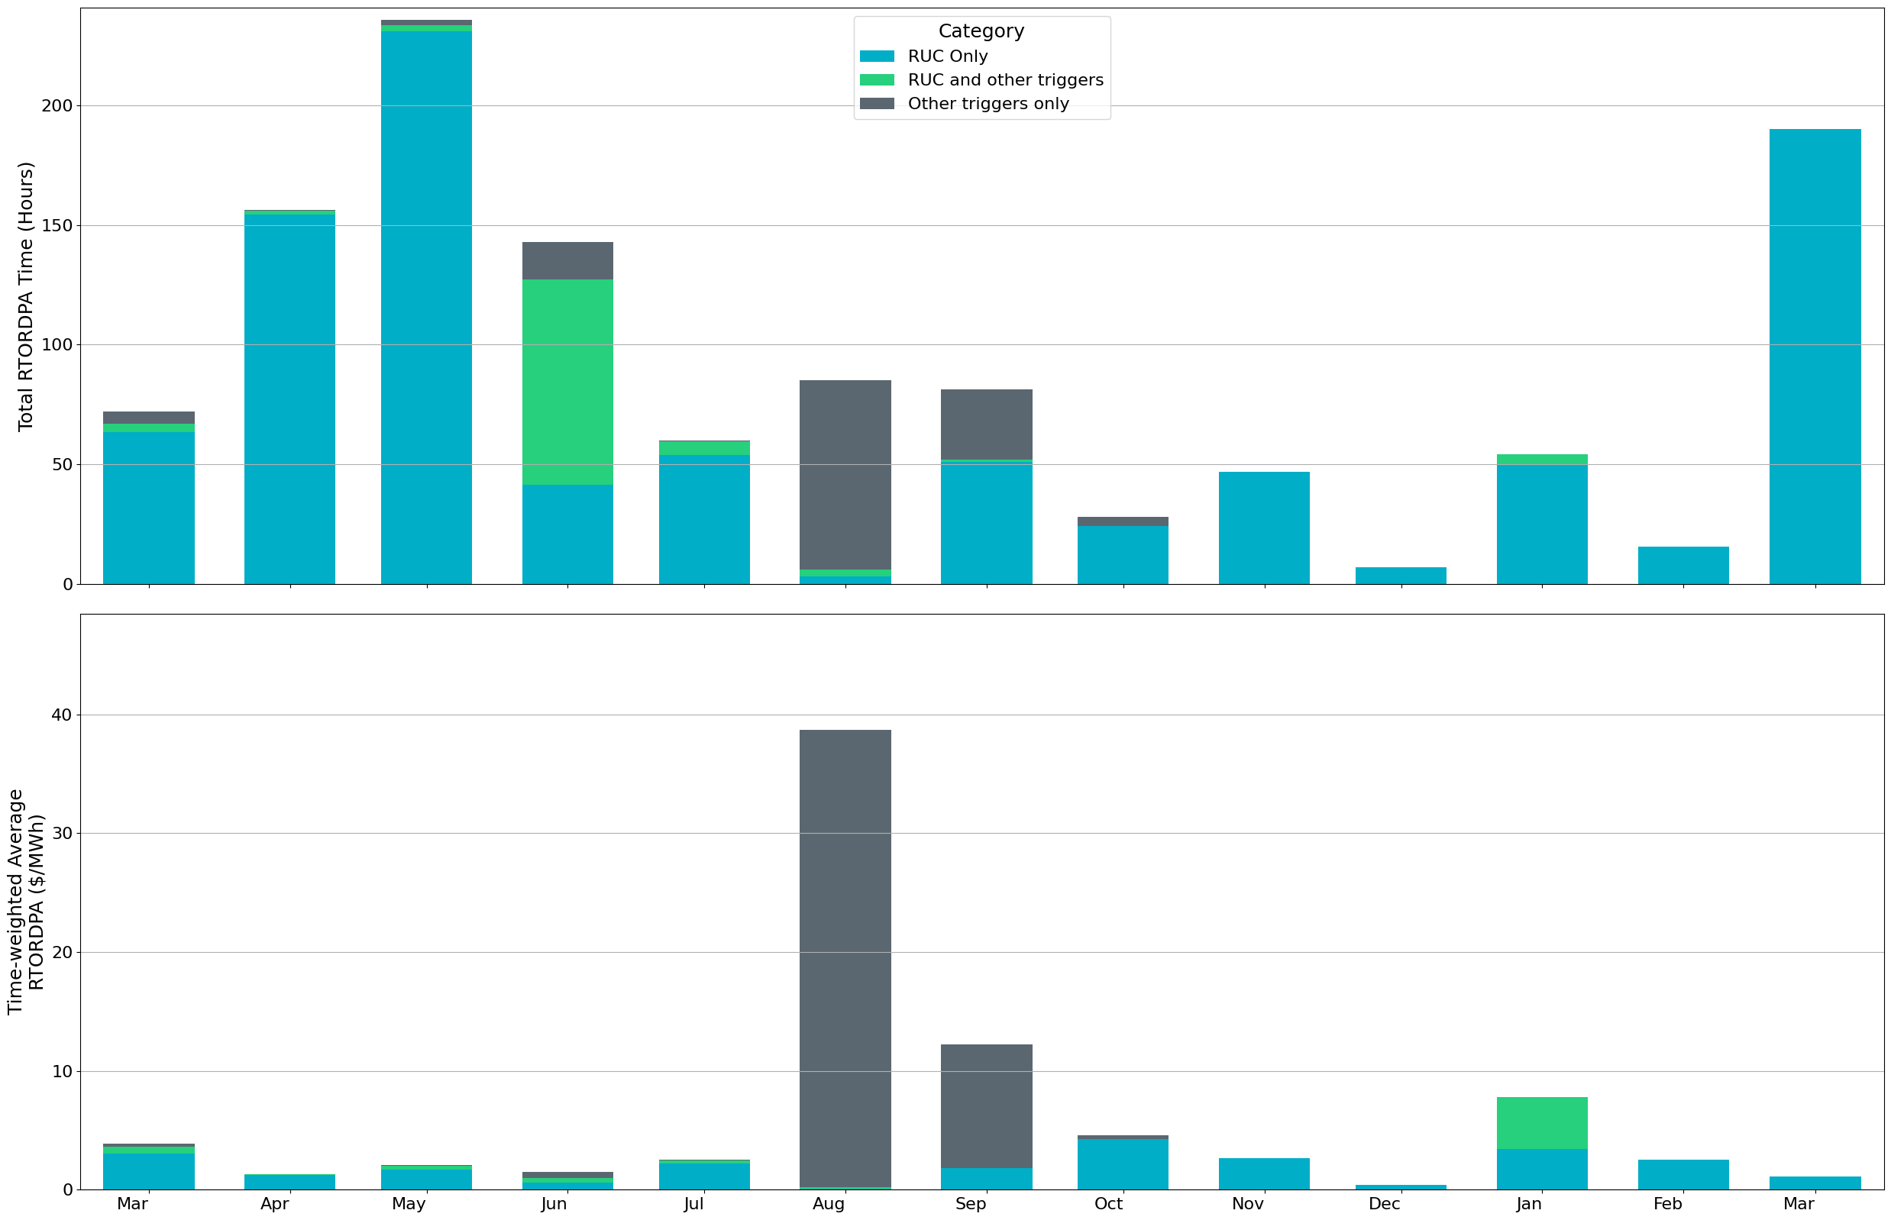
Reliability Deployment Price Adder: Last 13 Months
March 2024 had a total of 190.3 RTORDPA hours with an average value of $0.36/MWh.
These graphs show RTORDPA instances by reliability action: 'RUC Only' for instances triggered solely by Reliability Unit Commitment, 'RUC and other triggers' for instances with RUC and additional triggers, and 'Other triggers only' for instances with non-RUC triggers. The daily average RTORDPA is calculated using the total duration across all categories. See ERCOT protocol section 6.5.7.3.1 for details.

Slide 12
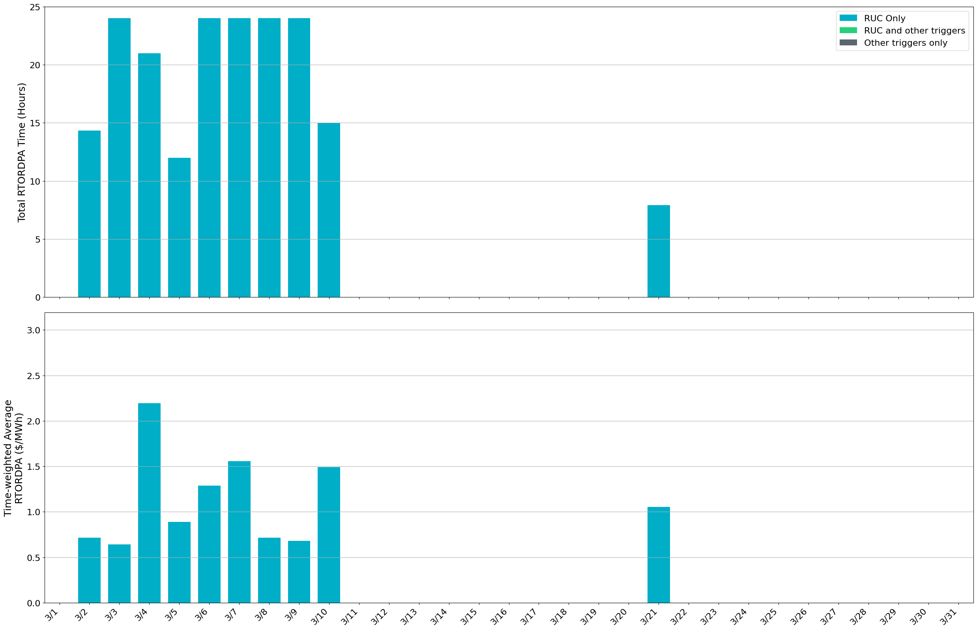
Reliability Deployment Price Adder: March 2024
OD 3/4 had the highest daily time-weighted average RTORDPA of $2.19/MWh.
These graphs show RTORDPA instances by reliability action: 'RUC Only' for instances triggered solely by Reliability Unit Commitment, 'RUC and other triggers' for instances with RUC and additional triggers, and 'Other triggers only' for instances with non-RUC triggers. The daily average RTORDPA is calculated using the total duration across all categories. See ERCOT protocol section 6.5.7.3.1 for details.

Slide 13
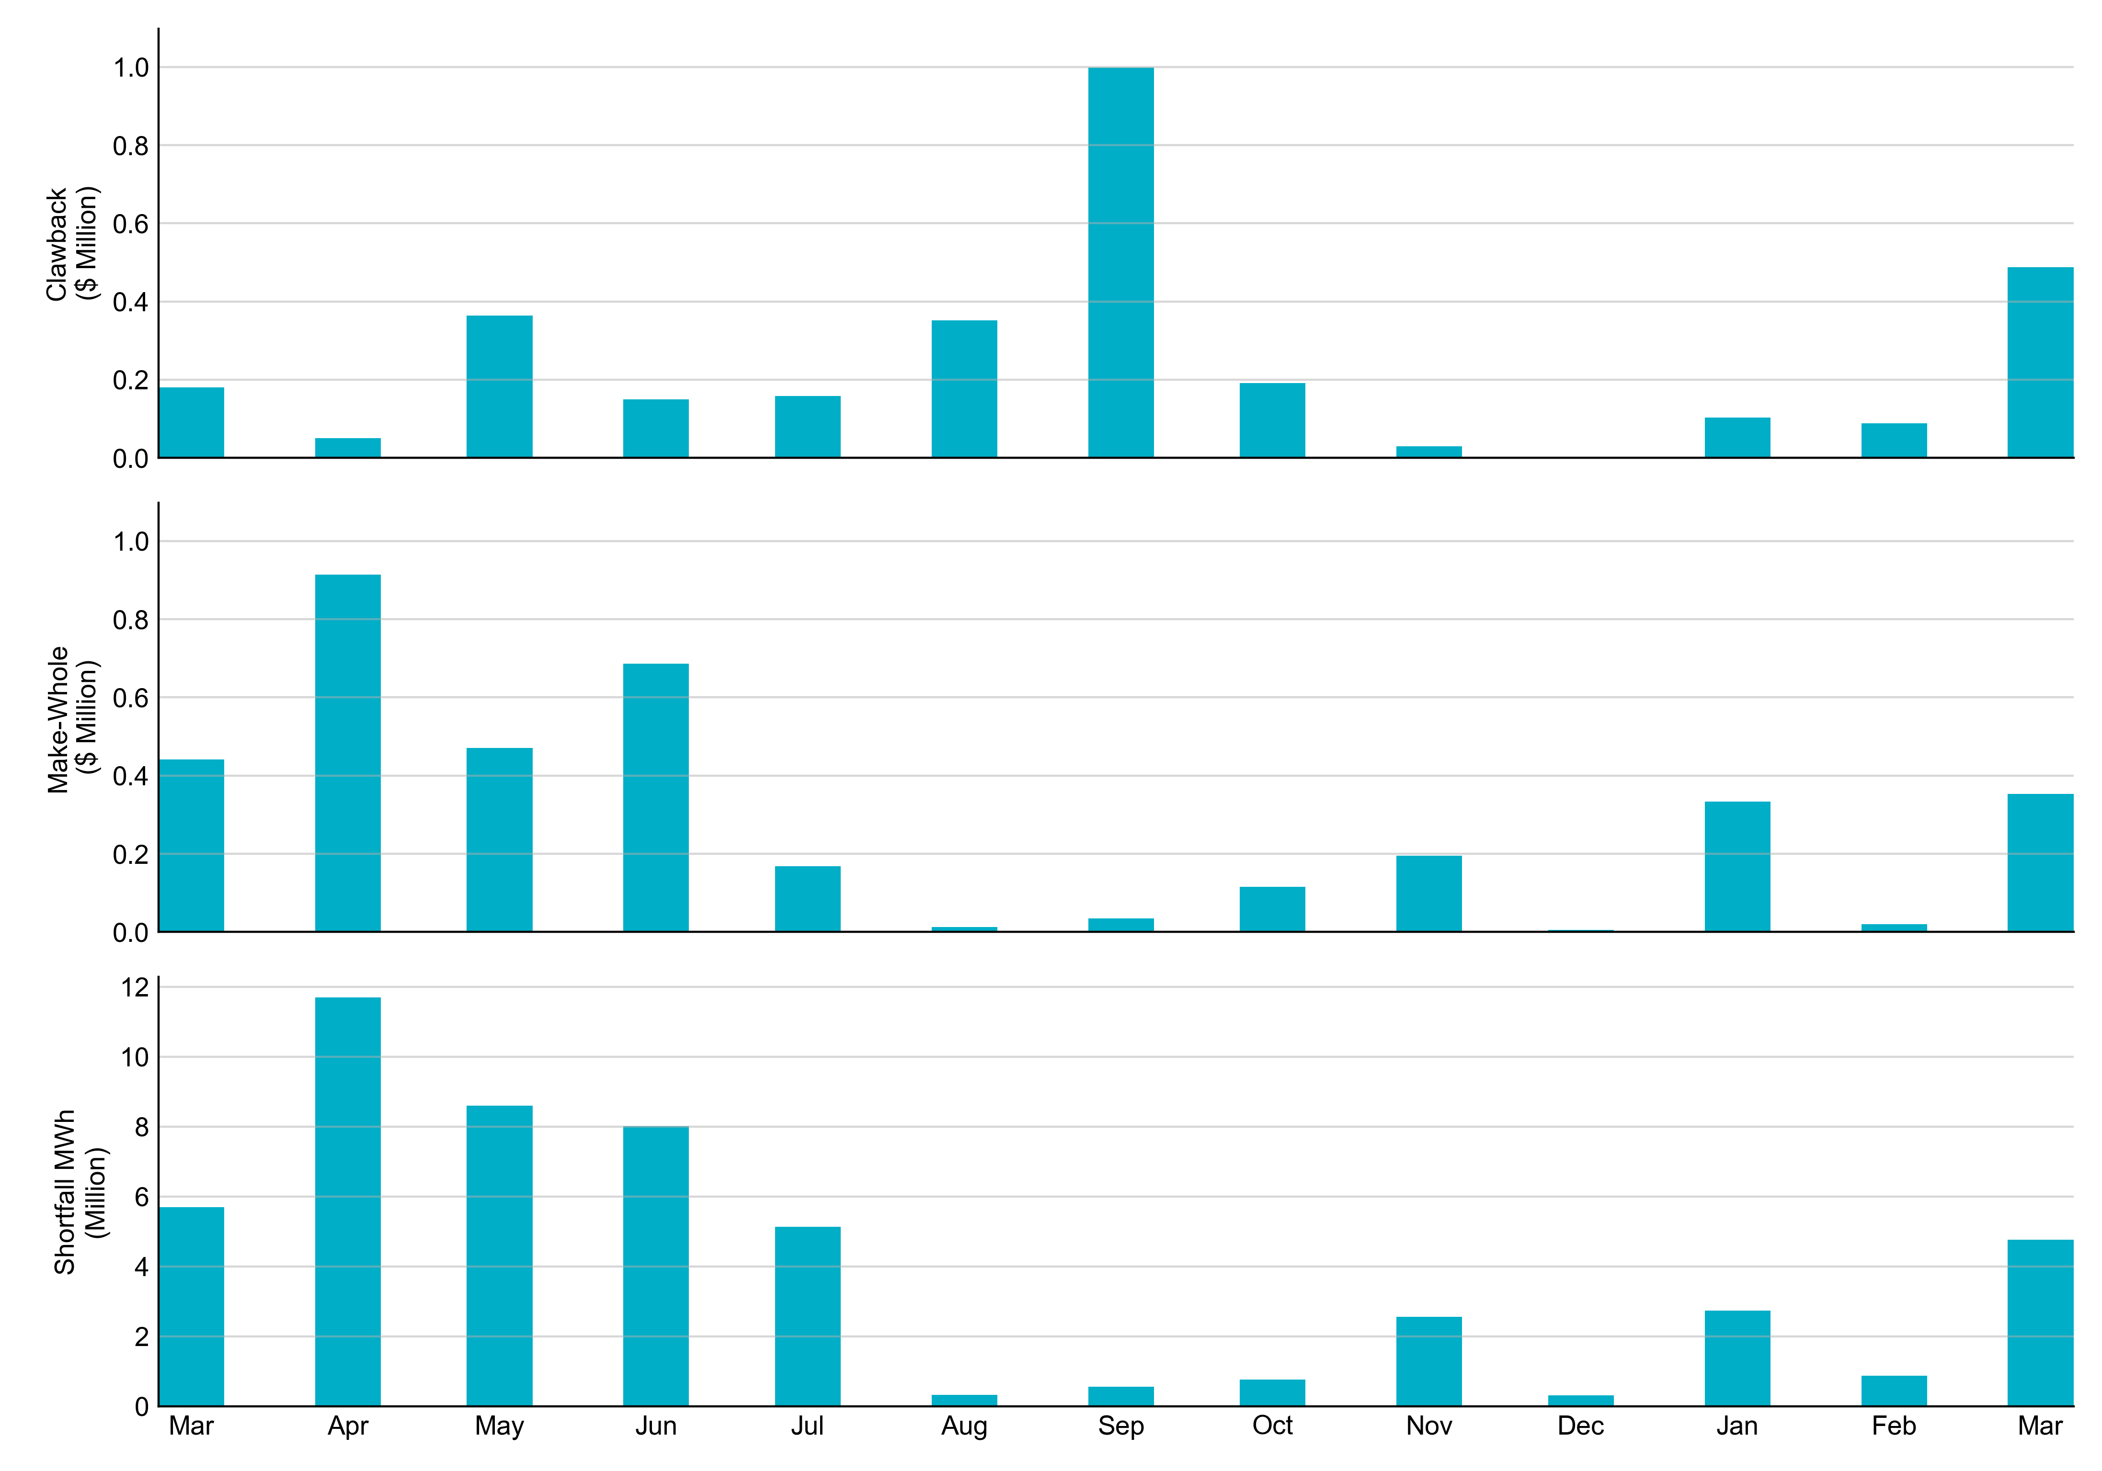
RUC Clawback, Make-Whole, and Shortfall
For March 2024, the total Clawback Charge was $0.48M. The total Make-Whole Payment was $0.35M, which was almost entirely covered through Capacity-Short Charges.
Of the $0.35M million in Make-Whole Payments made in March 2024, $2.82 was uplifted to load due to rounding.
The remaining amount was collected through Capacity-Short Charges.
Data as of April 2nd, 2024

Slide 14
RUC Clawback by Settlement Type
Month | Initial Settlement ($) | Final Settlement Change ($) | True-up Settlement Change ($) | Net as of April 2, 2024 ($)
Mar ‘23 | 179,783 | 0 | 0 | 179,783
Apr ‘23 | 53,643 | 0 | -3,557 | 50,087
May ‘23 | 426,519 | 0 | -62,724 | 363,795
Jun ’23 | 149,347 | 0 | 0 | 149,347
Jul ‘23 | 218,907 | -60,841 | 0 | 158,066
Aug ‘23 | 352,002 | 0 | 0 | 352,002
Sep ‘23 | 997,843 | 0 | 0 | 997,843
Oct ‘23 | 190,721 | 0 | - | 190,721
Nov ‘23 | 29,684 | 0 | - | 29,684
Dec ‘23 | 0 | 0 | - | 0
Jan ‘24 | 107,176 | -4,657 | - | 102,519
Feb ‘24 | 88,220 | - | - | 88,220
Mar ‘24 | 487,193 | - | - | 487,193
Negative dollars represent a payment from ERCOT to a market participant
“-” indicates settlement has yet to be completed.
Net figures may differ slightly due to rounding.

Slide 15
RUC Make-Whole by Settlement Type
Month | Initial Settlement ($) | Final Settlement Change ($) | True-up Settlement Change ($) | Net as of April 2, 2024 ($)
Mar ‘23 | -343,491 | 0 | -97,889 | -441,379
Apr ‘23 | -687,506 | 0 | -226,976 | -914,482
May ‘23 | -426,974 | 0 | -43,426 | -470,400
Jun ‘23 | -600,652 | 0 | 0 | -600,652
Jul ‘23 | -161,994 | -4,996 | 0 | -166,990
Aug ‘23 | -12,090 | 0 | 0 | -12,090
Sep ‘23 | -35,168 | 0 | 0 | -35,168
Oct ‘23 | -72,477 | -43,063 | - | -115,540
Nov ‘23 | -194,731 | 0 | - | -194,731
Dec ‘23 | -5,316 | 0 | - | -5,316
Jan ‘24 | -253,466 | -79,942 | - | -333,408
Feb ‘24 | -13,658 | - | - | -13,658
Mar ‘24 | -353,562 | - | - | -353,562
Negative dollars represent a payment from ERCOT to a market participant
“-” indicates settlement has yet to be completed.
Net figures may differ slightly due to rounding.

