Slide 1
NERC Projects
2023-01 EOP-004 IBR Event Reporting
&
2023-02 Analysis and Mitigation of BES Inverter-Based Resource Performance Issues
Patrick Gravois
ERCOT Operations Engineer
SDT Member
IBRWG Meeting
April 12, 2024

Slide 2
Project 2023-01 Background
Multiple widespread IBR generation loss events since 2020
Current EOP-004 criteria uses relatively large size threshold for generation loss events more suitable for synchronous generation
NERC Event Analysis (EA) team has analyzed IBR generation loss events that did not meet current EOP-004 criteria which highlighted systemic reliability risks posed by IBRs
NERC EA Process is voluntary in nature and involves significantly longer reporting timelines - EA team currently must wait until brief report is submitted before sending RFIs (~20 days after the event)
Difficult to perform root cause analysis and develop mitigation actions due to unavailability and overwriting of useful data
NERC 2020 San Fernando Disturbance Report recommendations:
Ad hoc reporting of events involving multiple generating resources and possible systemic issues is not an acceptable level of reporting
EOP-004 should be reviewed in terms of the thresholds used for generator tripping events and the extent of resources involved in the disturbance
IRPS drafted a SAR to address this outstanding recommendation
Project page for 2023-01 EOP-004 IBR Event Reporting

Slide 3
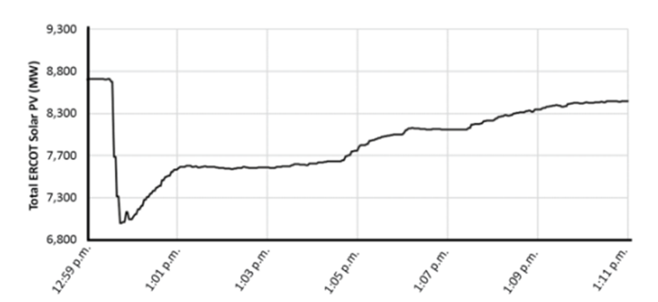
NERC Disturbance Reports
https://www.nerc.com/pa/rrm/ea/Pages/Major-Event-Reports.aspx

Slide 4
Project 2023-01 Industry Need
Loss of IBR generation events need to be identified in a timely manner to collect valuable data before it is overwritten; current standards only require this data to be retained for 10 days
Lower threshold of IBR generation loss needed to identify events involving multiple resources with systemic reliability risks
Revision to EOP-004 needed to align with NERC EA process and categorization to ensure generation loss events impacting multiple IBRs are identified and reported
Category 1i: A non-consequential interruption of inverter type resources aggregated to 500 MW or more not caused by a fault on its inverters, or its ac terminal equipment.
Category 1j: A non-consequential interruption of a DC tie(s), between two separate asynchronous systems, loaded at 500 MW or more, when the outage is not caused by a fault on the dc tie, its inverters, or its ac terminal equipment.
Improved reporting requirements will ultimately lead to improved performance of IBRs due to detailed analysis and coordination with affected entities

Slide 5
Project 2023-01 Update and Timeline
Initial ballot in September 2023
Initial ballot did not pass, with Industry citing the following concerns:
A desired definition for IBR which is not a footnote
500 MW threshold may be too low
Request to add “two or more” facilities
Modify language for “sudden loss” to exclude natural causes or normal reductions in generation
Unclear which Resources should be included in aggregated generation
BA the only entity required to report
Concerns were addressed through language changes or Industry outreach
Will use IBR definition from Project 2020-06 (footnote to be removed)
SDT feels 500 MW threshold should be maintained
11 IBR loss events >500 MW reported in last 4 years
Minimal effort to report
Over reported not a Compliance risk
Added clear language to exempt “non-events”
Clearly defines Resources to be included
Sent out for additional 45-day comment period ending 3/27/2024
Subsequent additional ballot scheduled for July/August 2024
NERC Board Adoption scheduled for December 2024

Slide 6
New Event Type and Thresholds for EOP-004
Event examples found in Technical Rationale

Slide 7
Project 2023-01 Implementation Plan
24-month implementation period upon approval
Becomes effective on the first day of the first calendar quarter after the effective date
Implementation Plan only applies to BAs
BAs are provided time to:
Identify which resources are IBR and aggregate, if they haven’t done so already
Develop process to quickly identify events that meet criteria
Create notification for control room staff
Only resources that BA already has telemetering data (visibility) need to be included; BA does not need to seek out telemetering data for resources for which they do not normally have visibility
No actions for Generator Owner / Generator Operator under the new IBR reporting Criteria
ERCOT began developing tools to identify IBR generation loss events after Odessa 2022 event
Will fine-tune process during 24-month implementation period

Slide 8
Project 2023-02 Background & Industry Need
Unexpected and unwarranted loss of IBR generation seen in past events poses a significant risk to BPS reliability
IBRs reduce output very quickly without operation of ac circuit breaker or other Protection Systems, unlike synchronous generation
PRC-004 is focused on Protection Systems and ensures misoperations are analyzed and mitigated
New Standard needed to ensure unexpected ceasing of current injection of IBRs is analyzed and mitigated by applicable GO
BA or ISO should also have authority to identify abnormal performance issues and initiate analysis and mitigation by the GO
Strong need for proactive analysis of IBR performance issues by GOs to ensure facilities are operating in reliable manner
Project page for 2023-02 Analysis and Mitigation of BES Inverter-Based Performance Issues

Slide 9
Project 2023-02 Update and Timeline
SDT have developed new Standard PRC-030-1 Unexpected Inverter-Based Resource Event Mitigation
25-day formal comment period began March 25 and ends April 18, 2024
Ballot pools forming through April 3, 2024
Initial ballots for Standard and Implementation Plan conducted April 9 – 18, 2024
Non-binding poll of associated Violation Security Levels also conducted April 9 – 18, 2024
Additional comment periods and balloting TBD
NERC identified Project 2023-02 as one of three Standards Development Projects to be filed for regulatory approval by Nov. 4, 2024 to address directives in FERC Order 901

Slide 10
PRC-030-1 Requirements
Applicability:
Functional Entities: Generator Owner
Facilities: Bulk Power System (BPS) Inverter-Based Resources (IBR)
R1. Each applicable Generator Owner shall have a documented process to identify unexpected changes¹ in power output occurring within a two-second period and is the greater of either 20% of the plant's gross nameplate rating, or 20 MVA.
¹ Unexpected changes in power output includes any change of generation that is not attributed to factors such as weather patterns, change of wind, change in irradiance, curtailment, ramping, planned outage, planned testing, or the loss of a Transmission Line connecting the IBR generators.
R2. Each applicable Generator Owner shall implement its process established in Requirement R1 to identify unexpected changes in power output.
R3. Each applicable Generator Owner shall provide data when requested from its Balancing Authority, Reliability Coordinator, or Transmission Operator regarding IBR responses during an identified system level event within 30 calendar days of the receipt of the request.

Slide 11
PRC-030-1 Requirements
R4. Each applicable Generator Owner shall analyze its IBRs performance within 45 calendar days of either the event identified pursuant to Requirement R2 or receipt of a request pursuant to Requirement R3. The analysis shall include all of the following:
4.1. The cause(s) of unexpected change(s) in power output;
4.2. The applicability to its other IBR facilities that could be affected by the same cause of unexpected change(s) in power output; and
4.3. Notification to each applicable Balancing Authority, Reliability Coordinator, or Transmission Operator of the analysis results.
R5. Each applicable Generator Owner shall, within 45 days of completing the analysis in Requirement R4, develop one of the following and provide it to each applicable Reliability Coordinator:
5.1. A Corrective Action Plan (CAP) for the identified Inverter Based Resource(s), including other applicable facilities owned by the Generator Owner as identified in Requirement R4 Part 4.2; or
5.2. A technical justification that addresses why corrective actions will not be applied nor implemented.
R6. Each applicable Generator Owner shall, for each of its CAPs developed pursuant to Requirement R5:
6.1. Implement the CAP;
6.2. Update the CAP if actions or timetables change; and
6.3. Notify each applicable Reliability Coordinator if CAP actions or timetables change and when the CAP is completed.

Slide 12
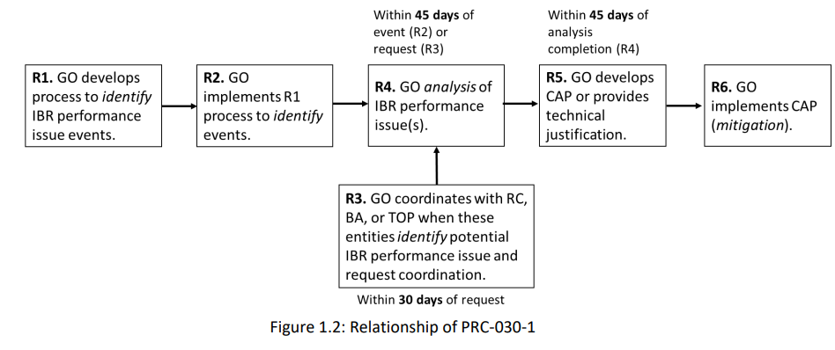
PRC-030-1 Flowchart (Technical Rationale)

Slide 13
PRC-030-1 Implementation Plan
6-month implementation period upon approval
Becomes effective on the first day of the first calendar quarter after the effective date
Implementation Plan applies only to GOs
GOs are provided time to develop and document process to identify events that meet R1 criteria

Slide 14
Questions?

