Slide 1
Inadvertent Gain Statistics
2015 – 2023 data
TDTMS Working Group

Slide 2
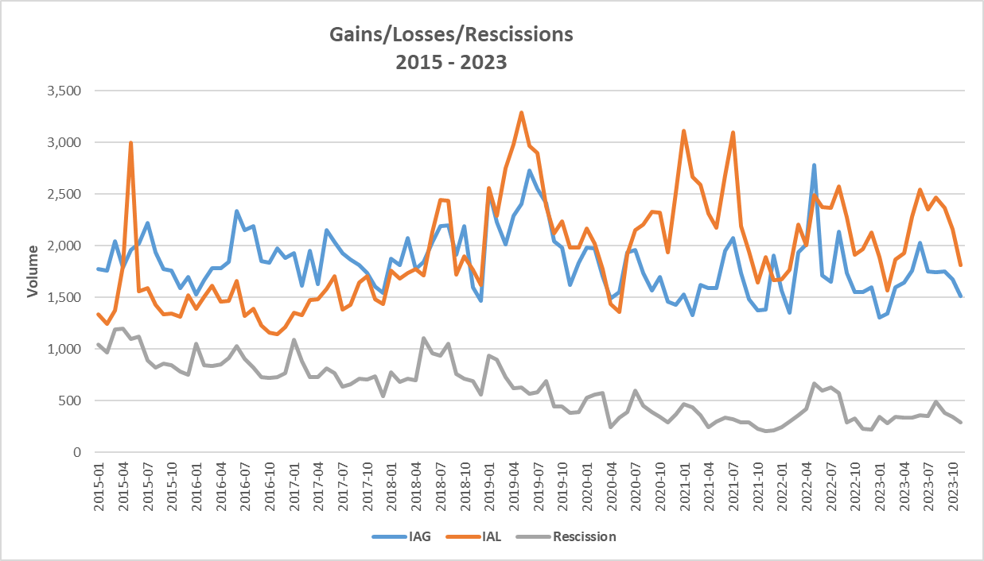
Market Performance - Volumes
Overall % Change in IAS volume per enrollment:
2015 to 2016 = (6.62%)
2016 to 2017 = (7.09%)
2017 to 2018 = 5.38%
2018 to 2019 = 10.59%
2019 to 2020 = (17.7%)
2020 to 2021 = (3.85%)
2021 to 2022 = 2.07%
2022 to 2023 = (4.76%)

Slide 3
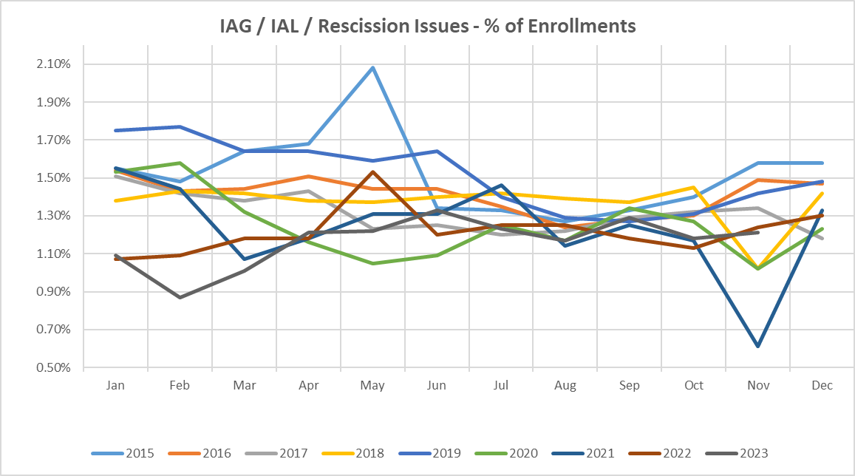
Market Performance - % of enrollments

Slide 4
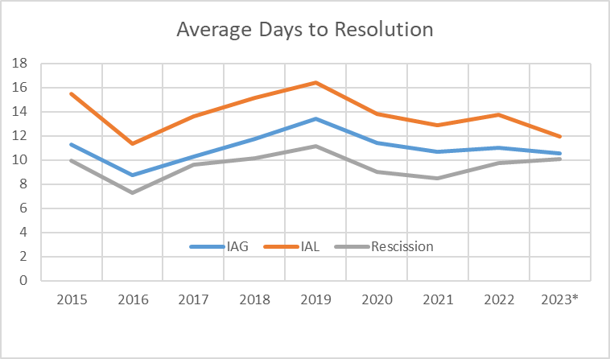
Market Performance – Resolution Days
Valid IAG/IAL/RESC Issues by Close Date

Slide 5
Inadvertent Gain Process Timeline
TDTMS analyzed the results of over 44,000 IAGs/IALs from July 2019 to July 2020, breaking down time required for each transition to provide insight into opportunities for efficiency…

Slide 6
Inadvertent Gain Process Timeline – Data Analysis
Summary of the latest TDTMS analysis from 2022 data (values in blue represent results from 2021 and 2020 analysis respectively) …
Over 59% (55%) (50%) of MTs are submitted within 7 days of the originating transaction
~ 45% (50%) of MTs are acknowledged same day they are submitted
95% (96%) (94%) of completed MTs – CRs reach an agreement within 7 days once opened
Hand-offs still exist in sending BDMVIs, however improved 2 – 12% (5-6%)
95% (96%) (90%) of IAGs are resolved in 21 days
91% (80%) of IALs are resolved in 21 days
CALL TO ACTION – REPs are encouraged to review and compare their performance to identify any opportunities to streamline their process
Posted to main TDTMS meeting page are the results of the three analyses conducted providing the performance of each REP (listed by respective REP#) https://www.ercot.com/committees/rms/tdtms:
  I

