Slide 1
ERCOT RTC+B SCED Tools
Jonas Kersulis
Raymund Lee
RTCBTF
April 10, 2024

Slide 2
Outline
Introduction
Motivation and purpose
Two RTC simulator tools for two different needs
Demonstration of small-scale Excel Simulator Tool
Overview of Production-scale Python Simulator Tool
Inputs and outputs
Capabilities and formulation (Current and Future)
Limitations

Slide 3
Introduction
KP1.1 (8) - ERCOT will work with stakeholders prior to RTC go-live to develop a framework and reporting to periodically review RTC pricing outcomes relative to pricing outcomes that would have been realized through the ORDC for a reasonable period of time.
The purpose of this presentation is to describe the capabilities and progress of two ERCOT-developed RTC simulator tools.
Comparing The Characteristics of Two RTC Simulator Tools
 | Small-Scale | Production-Scale
Platform | Excel | Python
Scale | Small 5-generator case, fixed topology, modifiable parameters | Production Imitation of future implementation of RTC
Use Case | Educational Simple scenarios to illustrate RTC characteristics and behavior | Analytical Perform “what-if” analysis Validate and test future production RTC results
Status | Completed | In progress

Slide 4
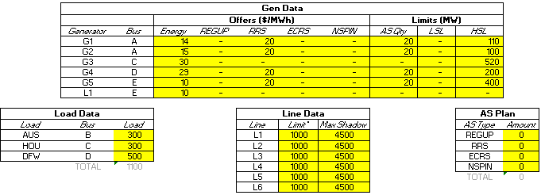
Demonstration of Small-scale Tool
This simple scenario illustrates how co-optimization can impact AS allocation and congestion management.
5 online generators with different Energy price points
4 generators each offer 20 MW of RRS @ $20/MWh
Increase RRS procurement amount from 0 MW to 50 MW, in increments of 10 MW.
Question: How will RTC allocate RRS after each increment?
Answer: RTC allocates RRS to resources with the highest priced energy offers.
Decrease transmission constraint L6 limit to 75 MW
Question: How will RTC manage the transmission constraint?
Answer: RTC re-dispatched energy and allocated RRS to the other side of the constraint.
Initial input parameters

Slide 5
Overview of Production-scale Tool
Inputs
Core Optimization
Outputs
System Data
GTBD
AS Plan
ASDC parameters
MCL, VOLL
System Outputs
System Lambda
Objective Function
Build and solve optimization problem
Resource Data
Status
Resource Type
Capacity and Ramping Limits
AS Capability and Qualification
Energy and AS Offers
Resource Outputs
LMPs
Energy Awards
AS MCPCs
AS Awards
Transmission Outputs
Constraint loading
Constraint shadow price
Transmission Constraints
Shift Factors
(Details on next slide)

Slide 6
Optimization Details
Decision Variables
Base points
AS awards
ASDC variables
Transmission slack variables
Power balance slack variables
Binary variables
Carrying NFRC
ESR Charge/Discharge
Objective
Minimize total system cost:
Energy award costs
AS award costs minus ASDC benefit
Transmission and overgen/undergen penalties
Constraints
Power balance
Total AS award MW = Cleared ASDC MW
Generator limits
Capacity Limits (LSL, HSL)
Ramp Limits (LDL, HDL)
Max AS award (based on qualification, status, ramp capability, overrides)
Linked AS Offers
Transmission Constraints
System-wide RRS procurement
Regulation Ramping Constraint
NFRC Conditional Constraint
SOC Conditional Constraints
Implemented
In progress
Notes:
System-wide RRS procurement constraint
min of 1420 MW RRSPF
limits RRSUF and RRSFF to 60% of total
Max 450 MW RRSFF

Slide 7
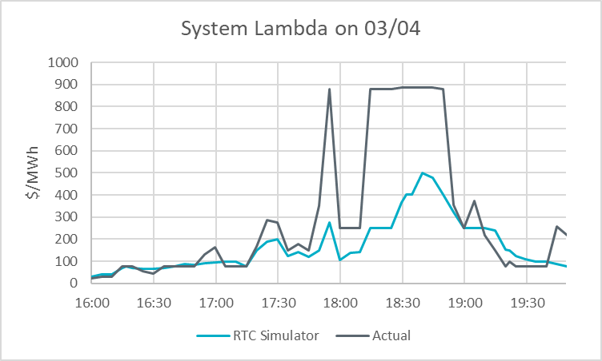
Capabilities and Limitations
Current Functionality
Replicate results of Excel Tool
Solve production-scale cases derived from historical SCED data
Perform non-sequential multi-interval simulation
Planned Functionality
Pricing run
ESR single model
Improved output data visualization
Sequential multi-interval simulation
Mitigation
Limitations
Market submission assumptions
Internal tool (ERCOT database access required)
Non-sequential multi-interval analysis comparing
simulated vs actual system lambda
*Results shown illustrate the tool’s current capability and do not necessarily reflect production RTC outcomes.
Notes:
Key milestones
- Can replicate results of 5-generator Excel Tool
- Can create a case using historical data

Slide 8
Summary and Next Steps
ERCOT wanted to share the details of the framework being developed
ERCOT is interested in feedback on this framework or Operating Days (to discuss at next RTCBTF)
Tool is still under development and will share updates on progress
Questions?

