Slide 1
Discuss March Request Regarding RUC of Resource with Long Min. Run Time
ERCOT Staff
April 3, 2024
WMS

Slide 2
Reliability Unit Commitment (RUC)
A cost-optimized process utilized by ERCOT to ensure adequate capacity is available in the proper locations to serve the forecasted load
RUC
Forecasted Load
Committed Capacity
RUC commits additional Capacity to meet
Demand + Reserves

Slide 3
Committed Capacity Margin (CCM) Calculation
Committed Capacity (CC)
CC is the summation of the latest COP HSLs for online (including Resource Status of OFFNS and OFFQS) Generation Resources, plus ECRS obligation from CLRs, and excludes DC tie Export Schedules
CC = Online COP HSL – max(DC tie Schedules,0) + Offline Non-Spinning + ECRS from CLR
CCM = CC – LF (Load Forecast)
 | DCSCHED
CC | HSLCOPE
 | OFFNS
 | ECRSOBLCL
LF
CCM
● HSLCOPE: | COP HSL | ● OFFNS: | Offline Non-Spin
● DCSCHED: | DC tie export schedules | ● ECRSOBLCL: | ECRS Obligation from CLRs

Slide 4
Reasons for RUC
RUC instructions are issued when under commitment is detected to serve forecasted load + reserves
RUC instructions are issued in anticipation of extreme cold weather/startup failures
Case 1) Under Commitment
CCM < 6,500 MW
HASL < Load Forecast (LF)
Case 2) Extreme cold days
CCM < 6,500 MW
HASL > Load Forecast (LF)
RUCed Capacity for CCM
RUCed Capacity for Shortfall
Offline GEN NSRS
Reg-Up RRS-GEN Online NSRS
RUCed Capacity
Offline GEN NSRS
Reg-Up RRS-GEN Online NSRS
6500 MW
Committed Capacity
CCM
Committed Capacity
CCM
Online HSL
6500 MW
Online HSL
Load Forecast
Shortfall
HASL
HASL
Load Forecast
Committed Capacity Margin (CCM) = CC - LF

Slide 5
Details on RUCed Units
On Mar 4th ERCOT RUCed four thermal units for a total of 992 MW (HSL) for 03/04 HE19
Unit | Commit Time | HSL (MW) | Delivery Date/Hours | Reason for Commitment
1 | 03/03 20:26 PM | 250 | 03/04 HE 01 – 22 | Manual commitment for capacity
2 | 03/04 00:34 AM | 230 | 03/04 HE 15 – 20 | HRUC recommended for capacity
3 | 03/04 05:36 AM | 120 | 03/04 HE 17 – 24 | Manual commitment for capacity
4 | 03/04 07:35 AM | 392 | 03/04 HE 18 – 20 | HRUC recommended for capacity
On Mar 5th ERCOT RUCed three thermal units for a total of 626 MW (HSL) for 03/05 HE 19
Unit | Commit Time | HSL (MW) | Delivery Date/Hours | Reason for Commitment
5 | 03/04 22:28 PM | 572 | 03/05 HE 16 – 24 | Manual commitment for capacity
6 | 03/05 02:26 AM | 18 | 03/05 HE 18 – 23 | HRUC recommended for capacity
7 | 03/05 11:34 AM | 36 | 03/05 HE 13 – 18 | HRUC for congestion

Slide 6
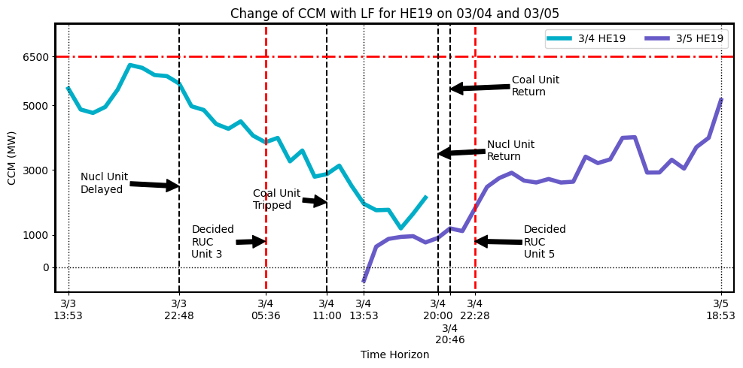
Committed Capacity Margin (CCM) – 03/04 and 03/05
On Mar 3rd at 22:48 PM, Large Nuclear Unit (HSL 1,330 MW) updated the COP to delay its return till Mar 4th 20:00 PM
On Mar 4th at 11:00 AM, Large Coal Unit (HSL 782 MW) tripped
TIME STAMP |  | D-1 13:53 | D-1 14:53 | D-1 15:53 | D-1 16:53 | D-1 17:53 | D-1 18:53 | D-1 19:53 | D-1 20:53 | D-1 21:53 | D-1 22:53 | D-1 23:53
CCM (MW) | 03/04 HE19 | 5,516 | 4,869 | 4,762 | 4,948 | 5,480 | 6,245 | 6,155 | 5,934 | 5,900 | 5,670 | 4,969
 | 03/05 HE19 | -410 | 635 | 873 | 935 | 957 | 764 | 902 | 1,198 | 1,116 | 1,799 | 2,479

Slide 7
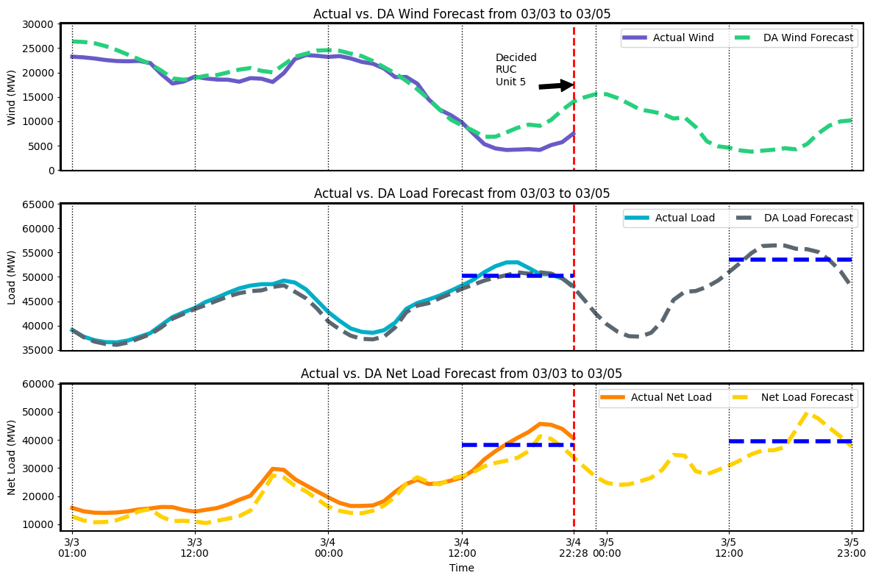
Actual vs. DA Forecast from 03/03 to 03/05
On Mar 4th, wind was over-forecasted, load was under-forecasted, and there was an overall under-forecast in net load
Furthermore, temperatures and net load on Mar 5th were forecasted to be higher than on Mar 4th, with the net load forecasted to be ~4,200 MW higher on Mar 5th
Avg. Actual Load:
50,259 MW
Avg. Forecast Load:
53,558 MW
Avg. Actual
Net Load:
38,237 MW
Avg. Forecast
Net Load:
39,400 MW
*No impact from Solar Forecast
Notes:
Can you also include a 3HA forecast? Will that show under forecast in net load for 3/4 also?

Slide 8
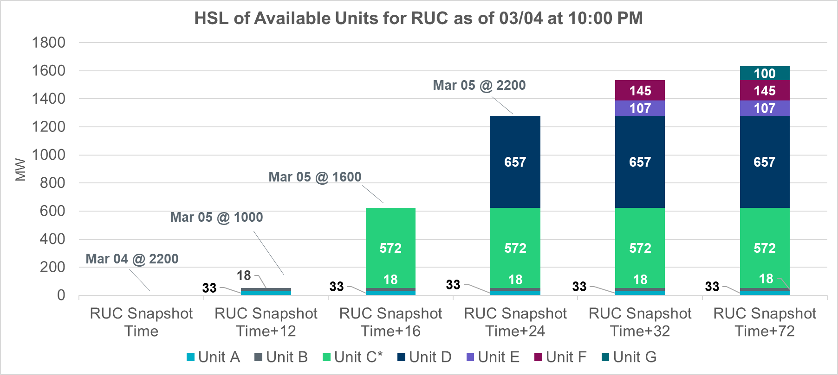
Offline Units for HE19 on 03/05
At 22:28 PM on 03/04, when the decision to commit additional units was made, Unit 5 had the shortest startup time among resources that were not short start units. Due to longer startup time, Unit D would not be available until after peak for 03/05.
Additionally, Unit A and Unit B were also RUCd at 02:38am on 03/05.
Unit C* represents Unit 5

Slide 9
Conclusion
The manual RUCs on 03/04 and 03/05 were in response to extremely low committed capacity margins projections for the peak hours on these days.
These were caused by forced outages, delays in outaged units returning to service, and higher forecasted net load.

Slide 10
Appendix

Slide 11
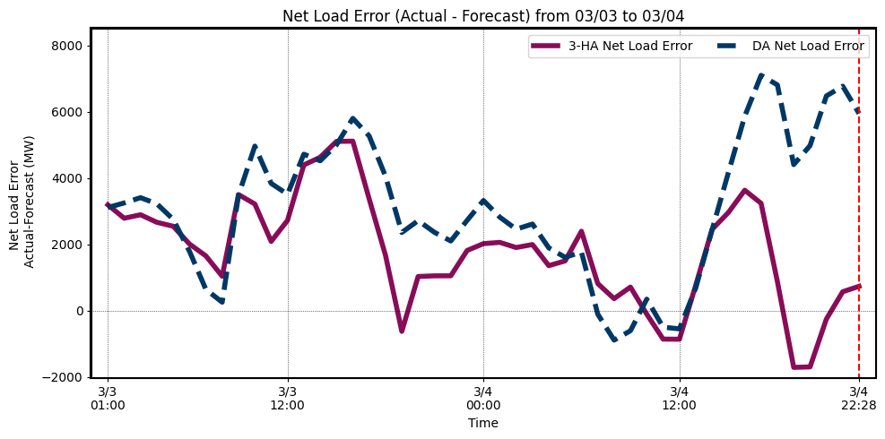
Net Load Forecast Error from 03/03 to 03/04
In consideration for Net Load Error on Mar 4th, we see that even in accounting for closer to the operating hour forecasts, the net load was still underestimated and was a concern for the net load forecast for 03/05.

Slide 12
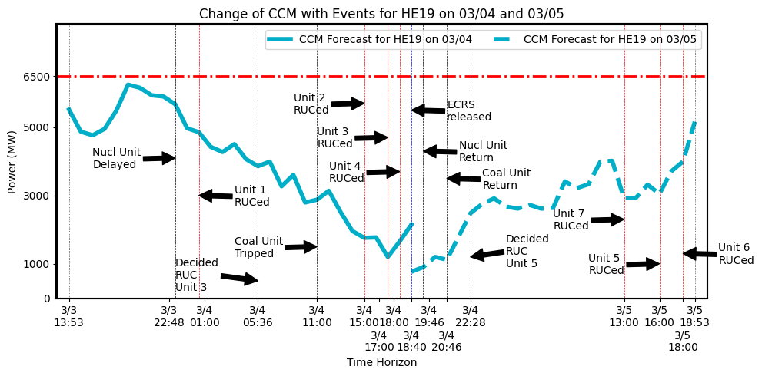
Details for HE19 on 03/04 and 03/05
On Mar 3rd at 20:26 PM, decided RUC Unit 1
On Mar 3rd at 22:48 PM, Large Nuclear Unit (HSL 1,330 MW) updated the COP to delay its return till Mar 4th 20:00 PM
On Mar 4th decided RUC Unit 2 (at 00:34 AM), Unit 3 (at 05:36 AM), and Unit 4 (at 07:35 AM)
On Mar 4th at 11:00 AM, Large Coal Unit (HSL 782 MW) tripped
On Mar 4th executed RUC 4 units, Unit 1 (at 01:00 AM, HSL 250 MW), Unit 2 (at 15:00 PM, HSL 230 MW), Unit 3 (at 17:00 PM, HSL 120 MW), and Unit 4 (at 18:00 PM, HSL 392 MW)
On Mar 4th at 18:40 PM, 550 MW ECRS released
On Mar 4th at 19:46 PM, Large Nuclear Unit returned
On Mar 4th at 20:46 PM, Large Coal Unit returned
On Mar 4th at 22:28 PM, decided RUC Unit 5
On Mar 5th decided RUC Unit 6 (at 02:26 AM) and Unit 7 (at 11:34 AM)
On Mar 5th executed RUC 3 units, Unit 7 (at 13:00 PM, HSL 36 MW), Unit 5 (at 16:00 PM, HSL 572 MW), and Unit 6 (at 18:00 PM, HSL 18 MW)

