Slide 1
Discuss NPRR1224 -Potential Changes to ECRS Deployment/Release Triggers
ERCOT Staff
April 4, 2024
ROS

Slide 2
Introduction
As part of the 2024 Ancillary Service (AS) Methodology discussion at the Technical Advisory Committee (TAC) and ERCOT Board (BoD), ERCOT was asked to review by April 30, 2024, the methodology used to compute ERCOT Contingency Reserve Service (ECRS) requirements, ECRS deployment triggers, and potential alternate solutions taking into account the analysis that the Independent Market Monitor (IMM) has conducted on the impact of ECRS.
ERCOT hosted a workshop on March 19, 2024, to discuss possible manual triggers to release ECRS sooner.
This slide deck provides details on the new trigger for manually releasing SCED dispatchable ECRS that was introduced at the March 19th workshop and included in NPRR1224.
Notes:
TAC Motion: To endorse the 2024 Ancillary Services Methodology as recommended by ERCOT on the commitment from ERCOT to bring the methodology back up for TAC review by April 30, 2024
Source: https://www.ercot.com/files/docs/2023/12/04/2023%20TAC%20AS%20Methodology%20Ballot%2020231204.xls
ERCOT BoD Slide #7
ERCOT has committed to TAC to perform additional assessment related to ECRS prior to April 30, 2024 which could result in an intra-year update to the methodology or deployment procedures related to ECRS.
Source: https://www.ercot.com/files/docs/2023/12/11/14.1%20ERCOT%20Recommendation%20regarding%202024%20ERCOT%20Methodologies%20for%20Determining%20Minimum%20Ancillary%20Service%20Requirements.pdf

Slide 3
Background
ERCOT Contingency Reserve Service (ECRS) is a service that is that is capable of being ramped to a specified output level within 10 minutes. ECRS is intended to cover the need to recover frequency following a large unit trip and cover for intra-hour net load (i.e., load – wind – solar) forecast errors.
ECRS may be provided by
unloaded, On-Line Generation Resource capacity;
Quick Start Generation Resources (QSGRs);
Load Resources that may or may not be controlled by high-set, underfrequency relays;
Controllable Load Resources; and
Generation Resources operating in synchronous condenser fast-response mode as defined in the Operating Guides.
ECRS may be deployed/released automatically or manually to
restore frequency within 10 minutes of a significant frequency deviation and recover deployed Regulation Service,
to compensate for intra-hour net load forecast uncertainty and variability on days in which large amounts of On-Line thermal ramping capability is not available, or
when there is a limited amount of capacity available for Security-Constrained Economic Dispatch (SCED).

Slide 4
Thoughts on 2024 ECRS Methodology and Deployment
ERCOT has reviewed the current methodology for computing minimum ECRS requirements and is not proposing any further changes in the ECRS methodology for 2024.
ERCOT and the IMM can revisit the ECRS methodology to consider the various operating scenarios under which ECRS deployment may be needed and the probabilistic risk of these and other contingencies, with the aim to formulating an approach for computing ECRS quantities in future, as part of the PUC AS Study.
Instead, ERCOT believes it is more appropriate to consider whether changes to the release of ECRS are warranted.
ECRS can be released automatically and manually.
Automatic release of ECRS triggers during a unit-trip type event when frequency drops below 59.91 Hz.
Manual release triggers are currently based on two assessments of available dispatchable capacity to serve forecasted 10 minute ahead net load
Some of the release of ECRS last summer occurred on scarcity days - i.e., days when the available dispatchable capacity was limited and the net load was extremely high. The manual ECRS triggers described above are not designed for these type of days. On these days some portion of ECRS be released earlier.

Slide 5
Options for releasing ECRS earlier
The IMM shared the following ideas on potential concepts that could be considered for releasing ECRS earlier (that could be considered prior to RTC).
Option 1: Release chunks of ECRS manually at particular system lambda price triggers
Option 2: Release chunks of ECRS at particular amounts of under-generation
Option 3: Standing deployment of some portion of ECRS at a price floor (potential future change)
ERCOT has reviewed these ideas and is supportive of making Nodal Protocol rules changes to adopt a concept like the one described in Option 3. Since this concept may need some system changes (potentially both for systems in ERCOT and at Market Participant end), this option may not be feasible to implement by Summer 2024.
For Summer 2024, ERCOT has worked with the IMM to develop a new manual trigger for releasing ECRS using the concept in Option 2 above.
ERCOT has submitted NPRR1224 to propose a new trigger to manually release ECRS from SCED dispatchable Resources when the system power balance constraint is consistently violated and the MW amount of the power balance violation is at least 30 MW for 10 consecutive minutes. ERCOT is open to stakeholder comments regarding alternative values of power balance violation and duration.

Slide 6
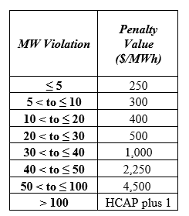
New Manual Trigger: Parameter Selection
Concept: Release SCED dispatchable ECRS up to 500 MW when in Real-Time, SCED starts using Power Balance Penalty to forego dispatching at least X MWs, i.e., total SCED BPs is less than GTBD consistently for Y consecutive minutes.
This condition would be an indication that from the SCED-perspective, it is more economic to rely on Regulation than deploy higher priced MWs.
Values of X & Y can be selected so that the manual release of ECRS would more closely reflect how the procurement of ECRS would work when RTC is implemented.
In reviewing the historic operations since implementation of ECRS, and the ASDC analysis, with X = 30 MW and Y = 10 minute, ERCOT would start considering release of the first 500 MW of SCED dispatchable ECRS when under-generation is 30 MW or more for 10 consecutive minutes.
Per the current power balance penalty curve, system lambda would likely be around $500/MWh or higher when this action is considered.
Note that, while ERCOT has included X=30 and Y=10 in NPRR1224, ERCOT is open to stakeholder feedback regarding alternative values of power balance violation and duration.

Slide 7
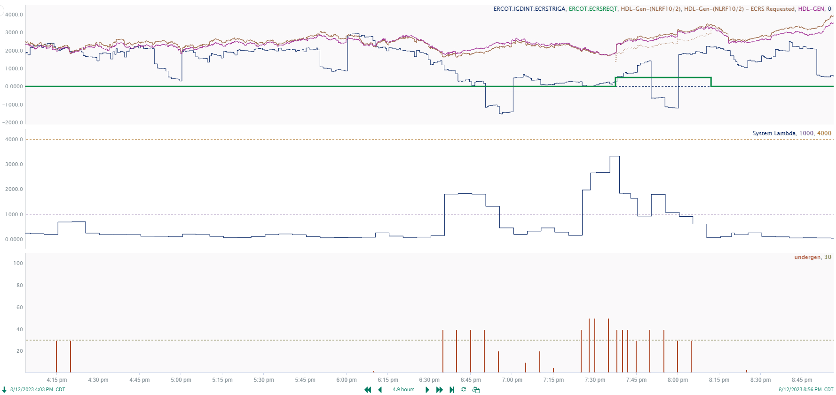
Example: 8/12/2023
Historical ECRS Release at: 7:37 PM
SCED Under-Generation
Under-Generation >= 30 for 10 minutes
Trigger at: 6:45 PM
The proposed new trigger would also recommend an earlier release of ECRS in this case.

Slide 8
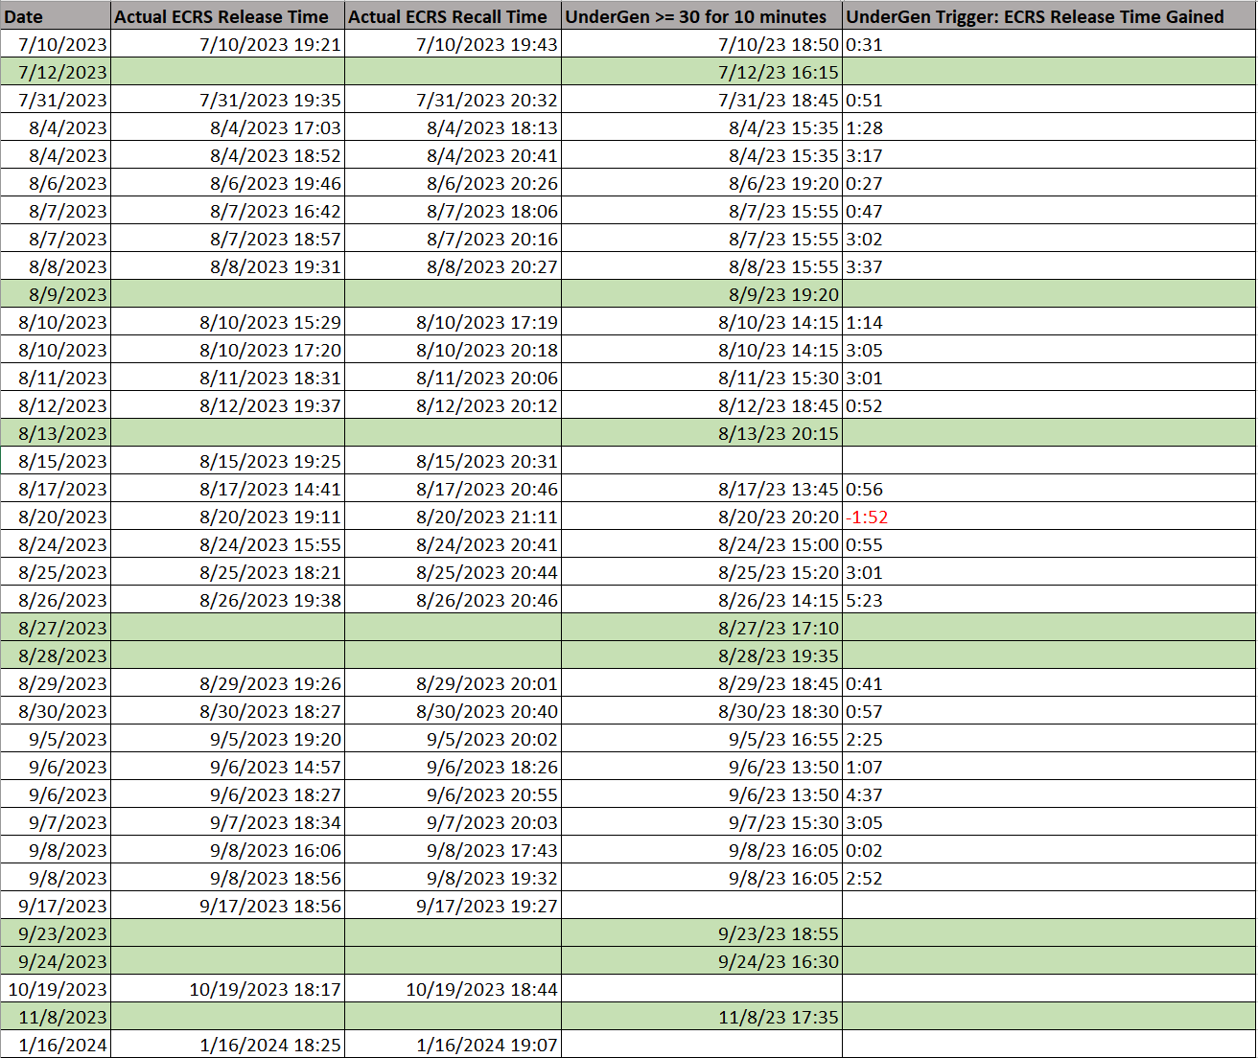
New Manual Trigger: Some Considerations
Using X=30, Y=10 on operation data since July 1, 2023 to test when the under-generation based concept would trigger ECRS release, it was observed that the concept picked:
same days when ECRS was released but in many cases indicates the need to release ECRS earlier
new days when ECRS wasn’t released
days with high pricing due to high congestion costs
Green indicates a day with no historical ECRS Release

Slide 9
New Manual Trigger: Deployments and Recall
Release ECRS when in-Real Time, SCED starts using Power Balance Penalty to forego dispatching at least 30 MWs, i.e., total SCED BPs is less than GTBD consistently for 10 consecutive minutes.
Deployment
When this trigger is met ERCOT may release up to 500 MW of SCED-dispatchable ECRS capacity.
Following such an ECRS release, if 30 MW or more of under-generation continues to persists, ERCOT may release additional SCED-dispatchable ECRS.
Note that when manually releasing ECRS, ERCOT may preserve some SCED-dispatchable ECRS to ensure that ERCOT has sufficient capacity that can respond and help recover frequency within the parameters required by NERC Reliability Standards. However, if the power balance constraint violation remains at or above 30 MW, ERCOT will continue to release ECRS in small blocks..
Recall
ERCOT will recall the manually released ECRS when the triggering condition has ended and system frequency is above 59.97 Hz.

Slide 10
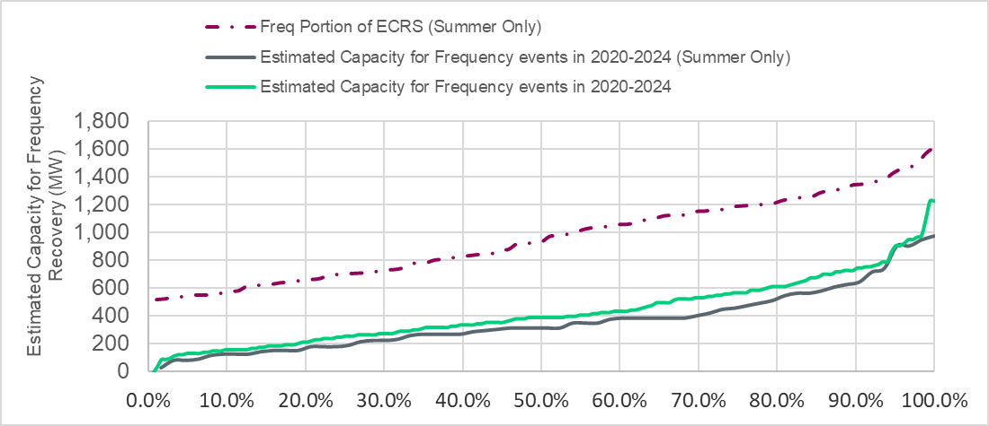
Recap Capacity for Frequency Recovery
A review of historical frequency events between 2020 and 2024 was conducted to estimate the capacity needed for recovering frequency to 59.98 Hz in these events as
Recovery-MW = (59.98Hz – B_{point}) * 895 MW/0.1Hz * 10
Based on this analysis of historic events, approximately 900 MW of SCED-dispatchable ECRS capacity is expected to be sufficient recover frequency during most of the unit trip events that are typically experienced
Percentile | Est. Capacity (Summer) | Est. Capacity
50th | 313.3 MW | 384.8 MW
70th | 409.9 MW | 528.0 MW
90th | 640.8 MW | 737.5 MW
95th | 887.8 MW | 897.2 MW
Max | 958.4 MW | 1226.2 MW

Slide 11
Summary and Next Steps
ERCOT is not proposing any further changes to the methodology used for computing minimum ECRS quantities in 2024.
ERCOT is open to continue discussing the IMM’s feedback on this as a part of the PUC AS study and 2025 AS Methodology discussion.
ERCOT is agreeable to a new trigger to deploy SCED-dispatchable ECRS.
Parameters for this new trigger will need to be defined.
ERCOT has submitted NPRR1224 to include this manual trigger for deploying ECRS. ERCOT is open to stakeholder feedback regarding alternative values
ERCOT is seeking Stakeholder feedback on NPRR1224.
Review Timeline for NPRR1224
April 03, 2024 – WMS
April 04, 2024 – ROS
April 05, 2024 – PRS
April 15, 2024 – TAC
April 23, 2024 – BoD

Slide 12
Appendix

Slide 13
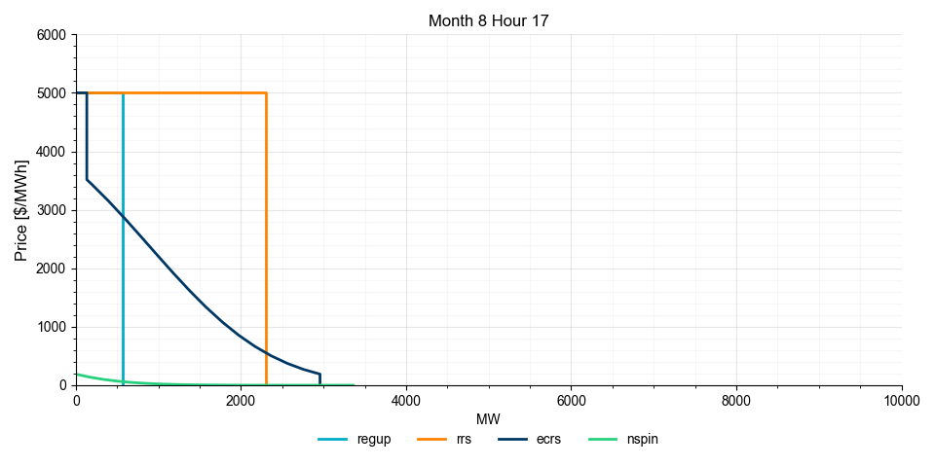
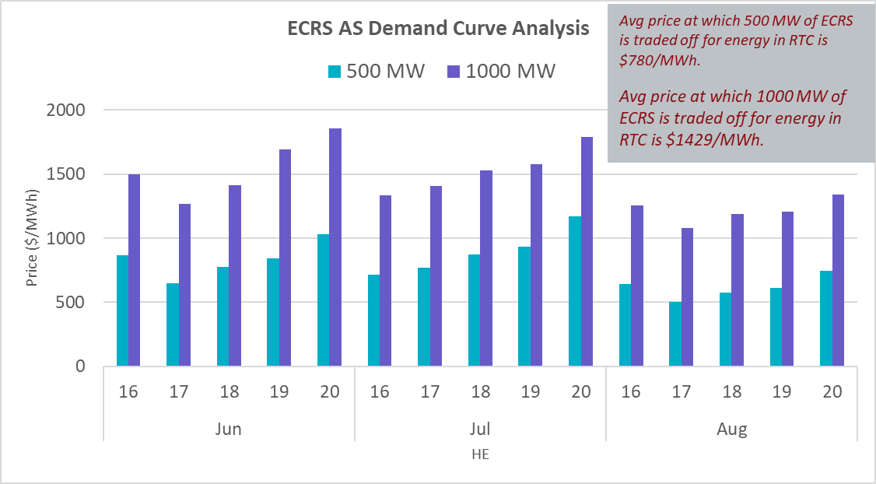
Quick Review of RTC AS Demand Curves
At its Feb 21, 2024 meeting, the RTCB Task Force reviewed the policy that has been approved to build AS Demand Curves for RTC.
The ECRS AS Demand Curves that would be produced for HE16 to HE20 in June, July and August 2024 were reviewed specifically to understand the price point at which RTC SCED would start going short on ECRS procurement during these hours.
~500 MW trade off in ECRS procurement at price of $503/MWh
During peak Summer hours, when prices reach approximately $780/MWh it is expected that RTC SCED will be short at least 500 MW in ECRS procurement, effectively releasing 500 MW of capacity for the energy market.

