Slide 1
TDTMS Update
RMS
APRIL 2, 2024

Slide 2
TDTMS
ERCOT Reporting
MIS API project update – Release to correct the issue of the missing key date in the GUI for initiating transactions if viewer is not the submitter is tentatively scheduled for March 24.
UPDATE-Retail Incident 2/12 – ERCOT was unable to send transactions for ~1hour from 7:56AM-8:57AM as well as reporting was affected. Issue triggered by a known bug which a new data center and storage refresh in 3-4 weeks may correct. Two market notices were sent to notice_extracts_retail@lists.ercot.com and notice_operations_retail@lists.ercot.com. . UPDATE: New design in testing and expected to take a month or so. No expected impacts when re-design is moved to production which the release will likely be combined with a normally scheduled one.
ERCOT Developer Portal – Available now online with full release scheduled for March 28: ERCOT Developer Portal. Portal offers technical support and is an open forum for all market participants to ask questions and search “how to.” ERCOT is also a moderator as well as cyber security enabled. Portal and all technology topics are discussed in Technology Working Group meetings. Market Notice announcing Portal: M-B022824-01 ERCOT to launch Developer Portal

Slide 3
TDTMS
ERCOT Reporting
SCR817 –Reviewed the edits to the Inadvertent Gain section of the User’s Guide which may impact a few other areas of the RMG. Tammy with ERCOT agreed to post the edits to the TDTMS meeting page, so that participants can review on their own and bring back questions/concerns to the April TDTMS meeting. Most edits pertain to the removal of TDSP step actions that will no longer be required after 5.0 release.
Reviewed “IA” and “CR” codes that must be present in all back dated MVIs related to IAS.
Rescissions must have the “CR” code and always be date of loss plus one day. Time to enter a rescission is decreasing from 25 calendar days to 15.
Discussed the transition plans for IAS in process at 5.0 release, Any MTs in process at the TDSP will follow the old path after 5.0 release. Any MTs pending with CRs will follow the new 5.0 path.
To be discussed further at future meetings.
TDSPs will review to determine what reject codes may be present if a CR does not have “IA” in the backdated MVI after 5.0 release.

Slide 4
TDTMS
RMGRR177 – Switch Hold Removal Clarification
Switch Hold Removal Clarification RMGRR was approved with one abstention at RMS on 2/6.
Update: The revision will be on the PUCT OM agenda in June and effective July 1

Slide 5
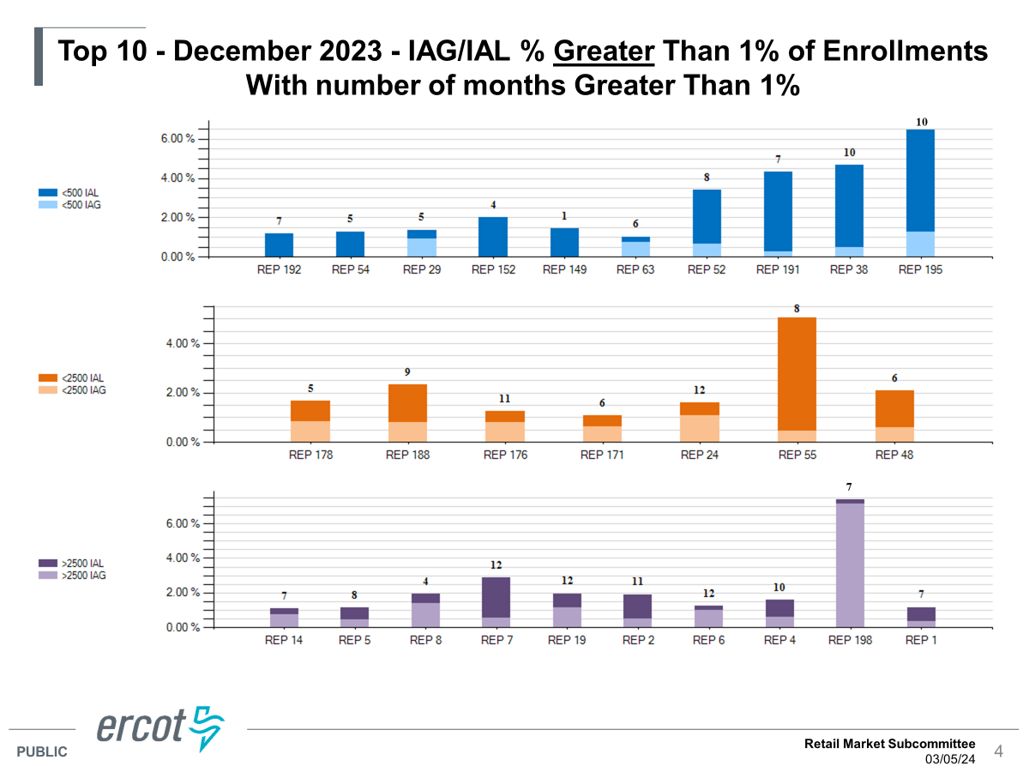
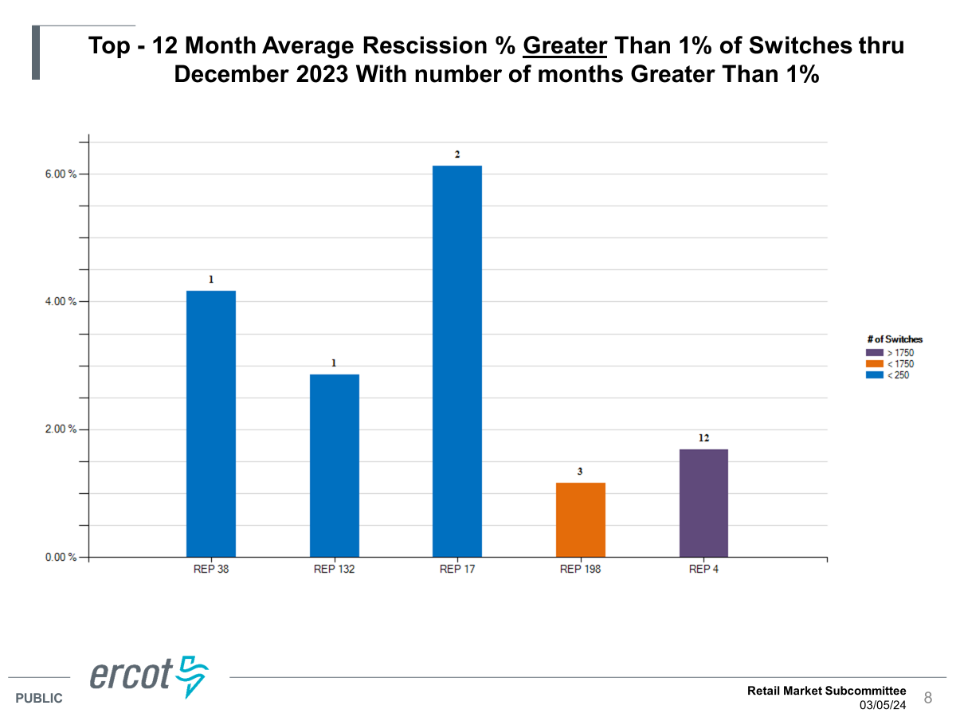
TDTMS
ERCOT’s IAG Report – December 2023

Slide 6
TDTMS
Review of ERCOT’s IAG Report – December 2023
The growing trend for IAGs with > 1% of enrollments makes up the majority of the volume (2520 counts) as opposed to the REPs with < 1% of enrollments (945 counts). This number used to be divided ~ 50/50. This would be an indicator the same “offenders” have continued business practices that lead to a higher % of IAGs.
Observations:
% of total enrollments has reduced overall (down to 1.04% as opposed to 1.2% as seen in the past
The number of REPs with ‘12’ representing the number of months with enrollments > 1% resulting in IAGs has declined over the years.
Fewer REPs with >1% of switches resulting in rescissions. Either this process is improving, or REPs are not sending as many switch transactions.
Sheri will provide graphical representation of trends as shown in MarkeTrak training for RMS viewing.

Slide 7
TDTMS
Next Meeting – Wednesday, April 10th
DRAFT Agenda:
System Instances & MT Performance
Listserv
ERCOT Reports
MIS API update – update on ‘key dates’ populating
SCR817 Business Requirements Discussion
MarkeTrak Subtypes Volume Analysis 2023 – progress update
Review of User’s Guide drafts
Data/Talking Points for Client Services on MarkeTrak analysis - update
Wednesday, April 10th - 9:30 AM WebEx only
IAG Report – Quarterly Review
Any other clarifications

