Slide 1
Supply Analysis Working Group Update April 2024 Update to WMS
April 3, 2024
Kevin Hanson (National Grid) Chair
Greg Lackey (CPS Energy) Co-Vice Chair
Pete Warnken (ERCOT) Co-Vice Chair

Slide 2
Overview
SAWG meeting occurred on March 22, 2024
Reference Technology Selection for the CONE Study (Brattle Group)
Reliability Standard and VOLL Study Updates (Pete Warnken)
CDR NPRR Comments and Discussion (Pete Warnken)
Discussion was held on NPRR 1219
Additional discussion expected next month
CONE Study/Peaker Net Margin NPRR (Pete Warnken)

Slide 3
Reference Technology Selection for the CONE Study p.1
Proposed technology is Aeroderivative Combustion Turbine
Proenergy GE LM6000PC with SPRINT
8x0 configuration with 484 MW Nameplate Capacity
Natural gas fuel type
Combustion controls are Selective Catalytic Reduction (SCR)
Located in Harris County with a Firm Gas Contract
51% of planned natural gas generation is in Harris County
Utilizes well water

Slide 4
Reference Technology Selection for the CONE Study p.2
Proposed alternative technology is PV + BESS Hybrid (“Solar Hybrid”)
PV capacity of 200 MW
BESS capacity of 100 MW with 2 hours duration
Storage augmentation assumed is every 5 years

Slide 5
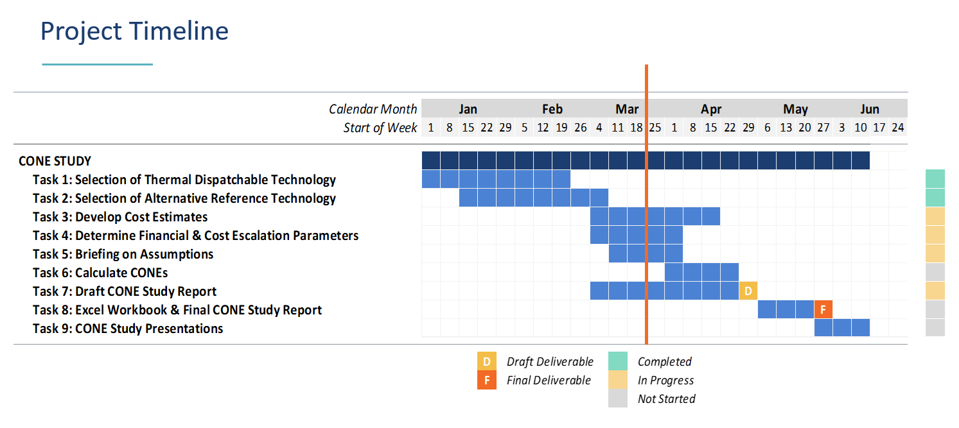
Reference Technology Selection for the CONE Study p.3
Weighted Average Cost of Capital (WACC) expected to be discussed at the April SAWG meeting
Draft report expected to be delivered by end of April

Slide 6
Reliability Standard Scenario Study (PUCT Docket 54584)
Completed Phase 4 modeling simulations
Developed summaries to show “societal” costs related to the 3 reliability standard criteria
Rerunning Phase 3 simulations due to a SERVM bug
Results expected by the April 11 PUC Open Meeting

Slide 7
VOLL Study Updates (PUCT Docket 55837)
Project update filed with the PUC on March 14, 2024
Expecting VOLL survey completion by end of Q3

Slide 8
CONE Study/Peaker Net Margin NPRR
Pete Warnken presented the draft language of the Proposed NPRR on Cost of New Entry studies
Proposal to have study conducted at least every four even-numbered year
Peaker net margin could be either a hard value in protocols or a calculated value
It will be discussed further next month

