Slide 1
Information Technology Report
Mick Hanna
Manager, Market Applications Services Support
ERCOT Public
April 2024

Slide 2
Incident Report Highlights
Service Availability – March 2024
  Retail Market IT systems did NOT meet all SLA targets.
  Market Data Transparency IT systems met all SLA targets.
Retail Incidents & Maintenance – March 2024
  March 15th ERCOT experienced a NAESB outage.
  March 17th ERCOT Planned Site Failover.
  March 24th Retail Database Maintenance.
Non-Retail Incidents & Maintenance –March 2024
  March 28th Planned Releases.
  March 14th Planned Site Failovers.
ListServ Incidents & Maintenance – March 2024
  March 17th Planned Site Failover
  SLA Documents and Incident Reporting
  https://www.ercot.com/services/sla/

Slide 3
MarkeTrak Performance
MarkeTrak
March 2024 | Availability (%) | Response Time (seconds) |  | SLO (seconds)
 |  | Monthly Average | 12 Month Average
API QueryDetail | 100.00 | .32 | .39 | 2
API QueryList | 100.00 | 1.77 | 2.67 | 10
API Update | 100.00 | .53 | .66 | 10
GUI | 99.86 | .99 | 1.61 | 10
Average | 99.97

Slide 4
March ListServ Stats
3835 Posts
391033 Recipients
RMS List Highlights
  301 Posts
  39 New Subscriptions
  7 Unsubscribes
TDTMS List Highlights
  12 Posts
  4 New Subscriptions
  0 Unsubscribe
  Weather Moratorium Actions
  No Auto Deletes
  No Sign Offs

Slide 5
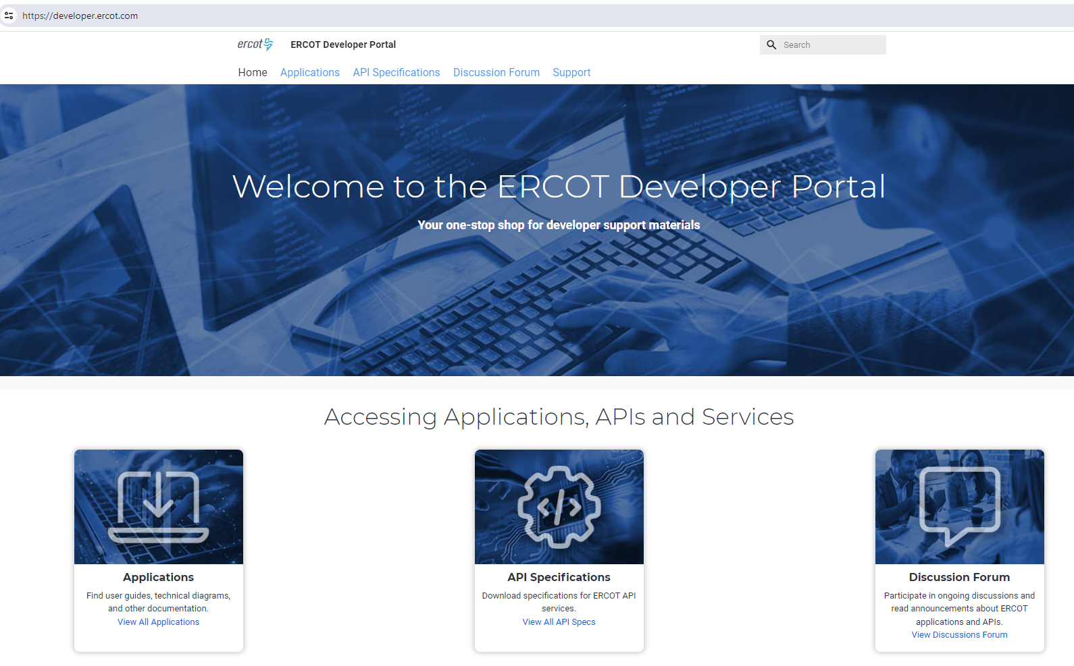
ERCOT Developer Portal

Slide 6
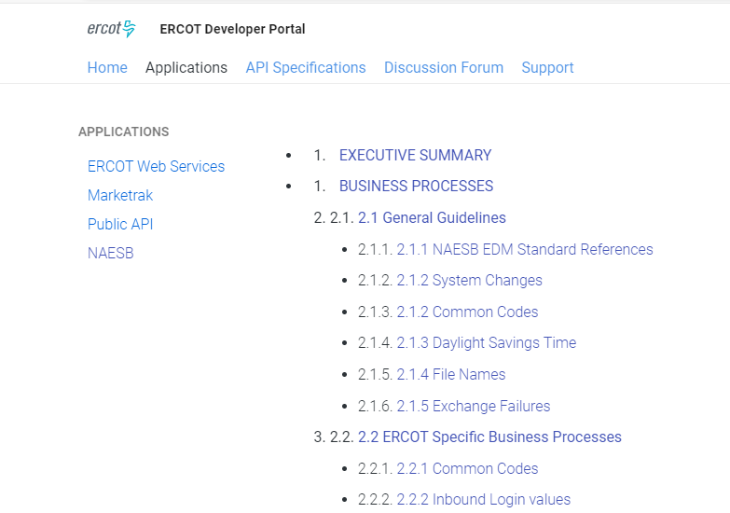
Applications

Slide 7
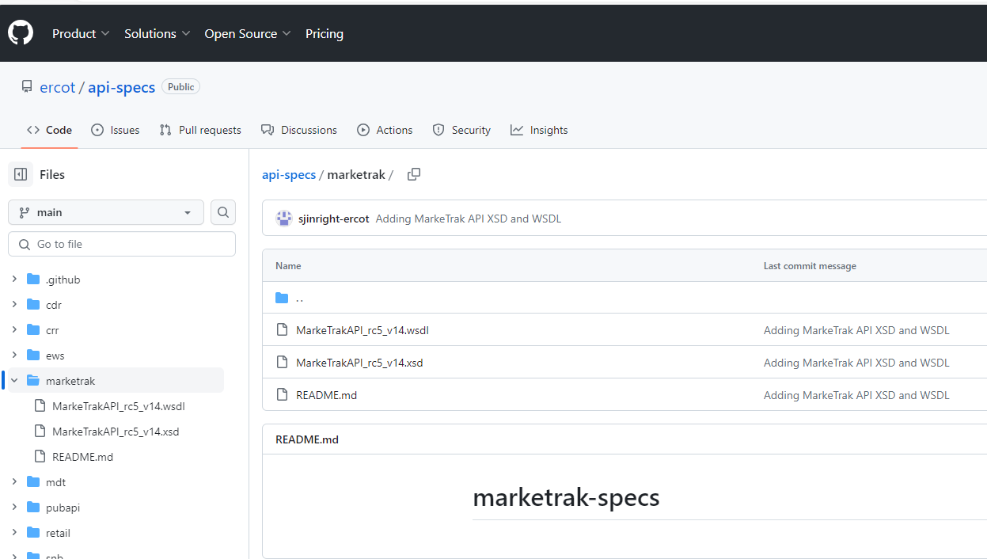
API Specifications

Slide 8
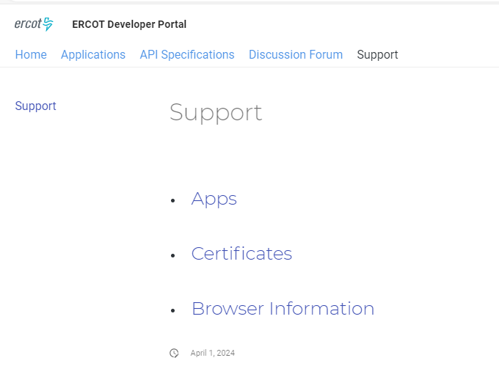
Support

