Slide 1
RTC+B Task Force
Update
Matt Mereness
TWG
March 28, 2024

Slide 2
Outline
Program update: RTC+B Program Update from Feb Board T&S
Reminder of RTCBTF Review Cycle
Current Issues for RTCBTF
  Issue 17 - RUC Capacity Short
  Issue 4 - Verifiable Cost Manual (Change for on-line hydro Resources per Key Principle 1.3(3))
  Issue 18 - Review of the AS Demand Curves in the context of current policy
Next steps

Slide 3
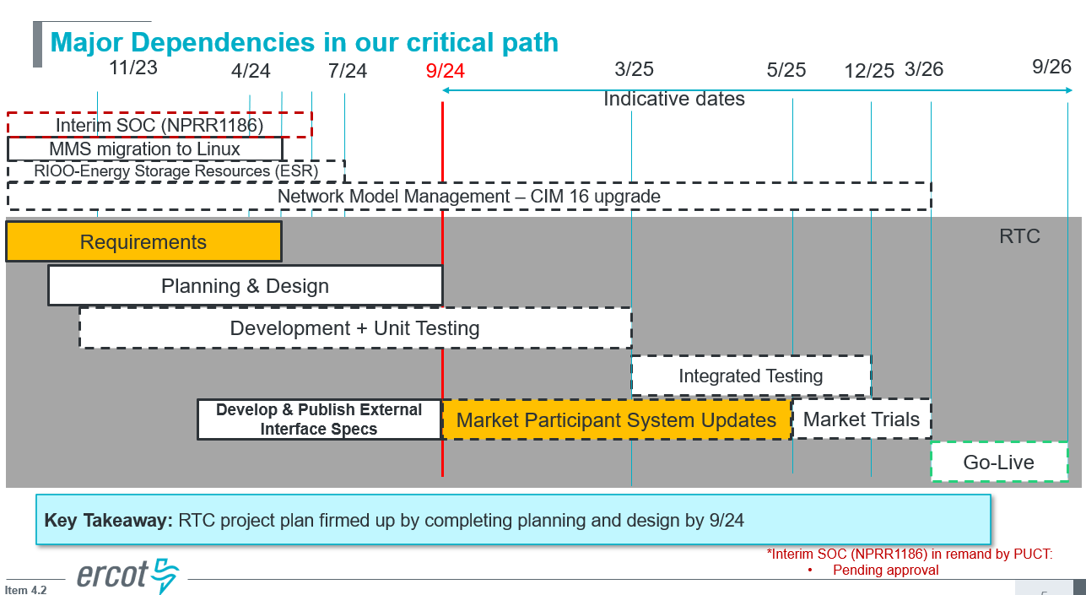
RTC+B Program Update
(excerpt from Feb Board T&S RTC Update)

Slide 4
Plans for Meetings and Review Cycles
Reminder of RTC+B Program Scope
  RTC Key Principles were approved to lay foundation of NPRR1007-1013
    Consolidated Key Principles: https://www.ercot.com/files/docs/2020/04/01/RTC_Key_Principle_Quick_Reference.docx
    Library of Key Principles: https://www.ercot.com/mktrules/puctDirectives/rtCoOptimization
  Battery Key Topic Concepts approved to lay foundation of NPRR1014
    https://www.ercot.com/mktrules/keypriorities/bes
  RTC State-of-Charge accounting in NPRR1204
Objective is to present concepts or issues that need to be resolved for an effective implementation.
  Coordinating timelines for interface requirements and testing,
  Providing the forum for any analysis or policy decisions (such as parameter values)
  Coordinating market readiness and cutover activities,
  Review draft Revision Requests or other artifacts necessary to successfully implement the program within the identified timeframes, and discussing other details as needed.
Lessons learned from RTCTF to avoid being delayed in decisions:
  Meeting #1: Initial concept presented by ERCOT staff
  Meeting #2: Comments and alternatives presented by MPs
  Meeting #3: RTCTF consensus achieved or escalated to TAC for a vote to decide the matter.

Slide 5
Current Issues List
Link to issues on RTCBTF home page
- Moving up discussion of interface changes and market trials
- Added discussion of AS Demand Curves per MP requests

Slide 6
Status of in-flight discussions
Issue 17 - RUC Capacity Short
  Second round of three discussions
    Walked through MP examples
    One suggestion to simplify and/or remove RUC capacity short. Policy to move to allocating all RUC make-whole to Load appears outside the scope of the task force.
    ERCOT plans to bring draft protocol language to April meeting.
Issue 4 - Change for on-line hydro Resources mitigation per Key Principle 1.3(3))
  First round of three discussions
    Initial review of concept
    Given that Hydro Resources operating in synchronous condenser mode are not dispatched by SCED, ERCOT proposes setting the Mitigated Offer Cap for all Hydro Resources to SWCAP.
    Plan to bring draft NPRR and verifiable cost language changes to April meeting
These two issues need to be resolved prior to go-live to close gaps in protocols.

Slide 7
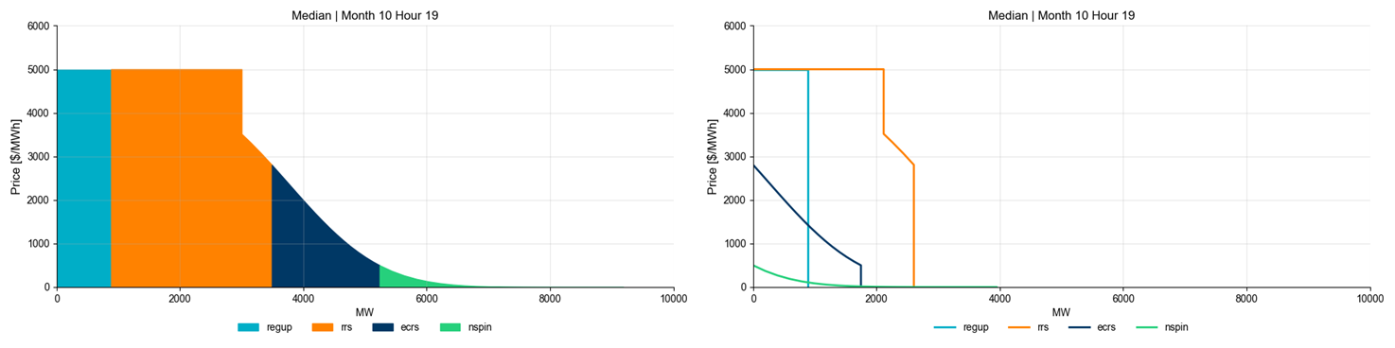
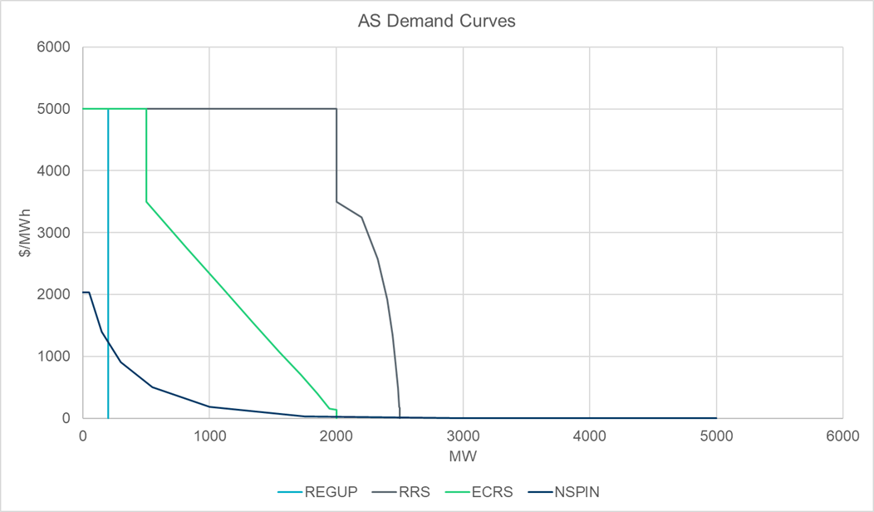
ASDC Concerns and Potential Next Steps
Issue 18 - Review of the AS Demand Curves in the context of current policy
  From an implementation perspective, ERCOT has developed the business requirements necessary to implement the AS Demand Curves per protocols.
  At request from MPs, ERCOT shared the current shape and distribution of AS Demand Curves as defined in protocols at the February RTCBTF
  Extensive MP discussion at March meeting regarding concerns over price formation with current protocol defined curves
    MPs raised questions as to whether the currently defined ORDC is aligned with operations (shape of ORDC).
    MPs raised questions of whether to revisit TAC decision and protocols on ASDC distribution under ORDC.

Slide 8
RTCBTF Next Steps
Discussion at next RTCBTF April 10
  Issue 17 - RUC Capacity Short (Round 3 with draft NPRR language)
  Issue 4 - Change for on-line hydro Resources mitigation (Round 2 with draft language)
  Issue 3 - Framework for periodic analysis comparing RTC and the current ORDC design – KP 1.1(8) (Round 1 concepts/capability)
  Issue 18 - Review of the AS Demand Curves in the context of current policy
    Facilitate discussion among MPs of next steps, but
      Recognize ERCOT will continue forward on current approved design for implementation.
      RTCBTF can be leveraged to discuss options, but market design changes will be done through normal policy and protocol change processes.
    For changing shape of ORDC
      AS Demand Curves based on ORDC (current guidance from 2019 memo to use ORDC for AS Demand Curves)
      Re-shaping ORDC (or de-coupling ASDC from ORDC) would be PUCT policy change (would likely take at least 9 months)
      Requires Protocol changes
      System changes are not expected (parameterized values) and could be implemented within a month of approval
    For changing distribution of AS under ORDC curve
      Requires Protocol changes
      Requires system changes to change distribution logic
      Currently ERCOT would consider this a Baseline 2 change (after initial go-live)
Potential RTC+B Technical Workshops (April-June 2024)
  Target audience, vendors and IT development/implementation staff
    ICCP configuration approaches for parallel testing and transition
    Technical review of initial versions of telemetry and market submission design specifications
Questions?

