Slide 1
Project Update
March 20, 2024
Troy Anderson
ERCOT Portfolio Management

Slide 2
Project Update Agenda
  Recent / Upcoming Project Highlights
  2024 Release Targets
  Major Projects
  Additional Project Status Information
  Priority/Rank Recommendations for Revision Requests with Impacts
    NPRR1205 – Revisions to Credit Qualification Requirements of Banks and Insurance Companies
  Technology Working Group (TWG)
    Items discussed at 2/22/2024 meeting
  Aging Revision Request Project Review
Location of Revision Request Project Information: http://www.ercot.com/services/projects

Slide 3
Recent / Upcoming Project Highlights
2024 February Off-Cycle Release – 2/16/2024 Complete
  Public API Enhancements
2024 February Release – R2 – 2/22/2024 Complete
  NPRR1132(a) – Communicate Operating Limitations during Cold and Hot Weather Conditions
  RRGRR032 – Related to NPRR1132
  NOGRR249(b) – Communication of System Operating Limit Exceedances
2024 February Off-Cycle Release – 2/26/2024 Complete
  NPRR1184(a) – Update to Procedures for Managing Interest on Cash Collateral
2024 March Off-Cycle Release – 3/1/2024 Complete
  NPRR1026(b) – Self-Limiting Facilities reporting
2024 March Release – R3 – 3/28/2024 In Flight
  NPRR1040 – Compliance Metrics for Ancillary Service Supply Responsibility
2024 April Off-Cycle Release – 4/1/2024 In Flight
  NPRR1165 – Revisions to Requirements of Providing Audited Financial Statements and Providing Independent Amount
Note: Projected Go-Live dates are subject to change.
Please watch for market notices as the effective dates approach.

Slide 4
2024 Release Targets – Approved NPRRs / SCRs / xGRRs
R1
R3
R5
January 1/25 | February 2/22 | March 3/28 | April 4/25 | May 5/30 | June 6/27
NPRR1092(b) PGRR098(a) ESR Telemetry Public API Enhancements | NPRR1132(a) RRGRR032 NOGRR249(b) NPRR1184(a) NPRR1026(b) | NPRR1040 NPRR1165 |  | NPRR1149 NPRR1121 NPRR1090 NPRR962 NPRR1196 SCR819 NPRR1111 Forecast Presentation Platform | NPRR1002 RRGRR023 NPRR1186 NPRR1149 NPRR1121 NPRR1090 NPRR962 SCR819 NPRR1111
R2
R4
R6
ü
ü
ü
ü
ü
ü
ü
ü
ü
NS
P
E
E
E
E
E
E
E
E
E
E
E
1/1
Moved to R7
6/13
Various effective dates
2/1
2/26
2/16
3/1
4/1
R7
R9
July 7/25 | August 8/22 | September 9/26 | October 10/24 | TX SET 5.0 11/10 | December 12/11-12/12
NPRR1131 NPRR1002 RRGRR023 | NPRR1139 SCR813 | NPRR1183 |  | NPRR1095 SCR817 SCR823 RMGRR172 RMGRR168 | NPRR1023
R8
R10
R11
NS
P
P
NS
E
E
E
E
NS
P
Go-live dates can differ from Protocol effective dates – Please refer to market notices for more details
APPENDIX
Red Text: New additions and target release changes
Strike-Through Text: Previous target release
(a), (b), etc.: Multiple phase release
Project Status Codes
NS = Not Started
I = Initiation
P = Planning
E = Execution
H = On Hold
NPRR1026(b) – SLF – Reporting portion
NPRR1092(b) – Limit RUC Opt-Out Provision
NPRR1132(a) – RIOO portion
NPRR1184(a) – Interest calculations
NOGRR249(b) – MIS posting
PGRR098(a) – Section 4.1.1.8
Release targets are subject to change

Slide 5
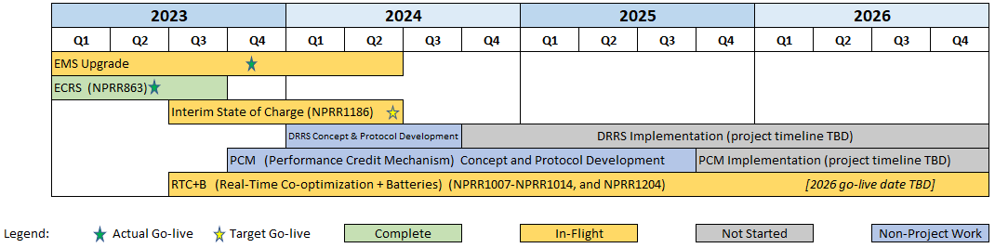
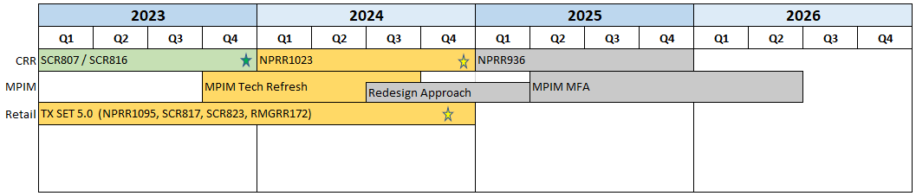
Major Projects
Other Project Highlights

Slide 6
Additional Project Status Information
RR | Description | Proj Phase | Additional Detail
NPRR1004 | Load Distribution Factor Process Update | Not Started | Analyzing a Q2 2024 start
NPRR1131 | Controllable Load Resource Participation in Non-Spin | Not Started | Approved for April 2024 start
NPRR1139 | Adjustments to Capacity Shortfall Ratio Share for IRRs | Not Started | Approved for April 2024 start
SCR799 | ERCOT Outage Study Cases in the System Operations Test Environment (SOTE) | Not Started | Targeting July 2024 start
NPRR1006 | Update RT On-Line Reliability Deployment Price Adder Inputs to Match Actual Data | On Hold | Market input requested to determine if these are High Priority compared to other Not Started and On Hold items
NPRR1058 | Resource Offer Modernization | Not Started
NPRR1091 | Changes to Address Market Impacts of Additional Non-Spin Procurement | Not Started
NPRR1128 | Allow FFR Procurement up to FFR Limit Without Proration | Not Started
NPRR1171 | Requirements for DGRs and DESRs on Circuits Subject to Load Shedding | Not Started
SCR805 | Provide Early Access to Certain 60-Day Reports to TSPs Upon Request | Not Started
Red Text: New additions and updates

Slide 7
Priority / Rank Recommendations for Revision Requests with Impacts
Recommendations for…
Revision Request | Description | Priority | Rank | Comments
NPRR1205 | Revisions to Credit Qualification Requirements of Banks and Insurance Companies | 2025 | 4520 | $80k-$120k, 5-8 months Impacted System(s): CMM, Data Warehouse Resource constraints make 2025 a more likely start year
PPL Rank Information
Next available 2024 Rank in Business Strategy = 4100
Next available 2025 Rank in Business Strategy = 4520
Next available 2026 Rank in Business Strategy = 4710
Next available Rank in Regulatory = 380

Slide 8
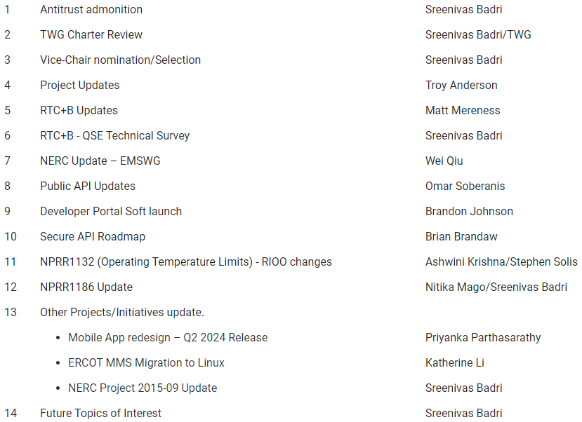
Technology Working Group (TWG)
2/22/2024 TWG discussion topics:
Next meeting: 3/28/2024

Slide 9
Aging Revision Request Project Review
The “Aging Revision Request” list used in 2022 has been updated for recent activity and will be posted prior to the February PRS meeting
Preliminary ERCOT comments will be included on many line items
Primary discussion at February PRS discussed the structure of the posted file and ERCOT’s initial comments
Follow-up discussion at March PRS:
  Reminder of process to strike aging Revision Requests (if needed)
  Review ERCOT recommendations
  Gantt chart (initial draft)
  Market feedback
TBD | NPRRs: 484,825(b),826,829,841,857,879,885,904,918,930,936,941,945,963,965,975,987,989,995,1004,1006,1007,1019,1020(b),1029,1030,1032,1034,1038, 1057,1058,1077,1091,1098,1105,1128,1131 SCRs: 799,805,810,818 PGRRs: 066,076,088,091,094,099,103 Other: OBDRR009,OBDRR017,RRGRR028

Slide 10
Aging Revision Request Project Review
Reminder: If PRS determines that one or more aging Revision Requests are candidates for removal, the process is to file a new RR to strike it
There are several historical examples of this from 2015:
  NPRR721 – Removal of Language related to NPRR455
  NPRR722 – Removal of Language related to NPRR181
  NPRR724 – Removal of Language related to NPRR493
  NPRR727 – Removal of Language related to NPRR327
  NPRR728 – Removal of Language related to NPRR484 and NPRR554
TBD | NPRRs: 484,825(b),826,829,841,857,879,885,904,918,930,936,941,945,963,965,975,987,989,995,1004,1006,1007,1019,1020(b),1029,1030,1032,1034,1038, 1057,1058,1077,1091,1098,1105,1128,1131 SCRs: 799,805,810,818 PGRRs: 066,076,088,091,094,099,103 Other: OBDRR009,OBDRR017,RRGRR028

Slide 11
Aging Revision Request Project Review
Draft Gantt chart
  Very preliminary
  Starting point for discussion on priorities
Other Topics
  Communication with TAC
  Transparency in our monthly reporting so Market Participants understand the status of each Revision Request
  Change in Priority recommendation from “requested start year” to “most likely start year” on new Revision Requests
  Assigning new priorities
Long-term discussion
  What are the constraints that prevent us from clearing the backlog?
TBD | NPRRs: 484,825(b),826,829,841,857,879,885,904,918,930,936,941,945,963,965,975,987,989,995,1004,1006,1007,1019,1020(b),1029,1030,1032,1034,1038, 1057,1058,1077,1091,1098,1105,1128,1131 SCRs: 799,805,810,818 PGRRs: 066,076,088,091,094,099,103 Other: OBDRR009,OBDRR017,RRGRR028

Slide 12
Aging Revision Request Project Review

Slide 13
Aging Revision Request Project Review

Slide 14
Aging Revision Request Project Review

