Slide 1
2023 EMS Events
Wei Qiu, NERC EA
ERCOT TWG Conference Call
March 28, 2024

Slide 2
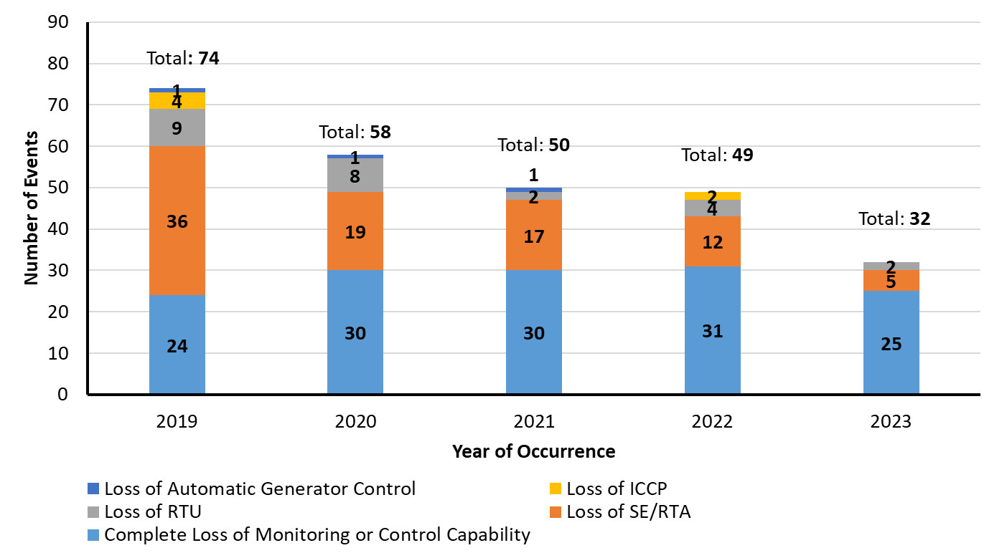
Overall Trend

Slide 3
What went well
Adapting to new normal
Database and system configuration/settings

Slide 4
What we can improve
Power Supply
External modeling and external measurements
Supportive Software
VPN (certificate)
SQL (space on hard disc)
Anti-virus (memory usage)

Slide 5
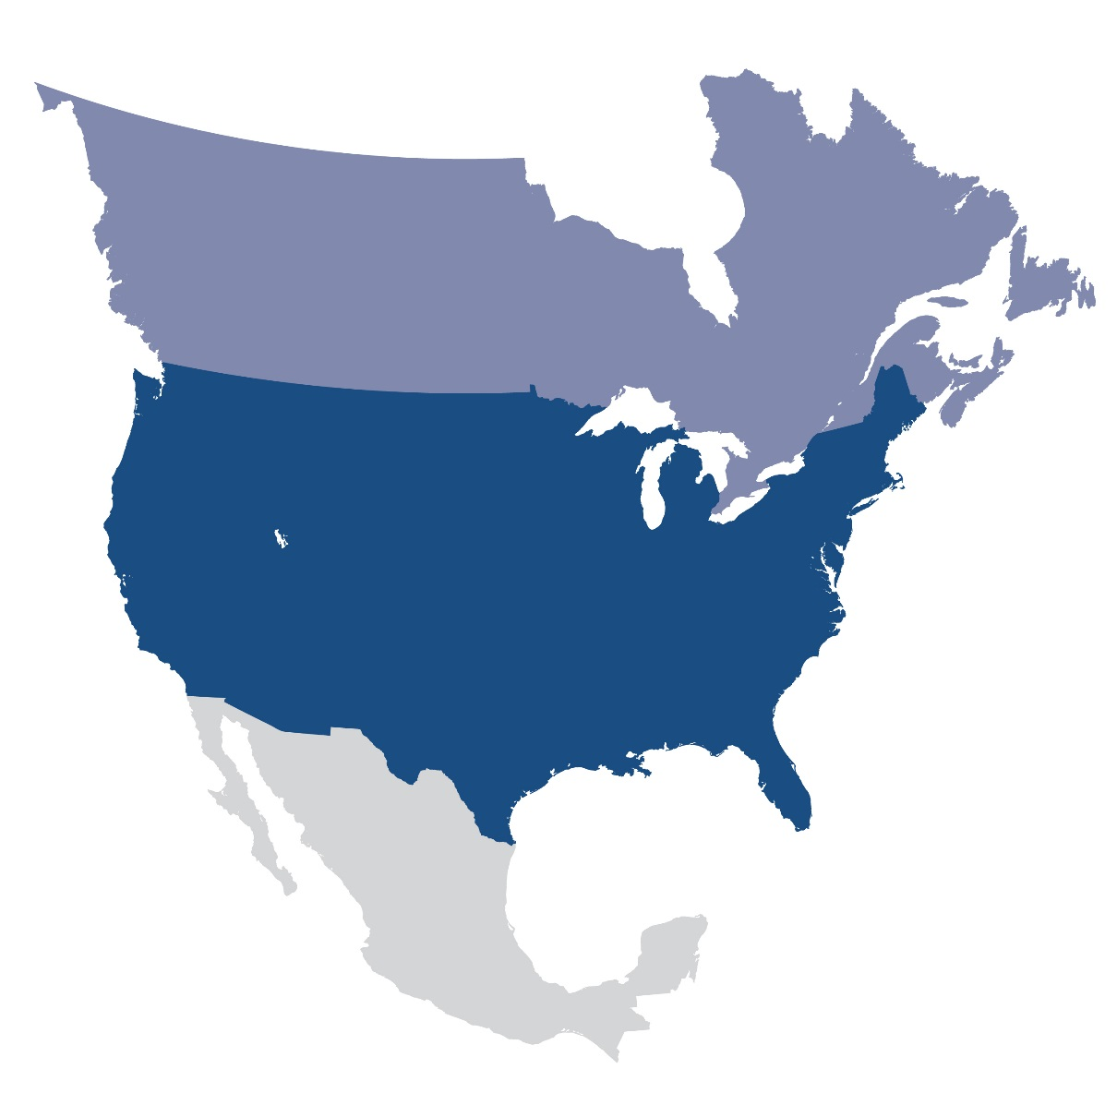
Questions and Answers
Contact Information:
wei.qiu@nerc.net

