Slide 1
Public API GA Release
Presented by: Omar Soberanis
Date: 3/28/2024

Slide 2
ERCOT Public API Updates
Important Notices
Release
Demo

Slide 3
Important Notices
Enhancements
  Upcoming – Multifile download.
  Apply additional indexing to improve performance
  List initial top reports in alphabetical order
Bug Fixes
  Canceling in the registration page
  Data details were being displayed incorrectly
  Last Updated information on Data Portal report list represents wrong information
  Downloaded file name does not display report name
Pending
  SCED 60 day data gap
  Try it is broken, don’t use it
Releases
  We are moving to Regular Deployment Cycle (Monthly Releases)

Slide 4
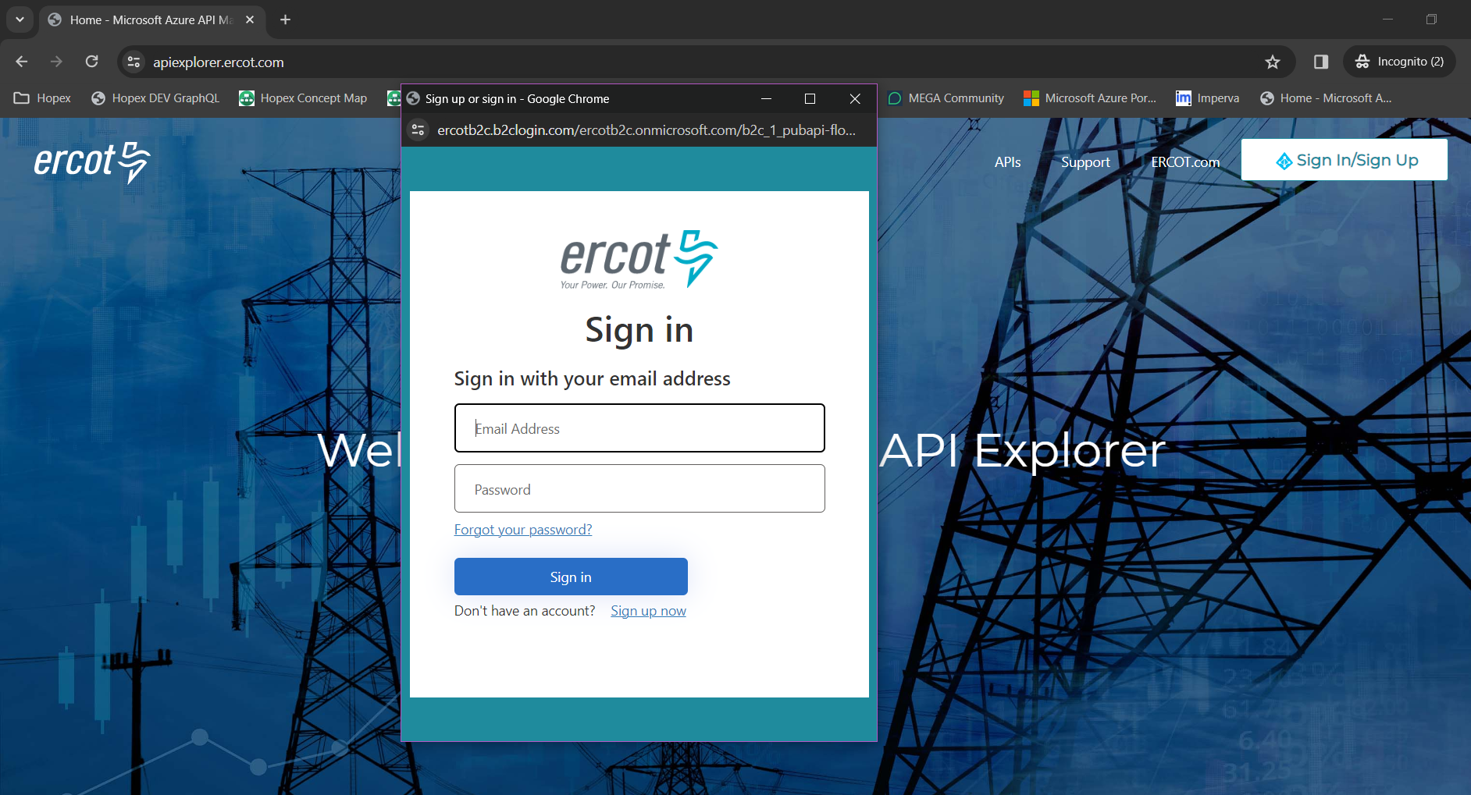
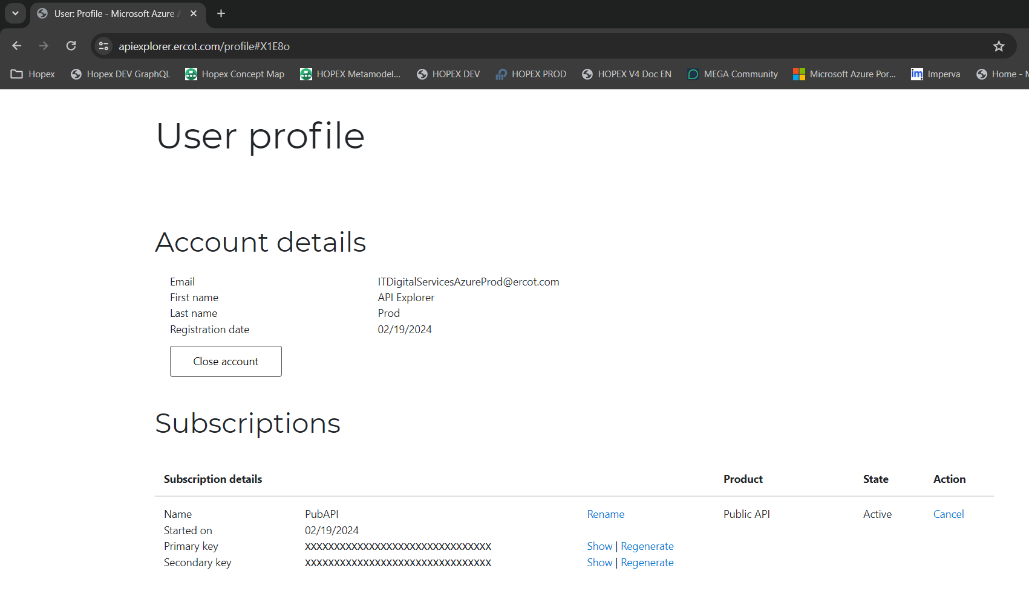
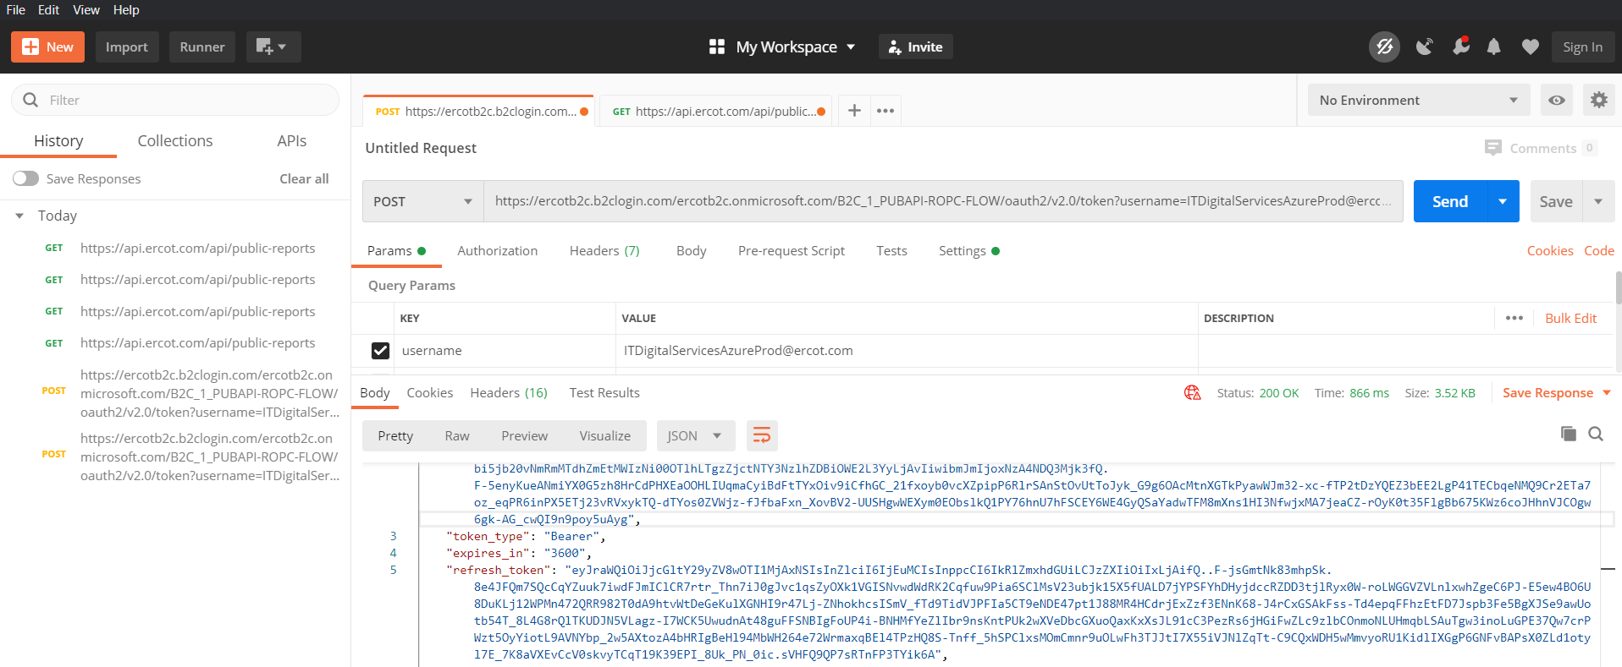
Demo

Slide 5

Q&A

