Slide 1
NPRR1186 Update
Sreenivas Badri
March 28, 2024

Slide 2
NPRR1186 Status
Objective of this NPRR is to implement improvements prior to the RTC+B project for better ESR State of Charge Awareness, Accounting, and Monitoring.
NPRR Status
On 1/18/2024, PUCT remanded this NPRR to the ERCOT Board.
Suggested modifications to section 8.1
ERCOT submitted comments to remove the revisions to Protocols Section 8.1
ERCOT Board approved
Pending PUCT approval

Slide 3
ERCOT System Changes
New ICCP Telemetry points for ESR additions

Slide 4
ERCOT System Changes
External Specs/xsd changes
3 new fields are being added to COP submissions
Max SOC
Min SOC
TargetBeginSOC
Changes are backward compatible for Non-ESRs and ESRs
Changes are in the ErcotTransactionTypes.xsd

Slide 5
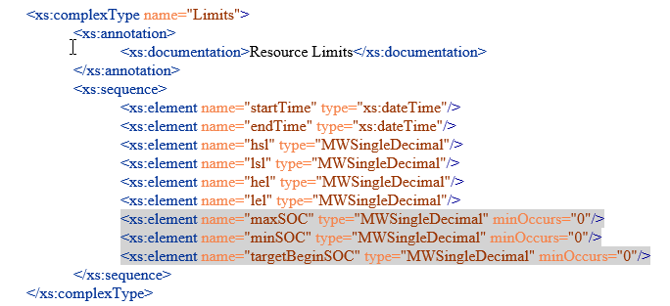
ERCOT System Changes
External Specification changes
The gray highlighted elements below were added for this NPRR

Slide 6
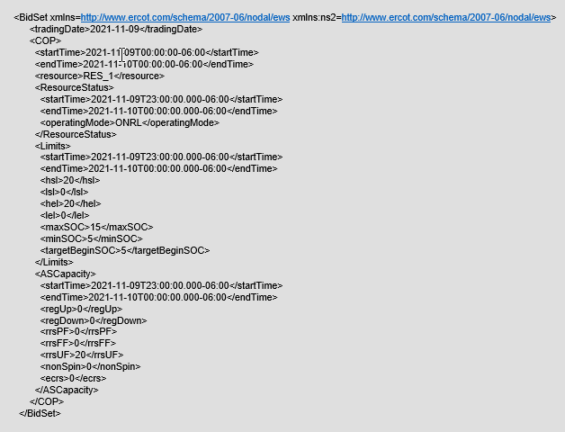
ERCOT System Changes
External Specification changes
COP submission xml example with SOC changes

Slide 7
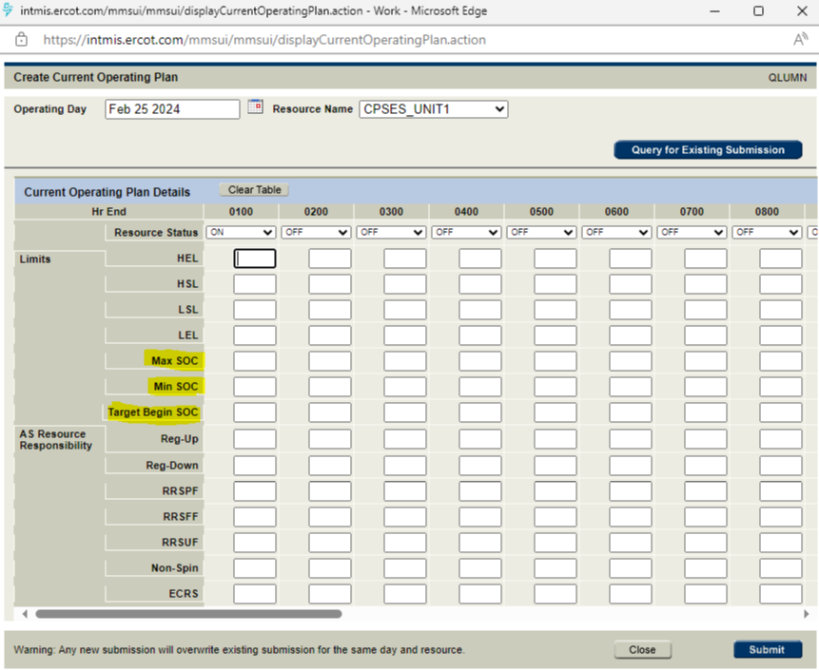
ERCOT System Changes
Market Manager UI changes
COP Submission with SOC changes

Slide 8
Timelines
ICCP Handbook was updated with new telemetry changes. ICCP handbook can be found at below link
https://www.ercot.com/services/mdt/userguides
Draft version of External Specs (XSD) changes (EIP External Interfaces Specification v1.26) are available in ercot.com (https://www.ercot.com/services/mdt/xsds).
Release Timelines (subject to change based on PUCT decision)
MOTE Testing to start from 05/16/2024
Go live date - 06/13/2024

