Slide 1
NERC Project 2015-09 Updates
Sreenivas Badri
March 28, 2024

Slide 2
NERC Project 2015-09 Updates
Project Scope
Communication of SOL exceedances to ERCOT TOs
Compliant with the new requirements by April 1, 2024
Project is in Execution Phase.
SOL exceedances communication to ERCOT TOs – Two methods
SOL exceedances presented in External Grid Geo application
TOs to filter the list of the Violations to only see their violations. (i.e. for which they are impacted).
Change went into production on 12/14/2023
Creation of SOL exceedances MIS Report
Posts pre and post contingency thermal, voltage, phase angle limit, and GTL results every 5 minutes that identifies SOL exceedances
Change went into Production on 02/22/2024
In the event of above both communication methods are NOT functional, ERCOT System Operators will notify ERCOT TOs that ERCOT’s tools for SOL Electronic Communication has a [planned / unplanned] Outage and ERCOT will make manual communication to all impacted TOs for SOL exceedances and mitigations as required.

Slide 3
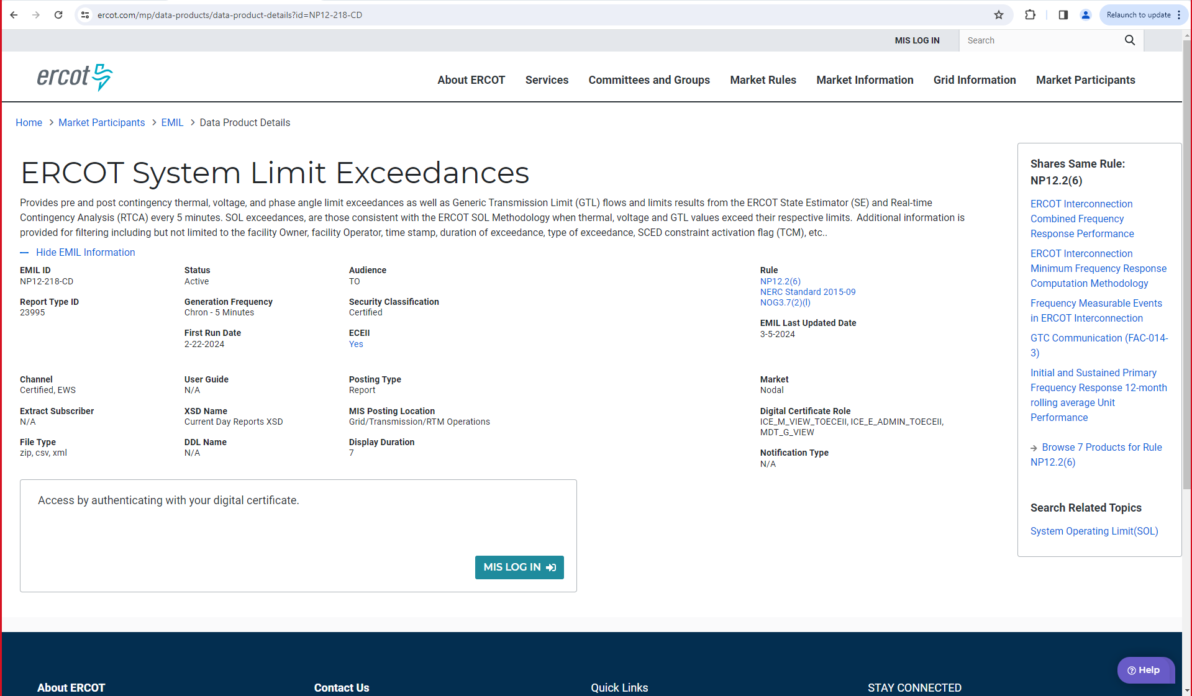
NERC Project 2015-09 Updates
MIS Report EMIL Information

Slide 4
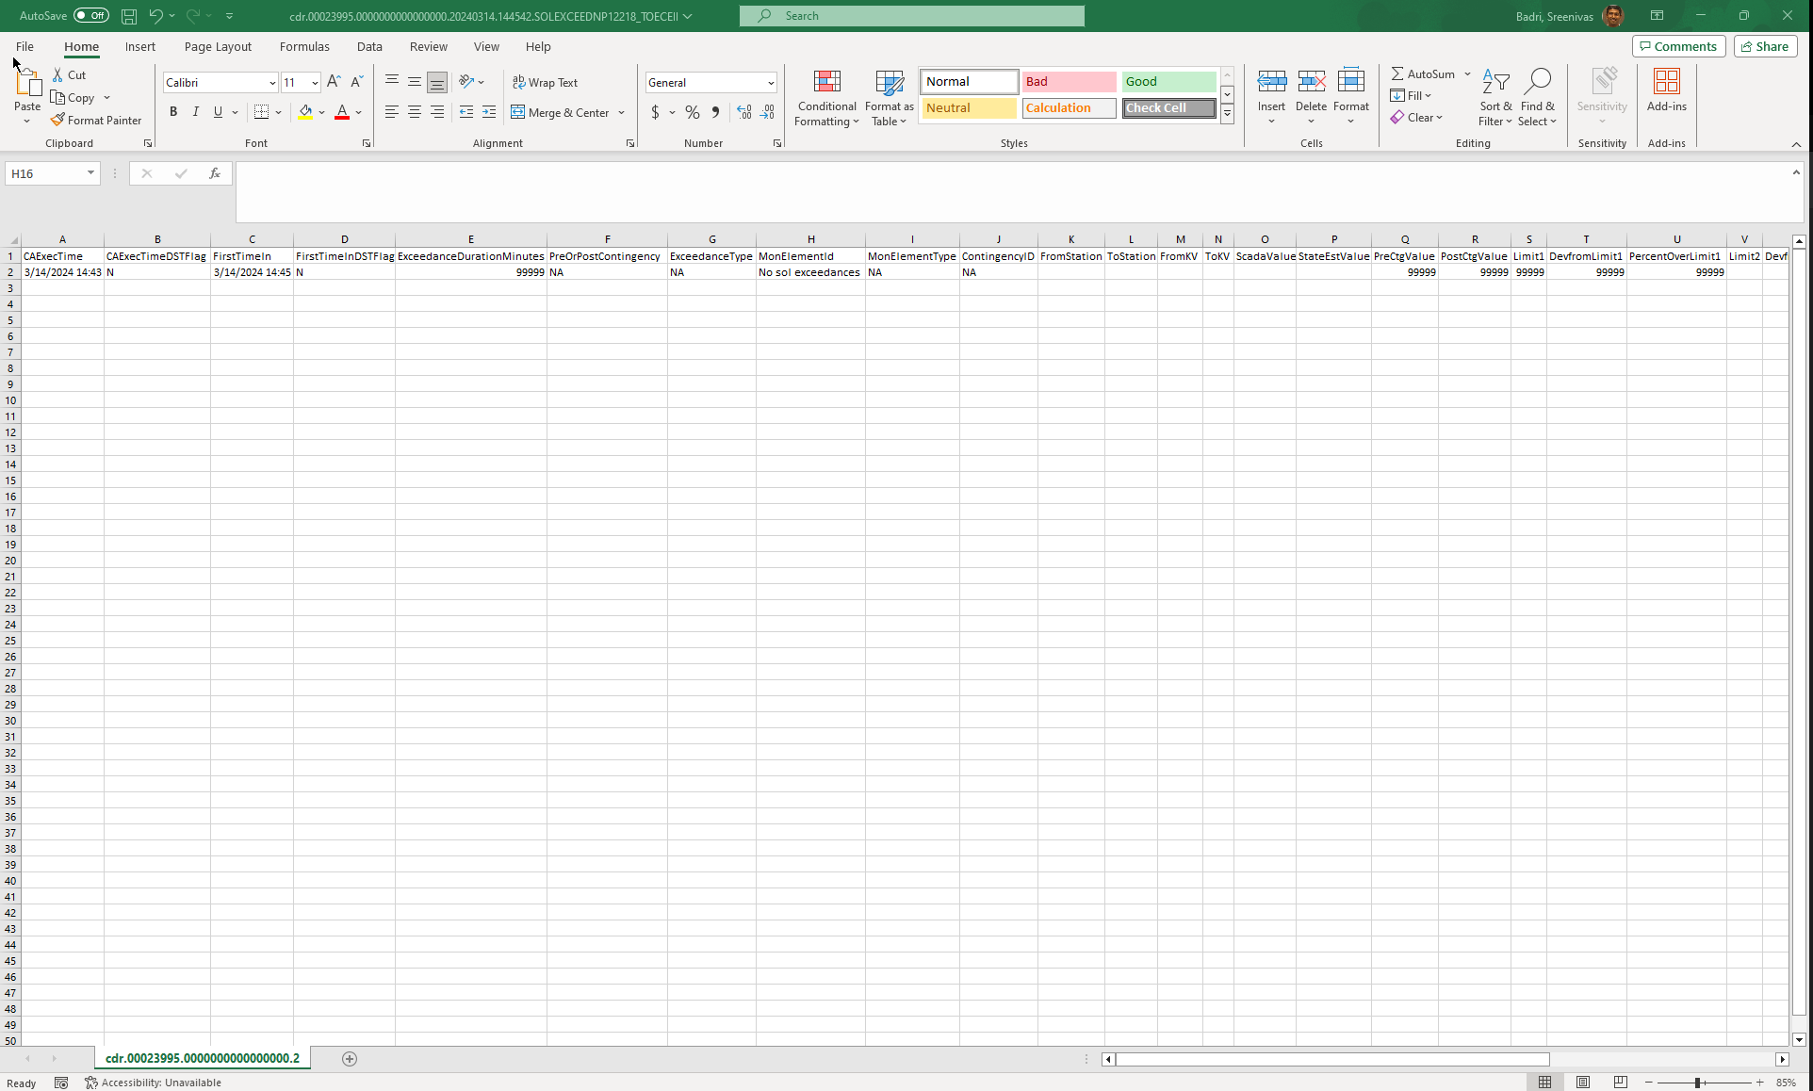
NERC Project 2015-09 Updates
When RTCA solves but does not report any SOL Exceedances
MIS Report NP12218 “MonElementId” column shows “No sol exceedances” as shown below
If MIS Report is not posted for a given 5-minute interval, it indicates that either there is a planned/unplanned outage or RTCA solution is not available.

