Slide 1
ERCOT Technology Working Group (TWG)
March 28, 2024

Slide 2
ERCOT TWG
WELCOME

Slide 3
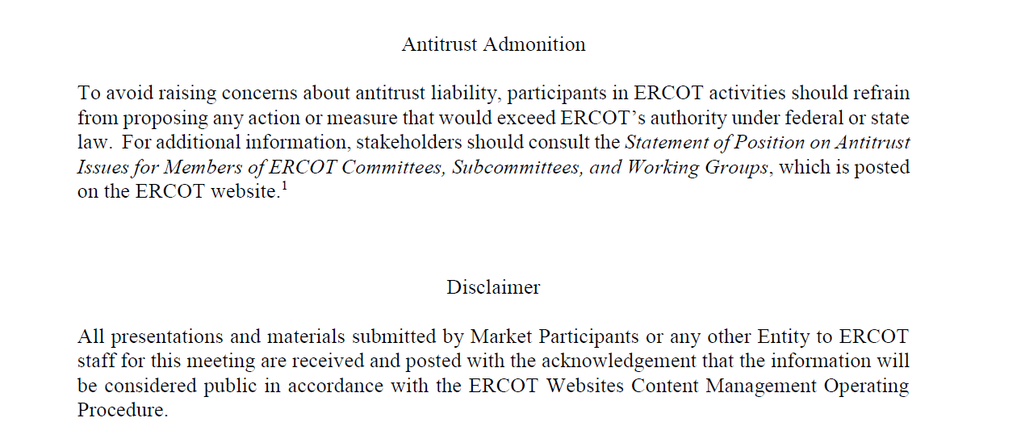
ERCOT TWG

Slide 4
ERCOT TWG Agenda
Item # | Item Description | Presenter | Start Time
1 | Antitrust admonition | Sreenivas Badri | 2:00 PM
2 | Project Updates | Troy Anderson | 2:05 PM
3 | RTC+B Updates | Matt Mereness | 2:15 PM
4 | RTC+B Technical discussions - Next Steps | Sreenivas Badri | 2:20 PM
5 | SCR820 Update - Real-Time Operator Messaging Tool - POC Demo | Sreenivas Badri/Satya Godavarti | 2:30 PM
6 | RIOO – Single Model ESR Project updates | Ashwini Krishna | 3:00 PM
7 | Developer Portal Go-live site walkthrough | Brandon Johnson | 3:15 PM
8 | Public API multi-download feature | Omar Soberanis | 3:25 PM
9 | Other Projects/Initiatives update. |  | 3:35 PM
 | NPRR1186 Updates | Sreenivas Badri
 | ERCOT MMS Migration to Linux | Katherine Li
 | NERC Project 2015-09 Update | Sreenivas Badri
10 | NERC Update – EMSWG | Wei Qiu | 3:45 PM
11 | Future Topics of Interest | Sreenivas Badri | 3:55 PM
12 | Adjourn | Sreenivas Badri | 4:00 PM

Slide 5
Project Updates
Project Updates – Troy Anderson

Slide 6
RTC+B Updates
RTC+B Updates – Matt Mereness

Slide 7
RTC+B – Technical Discussions
RTC+B Technical Discussions - Next Steps – Sreenivas Badri

Slide 8
SCR820 – Real-Time Operator Messaging Tool - POC
SCR820 Updates and Real-Time Operator Messaging Tool POC Demo - Sreenivas Badri/Satya Godavarti

Slide 9
RIOO – Single Model ESR Project Updates
RIOO – Single Model ESR Project Updates – Ashwini Krishna

Slide 10
Developer Portal and Public API Updates
Developer Portal Go Live site walkthrough – Brandon Johnson
Public API Multi-Download Feature – Omar Soberanis

Slide 11
Other Projects/Initiatives Update
NPRR1186 Updates – Sreenivas Badri
NERC Project 2015-09 Update – Sreenivas Badri
ERCOT MMS Migration to Linux – Katherine Li

Slide 12
NERC EMSWG Update
NERC EMSWG Update – Wei Qiu

Slide 13
ERCOT TWG – Open Forum
Future Topics of Interest
Topics and presentations from TWG members

Slide 14
ERCOT TWG
Thank You
You can reach me at
Sreenivas.Badri@ercot.com

