Slide 1
Day-Ahead Market (DAM) Point-to-Point (PTP) Activity Update
Alfredo Moreno
ERCOT
April 2, 2024

Slide 2
Past Discussion Recap
SCR798, PTP Obligation BID ID Limit, and NPRR925, Increasing Minimum Quantity for PTP Obligation Bids, were implemented August 2019
SCR814, PTP Obligation Bid Interval Limit, was implemented May 2022
PTP interval and Counter-Party (CP) counts have continued to increase over the years
Options were discussed on how to move forward with software/process updates, limit reductions, and PTP bid fees

Slide 3
PTP Total Intervals

Slide 4
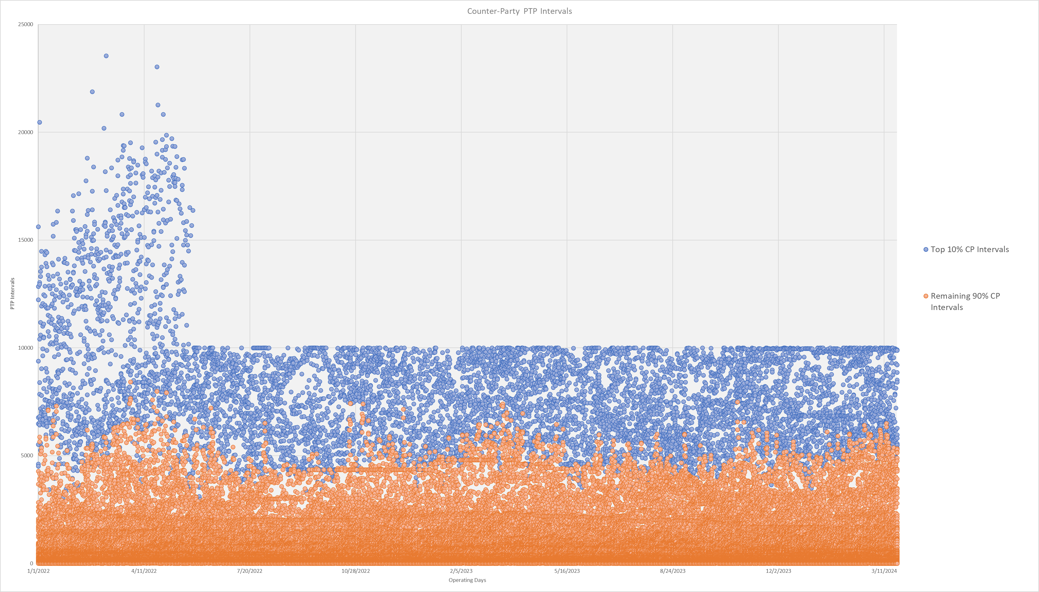
CP PTP intervals

Slide 5
Next Steps
Short-term, ERCOT will continue to monitor PTP activity and will reduce PTP limits as needed to avoid DAM delays/aborts
Long-term, ERCOT will pursue PTP fees and draft a NPRR to be brought back in a future WMWG

Slide 6
Questions?

