Slide 1
PDCWG Report to ROS
Chair: Kevin Bunch, EDF Trading North America
Vice Chair: Chad Mulholland, NRG
ROS
April 4th, 2024

Slide 2
Report Overview & Notes
Report Overview
Meeting Minutes
Analysis of Disturbances/Frequency Events
Follow up Discussion: RRS-PFR Limits
ERCOT Frequency Control Metrics and Regulation Reports
Business Practice Manual Update; ESRs Telemetry
TRE Report – Revisit a draft SAR regarding ESRs in BAL-001
BAL-001-TRE-2 FMEs and IMFR
1 FME in the month of February
39 Units failed Initial Response and 37 failed Sustained Response
7 Units failed carrying RRS
Frequency Control Report

Slide 3
Frequency Measurable Events Performance

Slide 4
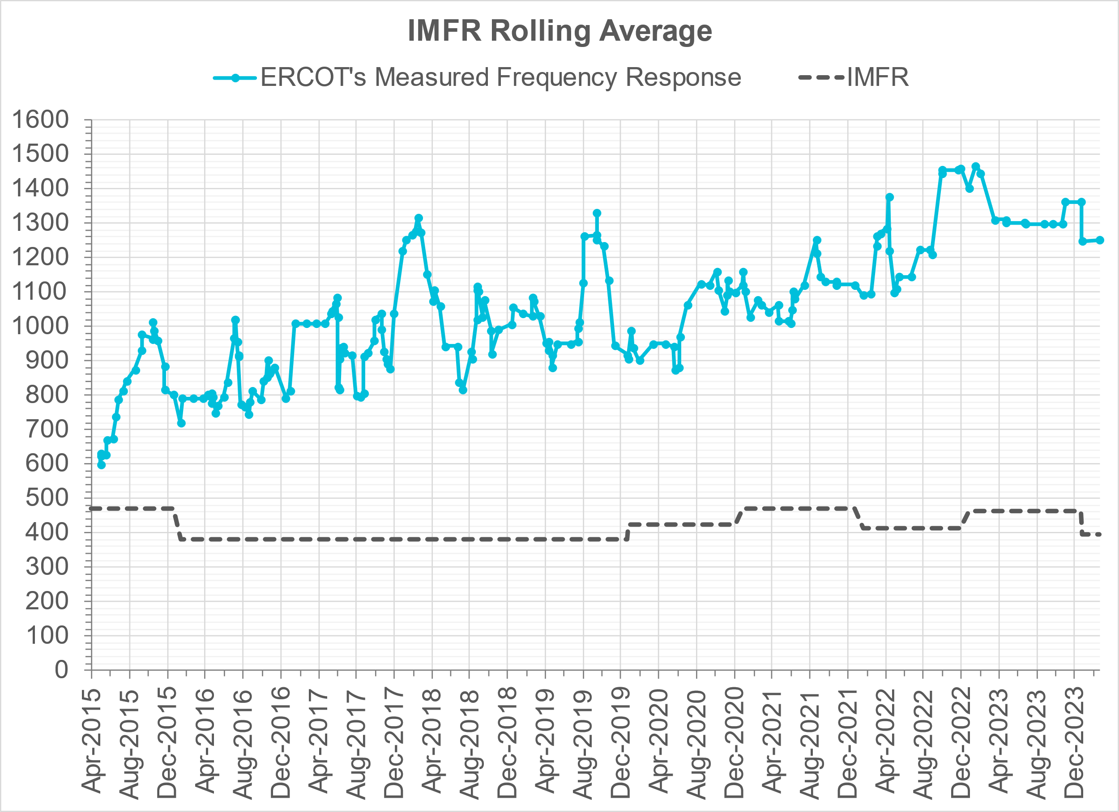
Interconnection Minimum Frequency Response (IMFR) Performance
IMFR Performance currently
1251.68 MW/0.1HZ
Frequency Response Obligation (FRO): 395 MW/0.1 Hz

Slide 5
Questions?

Slide 6
Frequency Control Report
February 2024

Slide 7
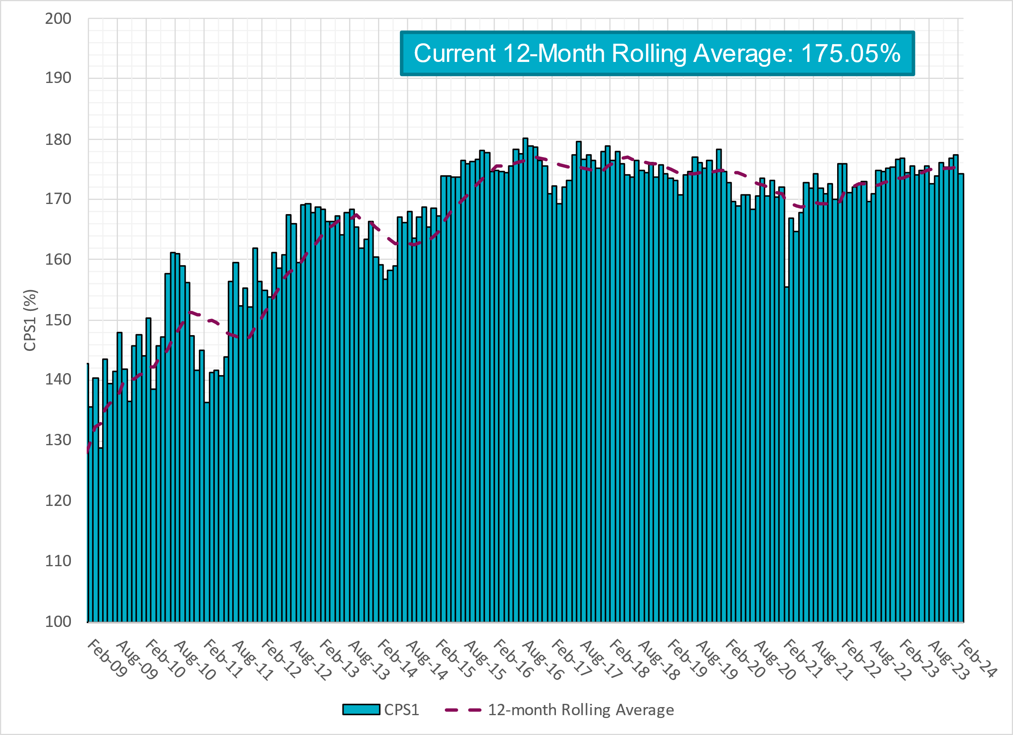
CPS1 Performance

Slide 8
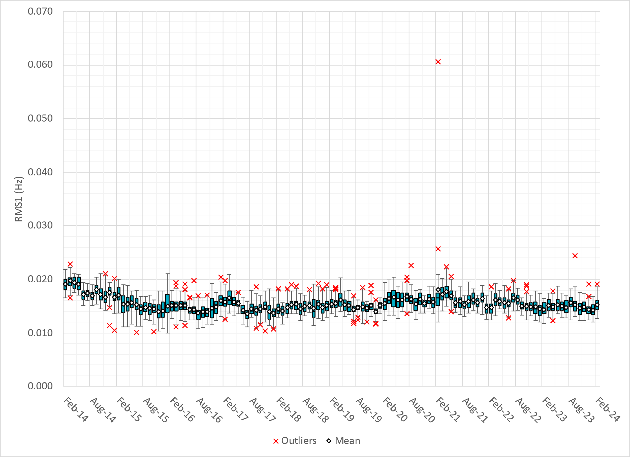
RMS1 Performance of ERCOT Frequency
Notes:
15.19 mHz on avg for February 2024

Slide 9
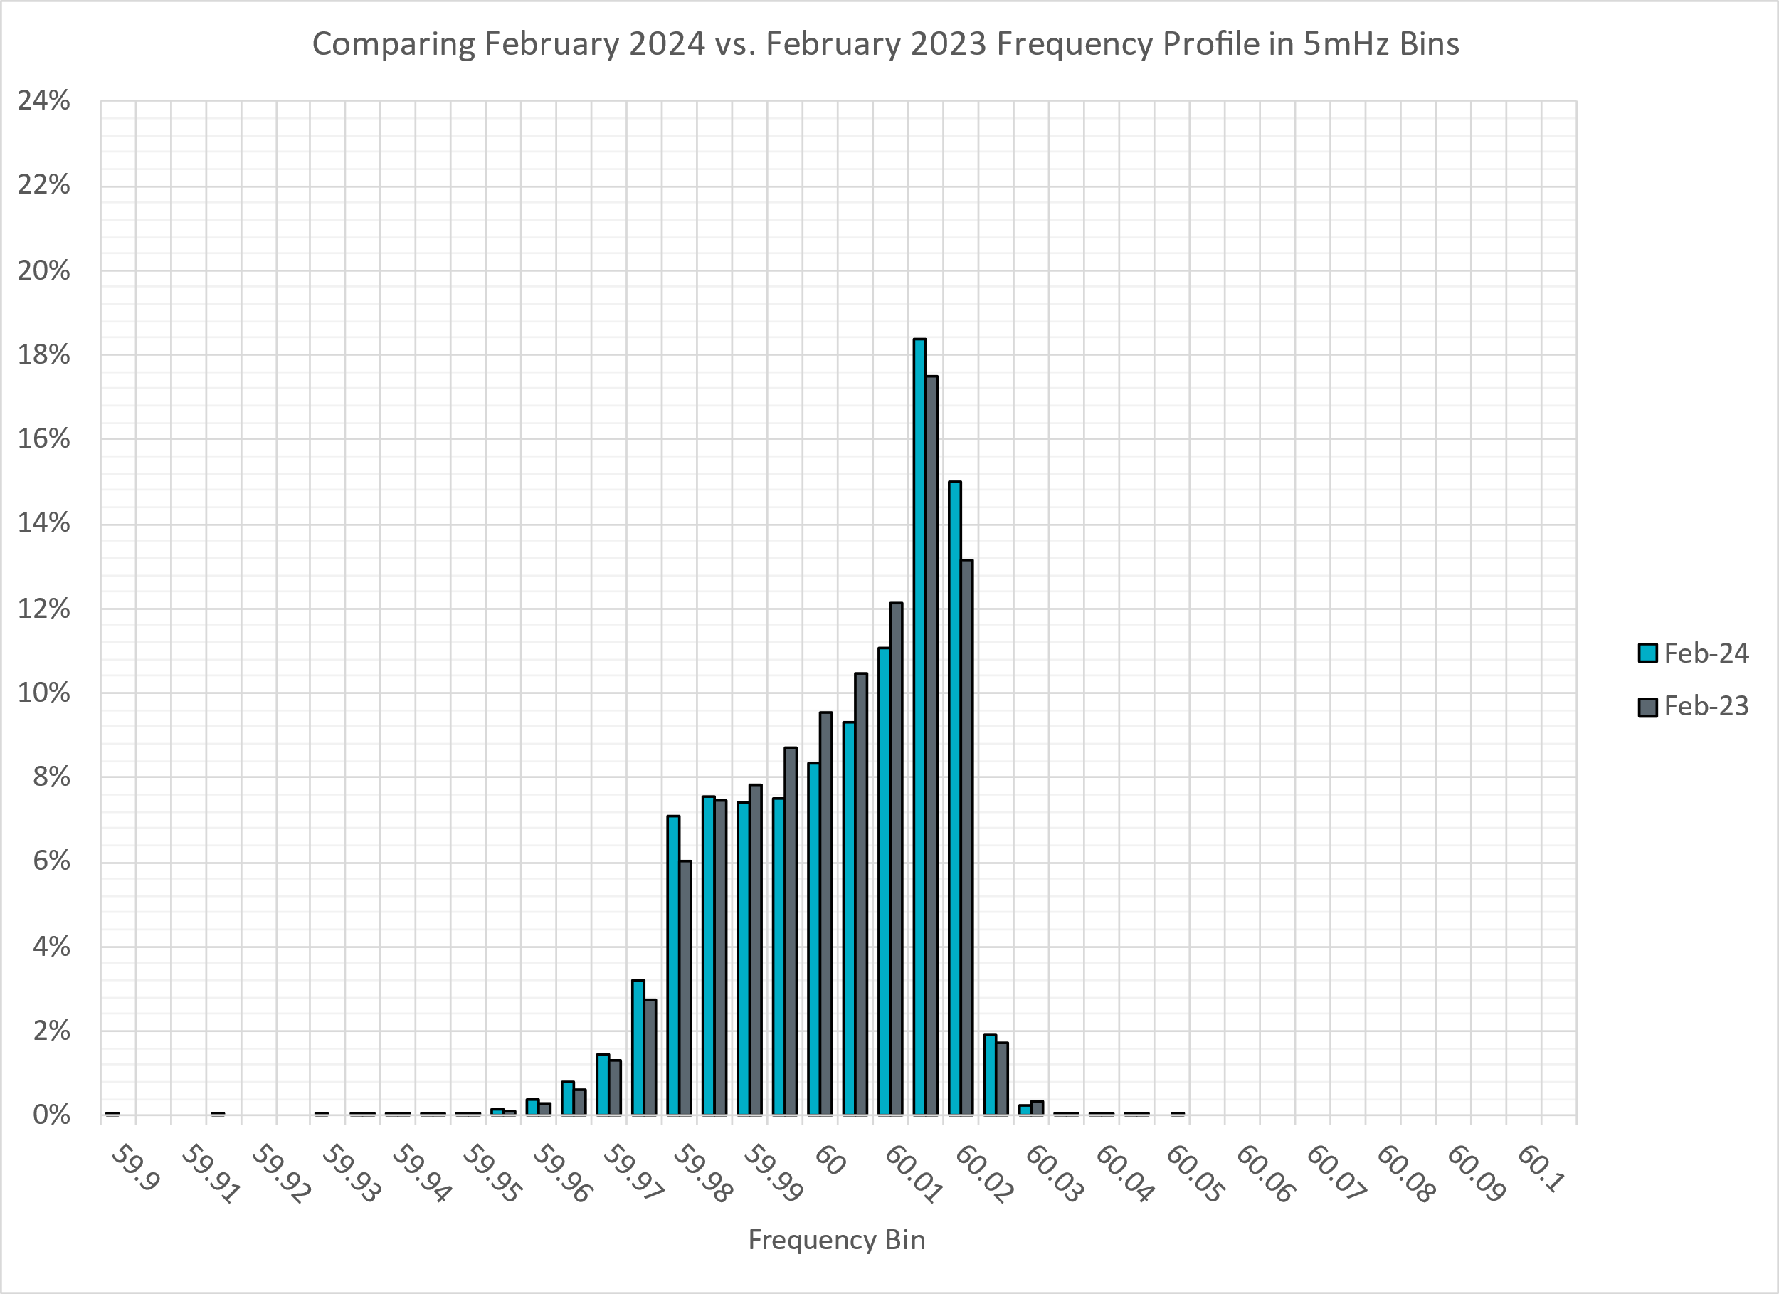
Frequency Profile Analysis

Slide 10
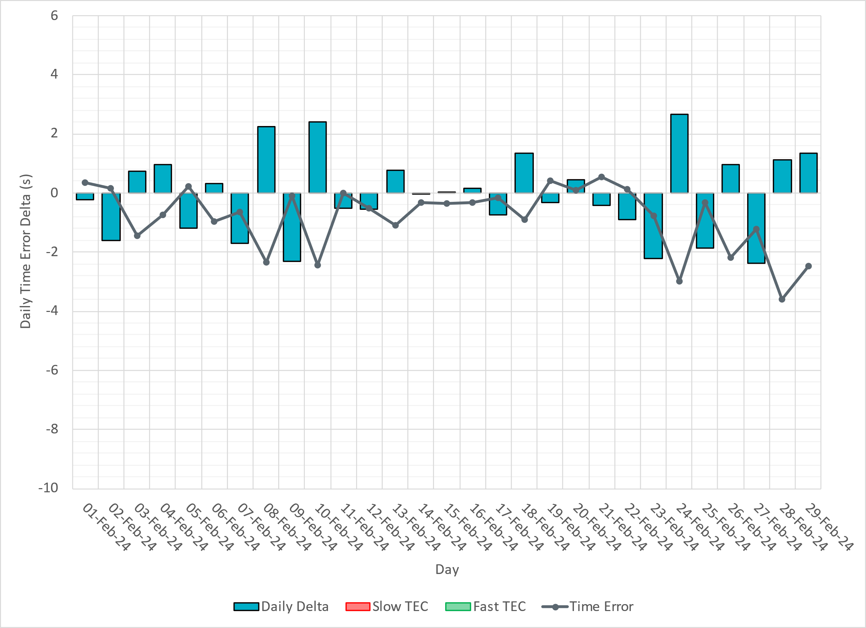
Time Error Corrections

Slide 11
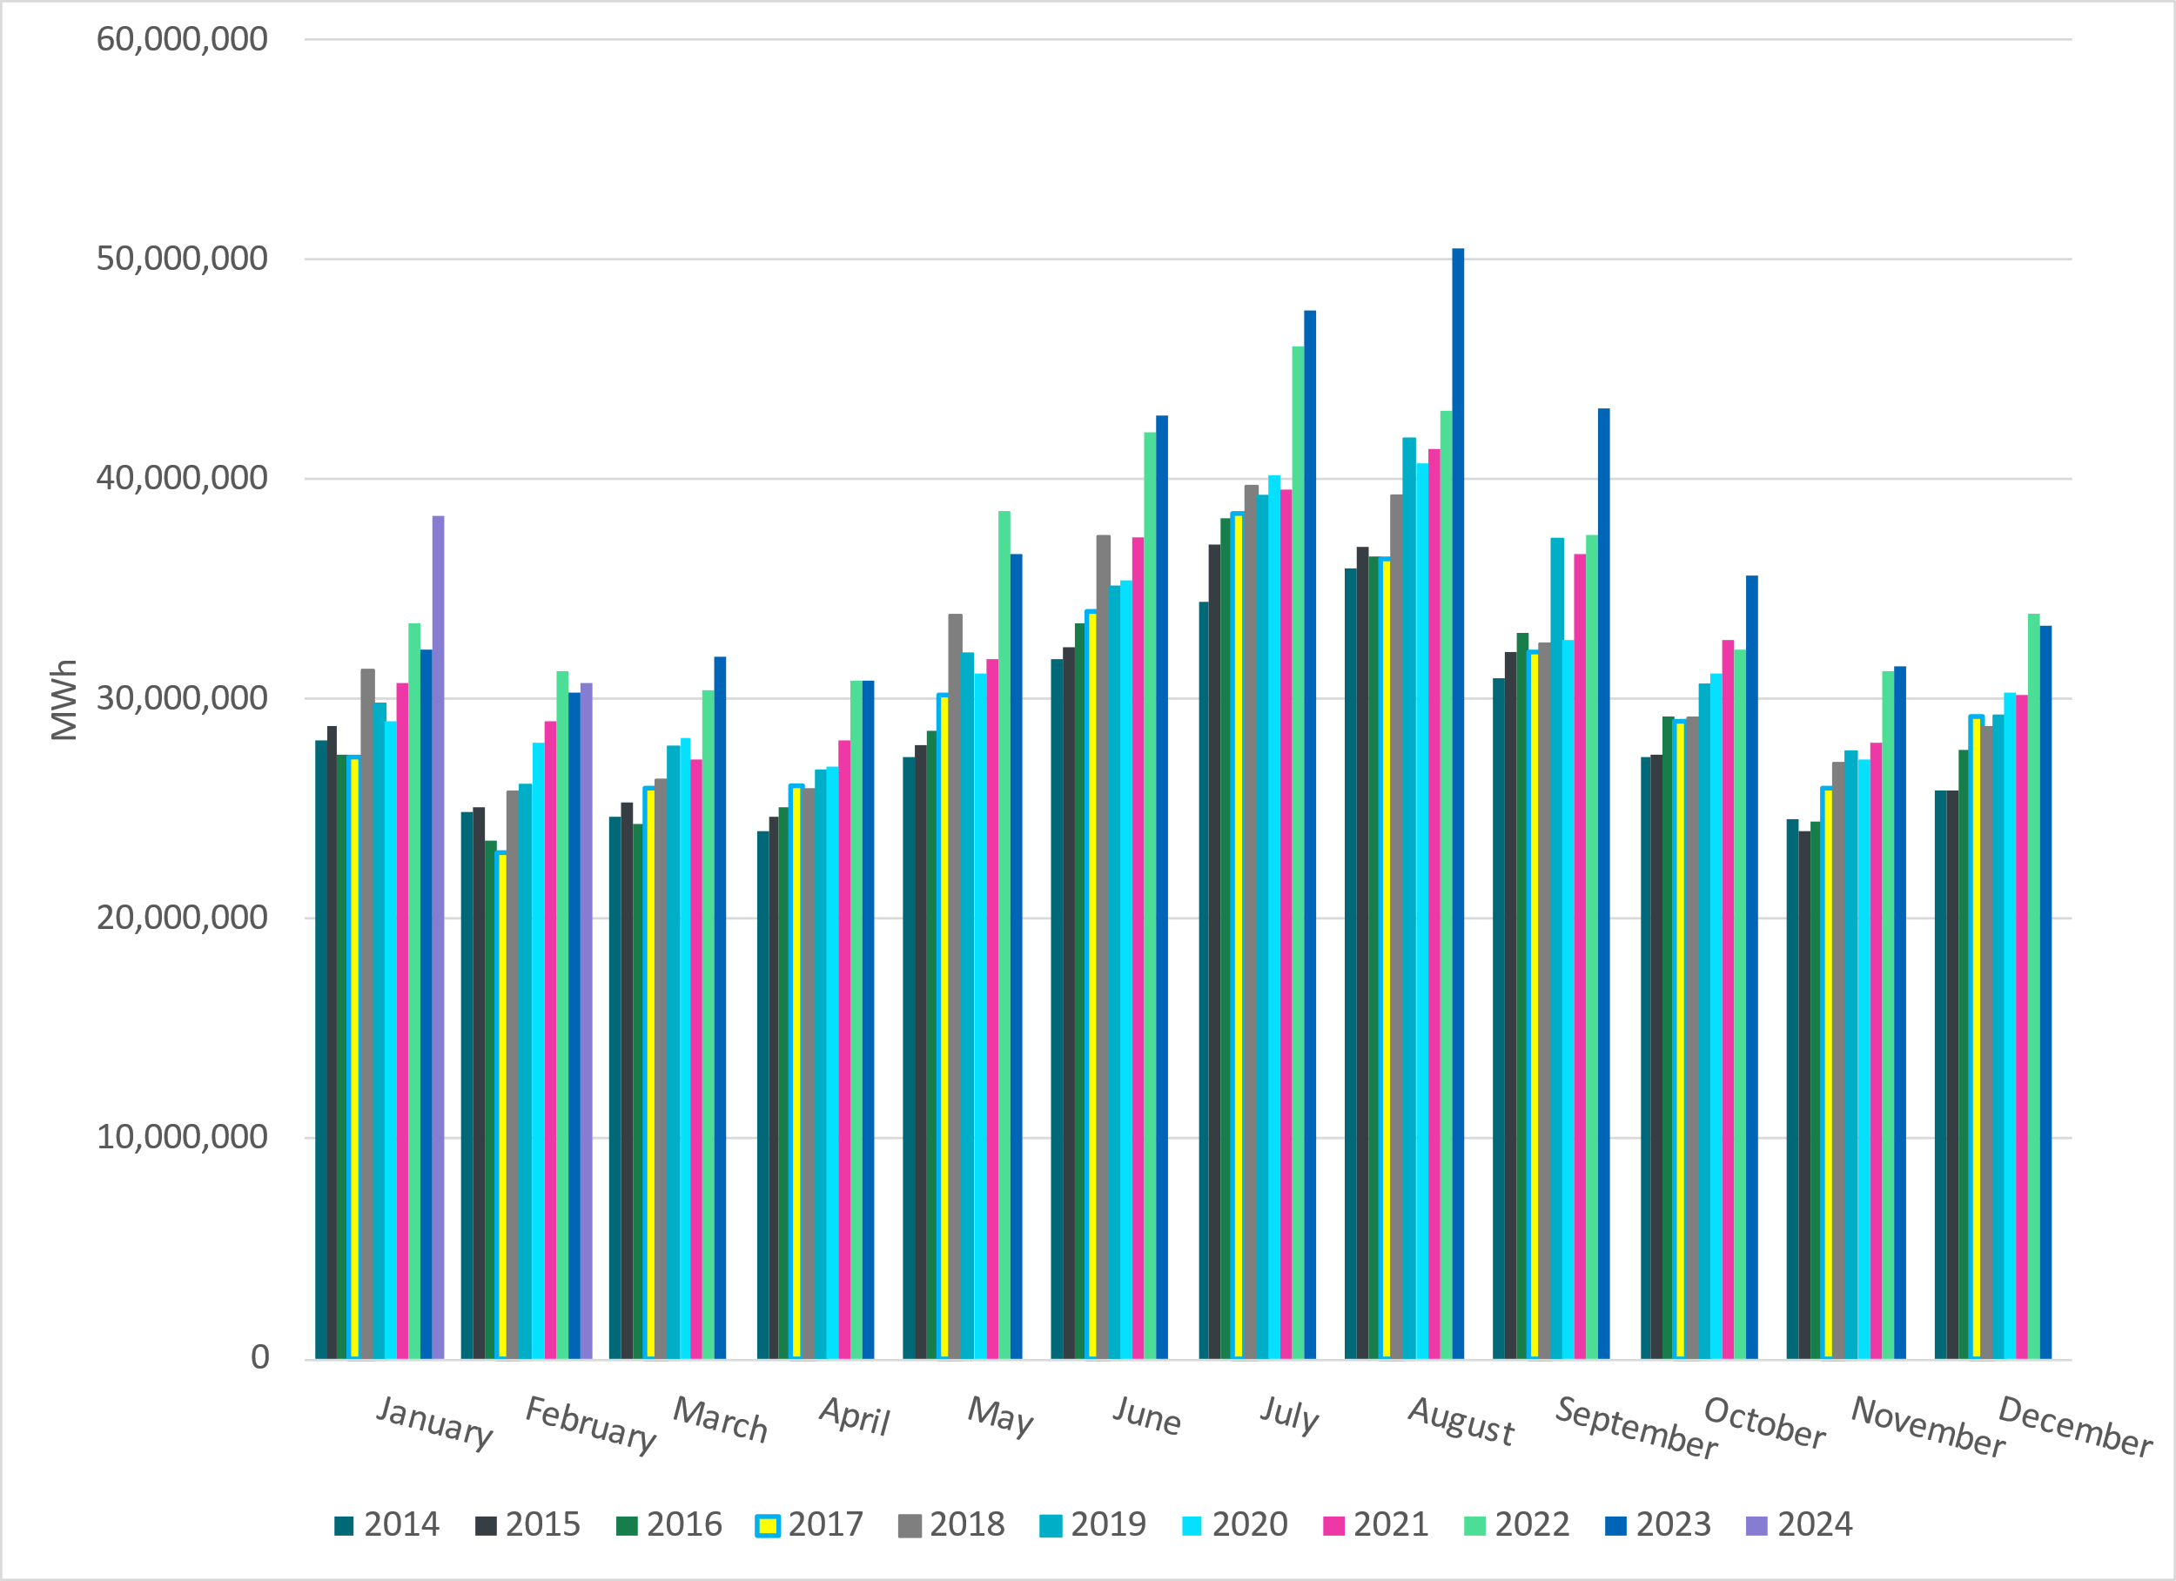
ERCOT Total Energy
Notes:
30,761,552 MWh

Slide 12
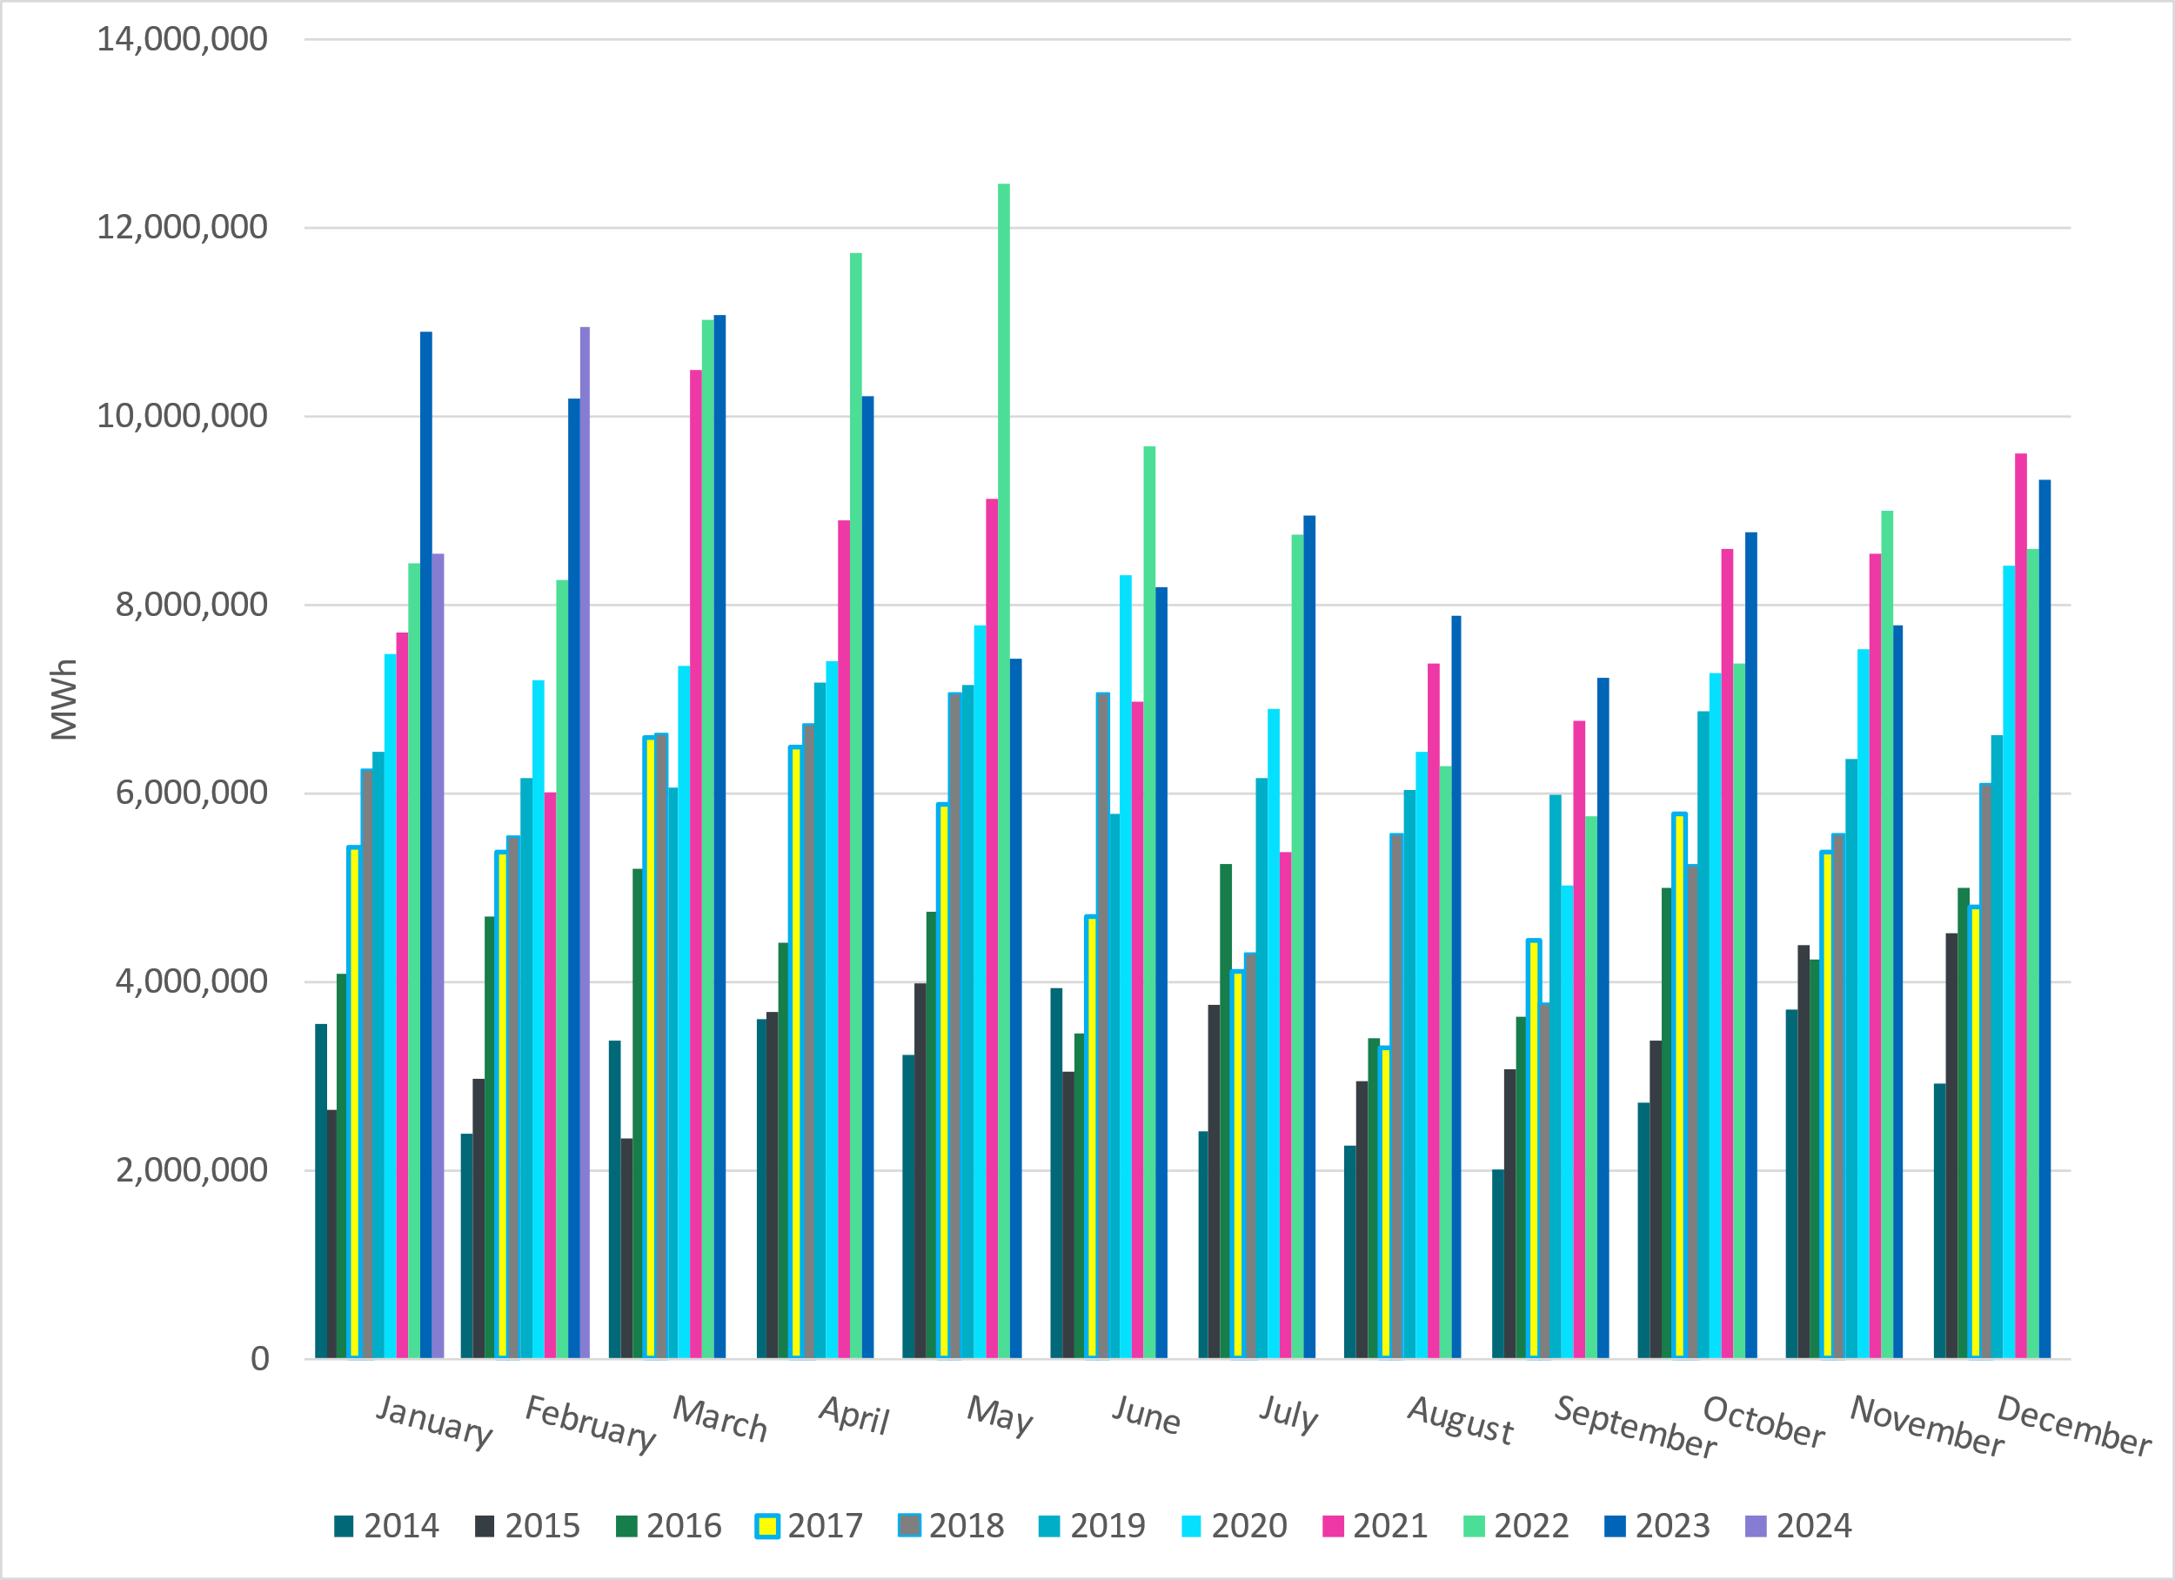
ERCOT Total Energy from Wind Generation
Notes:
10,944,115 MWH

Slide 13
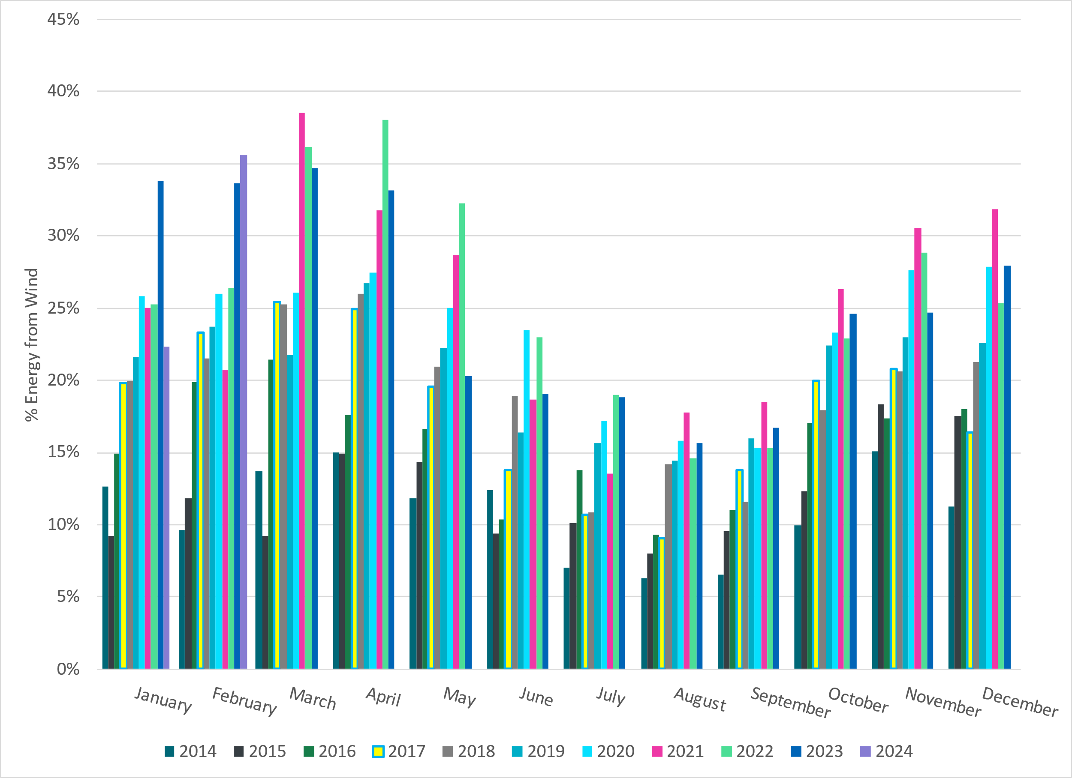
ERCOT % Energy from Wind Generation
Notes:
35.58% of total energy was provided by wind generation

Slide 14
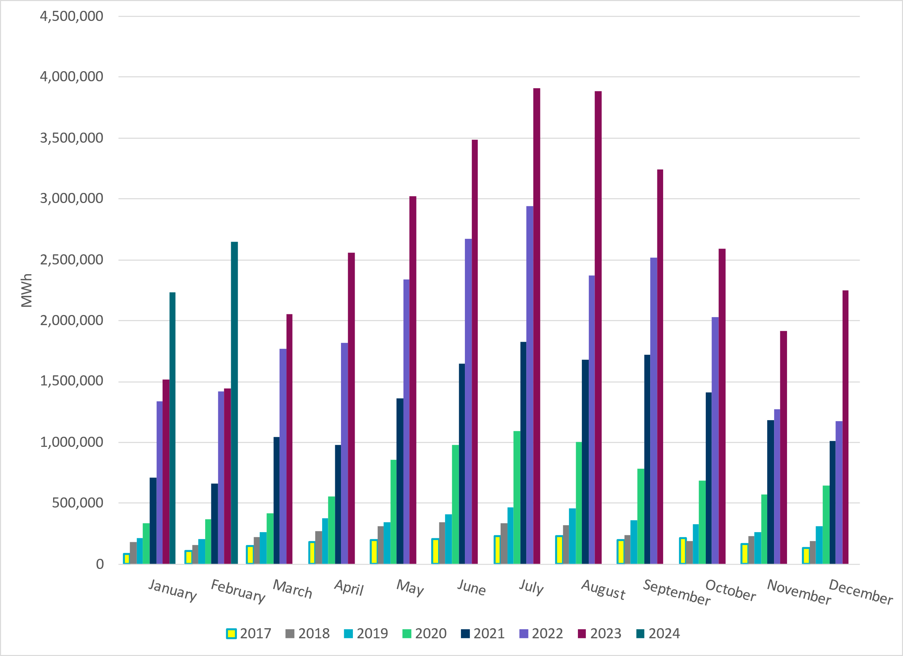
ERCOT Total Energy from Solar Generation
Notes:
2,646,220 MWh

Slide 15
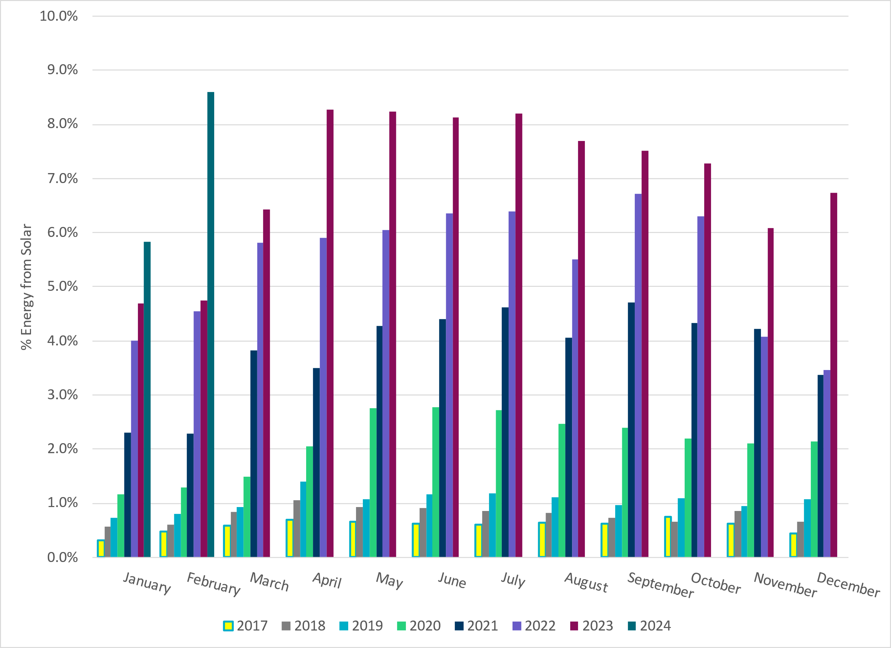
ERCOT % Energy from Solar Generation
Notes:
8.60% of total energy was provided by solar generation

Slide 16
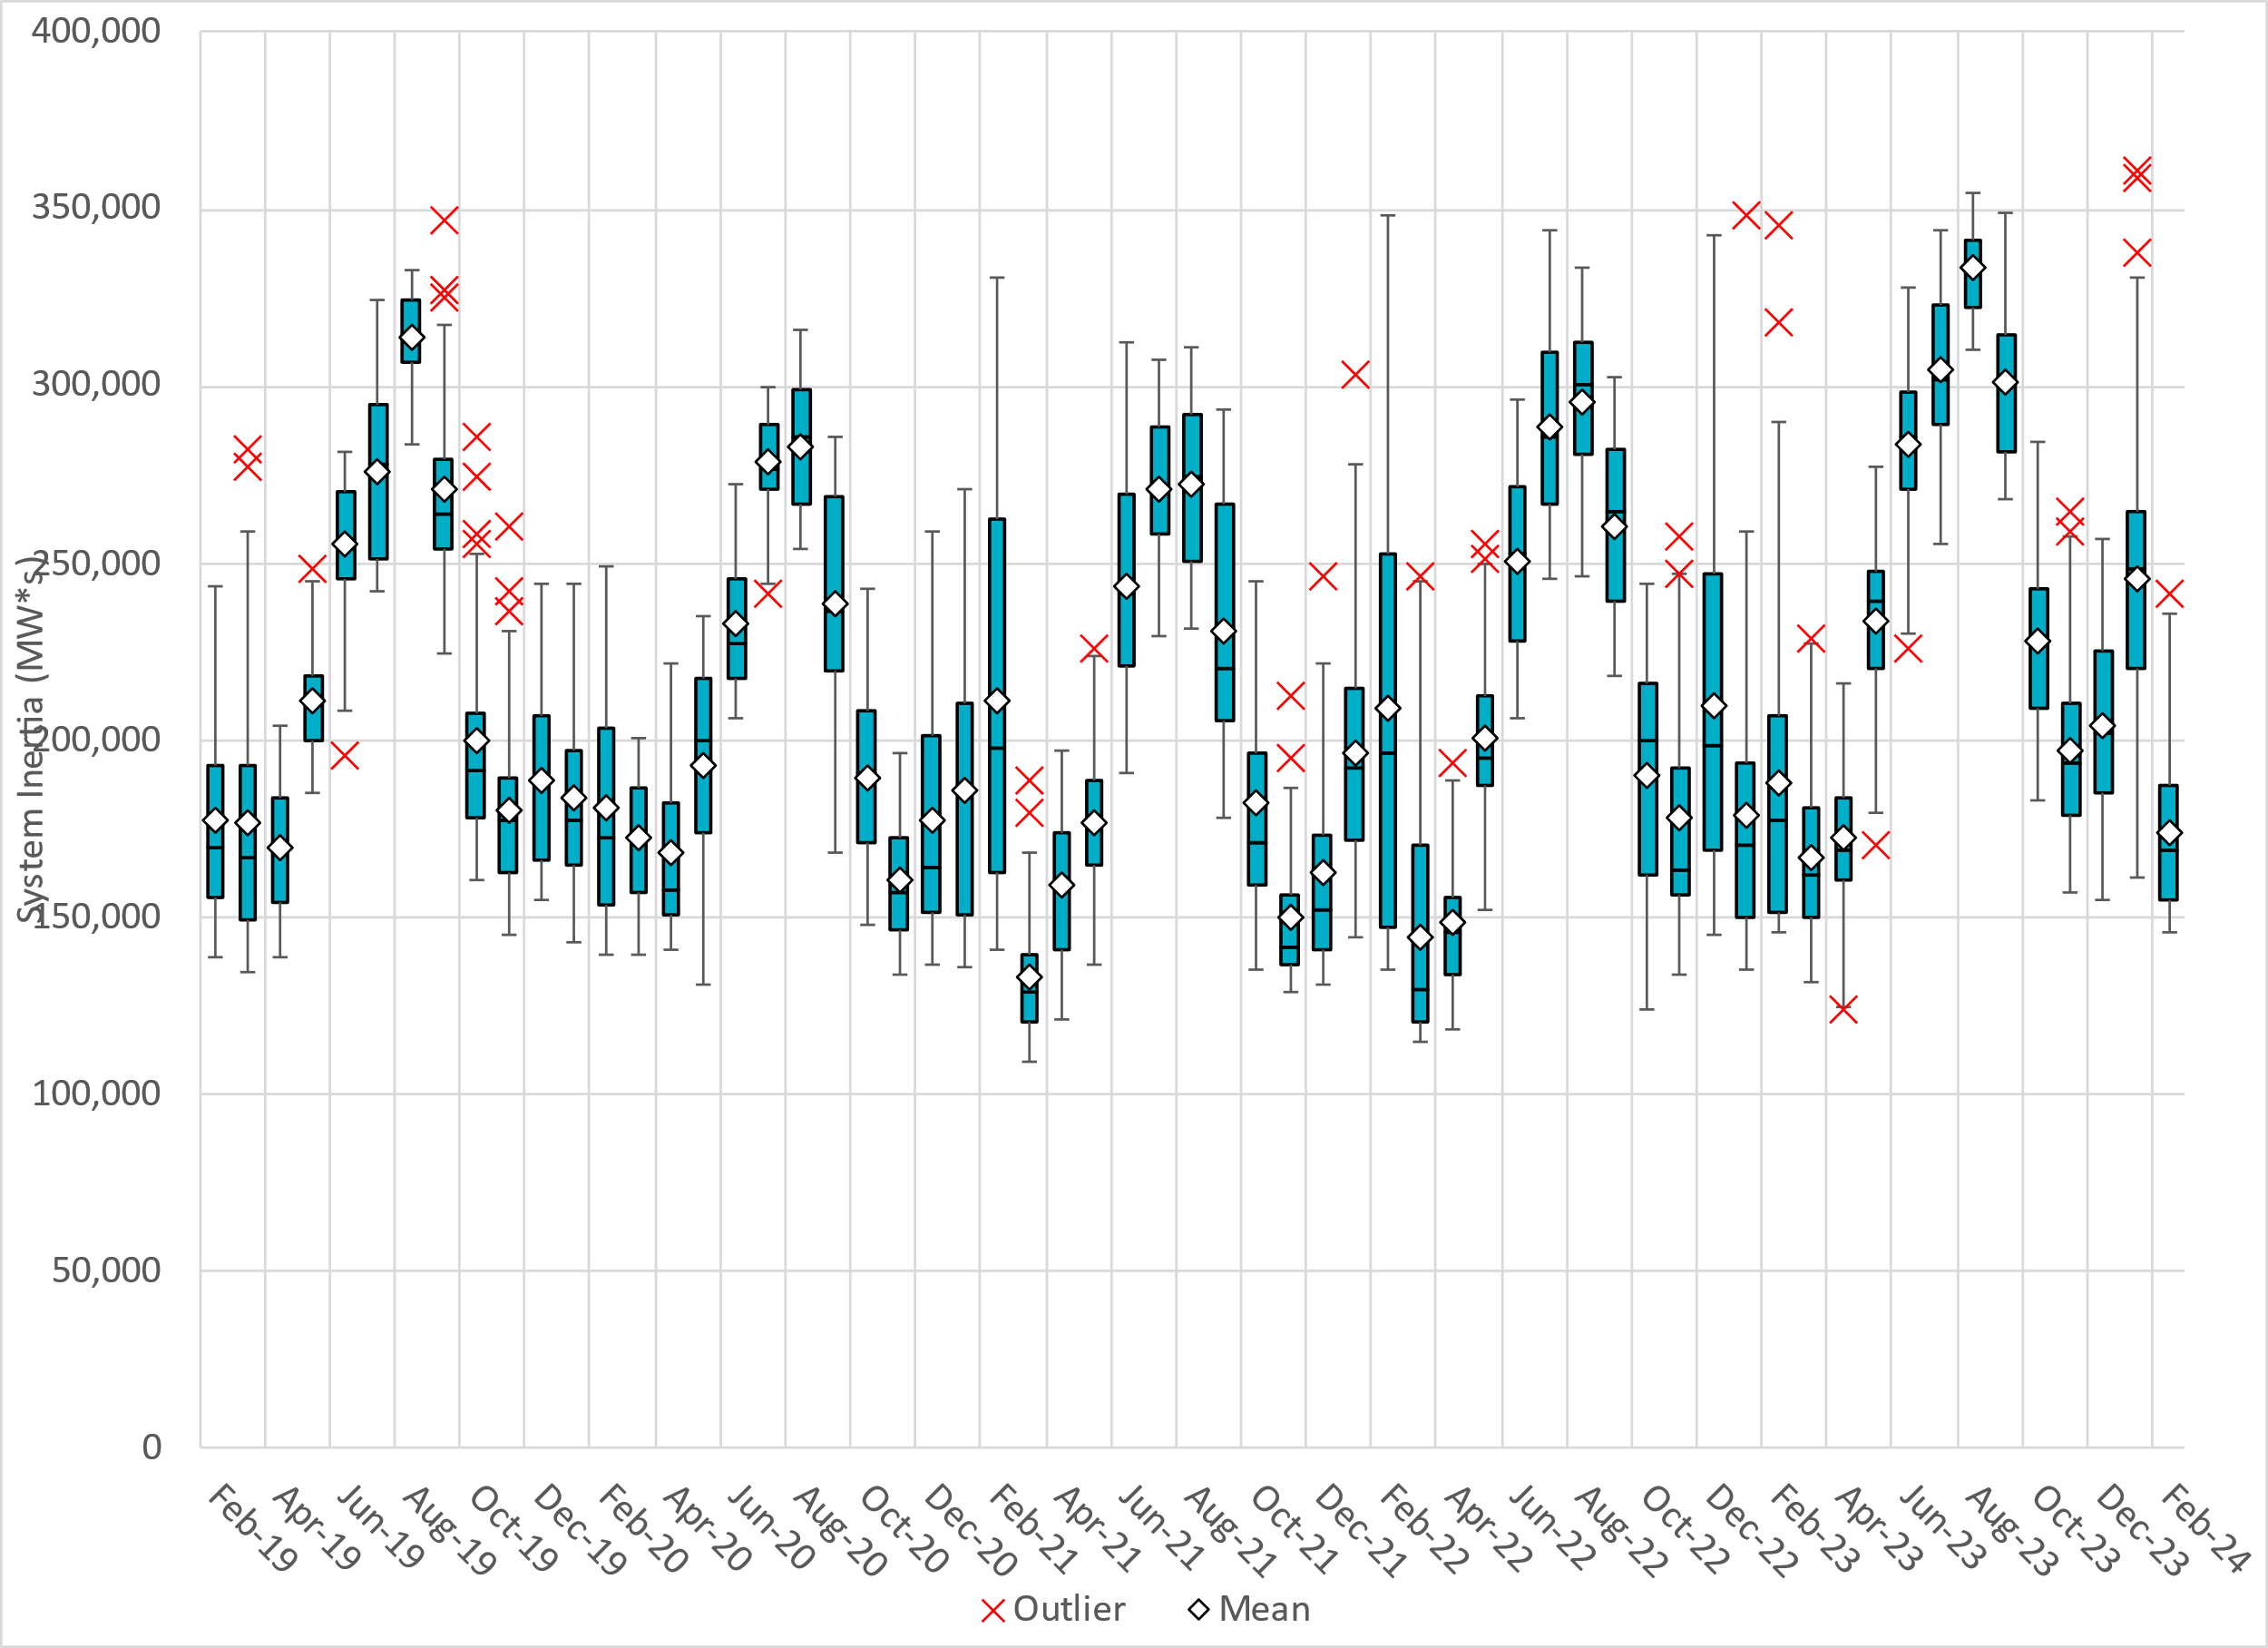
ERCOT Daily Minimum System Inertia
Notes:
Minimum Inertia in February 2024 = 145,331 MW*s on 2/25/2024
Historical Overall Minimum was 109,029 MW*s on 3/22/2021
Data:
Mean: 173,614 MW*s
Max: 241,450 MW*s on February 29th
Min: 145,331 MW*s on February 25th

Slide 17
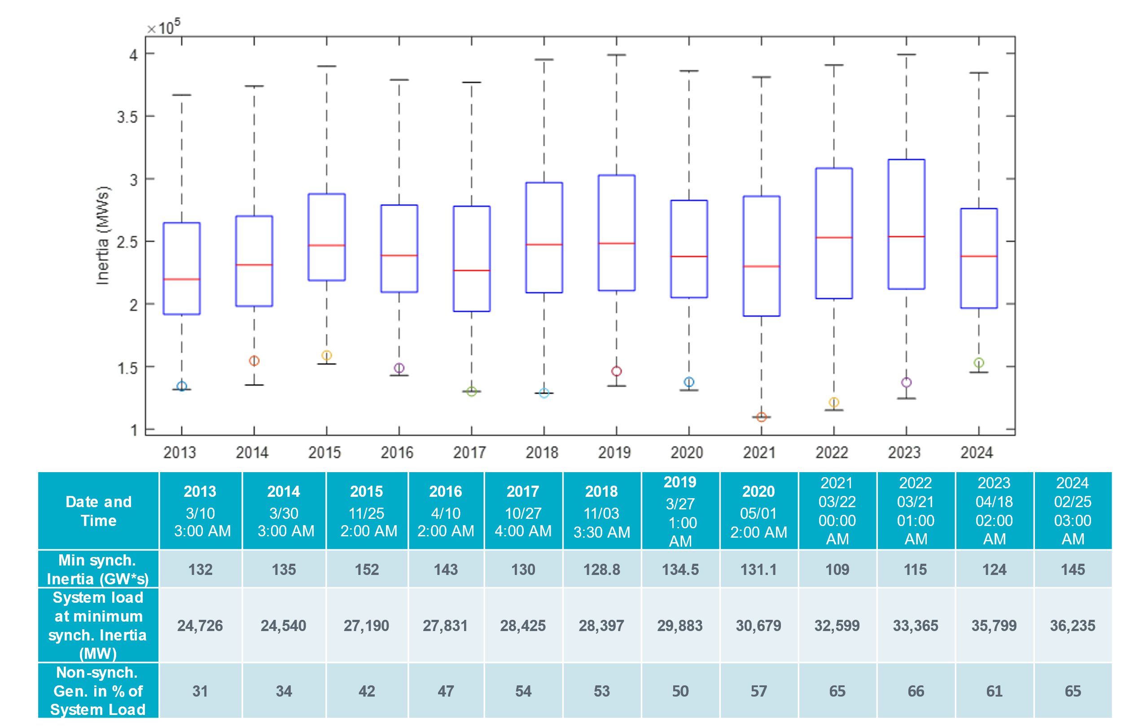
ERCOT Inertia Trend
Notes:
Summary of ERCOT intertia for the previous 10 years. Lowest inertia this year was on February 25th.
For each box, the central mark (red line) is the median, the edges of the box (in blue) are the 25th and 75th percentiles, the whiskers correspond to +/- 2.7 sigma (i.e., represent 99.3% coverage, assuming the data are normally distributed. The corresponding lowest inertia in each year is given in the table.
The circle on each boxplot is showing inertia during time when highest portion of load was served by wind/solar generation in that year.

