Slide 1
April 8, 2024 – Total Solar Eclipse
Riaz Khan
Luke Butler
Resource Forecasting & Analysis
Reliability and Operations Subcommittee (ROS)
April 4, 2024

Slide 2
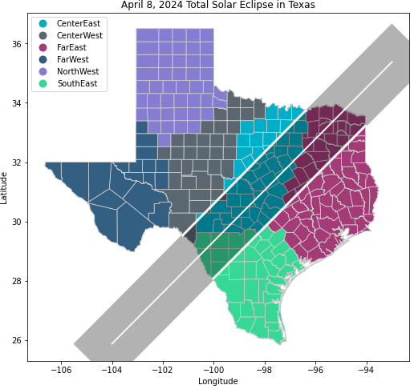
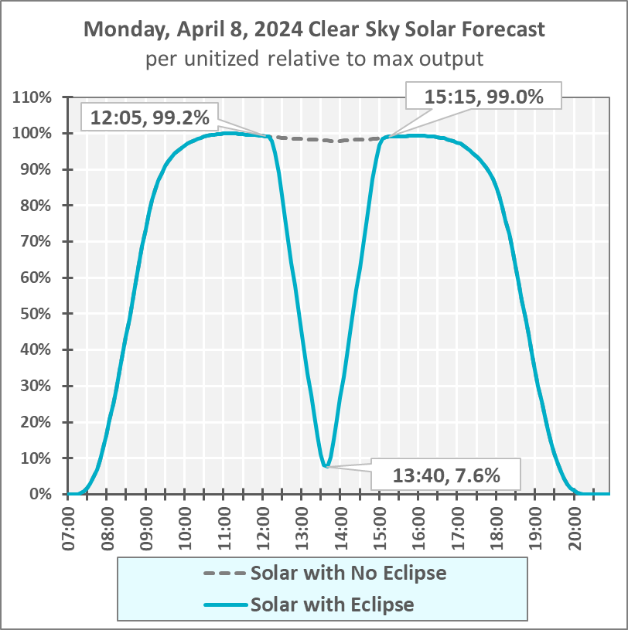
Total Solar Eclipse – Monday, April 8, 2024
On Monday, April 8, 2024, a total solar eclipse will pass over North America from southwest to northeast direction.
The eclipse in Texas will occur between approximately 12:10 (southwest point) and 15:10 CDT (northeast point), with sun coverage ranging from 81% to 99% in Texas.
ERCOT solar generation will be impacted during the eclipse, with the maximum impact occurring around 13:40, reducing solar generation to about 7.6% of its maximum clear sky output.
ERCOT is working with solar forecast vendors to ensure the forecasting models account for the impact of the eclipse. ERCOT will pre-posture the system as necessary to meet both the down and up solar ramps and use Ancillary Services for additional balancing needs.
Key Takeaway: ERCOT is planning for the total solar eclipse on April 8, 2024, and will use available tools to balance the system.

Slide 3
Activities Prior to Eclipse
E-11D
Thu Mar 28
E-6D
Tue Apr 2
E-5D
Wed Apr 3
E-4D
Thu Apr 4
E-3D
Fri Apr 5
E-2D
Sat Apr 6
E-1D
Sun Apr 7
Day of Eclipse (E)
Mon Apr 8
…
E-7D
Mon Apr 1
E-10D
Fri Mar 29
Day of Eclipse (E) – 11Day(D), Thu Mar 28: Send 1st market notice reminding market of eclipse.
E – 10D, Fri Mar 29: Receive and review ad-hoc forecasts from vendors for day of eclipse.
E – 7D, Mon Apr 1: Review forecast selections, monitor weather and potential for net load ramps.
E – 4D, Thu Apr 4: Send 2nd market notice reminding market of eclipse.
E – 2D, Sat Apr 6: Prior to the next day’s (Sunday’s) Day Ahead Market (DAM), review forecast selections and Ancillary Service (AS) requirements for the eclipse hours and assess if changes are necessary.
E – 1D, Sun Apr 7:
  After DAM clears and prior to Daily Reliability Unit Commitment (DRUC), assess sufficient capacity margin for eclipse window and if forecast selection changes are needed.
  After DRUC, review any RUC recommendations and projected committed capacity margin for eclipse hours.
Day of Eclipse, Mon Apr 8:
  At 10 AM, 2 hours prior to operating hour of eclipse window, assess forecast performance and review Generation To Be Dispatched (GTBD) parameters.

