Slide 1
DRRS Design to Meet HB1500 Intent
Shams Siddiqi, Ph.D.
Hunt Energy Network (HEN)
(512) 619-3532
shams@crescentpower.net
DRRS Workshop II
March 27, 2024

Slide 2
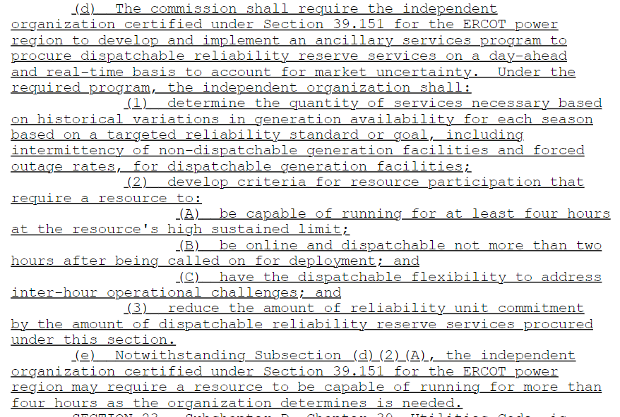
HB1500

Slide 3
Primary Goal of DRRS
HB1500: “determine the quantity of services necessary based on historical variations in generation availability for each season based on a targeted reliability standard or goal, including intermittency or non-dispatchable generation facilities and forced outage rates, for dispatchable generation facilities”
Any reliability standard ultimately adopted will likely require no more than 5-10 GW of firm Load shed that can be rotated during extreme events of significant duration
Severe winter storms of long duration, with little solar and wind support, are the most challenging for the ERCOT Grid – about 10 GW of additional dispatchable resources needed to meet any reasonable reliability standard
According to HB1500, DRRS should be designed to meet this reliability challenge
With its current suite of Ancillary Services, ERCOT meets all operational reliability needs as required by NERC and ERCOT has not identified the need for any additional AS for operational reliability
Thus, DRRS is not required for operational reliability but should be designed for meeting a targeted reliability standard or goal as specified in HB1500

Slide 4
DRRS Design to Meet Goal
DRRS duration requirement should be 24 hours at least for the winter months and may be as low as 4 hours in all other months and must be available within 2 hours
DRRS Resources must be offline available (QSGR qualify) until committed/released by ERCOT with DRRS payment clawed back with possible penalties if not available during critical times
DRRS will be available to RUC at significantly scaled down startup and min energy cost – no RUC makewhole payment to DRRS Resources
CLRs must consume at DRRS awarded capacity until released by ERCOT
Non-Spin could be repurposed for DRRS for quick implementation – Non-Spin ASDCs for non-winter months but much higher ASDC for winter reflecting significant costs of long duration dispatchable capacity shortfall
Starting quantity ~6GW for winter (utilize current Non-Spin MWs for other seasons) with pre-specified growth to meet reliability standard based on VOLL and LOLP
DRRS costs are allocated LRS and can be self-arranged and traded
Commitment of offline DRRS accounted for in RDPA

Slide 5
DRRS Implementation
Non-Spin could be repurposed for DRRS for quick implementation and to minimize cost impact on Load, or DRRS could be a separate AS
Starting quantity ~6GW in winter season with pre-specified quantities over future years to meet reliability standard at the earliest possible date considering time needed to build new dispatchable resources properly accounting for retiring dispatchable resources
DRRS is procured in DAM and co-optimized with Energy/AS and can be bilaterally traded and represents a physical commitment hours ahead since RUC looks hours ahead
Since DRRS quantities and prices would be significantly higher in winter months, DRRS is targeted to longer-duration dispatchable resources
Seasonal DRRS ASDCs reflecting varying DRRS seasonal quantity needs would be used to procure DRRS (DRRS ASDC is not tied to segmented ORDC for winter)

Slide 6
Proposed DRRS Implications
ERCOT Grid needs long-duration dispatchable resources to meet any reasonable reliability standard – proposed DRRS design would incentivize such resources and thus better meet the stated goal of HB1500
Non-performance clawback and possible penalties will encourage high availability during scarcity events and the development of firmer fuel supply
During non-winter months, solar ramp hours are relatively easy to forecast and load forecast errors are known at least a few hours ahead – thus, DRRS can meet those needs making Non-Spin redundant (online Non-Spin provides little reliability benefit anyway); thus Non-Spin could be retired
Proposed DRRS would incentivize newer longer-duration dispatchable resources that thrive on capturing high prices in an IRR saturated market
Proposed DRRS would not adversely impact market prices since RDPA would reverse any price suppression due to DRRS deployment
This DRRS proposal is much more targeted to longer duration dispatchable resources and has a significantly better likelihood of resulting in new build of such capacity whereas PCM is not as targeted and likely to have minimal impact on new build of such capacity especially with $1B/year cap

