Slide 1
Credit Finance Sub Group Update to the Technical Advisory Committee
Brenden Sager, Austin Energy, Chair
Loretto Martin, NRG, Vice Chair
27 March 2023

Slide 2
General Update
  20 March CFSG meeting
  Voting matters
    Operational NPRR’s without credit impacts
  Discussion items
    EAL Change Proposals
    Independent Amount Posting Requirement
    NPRR 1215 Clarifications to DAM and Energy-Only Offer Calc
  Regular credit exposure updates

Slide 3
NPRR Reviewed
NPRR1212, Clarification of Distribution Service Provider’s Obligation to Provide an ESI ID. This Nodal Protocol Revision Request (NPRR) revises Section 10.3.2 to clarify the obligation of a Distribution Service Provider (DSP) to provide ERCOT with an Electric Service Identifier (ESI ID) for a Resource site that consumes Load other than Wholesale Storage Load (WSL) and that is not behind a Non-Opt-In Entity (NOIE) tie meter.
CFSG Review as operational without credit impacts

Slide 4
Independent Amount Posting
Upon implementation of NPRR 1165 April 1, all CP will be required to post IA
CRR only = $500K; Multi-market = $200K
Ramsey Cripe of SEnergy presented concerns over added costs and liquidity constraints for smaller MP’s
Could also reduce overall hedging in the market
ERCOT responded that smaller players can have CRR activities that result in obligations to ERCOT
Entire market has an obligation to prevent default as participants regardless of exposure
Resources limited to implement ctpy-level collateralization

Slide 5
NPRR 1215 Clarifications to the Day-Ahead Market (DAM) Energy-Only Offer Calculation
NPRR from ERCOT to address issue observed by MP’s of ambiguities in protocol language around DAM Energy-Only Offer Calculation
ERCOT proposed an administrative clean up of the language which will not impact market operations
  Two clarification edits to reflect that the “absolute value” of negative prices is used to increase exposure when prices are negative.
  Paragraph reference error resolved
  Incorporation of the as-built value of e2 used in the calculation of credit Exposure for Dam Energy-Only Offers.
CFSG discussed related matters and plans to vote on the NPRR at the April meeting

Slide 6
NPRR 1184 Cash Collateral Interest
ERCOT moved from annual collateral interest payments on cash held at ERCOT to monthly interest
ERCOT credits interest earned on Cash Collateral held from Counter-Parties on a monthly basis and posts interest to each CP’s respective collateral no later than 15 days after each month-end.
Any corrections to cash balances must be made prior the interest calculation date (around 10th) in order to avoid any retroactive corrections to interest.
CPs need to review their respective cash collateral transactions and inform ERCOT Credit staff of any misapplication of collateral prior to the 10th day of each month.

Slide 7
NPRR 1184 Cash Collateral Interest
Circumstances resulting in misapplication of collateral:
  A counterparty did not properly identify for which counterparty the cash collateral is for (i.e., did not include the CP number and name in wire)
  New counterparty wired initial cash collateral and failed to properly identify the name of the registered market participant in the wire
  Mystery wires with no identification whatsoever
ERCOT is considering updating protocols related to specific instructions for cash collateral payments

Slide 8
M-A122123-01 Payment Processing System
On January 26, 2024, ERCOT will implement an automated payment processing system.
Invoice Payment: Add the full invoice ID, alpha and numeric, in the remark/details of the wire.
Invoice Payment: Must be received by 10:00AM on the day after the invoice was issued in order for the outstanding invoice amount to be excluded from the intra-day TPEA that is calculated in the afternoon.
Do not pay WAN and ERO invoices into the Market Bank Account. Follow the instructions included on the WAN and ERO invoices.
Cash Collateral Deposit: Add the Counter-Party number in the remark/details of the wire.
Collateral Deposit for CRR auctions: Must be received by 3:00PM on the CRR lock date in order to be included in ACL for the CRR auction being initiated the same day.
ERCOT will be making the following changes to its procedures:
Reminder emails for non-payment will be sent earlier in the day, and again in the afternoon, if required.
As a reminder, per Protocol Section 9.7.1, any payment not received by 5:00PM on its due date will be considered late.

Slide 9
EAL Changes and Analysis
DC and Rainbow requested changes to the Estimated Aggregate Liability report that represents parameters defining the CP’s collateral obligation to ERCOT
Members expressed desire to have settlement from RT and DA combined in the calculation
  Current forward adjustment factors apply separately to DA and RT
Evaluating lookback period designed to protect against default mass transition
  Varies but can reflect up to 40 days of invoices and financial market activity
Evaluating Forward Adjustment Factors (FAFs), ratios of future and past prices scaling invoices
CFSG will continue to review EAL calculation methodology
ERCOT Credit team is evaluating four scenarios presenting these to CFSG in detail.

Slide 10
EAL Changes and Analysis
ERCOT looked at calculation parameters around Winter storm Elliott and discovered netting of Day Ahead and Real Time does not provide for a desired collateral cushion going into the event
The current methodology with a 40 day lookback period applied to the Real Time liability also allows for increased collateral requirements going into an event
Proposed changes tend to lag existing methods in producing increased collateral requirements going into a pricing event
For example, a retailer hedged bilaterally beyond their liability will minimize DAM activity and receive credits in RTM. Under such a scenario, the underlying obligation to ERCOT is minimal and will NOT increase collateral requirements going into the event
  However, with separate DA/RT against forward adjustment factors and historical lookbacks, increasing prices do trigger increasing collateral obligations

Slide 11
Monthly Highlights January – February 2024
Market-wide average Total Potential Exposure (TPE) decreased from $1.80 in January 2024 to $1.34 billion in February 2024.
  TPE decreased due to lower forward adjustment factors and real-time and day-ahead prices
Discretionary Collateral is defined as Secured Collateral in excess of TPE,CRR Locked ACL and DAM Exposure
  Average Discretionary Collateral decreased from $5.57 billion in January 2024 to $4.60 billion in February 2024
No unusual collateral call activity

Slide 12
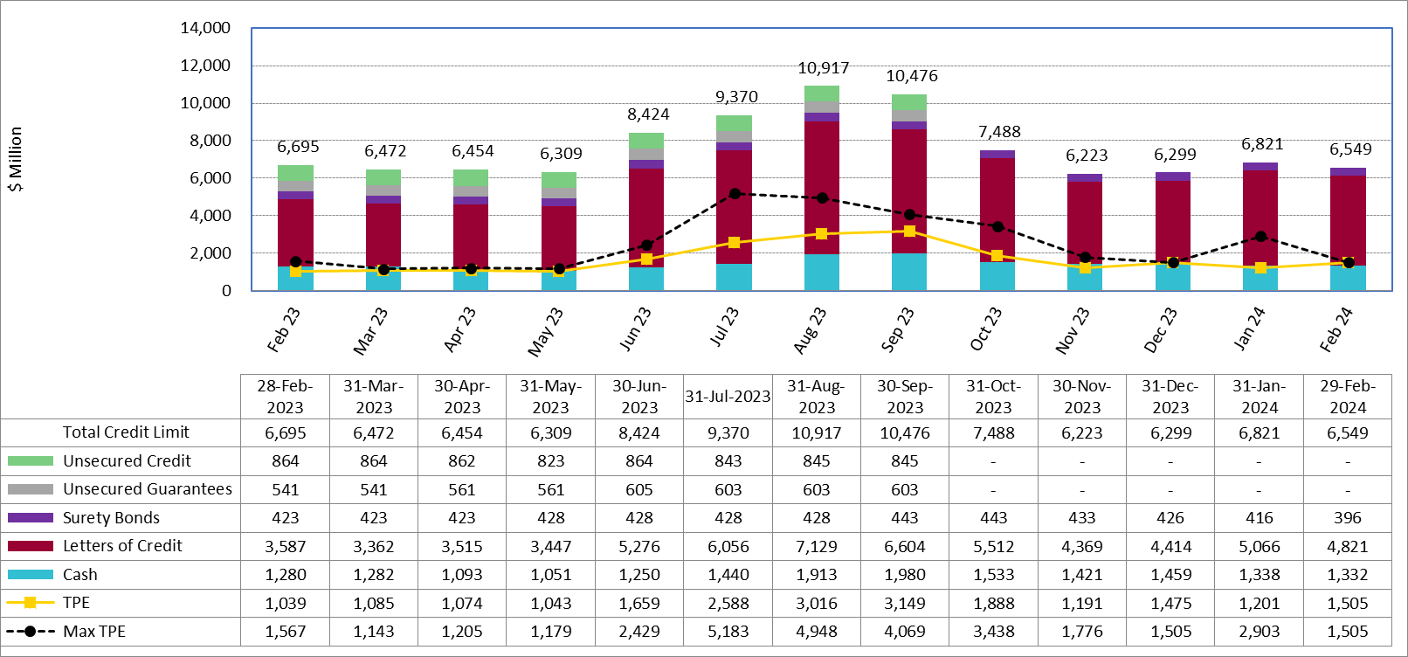
Available Credit by Type Compared to Total Potential Exposure (TPE) YTD February 2024

Slide 13
Discretionary Collateral Jan-Feb 2024

Slide 14
Issuer Credit Limits vs Total LC Amounts Per Issuer
As of February 29, 2024
There are a total of 36 banks that have issued LCs.

Slide 15

Questions?

