Slide 1
Monthly Review of Reliability Unit Commitment Market Impacts – February 2024
Wholesale Market Working Group
ERCOT Staff

Slide 2
RUC Resource-Hours
February 2024 | Total | Opt-Out | Non-Opt-Out
Instructed Resource-Hours
Total Count | 20 | - | 20
Effective Resource-Hours*
Total Count | 17.3 | - | 17.3
Average Megawatts (MW) for Effective Resource Hours
Average LSL | 203.1 | - | 203.1
Average LDL | 217.2 | - | 217.2
Average BP | 225.4 | - | 225.4
Average HSL | 486.8 | - | 486.8
* The difference between “Instructed” and “Effective” values is a result of Resources starting up, shutting down, receiving partial hour instructions, or otherwise not being dispatchable by SCED.

Slide 3
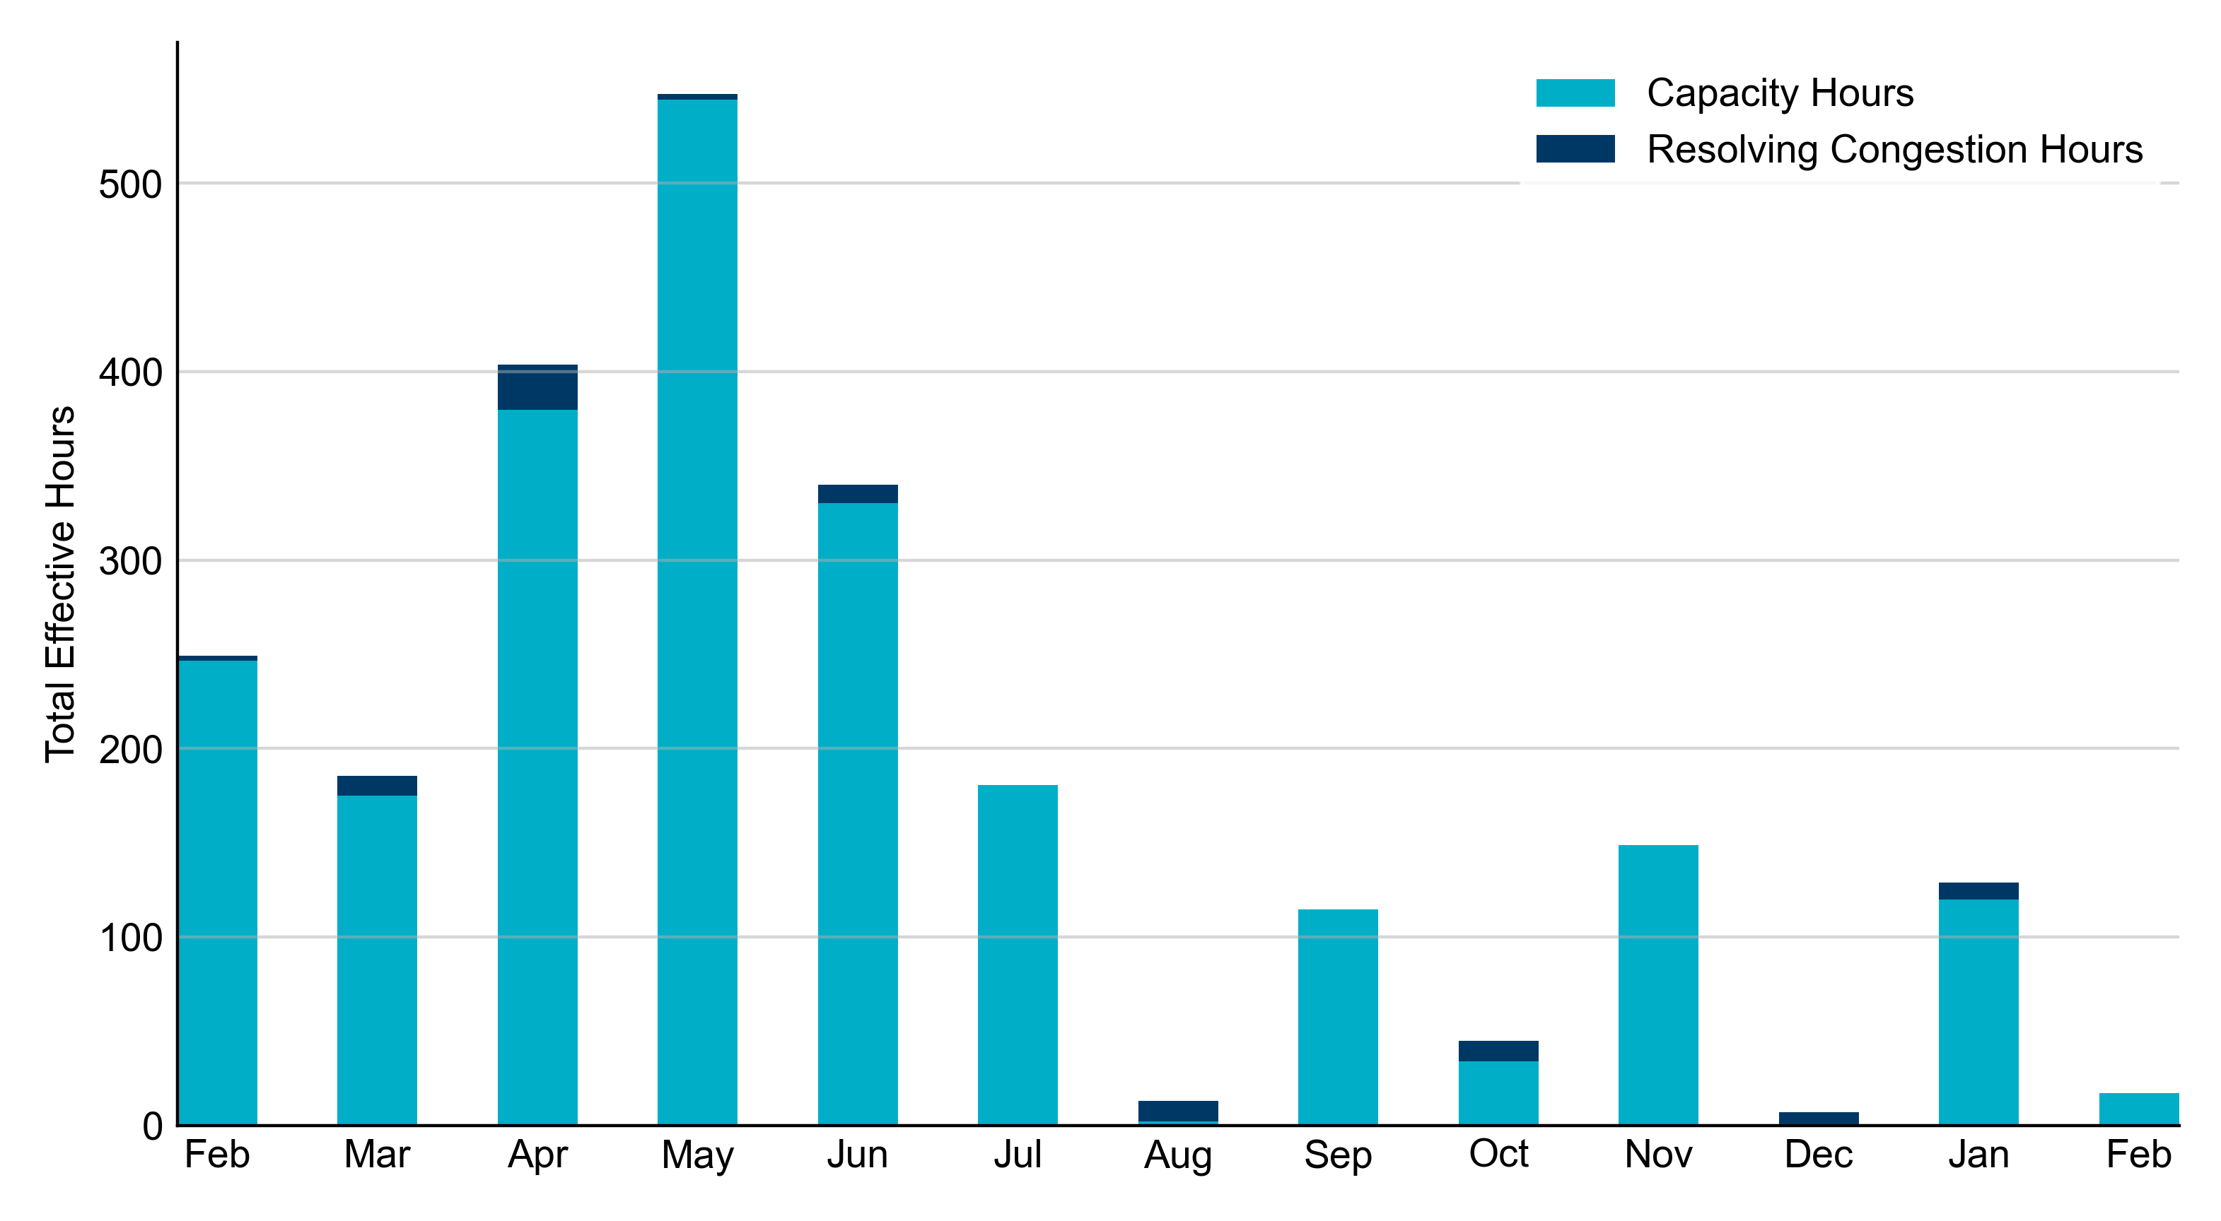
RUC Instruction Reasons: Last 13 Months
RUC in February 2024 was primarily to ensure sufficient capacity.

Slide 4
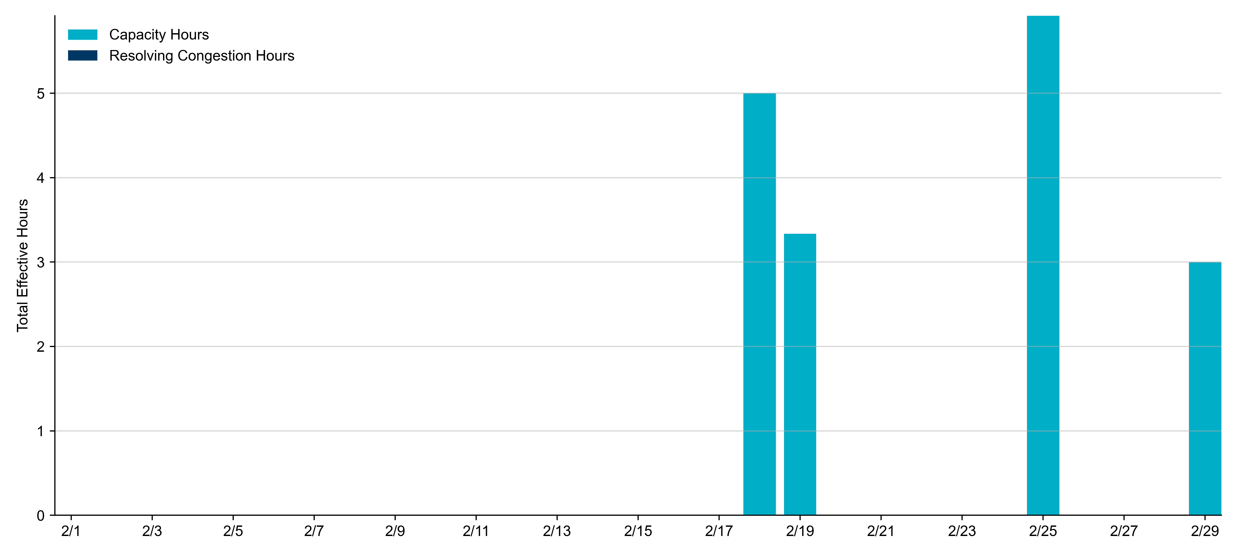
RUC Instruction Reasons in February 2024
17.3 effective RUC Resource-hours.
  17.3 hours (100%) for capacity concerns.

Slide 5
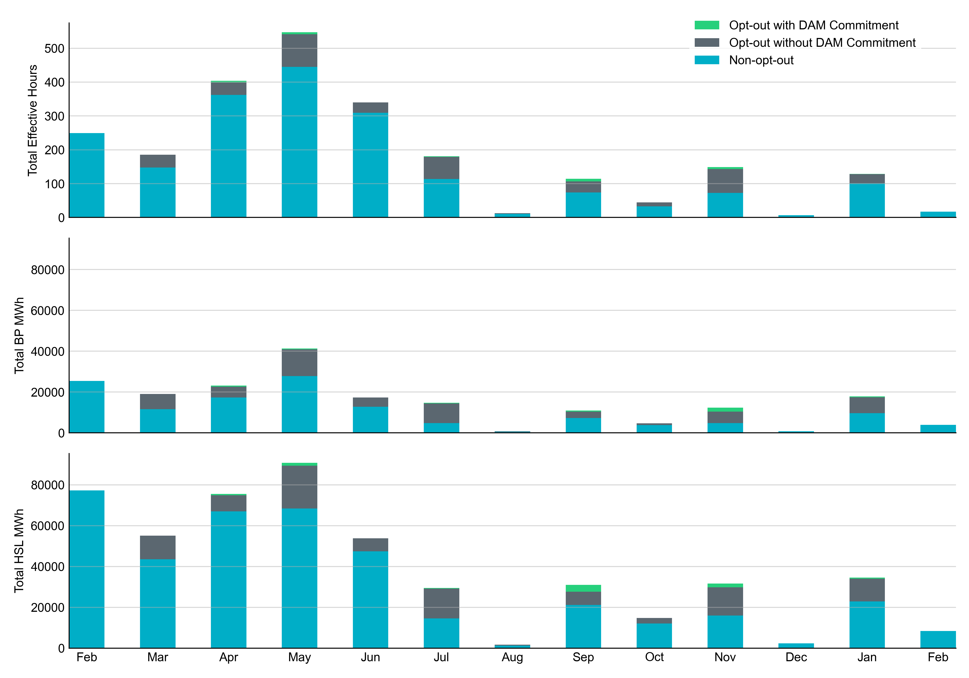
Non-opt-out and Opt-out Totals: Last 13 Months
February 2024 had a total of 17.3 non-opt-out effective Resource-hours, which was 100% of the effective Resource-hours for the month, as there were no opt-out effective Resource-hours.

Slide 6
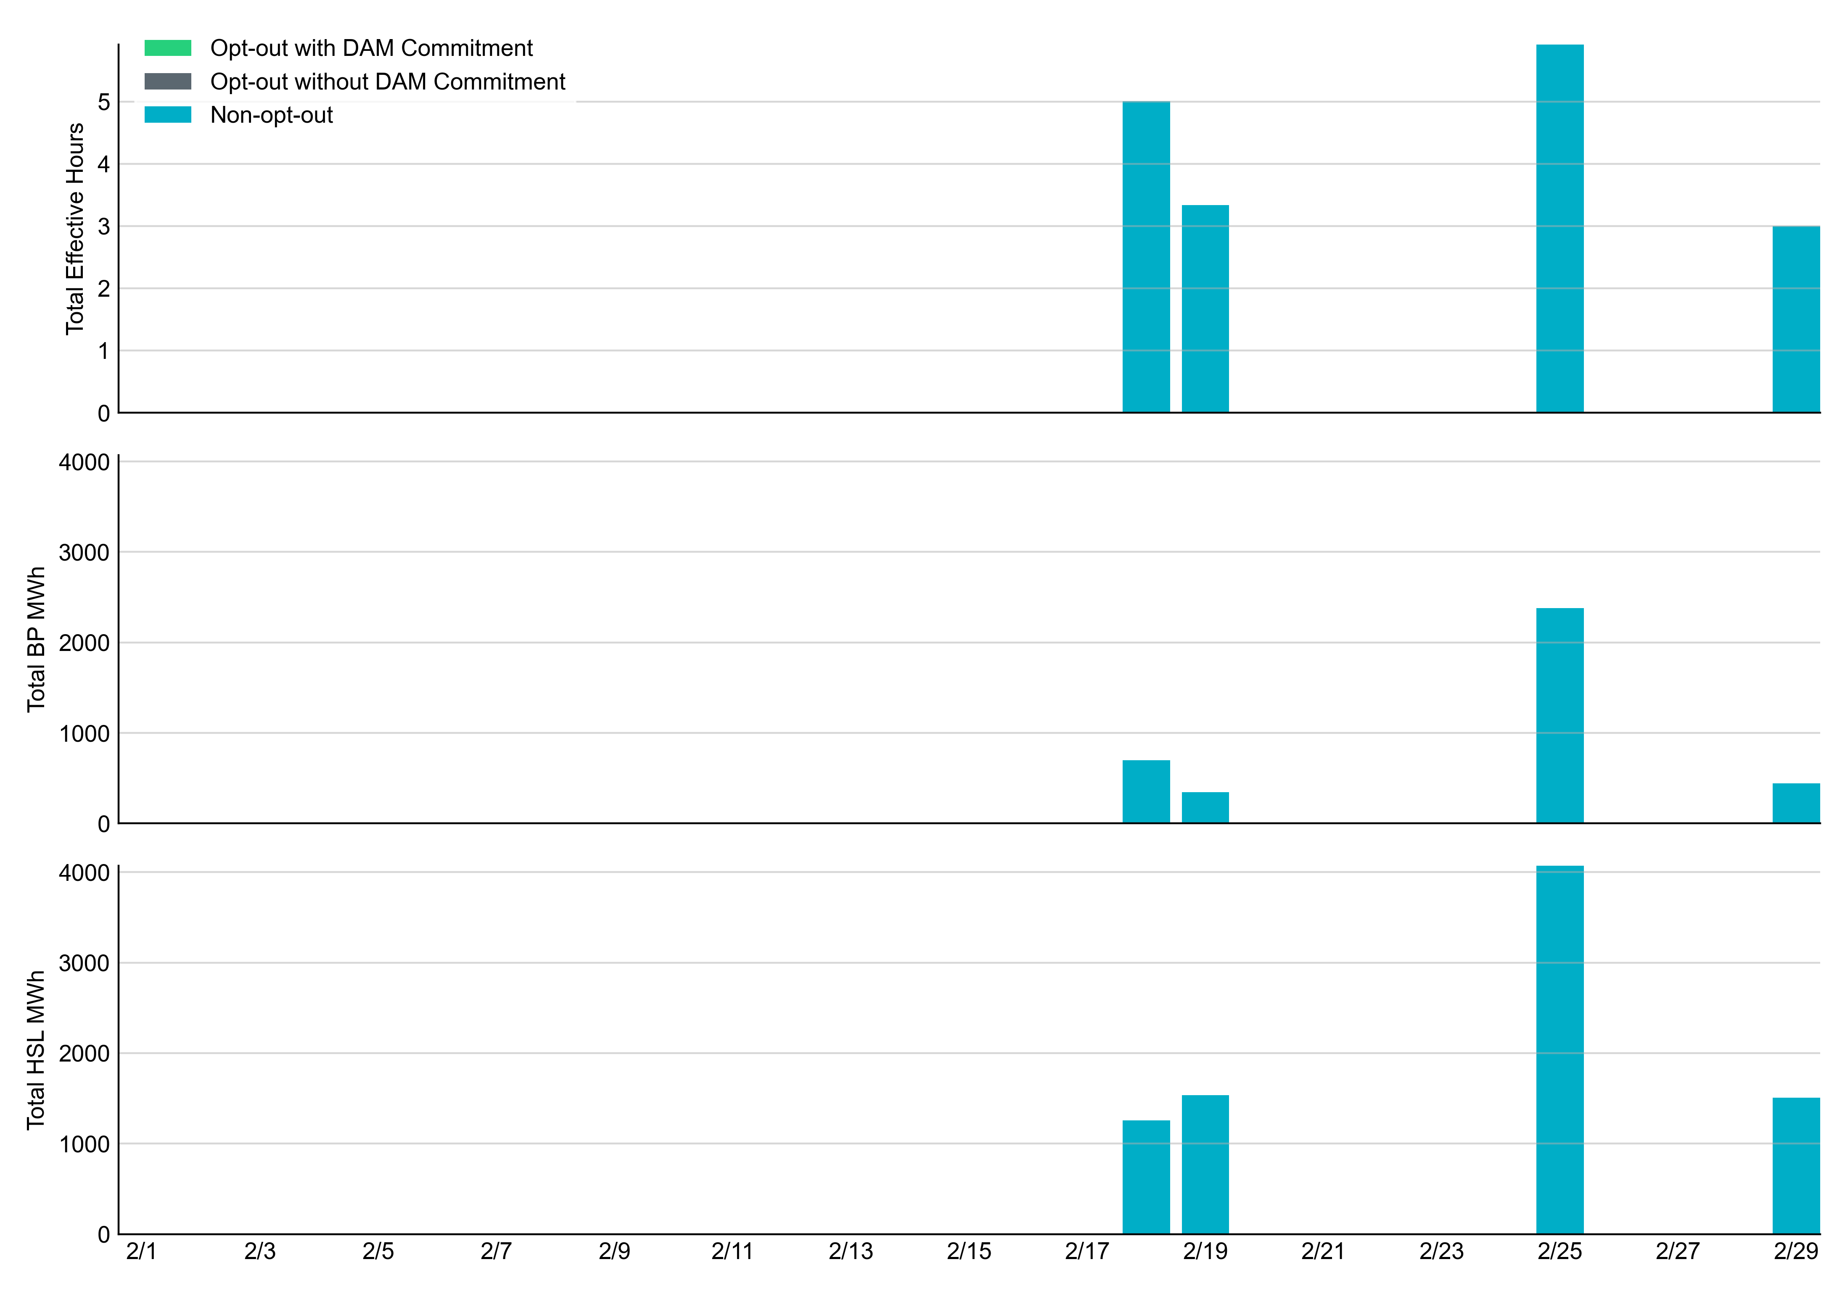
Non-opt-out and Opt-out Totals: February 2024

Slide 7
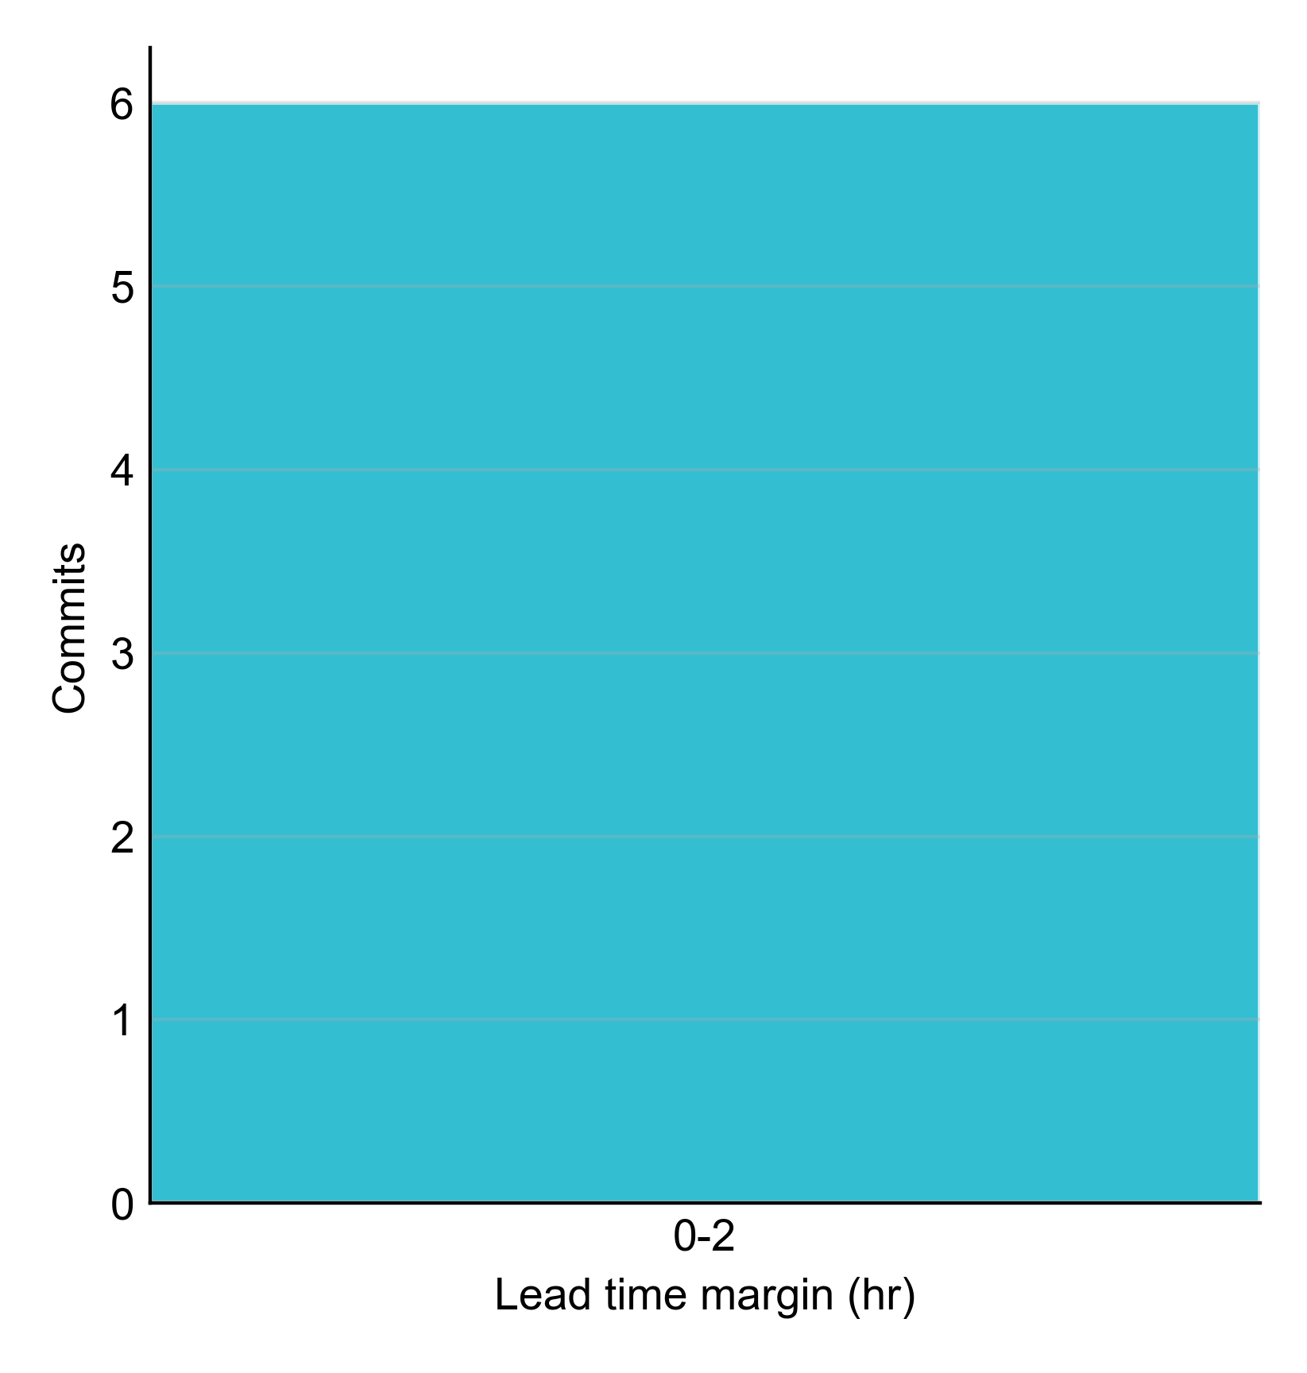
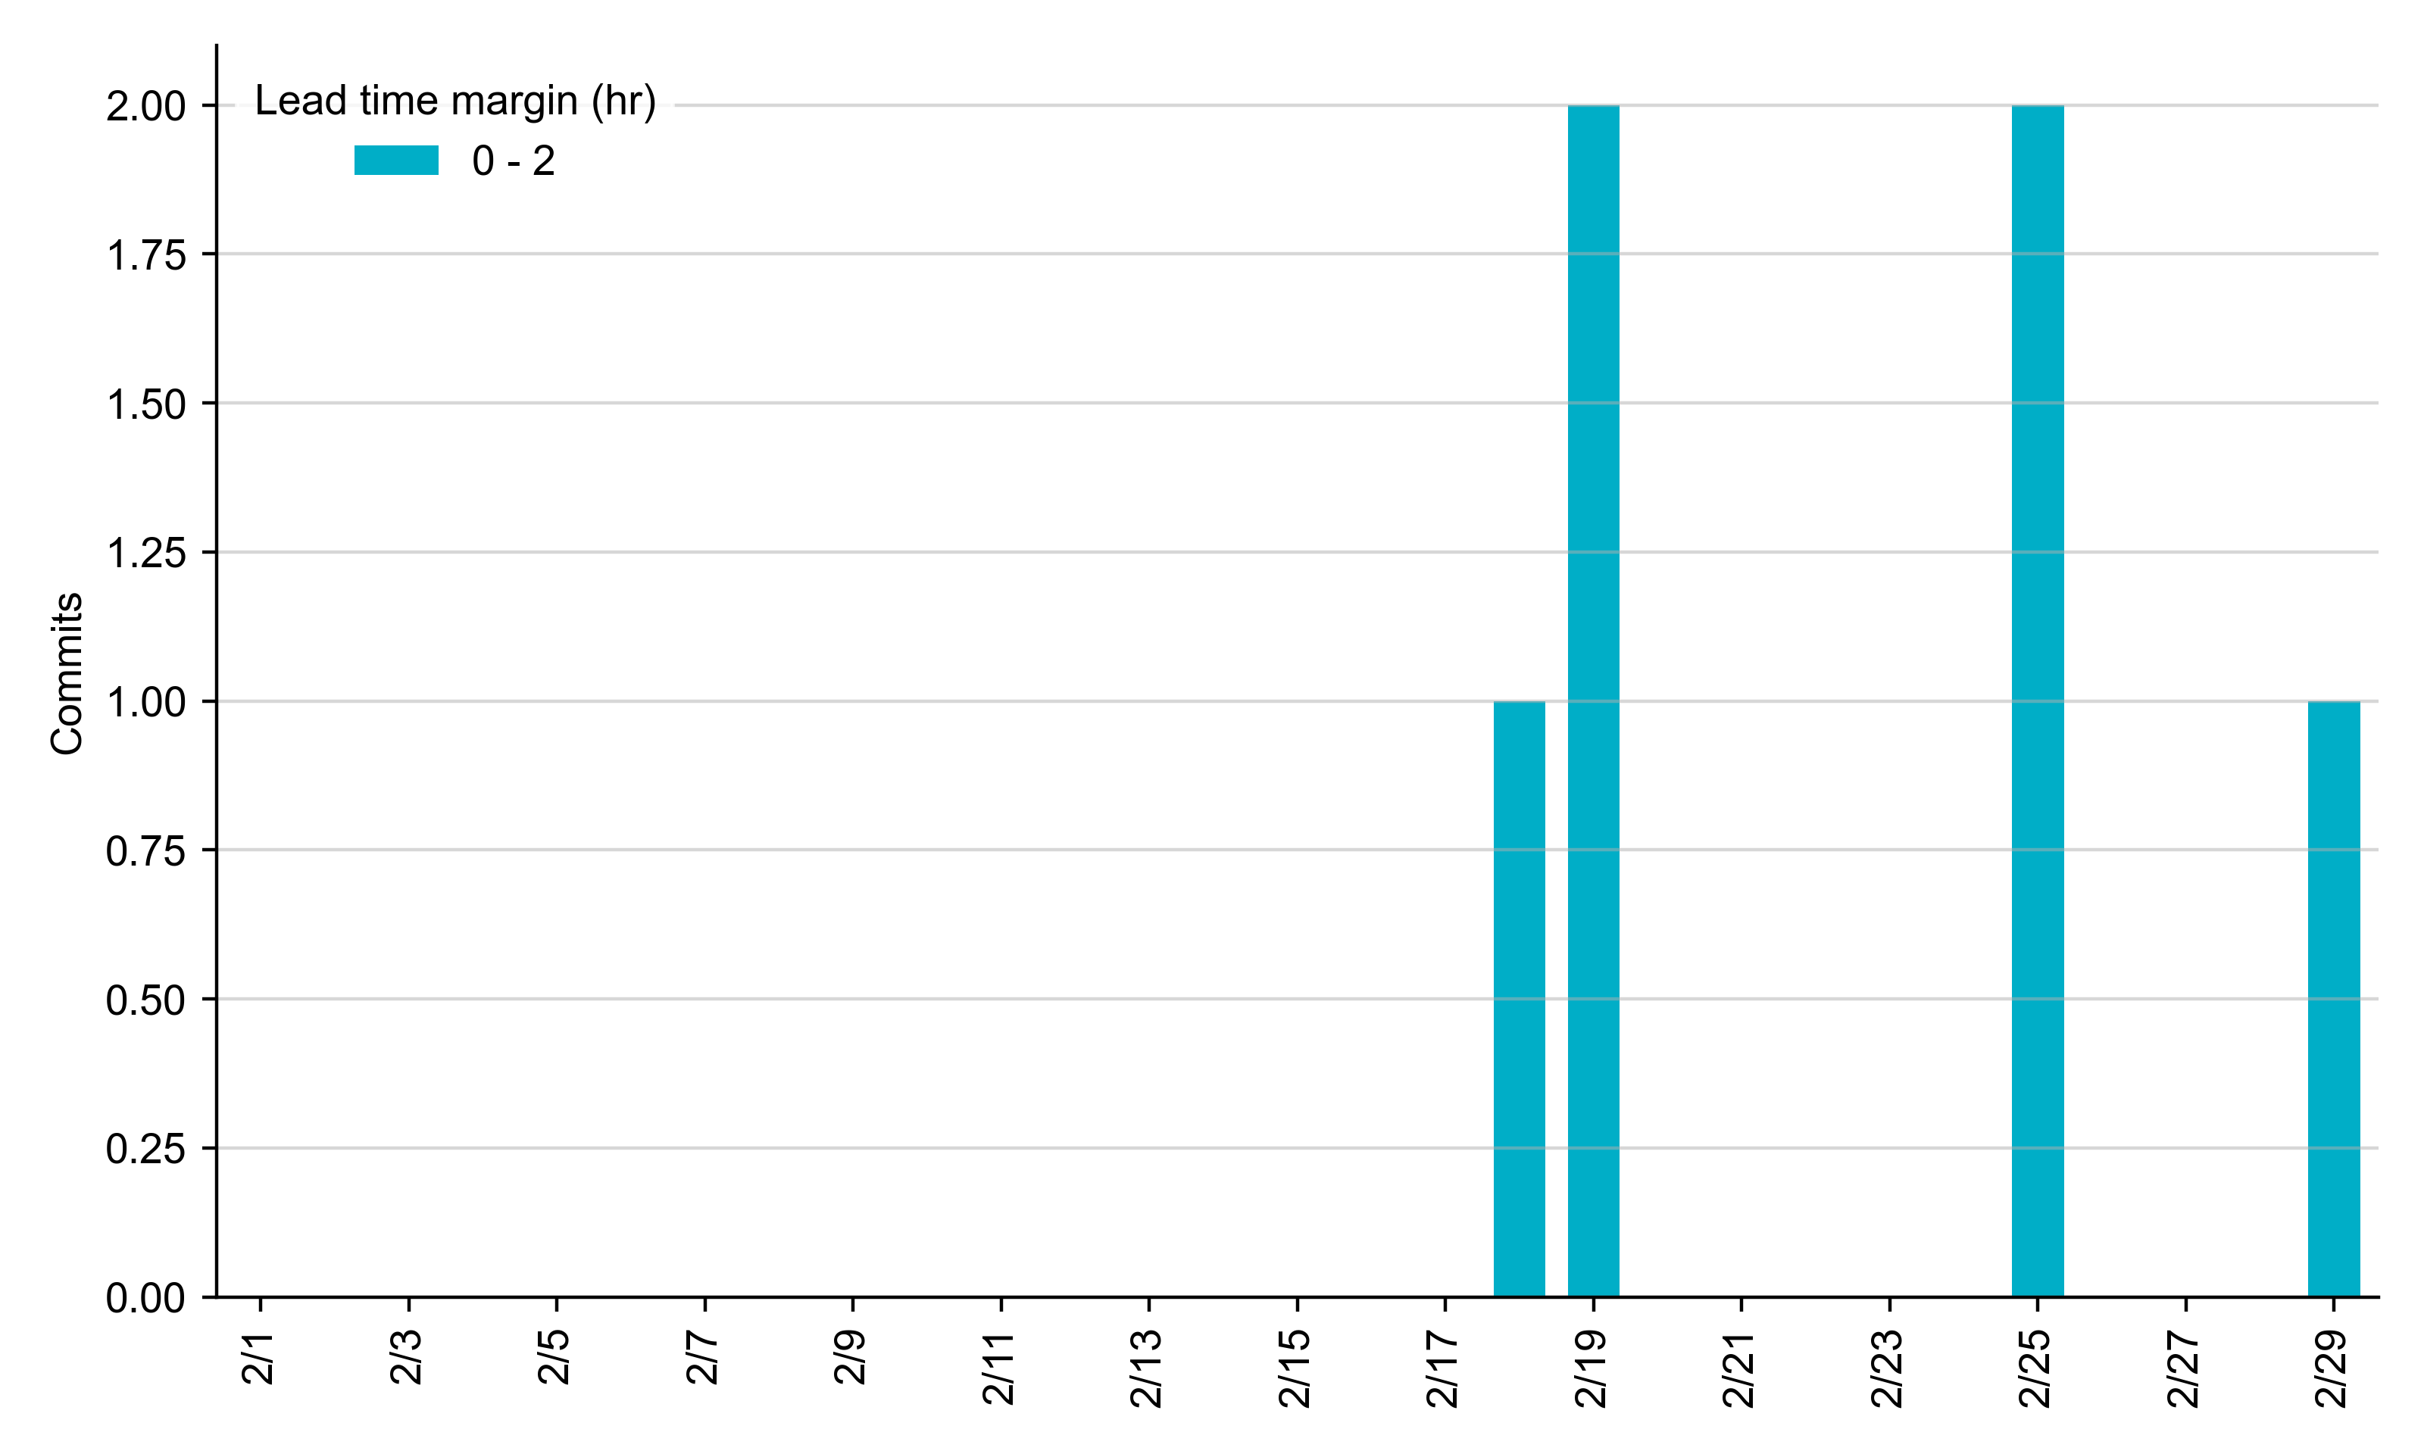
RUC Lead Time Margin: February 2024
All RUC commit windows had lead time margin at or below 2 hours.
Lead time refers to the length of time between a RUC instruction and the start of the commitment window.
Lead time margin is the difference between lead time and the Resource’s startup time.
In cases where a Resource is committed for multiple back-to-back time blocks, lead time margin is calculated from the first instruction.
Notes:
The first bin is both-inclusive (i.e. [0, 2] ), while subsequent bins are left-inclusive (i.e. [2, 3), [3, 4), etc.).

Slide 8
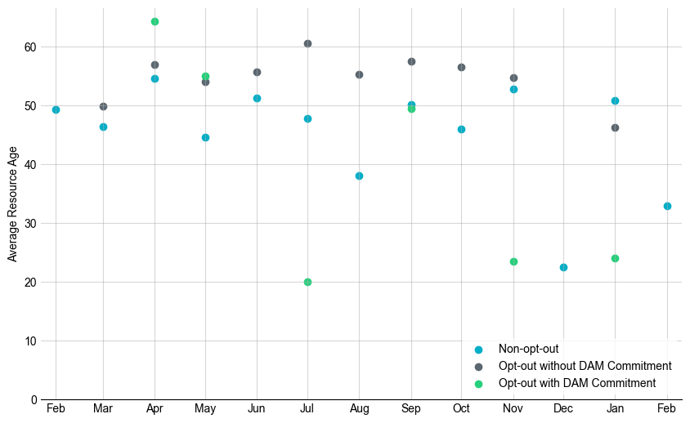
Average Resource Age: Last 13 Months
In February 2024, the average age of RUC-committed Resources was 32.9 years for non-opt-out Resource-hours and there no opt-out Resource-hours with or without DAM Commitments.
Note: For Resource configurations with multiple physical generators, the age of the oldest generator is used.

Slide 9
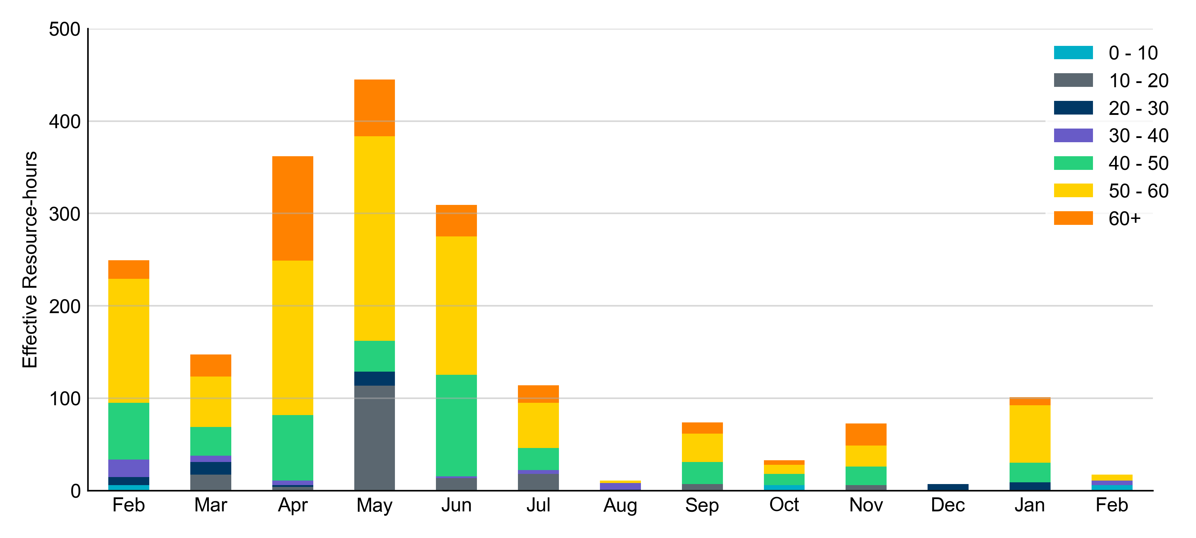
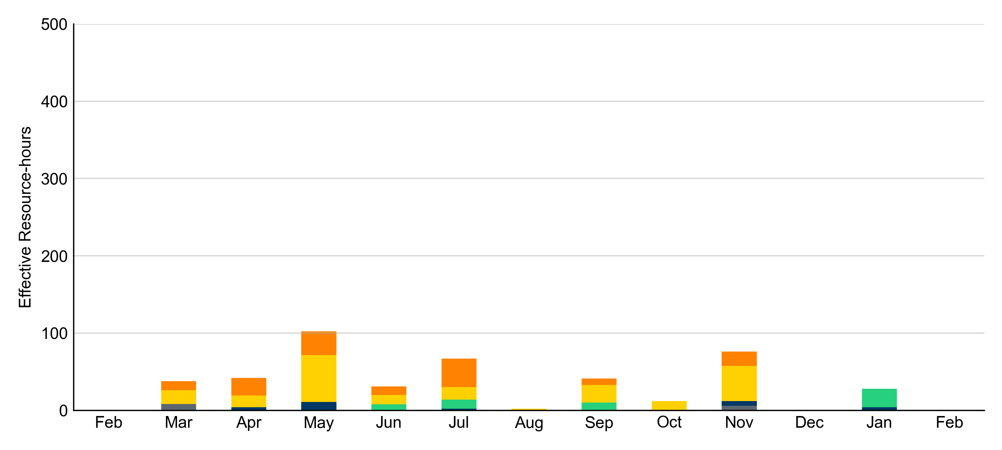
Age Category: Last 13 Months
Most RUC-Committed Resources in February 2024 were older than 50 years.
Non-opt-out
Opt-out

Slide 10
RUC-Instructed Resource Dispatch above LDL
February 2024
There were 2.9 effective Resource-hours in which Resources that did not successfully opt out were dispatched above their LDL in February 2024.
  For all these Resource-hours, the LMP for the RUC-instructed Resource was below the RUC offer floor.
    For all these Resource-hours, the RUC-instructed Resource was mitigated.
Additionally, there were no Exceptional Fuel Cost submissions for any RUC-Committed Resources in February 2024.

Slide 11
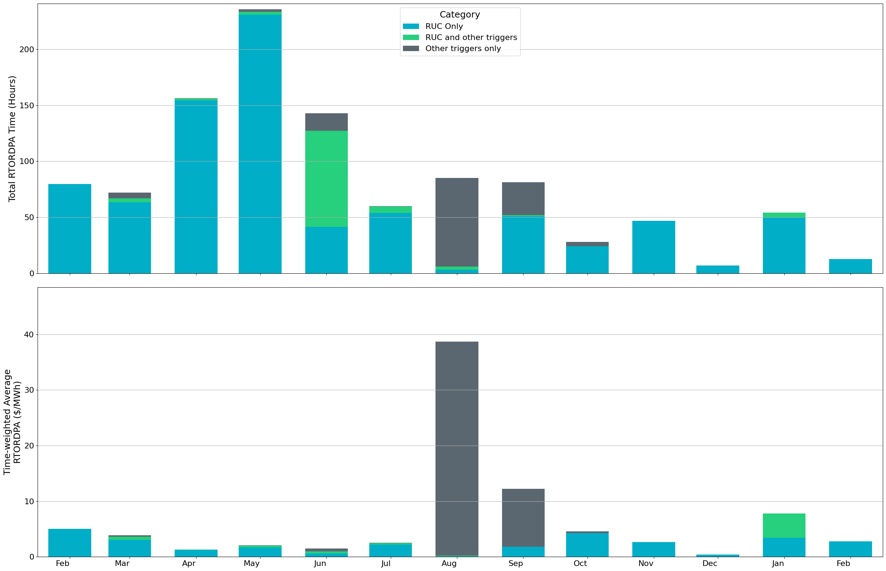
Reliability Deployment Price Adder: Last 13 Months
February 2024 had a total of 15.67 RTORDPA hours with an average value of $0.32/MWh.
These graphs show RTORDPA instances by reliability action: 'RUC Only' for instances triggered solely by Reliability Unit Commitment, 'RUC and other triggers' for instances with RUC and additional triggers, and 'Other triggers only' for instances with non-RUC triggers. The daily average RTORDPA is calculated using the total duration across all categories. See ERCOT protocol section 6.5.7.3.1 for details.

Slide 12
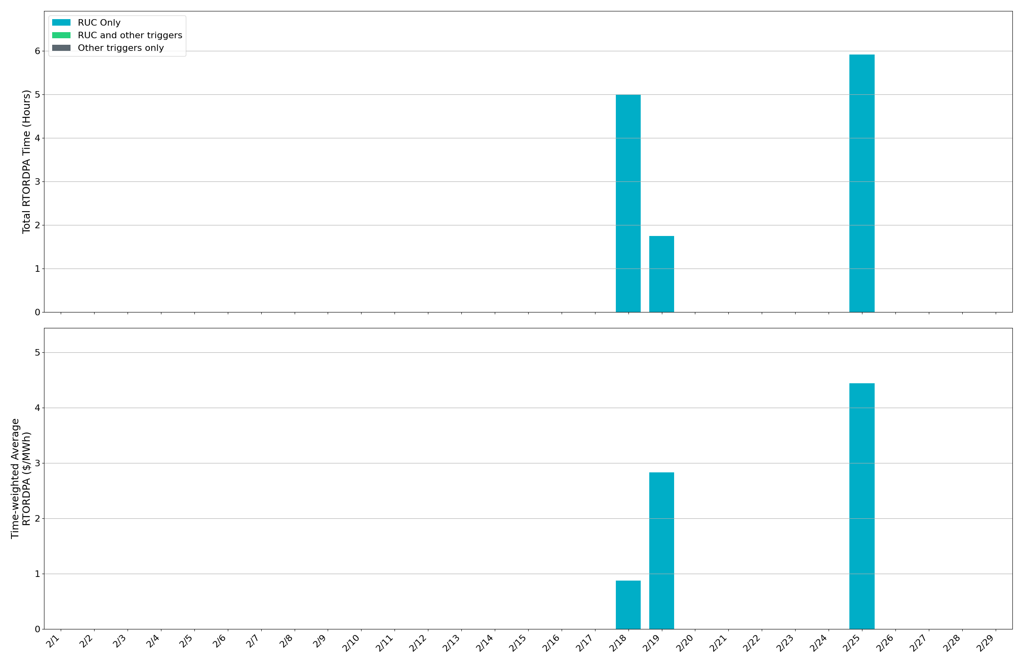
Reliability Deployment Price Adder: February 2024
OD 2/25 had the highest daily time-weighted average RTORDPA of $4.44/MWh.
These graphs show RTORDPA instances by reliability action: 'RUC Only' for instances triggered solely by Reliability Unit Commitment, 'RUC and other triggers' for instances with RUC and additional triggers, and 'Other triggers only' for instances with non-RUC triggers. The daily average RTORDPA is calculated using the total duration across all categories. See ERCOT protocol section 6.5.7.3.1 for details.

Slide 13
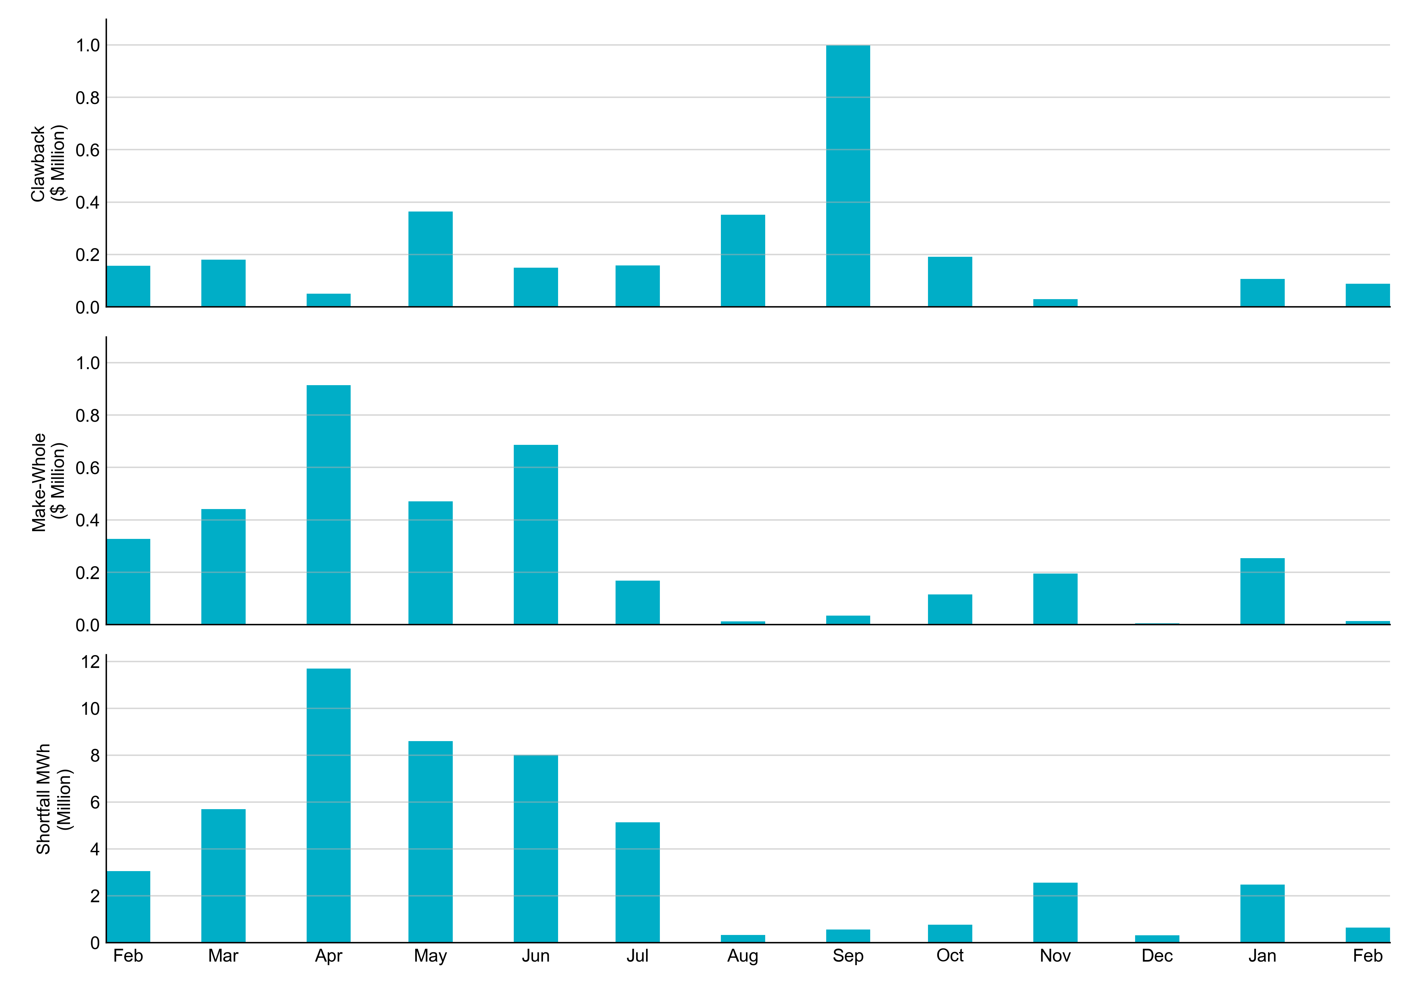
RUC Clawback, Make-Whole, and Shortfall
For February 2024, the total Clawback charge was $0.09M. The total Make-Whole payment was $0.01M, which was almost entirely covered through capacity-short charges.
Of the $0.01M million in Make-Whole payments made in February 2024, the majority was collected through Capacity Short Charges.
Data as of March 6^{h}, 2024

Slide 14
RUC Clawback by Settlement Type
Month | Initial Settlement ($) | Final Settlement Change ($) | True-up Settlement Change ($) | Net as of May 9, 2024 ($)
Feb ‘23 | 158,319 | 0 | -1,348 | 156,971
Mar ‘23 | 179,783 | 0 | - | 179,783
Apr ‘23 | 53,643 | 0 | -3,557 | 50,087
May ‘23 | 426,519 | 0 | -62,724 | 363,795
Jun ’23 | 149,347 | 0 | 0 | 149,347
Jul ‘23 | 218,907 | -60,841 | 0 | 158,066
Aug ‘23 | 352,002 | 0 | 0 | 352,002
Sep ‘23 | 997,843 | 0 | 0 | 997,843
Oct ‘23 | 190,721 | 0 | 0 | 190,721
Nov ‘23 | 29,684 | 0 | - | -
Dec ‘23 | 0 | 0 | - | -
Jan ‘24 | 107,176 | -4,657 | - | -
Feb ‘24 | 88,220 | - | - | -
Negative dollars represent a payment from ERCOT to a market participant
“-” indicates settlement has yet to be completed.
Net figures may differ slightly due to rounding.

Slide 15
RUC Make-Whole by Settlement Type
Month | Initial Settlement ($) | Final Settlement Change ($) | True-up Settlement Change ($) | Net as of May 9, 2024 ($)
Feb ‘23 | -295,131 | 0 | -31,972 | -327,103
Mar ‘23 | -343,491 | 0 | -97,889 | -441,379
Apr ‘23 | -687,506 | 0 | -226,976 | -914,482
May ‘23 | -426,974 | 0 | -43,426 | -470,400
Jun ‘23 | -600,652 | 0 | -86,170 | -686,821
Jul ‘23 | -161,994 | -4,996 | -855 | -167,845
Aug ‘23 | -12,090 | 0 | - | -12,090
Sep ‘23 | -35,168 | 0 | - | -35,168
Oct ‘23 | -72,477 | -43,063 | - | -115,541
Nov ‘23 | -194,731 | 0 | - | -
Dec ‘23 | -5,316 | 0 | - | -
Jan ‘24 | -253,468 | -79,942 | - | -
Feb ‘24 | -13,658 | 0 | - | -
Negative dollars represent a payment from ERCOT to a market participant
“-” indicates settlement has yet to be completed.
Net figures may differ slightly due to rounding.

