Slide 1

ERCOT CONE Study
Reference and Alternative Technology Selection
Prepared By
  The Brattle Group
  Sam Newell
  Andrew W. Thompson
  Rohan Janakiraman
  Sargent & Lundy
  Sang Gang
  Joshua Jungé
  Hyojin Lee
Prepared For
  ERCOT Supply Analysis Working Group
MARCH 22, 2024

Slide 2
Agenda
Selection of the Reference Technology
Selection of the Alternative Reference Technology
Project Timeline and Next Steps

Slide 3
Reference Technology

Slide 4
Purpose of Reference Technology Selection
Reference technology
Objective: describe a thermal dispatchable plant that is most likely to be developed in ERCOT in the next few years, as a basis for calculating a Cost of New Entry (CONE) metric useful for resource adequacy planning and market parameters
Approach: determine “revealed preference” by reviewing plants recently built and under development
Characteristics included
  Technology type, turbine model, plant size and configuration
  Typical practices for direct electrical interconnection, fuel infrastructure and supply (e.g., dual fuel or firm gas), power augmentation (e.g. turbine inlet air cooling technology), emissions controls, and weatherization

Slide 5
Proposed Specifications for Reference Technology
Reference technology

Slide 6
Technology Type and Turbine Model
Reference technology
Constructed our “Primary Thermal Dataset” of recently built and planned thermal dispatchable generation with actual or planned COD between 2021 to 2026:
  Data provided by WattBridge
  Cross-referenced against data from Hitachi ABB Velocity Suite, ERCOT CDR report, Texas Commission on Environmental Quality
  Excluded small cogeneration or internal combustion generation plants
This resulted in 14 generators which were all natural gas-fired plants with a total nameplate capacity of 5.1 GW, 98% of capacity is from GE LM6000 aeroderivative combustion turbines
Thermal Dispatchable Generation in ERCOT (COD 2021 – 2026)
Notes and Sources: [1] to [14]:
Confidential data provided by ERCOT staff.
Hitachi ABB Velocity Suite, Generating Unit Capacity Dataset, January 22, 2024.
ERCOT, Report on the Capacity, Demand, and Reserves in the ERCOT region (2024-2033), December 8, 2023.
Texas Commission on Environmental Quality, Issued Air Permits for Gas Turbines 20 MW or Greater, July 1, 2023.

Slide 7
Configuration and Nameplate Capacity
Reference technology
WattBridge is the developer with most of the recently built and planned thermal dispatchable capacity, which all use the same turnkey natural gas-fired plant design (PROENERGY LM6000PC with SPRINT)
Filtered Primary Thermal Dataset for planned plants by WattBridge to determine most representative configuration and plant capacity resulting in 5 plants (2.1 GW capacity)
Gas-fired plants tend to be built with even-number units, so we selected a 8 x 0 configuration resulting in nameplate capacity of 484 MW based on the average number of units of planned WattBridge plants and Sargent & Lundy experience
Planned Thermal Dispatchable Generation in ERCOT by WattBridge
(COD 2023 – 2026)
Notes and Sources: [1] to [5]:
Confidential data provided by ERCOT staff.
Hitachi ABB Velocity Suite, Generating Unit Capacity Dataset, January 22, 2024.
ERCOT, Report on the Capacity, Demand, and Reserves in the ERCOT region (2024-2033), December 8, 2023.
Texas Commission on Environmental Quality, Issued Air Permits for Gas Turbines with Electric Output 20 MW or Greater, July 1, 2023.

Slide 8
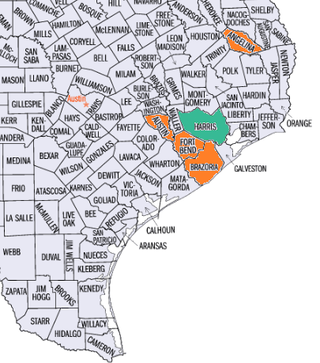
Location
Reference technology
Locations of Planned Thermal Dispatchable Gas Capacity in ERCOT (COD 2023-2026)
All of the planned gas-fired plants are located in 5 counties in Southeast Texas
51% of planned natural gas generation capacity is in Harris County (highlighted in green), so Harris county was selected as the location
Sources: Confidential data provided by ERCOT staff; Hitachi ABB Velocity Suite, Generating Unit Capacity Dataset, January 22, 2024; ERCOT, Report on the Capacity, Demand, and Reserves in the ERCOT region (2024-2033), December 8, 2023; Texas Commission on Environmental Quality, Issued Air Permits for Gas Turbines with Electric Output 20 MW or Greater, July 2, 2023.

Slide 9
Alternative Reference Technology

Slide 10
Purpose of Alternative Technology Selection
Alternative Reference technology
Objective: describe a dispatchable renewable plant that is most likely to developed in ERCOT in the next few years as a basis for sensitivity analysis of the Cost of New Entry (CONE) reliability metric
Approach: again use “revealed preference” based on developers’ actual plants/plans
Characteristics to include:
  Generator technology type and size
  Storage technology type, size, and duration
  Location of a representative plant
  Typical engineering design for power coupling, DC / AC ratio, battery chemistry and battery augmentation schedule

Slide 11
Proposed Specifications for Alternative Reference Technology
Alternative Reference technology

Slide 12
Alternative Reference Technology
ALTERNATIVE Reference technology
Created “Primary Solar Hybrid Dataset” by filtering ERCOT January 2024 GIS Report and confidential duration data provided by ERCOT staff (70 plants and 20 GW of capacity), considering plants:
  with a COD between 2021-2026
  excluded those without storage
  separated those with and without a signed Interconnection Agreement
Solar hybrid and standalone storage are both prevalent
Solar hybrid was selected because it is dispatchable and produces primary energy
Comparison of Existing or Planned Storage and Generator Capacities for Hybrid and Standalone Storage Plants in ERCOT (COD 2021 – 2026)
Notes and Sources: IA = Interconnection Agreement.
[1] to [4]:
Confidential data provided by ERCOT staff;
ERCOT, January 2024 Generator Interconnection Status (GIS) Report, February 12, 2024.

Slide 13
PV Capacity
ALTERNATIVE Reference technology
Planned ERCOT Solar Generation Capacity and Solar Hybrid Plants Size Distribution (COD 2023-2026)
Filtered the Primary Solar Hybrid Dataset for only planned plants with a signed Interconnection Agreement (IA) which resulted in 55 plants total (16 GW)
The histogram on the right displays the number of plants (teal, right axis) and solar generation portion of capacity (blue, left axis) for the planned solar hybrid plants and shows grouping around 200 MW, the median generator size is 204 MW
Based on the distribution of solar generator sizes, we selected 200 MW to be the representative solar capacity
Solar Generator Capacity (MW)
Number of Plants
Generator Size Bin (MW)
Sources:
Confidential data provided by ERCOT staff;
ERCOT, January 2024 GIS Report, February 12, 2024.

Slide 14
PV Module Technology and Tracking System
ALTERNATIVE Reference technology
PV Technology Characteristics of Existing or Planned Solar Hybrid Plants (COD 2021-2026)
Cross referenced the Primary Solar Hybrid Dataset (70 plants) with confidential solar project data prepared by UL Solutions for ERCOT, which resulted in 29 solar hybrid plants (7.8 GW of capacity) that overlapped between the two datasets
Based on these 29 solar hybrid plants, 58% of solar hybrid capacity has monocrystalline solar panels, 54% has bifacial solar panels, and 74% has a single-axis tracking system
Additionally, Sargent & Lundy reviewed their extensive project database and public sources (Form EIA-860) for ERCOT solar hybrid projects which confirmed our analysis, so we selected a PV system with monocrystalline and bifacial solar panels with a single-axis tracking system
Notes and Sources: Confidential data provided by ERCOT staff; ERCOT, January 2024 GIS Report, February 12, 2024.

Slide 15
Storage Technology, Storage Capacity, and Duration
ALTERNATIVE Reference technology
From our Primary Solar Hybrid Dataset (70 plants total), all storage systems were lithium-ion and the median duration and median storage-to-solar capacity ratio were 2-hours and 50%, therefore we selected a lithium-ion battery system with a 2-hour duration and 50% storage-to-solar capacity ratio
Based on the 200 MW PV generator size and the 50% storage-to-solar capacity ratio, we selected a 100 MW storage capacity
Storage Durations for Existing or Planned Solar Hybrid Plants vs. Standalone Storage in ERCOT (COD 2021 – 2026)
Notes and Sources: IA = Interconnection Agreement.
Confidential data provided by ERCOT staff;
ERCOT, January 2024 GIS Report, February 12, 2024.

Slide 16
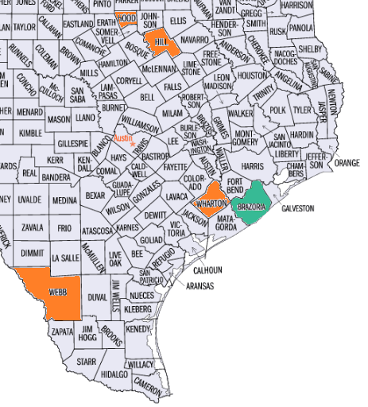
Location
ALTERNATIVE Reference technology
Locations of Planned Solar Hybrid Plants in ERCOT (COD 2023 – 2026)
Filtered the Primary Solar Hybrid Dataset for only planned plants which resulted in 55 plants total (16 GW)
37% (5.8 GW) of solar generator capacity is in the top 5 counties (see the highlighted counties in the map) and Brazoria County (in green) is the county with the most capacity and contains 12% (1.9 GW) of the total, so we selected Brazoria County as the reference location
Sources:
Confidential data provided by ERCOT staff;
ERCOT, January 2024 GIS Report, February 12, 2024.

Slide 17
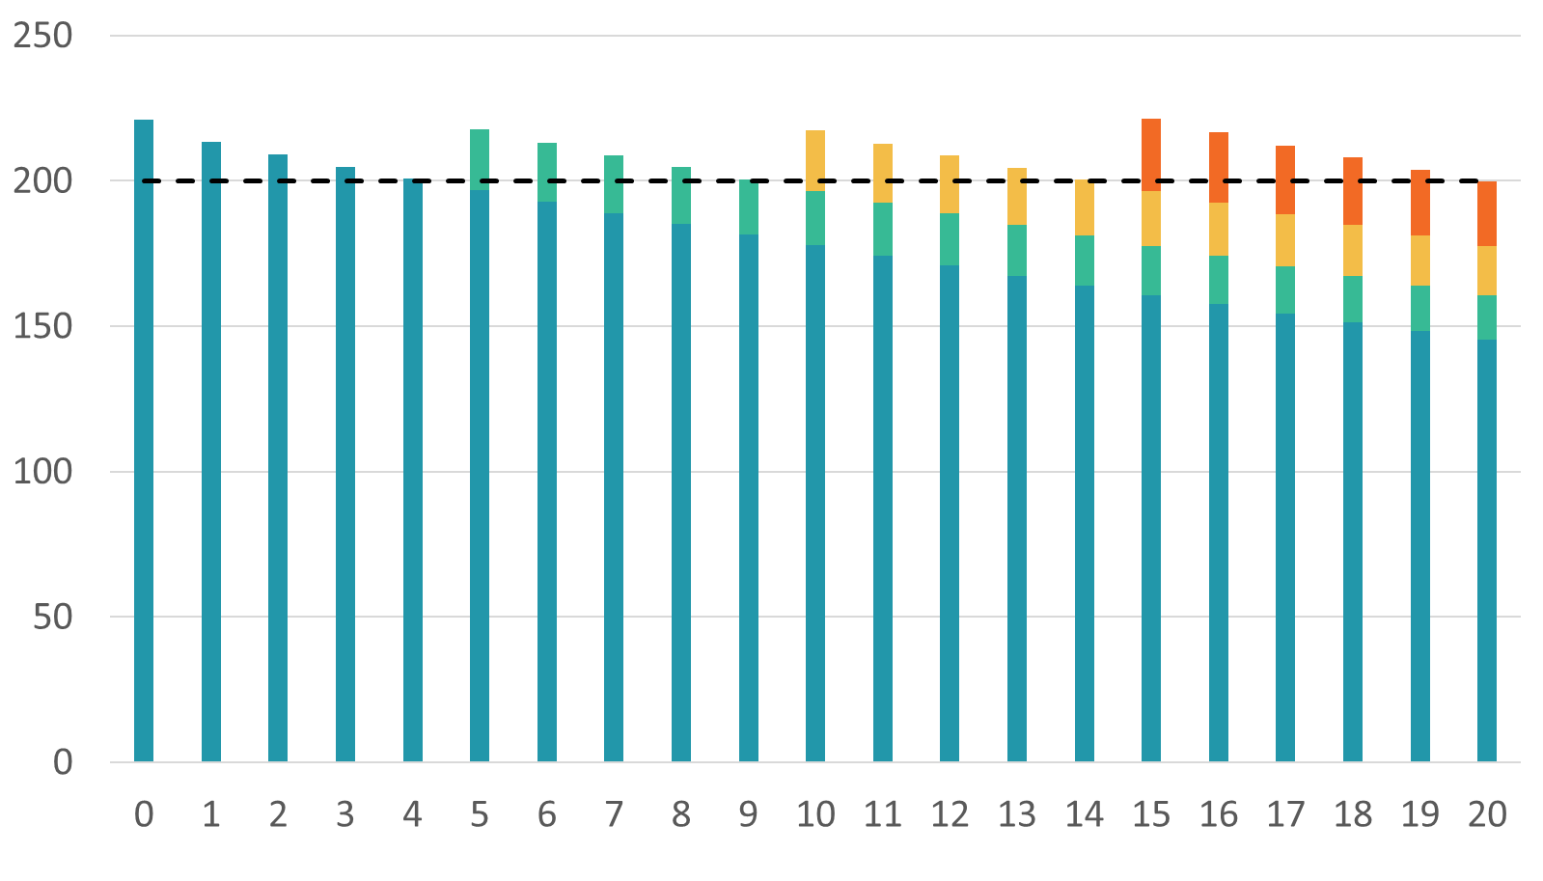
Storage Augmentation (1/2)
ALTERNATIVE Reference technology
Problem of battery degradation: Li-ion battery systems degrade due to time, usage, and environmental factors. This degradation impacts the capacity, duration, and efficiency of the storage system, so to maintain capabilities as sized for the interconnection and hybrid system (as well as contract and warranty terms) mitigation techniques are needed.
Storage augmentation: is a common practice for Li-ion storage systems which entails over-building a fixed percentage of design capacity and over-designing some system components (such as battery module rack space) to later enable battery modules to be added (augmented) during the project lifetime to offset degradation during normal system operations.
Illustrative Example of BESS Overbuild and Augmentation Approach
3rd Augmentation
Initial Overbuild
2nd Augmentation
1st Augmentation
Min Threshold
Initial Capacity
System Energy (MWh)
Year

Slide 18
Storage Augmentation (2/2)
ALTERNATIVE Reference technology
How augmentation frequency is determined: if the project’s financial plan includes augmentation, the frequency may depend on several factors including the project use case, battery degradation profile, capacity requirements of project agreements, site space availability constraints, and anticipated costs for batteries at the anticipated dates of augmentation.
How we selected the augmentation approach: the battery cycling and augmentation frequency we selected is based on a review of financial models from several similar PV+BESS installations and the median augmentation period. In ERCOT, solar hybrid plants are intended primarily for energy shifting. Based on our review, for this service we assumed on average one cycle per day for the battery storage component and predict annual degradation based on battery manufacturer warranty curves for the anticipated time and energy throughput. We selected an augmentation frequency of every 5 years with an initial overbuild to ensure the energy capacity exceeds the minimum required system output.
How this is included in CONE calculation: this is included as separate line items to i) fixed O&M cost based on an annualized cost of storage augmentation over the project lifetime and ii) CAPEX based on the additional balance of plant equipment (e.g., reserved rack space and conductors) included in the initial construction to accommodate future augmentation.

Slide 19
Timeline and Next Steps

Slide 20
Project Timeline

Slide 21
Next Steps
Develop Cost Estimates for Reference and Alternative Technologies
Determine Financial and Cost Escalation Parameters

