Slide 1
Discussion on Studies Related to Common Mode Failure Risk
ERCOT Staff

Slide 2
Let’s start at this slide…

Slide 3
Background and Introduction
ERCOT builds a 100mHz margin in the studies used to establish RRS requirements.
This margin helps in responding to differences between study setup/assumptions and Real Time that may affect response, such as:
Starting frequency in studies is 60 Hz but may be lower in Real Time,
Study models may not fully account for all of the non-linearities that may affect response in Real Time,
Some RRS-PFR resources may fail during an event, i.e. failing to perform or tripping.
This slide deck summarizes the GE’s recommended study on this issue and shares the complementary assessments ERCOT has conducted using GE’s methodology to derive a recommendation on maximum limit of RRS-PFR from any single resource.
GE recommends that by imposing a maximum limit on the amount of RRS-PFR from a single Resource, ERCOT may be able to mitigate the common mode risk associated with too much PFR from one unit and that unit failing.
To determine the maximum limit of RRS-PFR from any single resource, GE has recommended a study methodology that assesses the impact of PFR failure (common mode failure) on frequency nadir degradation for loss of 2,805 MW.

Slide 4
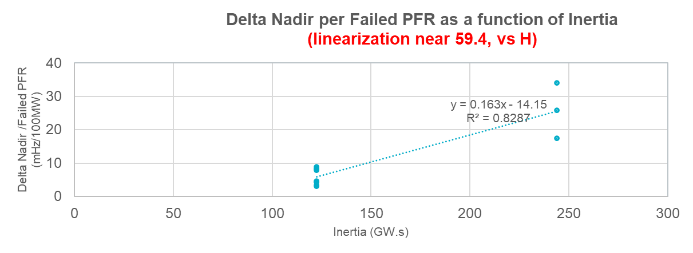
Summary of the GE Studies on PFR Failure
GE conducted a series of dynamic simulations to study the impact of PFR failure on the decline in frequency nadir during an event that is triggered by loss of 2,805 MW* of generation.
These studies were run under two inertia conditions, namely 122 GWs and 244 GWs.
For each inertia condition, the change in frequency nadir caused by X MW of PFR failure was recorded. In each failed PFR scenario that was assessed, a change in frequency nadir per 100 MW of failed PFR was computed.
GE Simulation Results for 122 GWs Case
 | Failed PFR (MW) | Delta Nadir (Hz) | Delta Nadir /Failed PFR (mHz/100MW)
S1 | 573 | 0.0444 | 7.7495
S2 | 700 | 0.0311 | 4.4529
… | … | … | …
S9 | 468 | 0.0381 | 8.1429
GE Simulation Results for 244 GWs Case
 | Failed PFR (MW) | Delta Nadir (Hz) | Delta Nadir /Failed PFR (mHz/100MW)
S1 | 300 | 0.0772 | 25.7309
S2 | 269 | 0.0913 | 33.9029
S3 | 300 | 0.0519 | 17.2900
Delta Nadir/Failed PFR (mHz/100MW) = 0.163*Inertia (GWs) - 14.15
*2,805 MW is ERCOT’s current Resource Loss Protection Criteria (RLPC) under NERC’s BAL-003

Slide 5
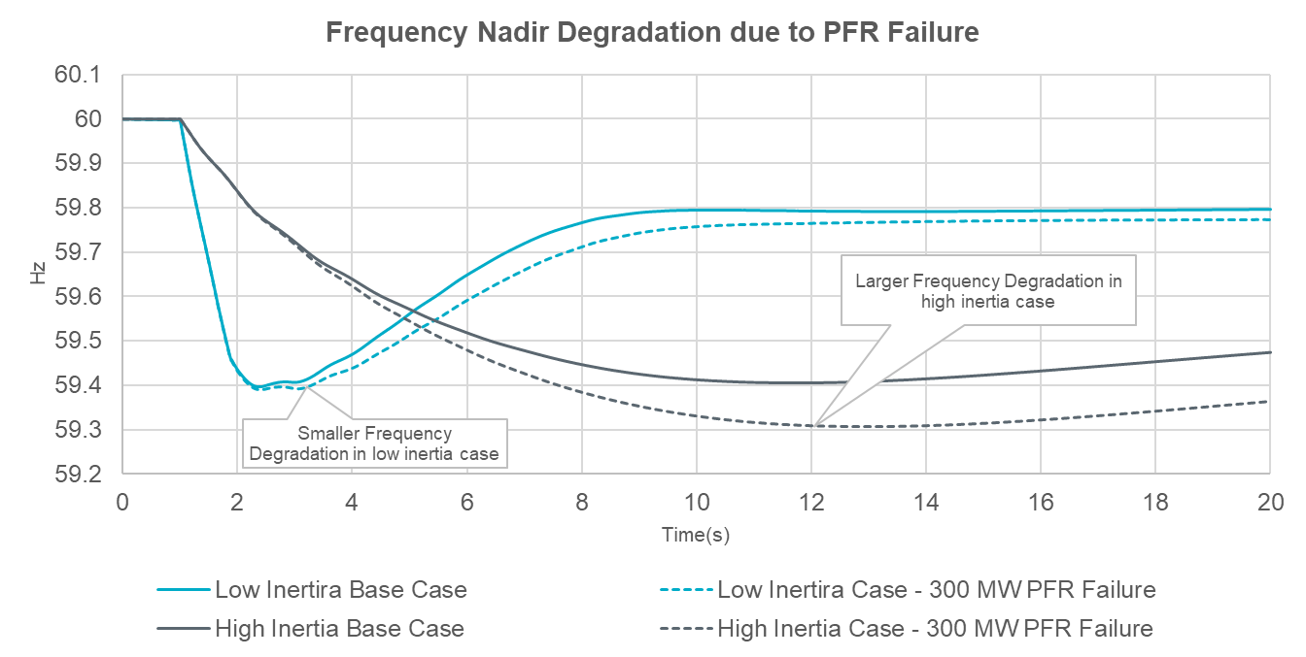
Frequency Sensitivity to PFR Failure
It is worth noting that these studies observed that the grid is more sensitive to PFR failure, per MW during higher inertia conditions. As inertia drops, the system needs more PFR to meet target of 59.4Hz nadir. Therefore, each MW of PFR has less impact.

Slide 6
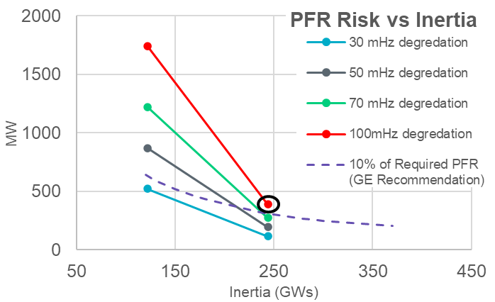
GE Studies on PFR Failure and RRS-PFR Limit
Delta Nadir/Failed PFR (mHz/100MW) =0.163*Inertia (GWs) -14.15
Inertia | PFR Failure (MW)
Inertia | 30mHz degradation | 50mHz degradation | 70mHz degradation | 100mHz degradation
122 GWs | 523 | 872 | 1220 | 1743
244 GWs | 117 | 195 | 273 | 390
= “When inertia is ~122 GW.s, in an event triggered by loss of 2,805 MW, a 523 MW PFR failure would result in 30mHz degradation in frequency.”
= “When inertia is ~244 GW.s, in an event triggered by loss of 2,805 MW, a 390 MW PFR failure would result in 100mHz degradation in frequency.”
To ensure that frequency degradation stays below 100mHz for PFR failure from a single resource, GE has suggested considering a limit that is equal to 10% of total PFR procured.

Slide 7
Thinking through GE’s Initial Recommendation further
In the suggested 10% approach, the maximum limit of RRS-PFR from a single Resources would vary dynamically with grid inertia conditions.
Based on the 2024 RRS quantities the limit change every hour and its value would range between 230 MW to 520 MW.
Based on 2023 inertia, a failed response from one resource providing 10% of total procured PFR would result in a frequency degradation of 50mHz or higher 79% of the time. ERCOT considers this to be a risk to reliability.
To implement a concept like this, changes will be needed to both ERCOT Market and Energy Management Systems.
Given the sensitivity of the issue and knowing that there will be some involved systems with changes, ERCOT conducted analysis to assess if the proposed study approach can be applied to derive a static RRS-PFR limit that can apply agnostic of grid inertia.
In the short term, a static RRS-PFR limit will be simpler to implement and monitor. ERCOT expects minimal system changes to implement this.
*Based on 2023 Inertia, the percentage of hours with different levels of frequency degradation was calculated.

Slide 8
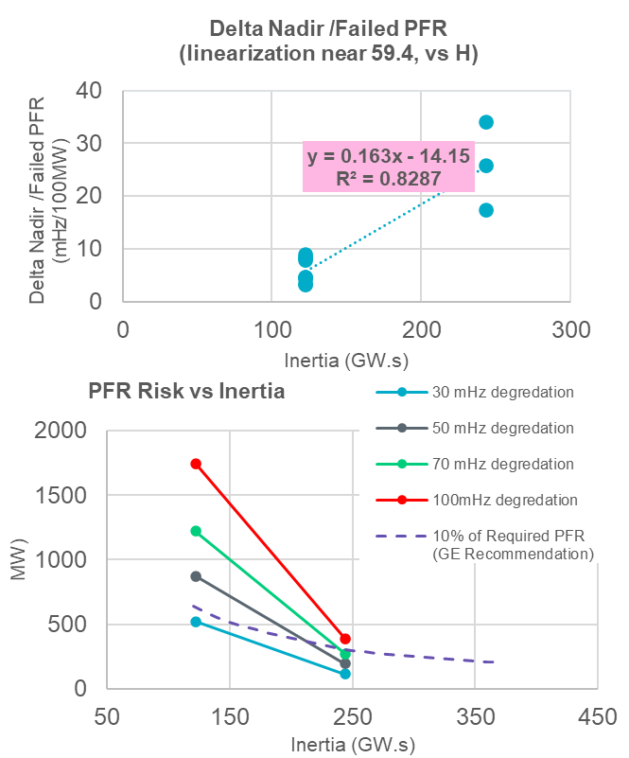
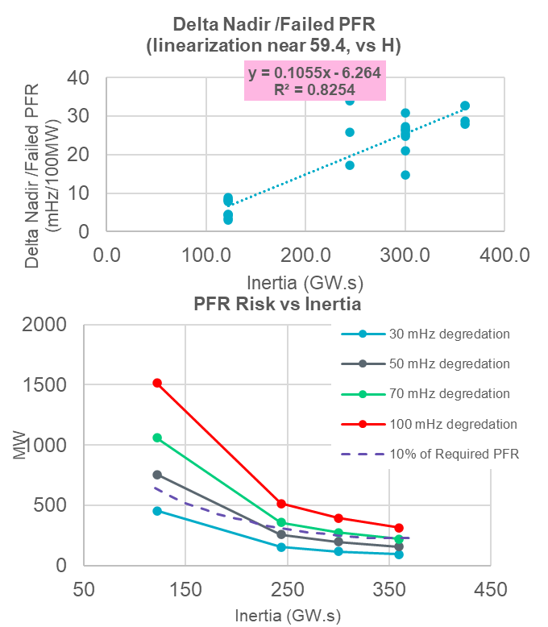
ERCOT’s complementary Studies on PFR Failure
The study was extended into two additional higher inertia conditions namely 300GWs and 360GWs.
ERCOT Study
(300 GWs, 360 GWs)

Slide 9
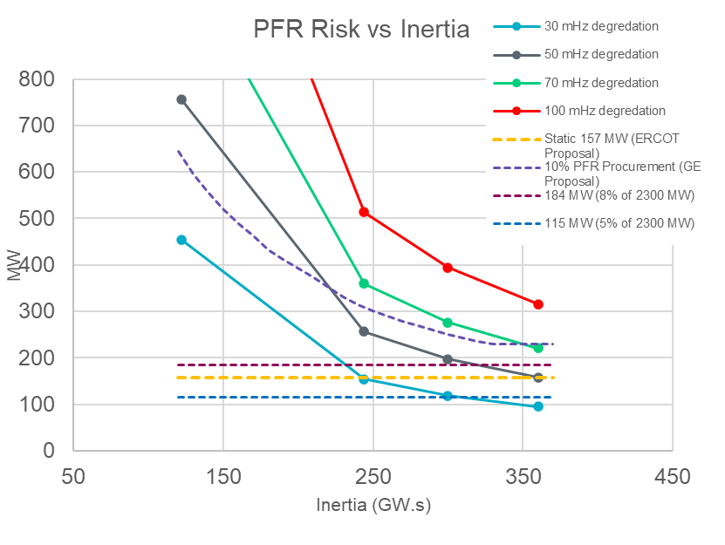
ERCOT’s complementary Studies on PFR Failure, Contd.
To derive a static RRS-PFR limit using the recommended GE study methodology, using the updated relationship between PFR failure and inertia, a value that will keep expected frequency degradation below 50mHz under all relevant inertia conditions was identified.
If the maximum RRS-PFR limit for a Resource is established at 157 MW, the frequency degradation risk associated with response failure from one resource, is expected to be below 50mHz.
*Based on 2023 Inertia, the percentage of hours with different levels of frequency degradation was calculated.

Slide 10
Trend in Real Time provision of RRS-PFR by a single Resource
The tables below show the trends hourly maximum RRS-PFR provided by a single Resource between 2020 and 2023 both system-wide and technology-specific.
For the purpose of this analysis, Combined Cycle Plants are treated as a single resource and hydro generating units that operate in RRS in synchronous condenser fast response mode are excluded.
Hourly Max – All units | 50th | 75th | 90th | 95th | Max
2020 | 120 | 125 | 153.01 | 180 | 180.1
2021 | 100 | 120 | 155 | 180 | 190
2022 | 100 | 100 | 112.6 | 125 | 180
2023 | 98 | 130 | 150 | 150 | 150
Hourly Max – CC* | 50th | 75th | 90th | 95th | Max
2020 | 120 | 125 | 153.01 | 180 | 180.1
2021 | 100 | 120 | 155 | 180 | 190
2022 | 47 | 77 | 110 | 125 | 180
2023 | 23 | 40 | 100 | 100 | 122
Hourly Max – (non-CC) Thermal | 50th | 75th | 90th | 95th | Max
2020 | 54 | 65.2 | 72 | 75 | 112.8
2021 | 72 | 85 | 100 | 100 | 143
2022 | 57.7 | 72 | 80 | 86 | 142
2023 | 50 | 75 | 90 | 100 | 143
Hourly Max – ESR | 50th | 75th | 90th | 95th | Max
2020 | 9.9 | 9.9 | 9.9 | 9.9 | 100
2021 | 20 | 98.8 | 100 | 100 | 101
2022 | 81.1 | 100 | 100 | 100 | 135.8
2023 | 95 | 130 | 150 | 150 | 150
Hourly Max – CLR | 50th | 75th | 90th | 95th | Max
2020 | 0 | 0 | 1.8 | 1.8 | 1.8
2021 | 18 | 45 | 84 | 90 | 90
2022 | 90 | 100 | 100 | 100 | 137.8
2023 | 18 | 64.9 | 80 | 85 | 85
*RRS responsibility from Combined Cycle Plants accounts for all units within a combine cycle train.

Slide 11
HSL Range of Potentially Impacted Resource
Are units potentially impacted by a limit of 157 MW on RRS-PFR?
Looking at data from 2021-2023 along with units in the commissioning queue the table below shows:
Some conventional resources in operations today may be impacted with no impact for those in the queue.
Some impact for ESRs that are operational today, but very many that are in the queue.
Resource Type | Currently Operating | In the queue
CC | 820 MW-1317MW (9 resources) | No Impact
Non-CC Thermal | 820 MW-857MW (7 resource) | No Impact
ESR | 190 MW-220 MW (3 resources) | 164 MW-510 MW (45 resources)
*considering 5% droop for conventional and 1% droop for ESRs

Slide 12
Summary and Recommendation from this analysis
By imposing a maximum limit on the amount of RRS-PFR from a single Resource, ERCOT may be able to mitigate the common mode risk associated with lack of response during an event.
The concept of a dynamic RRS-PFR limit based on estimated inertia is likely better applied after the implementation of the Real Time Co-optimization (RTC) project, wherein Ancillary Services will be awarded in Real Time. ERCOT recommends revisiting whether a dynamic approach can be used to limit maximum RRS-PFR awarded to a single Resource after RTC is implemented.
ERCOT recommends initially establishing a static limit on the maximum RRS-PFR a single resource can provide. A static RRS-PFR limit value should be selected such that the expected frequency degradation stays below 50mHz.
A static RRS-PFR limit will be simpler to implement and monitor in the short term. There will be minimal system changes involved.
Using a 50mHz threshold allows the remaining 50mHz margin to be available to cover other issues that may occur simultaneously in Real Time.
Based on the studies conducted, ERCOT recommends initially establishing 157 MW as the static limit on the maximum amount of RRS-PFR a single Resource can provide.
ERCOT will revisit these studies periodically to identify if any changes can be made to the static RRS-PFR limit value.

Slide 13
Discussion

Slide 14
Study Setup
For each inertia case
Step1: For each inertia case, Turn on enough governors to establish a base scenario where system frequency nadir is around 59.4Hz for loss of 2805 MW Gen.
Step2: Start to disable selected number of governors to mimic a scenario of X MW PFR failure.
Step3: Record frequency nadir in each scenario for loss of 2805 MW Gen.
Step4: Calculate Frequency nadir change per 100 MW PFR failure.
Step5: Continue the above process for more cases with different inertia.
Step6: Perform linear regression between inertia and frequency nadir change per 100 MW PFR failure.
Step7: Establish boundaries of PFR failure MW with predefine frequency nadir degradation levels.
300 GWs
 | Nadir | Delta Nadir | Failed PFR (MW) | Delta Nadir/ Failed PFR (mHz/100MW)
S1 | 59.3990 | 0.0148 | 100 | 14.7662
S2 | 59.3717 | 0.0421 | 200 | 21.0442
S3 | 59.3377 | 0.0760 | 300 | 25.3393
S4 | 59.3092 | 0.1046 | 400 | 26.1430
S5 | 59.2803 | 0.1335 | 500 | 26.7005
S6 | 59.2654 | 0.1484 | 600 | 24.7270
S7 | 59.2228 | 0.1909 | 700 | 27.2748
s8 | 59.1216 | 0.2921 | 950 | 30.7500
360 GWs
 | Nadir | Delta Nadir | Failed PFR (MW) | Delta Nadir/ Failed PFR (mHz/100MW)
s1 | 59.3769 | 0.0278 | 100 | 27.8152
s2 | 59.3471 | 0.0576 | 200 | 28.7940
s3 | 59.3063 | 0.0983 | 300 | 32.7742
s4 | 59.2741 | 0.1306 | 400 | 32.6521
Notes:
Include 122 GWs

