Slide 1
ESR AS Telemetry Update
ERCOT Staff
March 20, 2024

Slide 2
Overview
February 1st ERCOT enabled logic to consume update ESR AS Telemetry Changes
All up AS Responsibilities be carried first on the ESR-GR side of the ESR up till HSL and any remaining up AS Responsibility then be carried on the ESR-CLR side. Similarly, all the Regulation Down Responsibility be carried first on the ESR-CLR side of the ESR up till MPC and any remaining Regulation Down Responsibility then be carried on the ESR-GR side.
The telemetered Regulation Up and Regulation Down participation factors are expected to be updated based on Regulation deployment amounts for both ESR-GR and ESR-CLR so that ERCOT can compute expected Regulation deployment from both sides of the ESR.
Redline BPM Posted to the meeting page to cover latest update.
Additional Clarification needed for a few topics:
What is the expectation for ESR real time resource status (RST) telemetry when providing Regulation?
What should COP reflect for Resource Status when using dynamic Participation Factors (PF)

Slide 3
Treat Dual Model Telemetry as Single Model ESR
With these changes the telemetry setup for ESRs will become closer to the telemetry setup expected with single model ESR implementation.
All up AS Responsibilities be carried first on the ESR-GR side of the ESR up till HSL and any remaining up AS Responsibility then be carried on the ESR-CLR side.
Similarly, all the Regulation Down Responsibility be carried first on the ESR-CLR side of the ESR up till MPC and any remaining Regulation Down Responsibility then be carried on the ESR-GR side.
With this change, there is no need to transition the AS Responsibilities to the charging side as the ESR starts charging in response to a charging Base Point.
In case of Regulation, Regulation Up and Regulation Down participation factors can be used to indicate which side of the ESR is responding to the Regulation deployment.
ESR-HSL
ESR-GR
Up AS
0
ESR-CLR
Down AS
ESR-LSL

Slide 4
Resource Status in COP
Using the same base example of AS telemetry expectations.
COP should show Regulation UP on the ESR-GR and Regulation Down on the ESR-CLR regardless of how its being provided in real time across the ESR.
ESR-HSL
ESR-GR
Up AS
0
ESR-CLR
Down AS
ESR-LSL

Slide 5
Example 1 – 50 MW RegUp and 50 MW RegDown
In this example the ESR has enough room to carry the Regulation AS responsibility without any overflow. i.e., RegUp on Gen and RegDown on CLR.
GR-HSL = 100
GR-REGUP-Responsibility (RGURS) = 50 MW
GR-REGDOWN-Responsibility (RGDRS) = 0
CLR-REGUP-Responsibility (RGURS) = 0
CLR-REGDOWN-Responsibility (RGDRS) = 50 MW
CLR-MPC = 100
In this scenario, since both sides are telemetering regulation responsibility the ESR-GR and ESR-CLR will need to be in a valid regulation resource status of (ONREG, ONRGL, ONFFRRRS) regardless of the Participation Factor (PF).
HSL = 100
RGURS=50
HASL = 50
ESR-GR
RGDRS=0
0
RGURS=0
HASL = 50
ESR-CLR
RGDRS = 50
MPC = 100

Slide 6
Example 2 – 50 MW RegUp and 0 MW RegDown
In this example the ESR has enough room to carry the Regulation AS responsibility without any overflow. i.e., RegUp on Gen and RegDown on CLR.
GR-HSL = 100
GR-REGUP-Responsibility (RGURS) = 50 MW
CLR-REGUP-Responsibility (RGURS) = 0
CLR-MPC = 100
In this scenario, ONLY the ESR-GR is telemetering regulation responsibility, so the ESR-GR must be in RST = ONREG while ESR-CLR can be ONCLR.
IF the ESR-CLR begins to charge which would cause the ESR-CLR Reg Up PF to be non-zero then the ESR-CLR would need to be in RST = ONRGL.
HSL = 100
RGURS=50
HASL = 50
ESR-GR
RGDRS=0
0
RGURS=0
ESR-CLR
RGDRS = 0
HASL = MPC =100

Slide 7
Example 3 – 0 MW RegUp and 50 MW RegDown
In this example the ESR has enough room to carry the Regulation AS responsibility without any overflow. i.e., RegUp on Gen and RegDown on CLR.
GR-HSL = 100
GR-REGUP-Responsibility (RGURS) = 50 MW
GR-REGDOWN-Responsibility (RGDRS) = 0
CLR-REGUP-Responsibility (RGURS) = 0
CLR-REGDOWN-Responsibility (RGDRS) = 50 MW
CLR-MPC = 100
In this scenario, ONLY the ESR-CLR is telemetering regulation responsibility, so the ESR-CLR must be in RST = ONRGL while ESR-GR can be ON.
IF the ESR-GR begins to discharge which would cause the ESR-GR Reg Down PF to be non-zero then the ESR-GR would need to be in RST = ONREG.
HSL = HASL = 100
RGURS=0
ESR-GR
RGDRS=0
0
RGURS=0
HASL = 50
ESR-CLR
RGDRS = 50
MPC = 100

Slide 8
Additional Detailed Example
Following slides will show an example discussing the use of dynamic participation factors during a regulation Up Deployment while maintaining Regulation Up Responsibility on the ESR-GR.
ESR Details:
ESR HSL/MPC = =/-100 MW
ESR-Regulation Up Responsibility = 80 MW
ESR-Regulation Down Responsibility = 0 MW
ESR-GR HASL = 20 MW
ESR-CLR HASL = -100MW
ESR-GR LASL = ESR-CLR LASL = 0 MW
ESR-GR BP = 0 MW
ESR-CLR BP = 0 MW to start but then changes to -30 MW then to -78MW
As the ESR-CLR UDBP begins to ramp to meet the new charging BPs the participation factors for the GR and CLR will adjust to represent the portion of regulation being provided by each side.
The Regulation Up Responsibility is not moved at any time.

Slide 9
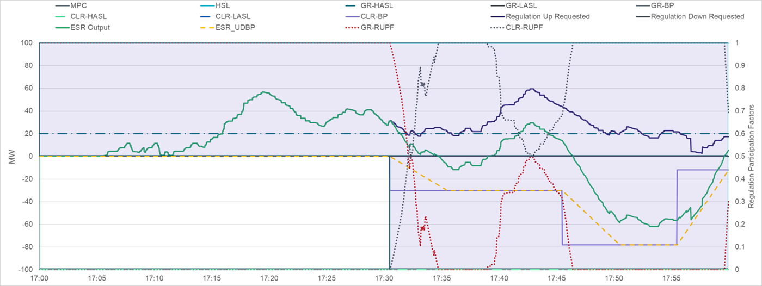
Additional Example
ESR-GR = Reg Up of 80 MW
ESR-CLR= Reg Down of 0 MW
Purple shading indicates when the ESR-GR and ESR-CLR will need to be in a regulation resource status based on participation factors.
Notes:
Regulation Responsibility on GR = 80 MW
Regulation Down on CLR = 22 MW

Slide 10
Questions?

