Slide 1
ERCOT Frequency Control Report
February 2024
ERCOT
Operations Planning
PDCWG | March 20, 2024

Slide 2
Summary of February 2024
CPS1: 174.21%
Current CPS1 12-Month Rolling Average: 175.05%
4 BAAL Exceedance(s)
1 hourly CPS1 score below 100%
BAAL-003 Events have updated through 2022
2022 BAAL-003 FRM Performance: -1060.40
2024 RMS1 Statistics
  Mean: 14.7 mHz
  Min: 11.97 mHz
  Max 19.16 mHz
Energy Statistics
  Total Energy: 30,761,552 MWh
  Wind Energy: 10,944,115 MWh
  Percent Energy from Wind: 35.58%
  Solar Energy: 2,646,220 MWh
  Percent Energy from Solar: 8.60%
Minimum System Inertia
  Mean: 173,614 MW*s
  Max: 241,450 MW*s on February 29th
  Min: 145,331 MW*s on February 25th

Slide 3
Frequency Control
CPS1, BAAL, & RMS1

Slide 4
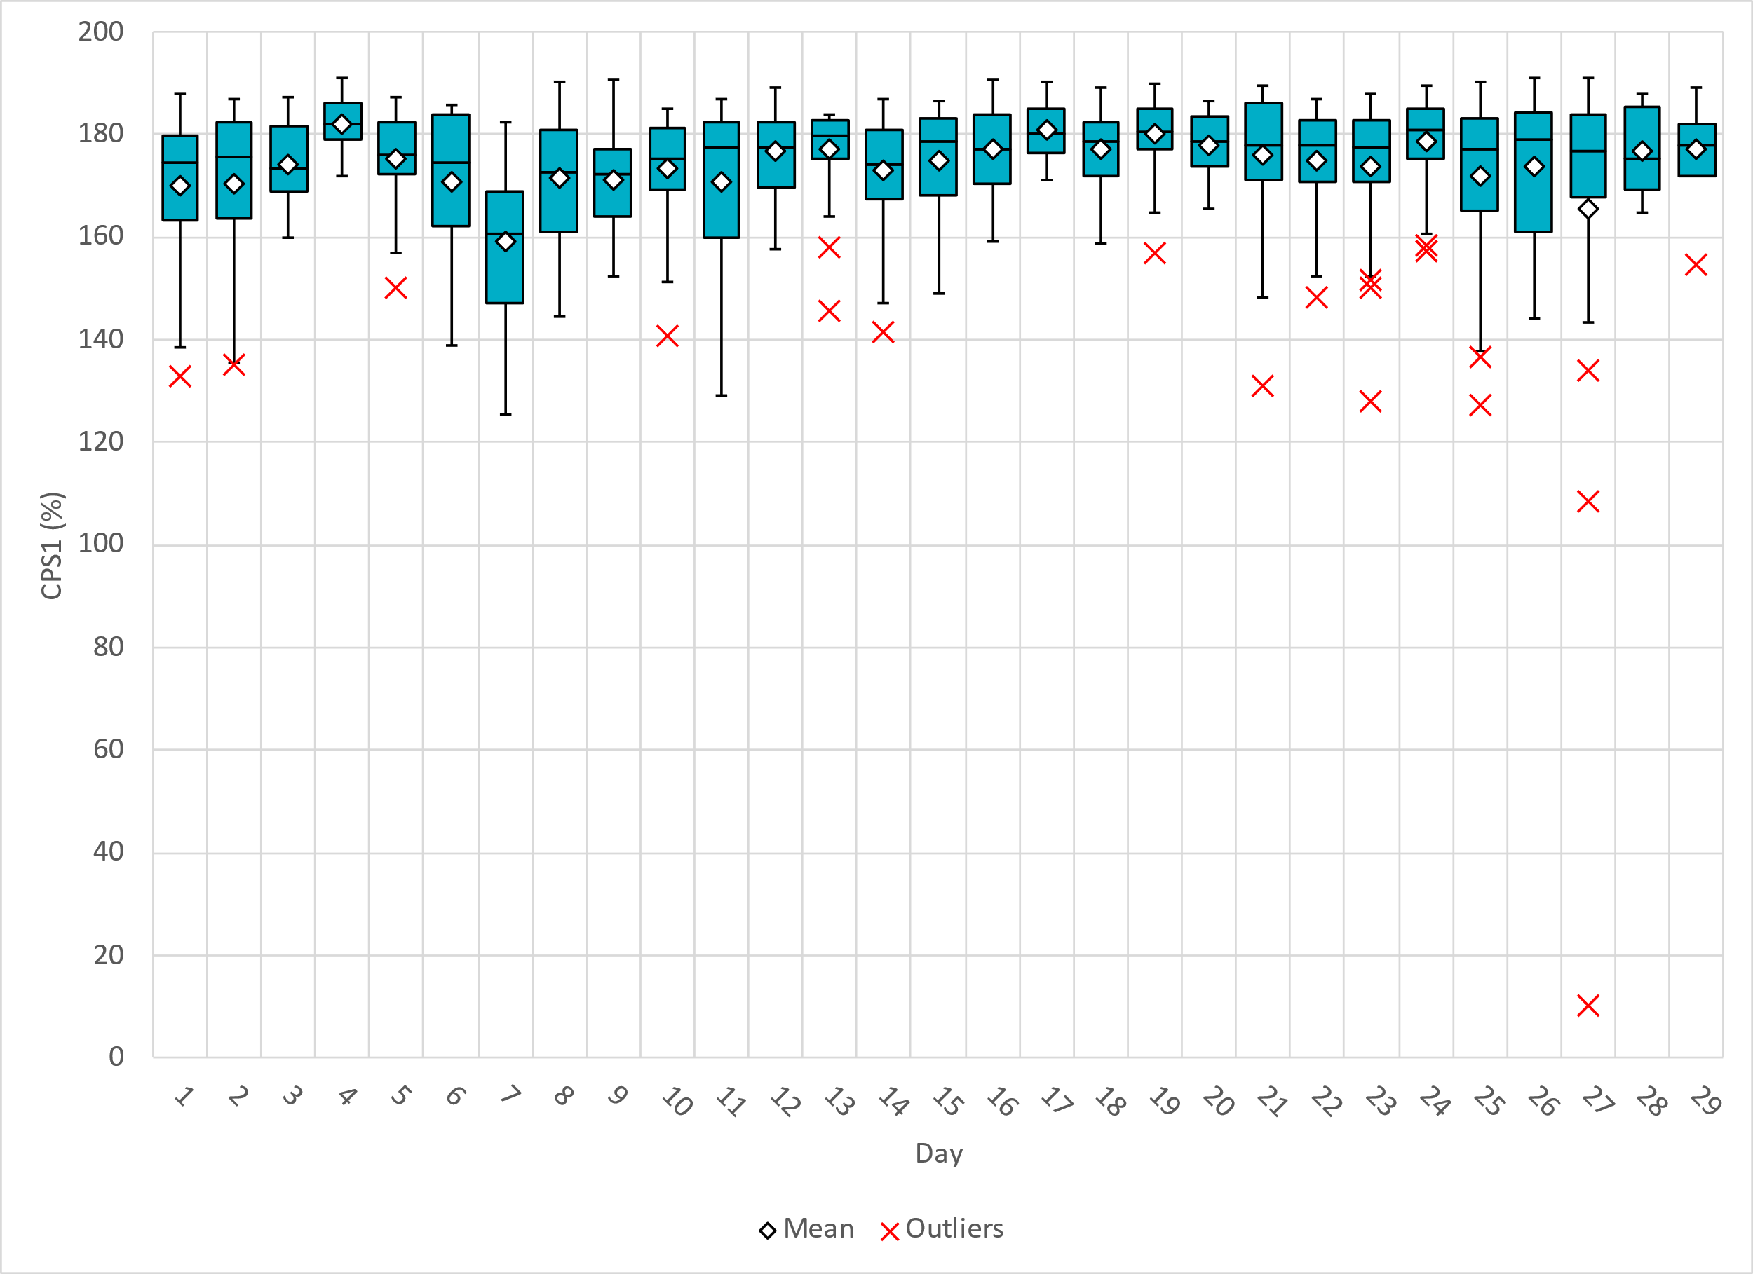
Hourly CPS1 by Day
Feb-24 CPS1 (%): 174.21
Notes:
Feb. CPS1 Score is 174.21%, there is one outlier below 100%. This took place on the 27th following a unit trip.

Slide 5
BAAL Exceedances & Violations
There were 4 BAAL exceedance(s) in February.
  4 on February 27th, 2024
    760 MW unit loss while frequency was below the lower dead band
    Large wind and solar ramp over-forecast error
Notes:
4 on February 27th
- 760 MW unit trip while frequency was below the low deadband.
- Leading into the trip the wind RR was overforecasted by 90MW/min
- 5 min RR forecast = 150 MW, actual RR -300
- Solar forecast RR was overforecasted by 120 MW/min

Slide 6
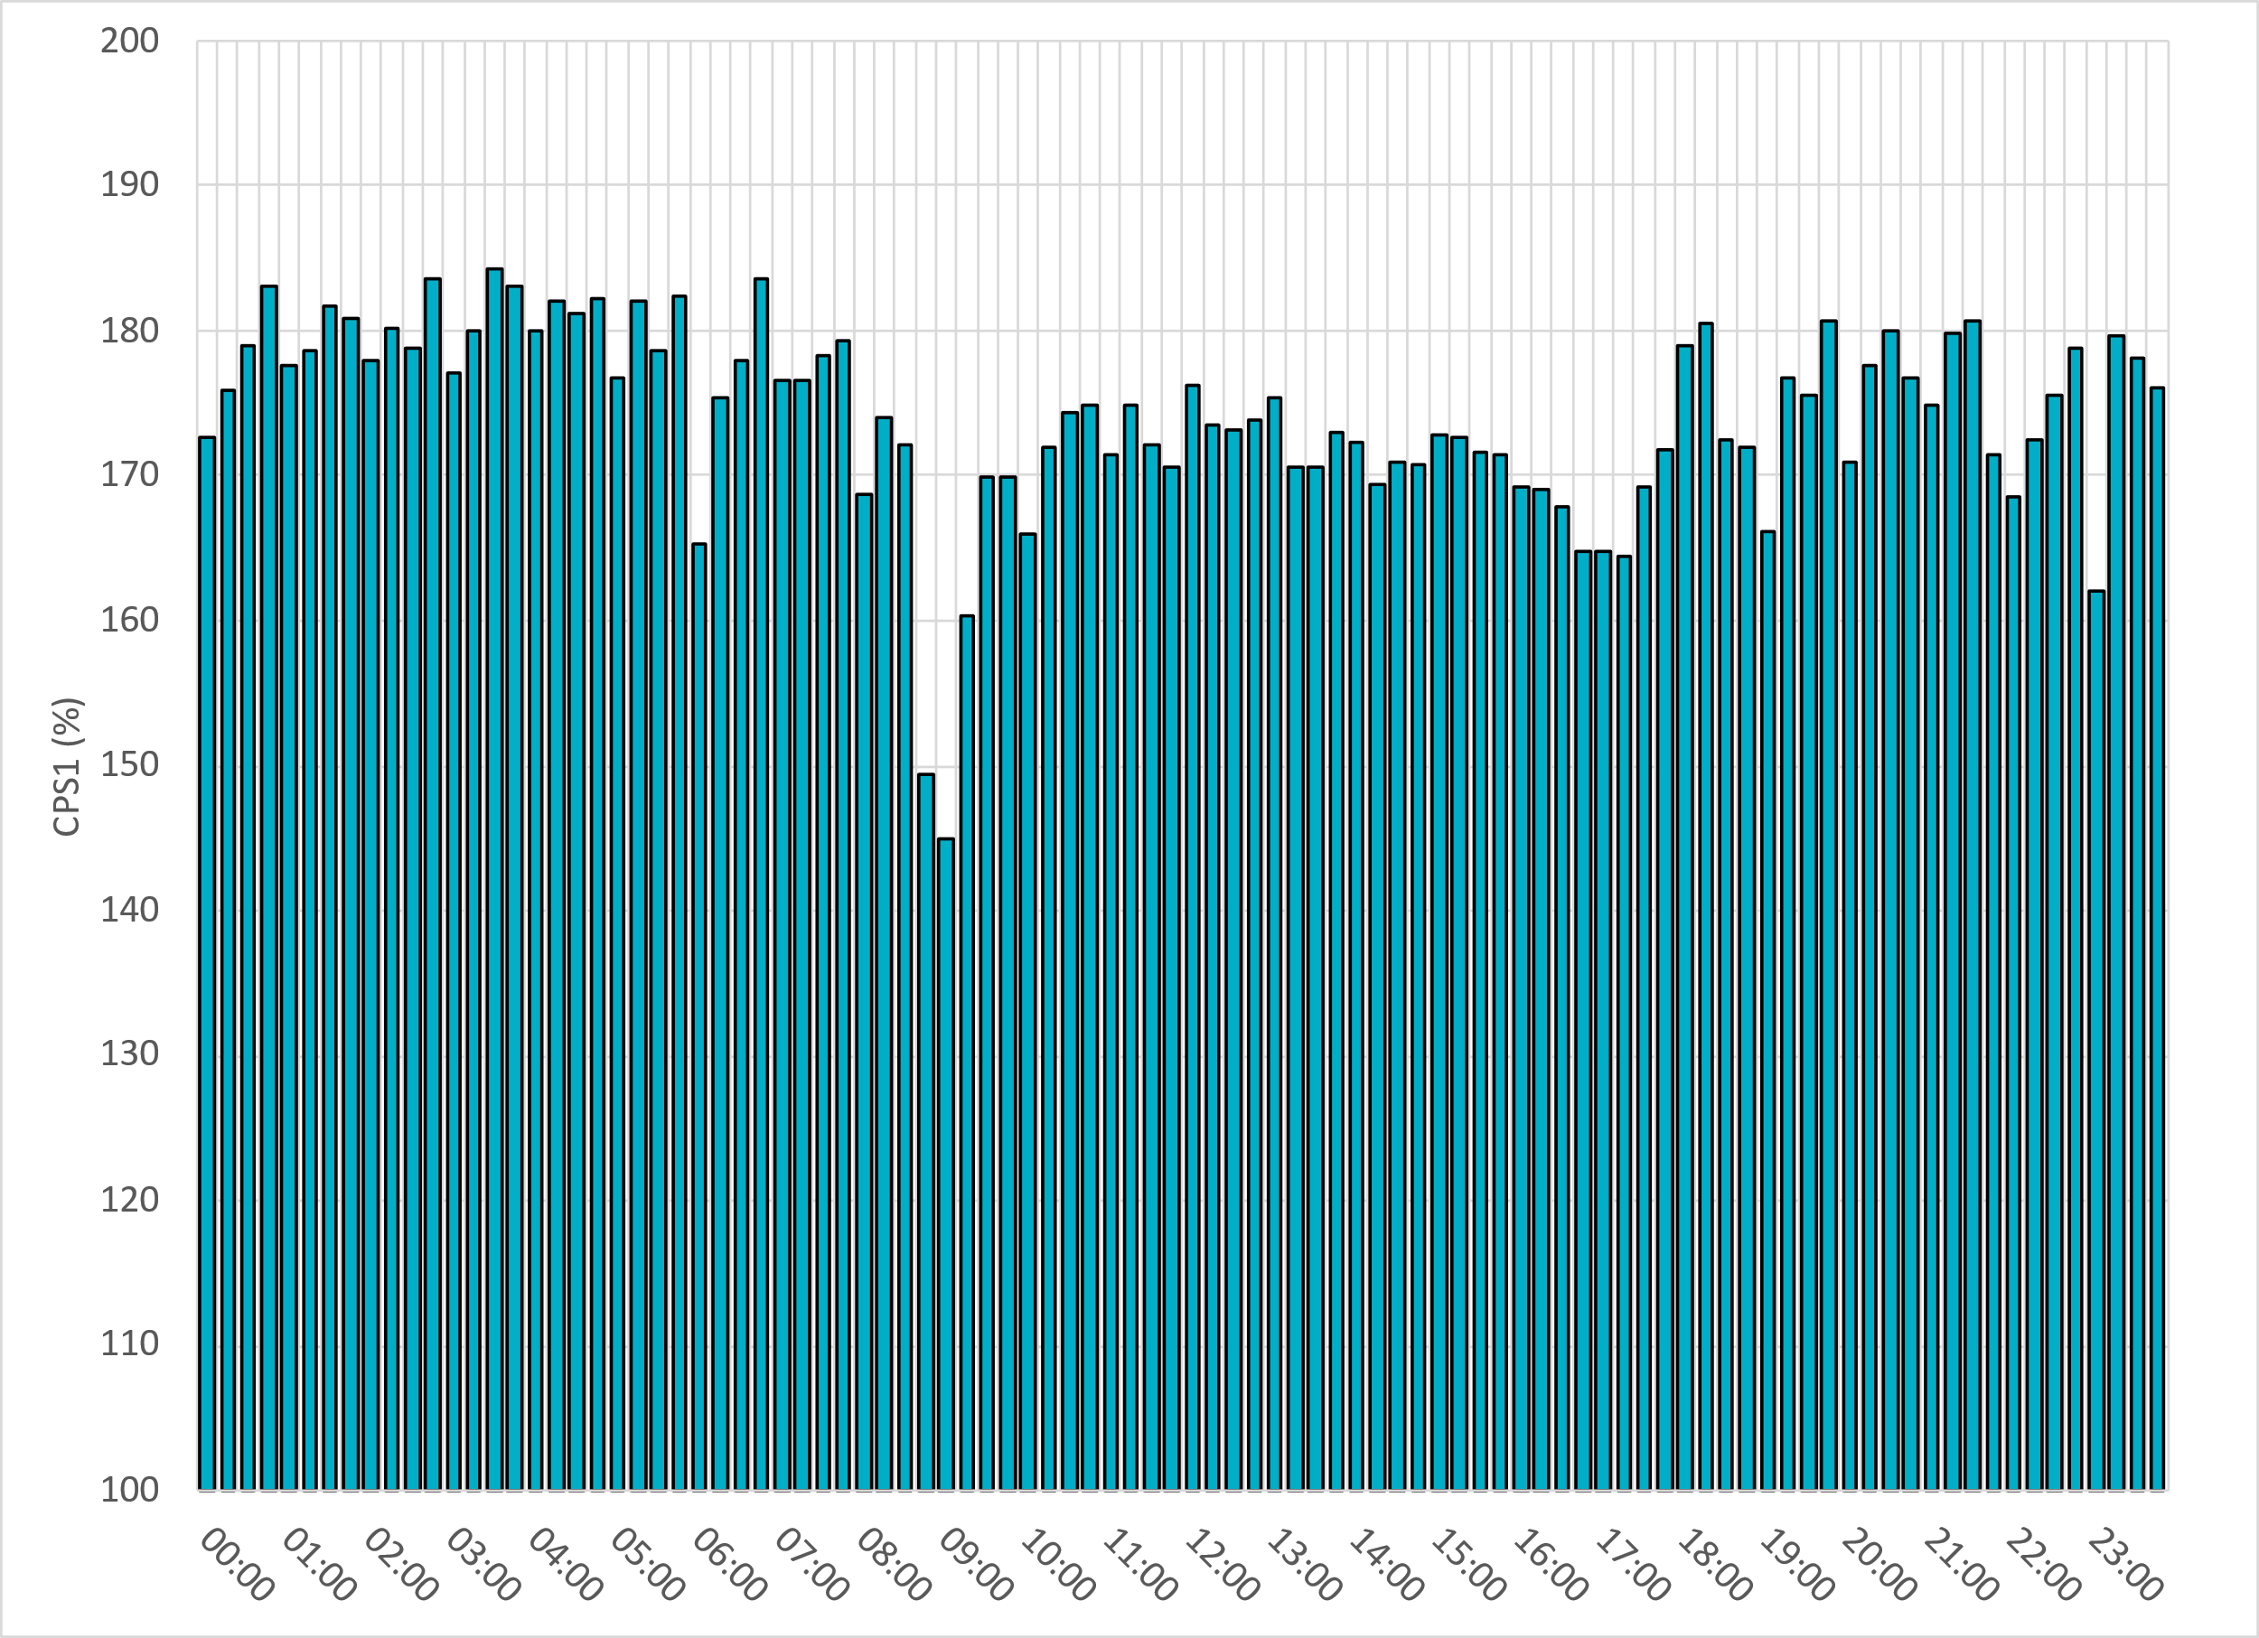
15-Minute Average CPS1%
Feb-24 CPS1 (%): 174.21
Notes:
CPS1 score is above 150% for all but 2 15-minute intervals. Low CPS1 score in this period is the result of inaccurate wind and solar forecasting during morning ramps.

Slide 7
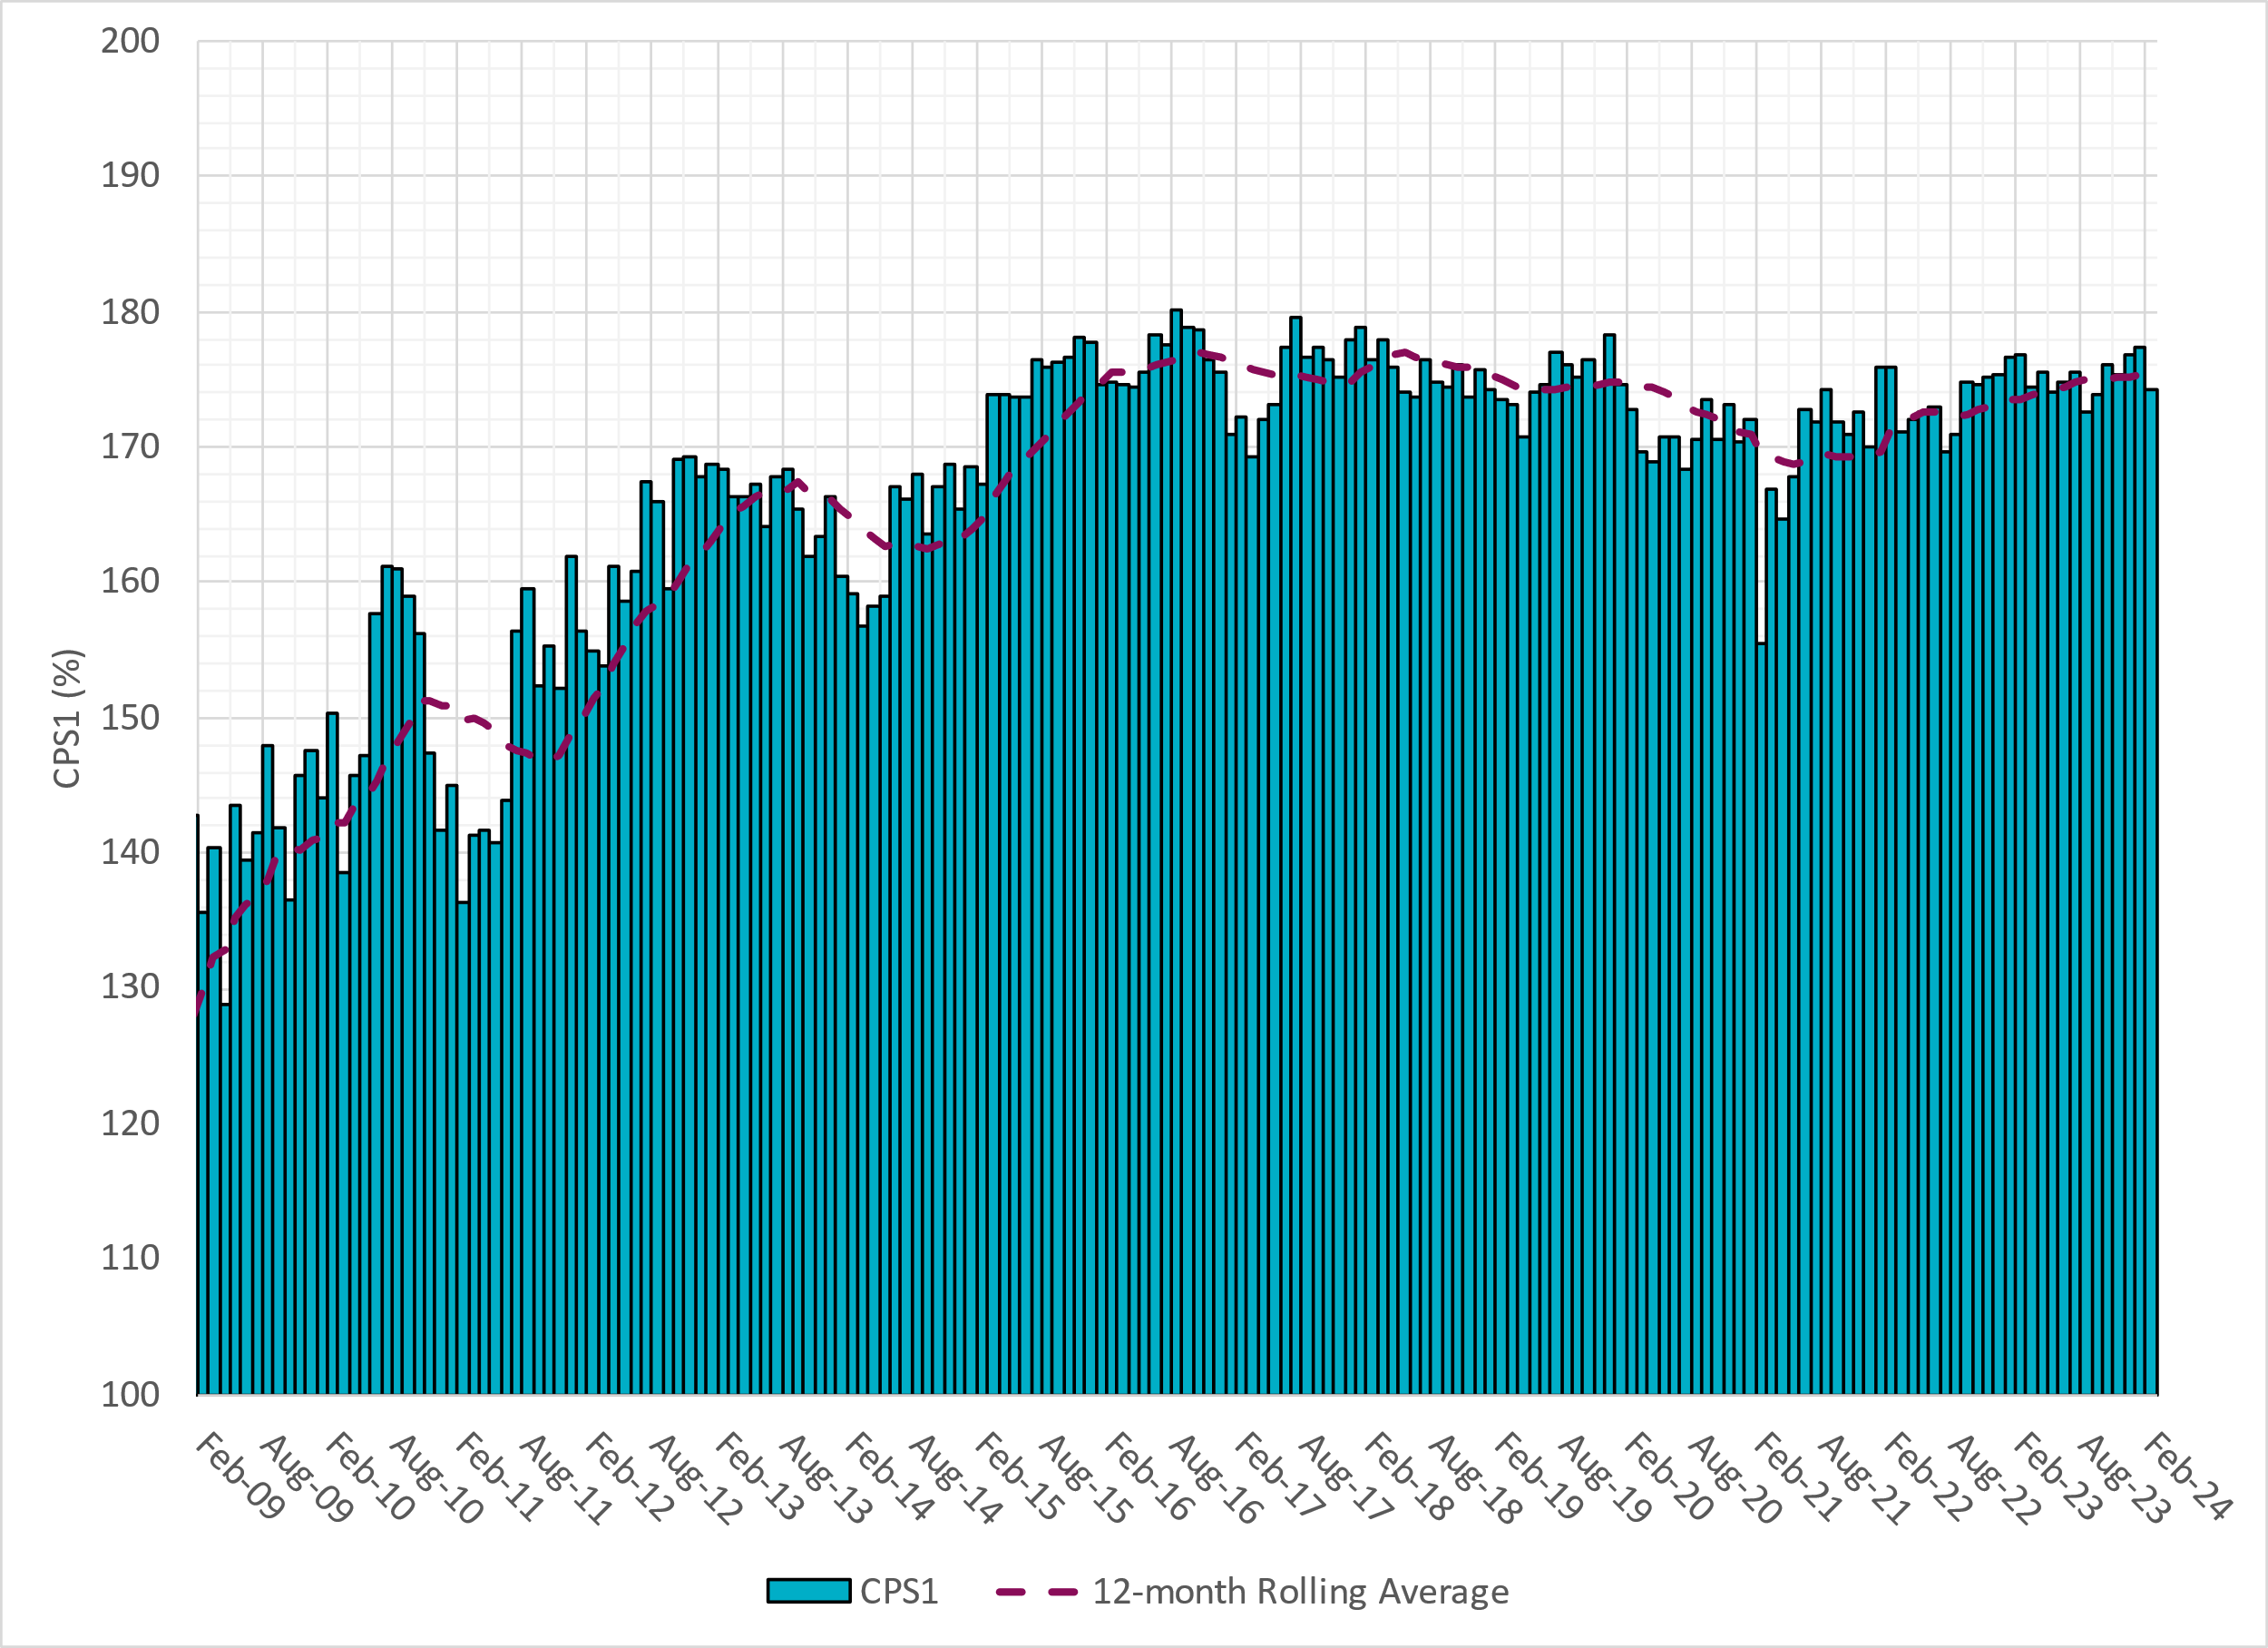
12-Month Rolling Average CPS1
Current 12-Month Rolling Average: 175.05%
Notes:
12 month rolling average CPS1 score is 175.05 which is in line with expectations, and the CPS1 score for February is consistent with previous months.

Slide 8
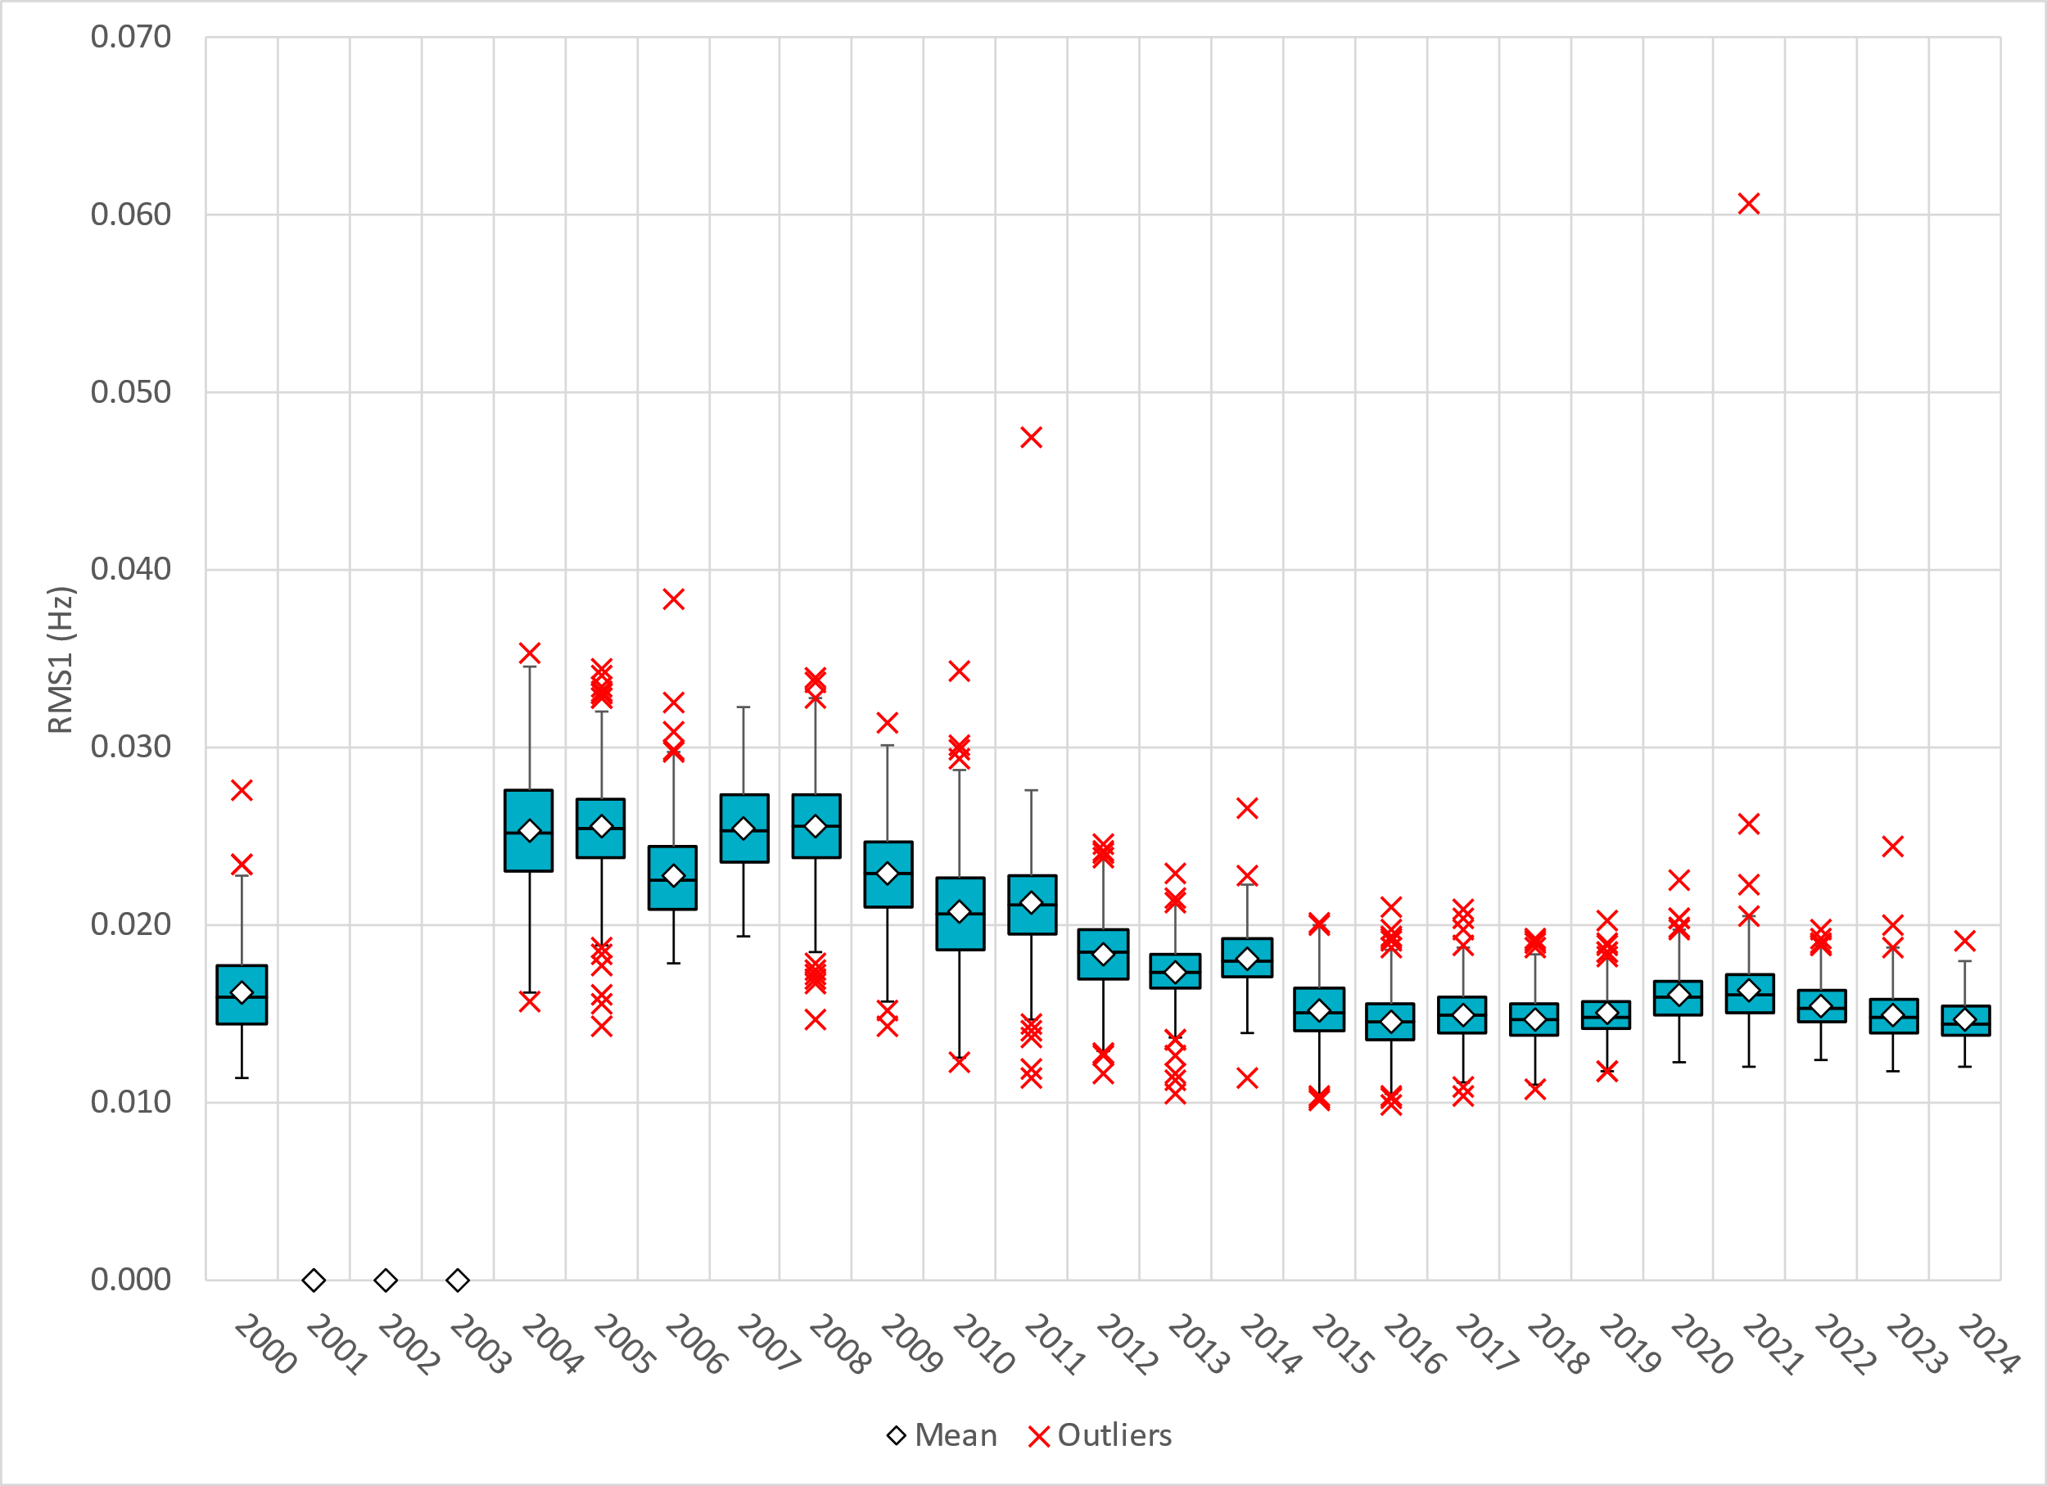
Daily RMS1 of ERCOT Frequency by Year
Notes:
Daily RMS1 frequency by year is similar compared to 2023.
2024 Stats:
Mean: 14.7 mHz
Min: 11.97 mHz
Max 19.16 mHz

Slide 9
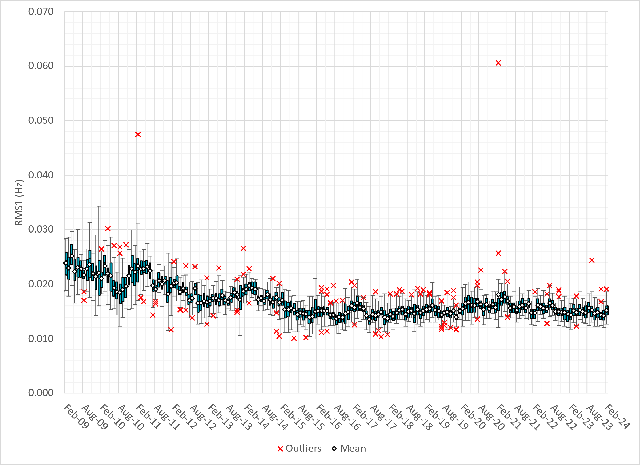
Daily RMS1 of ERCOT Frequency by Month
Notes:
A More granular look at last 15 years of RMS1 by month
15.19 mHz on avg for February 2024

Slide 10
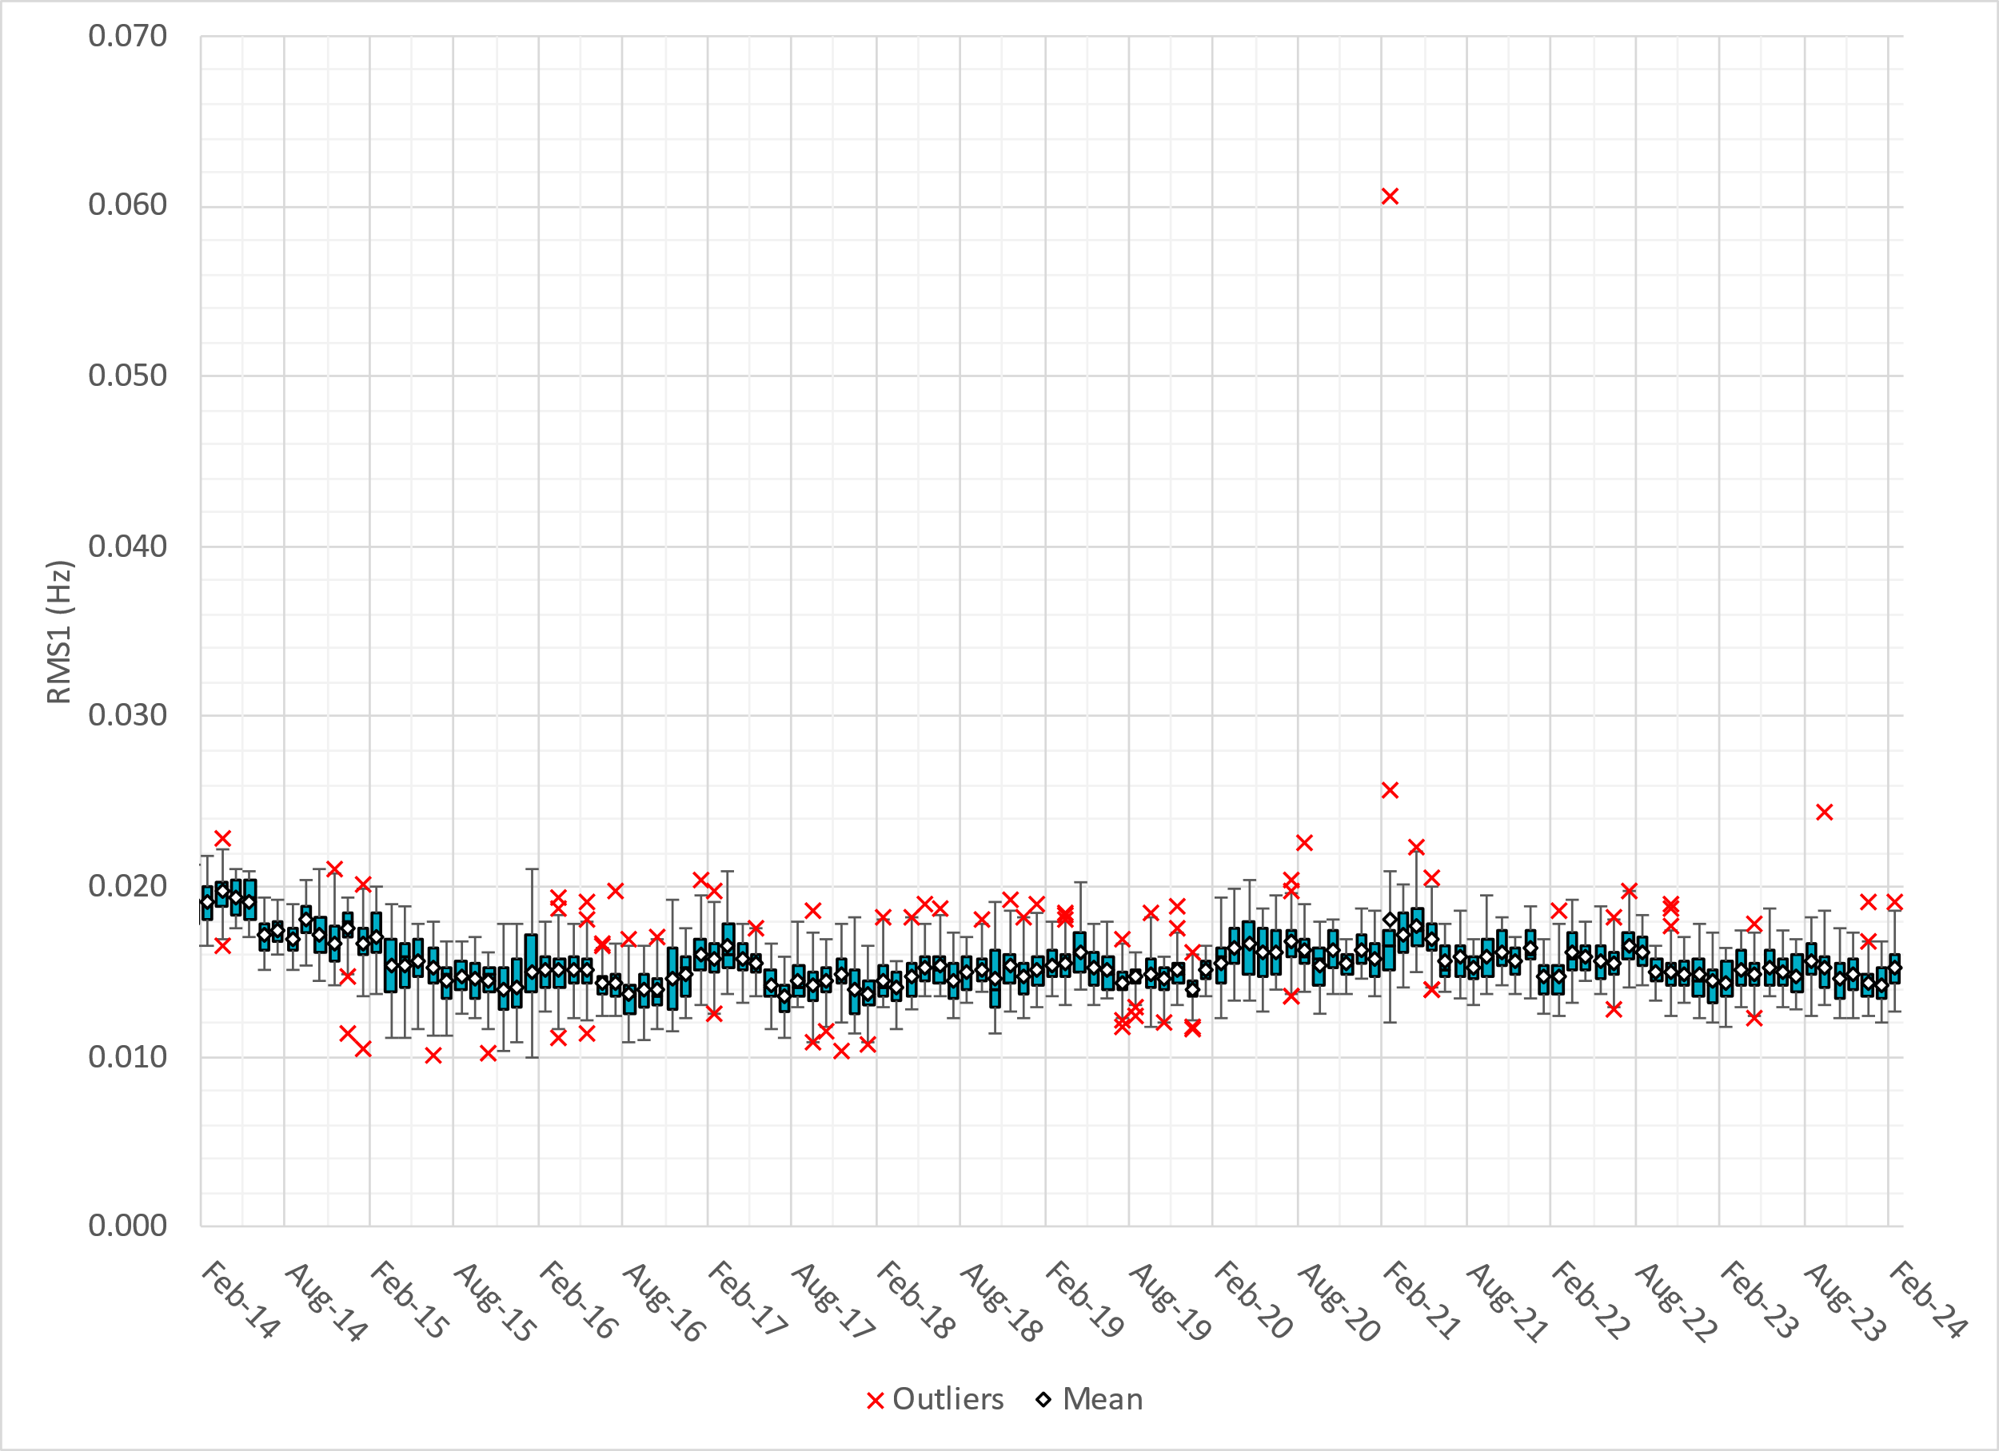
Daily RMS1 of ERCOT Frequency by Month
Notes:
Same data with 10 years shown instead of 15

Slide 11
Frequency Profile Comparison

Slide 12
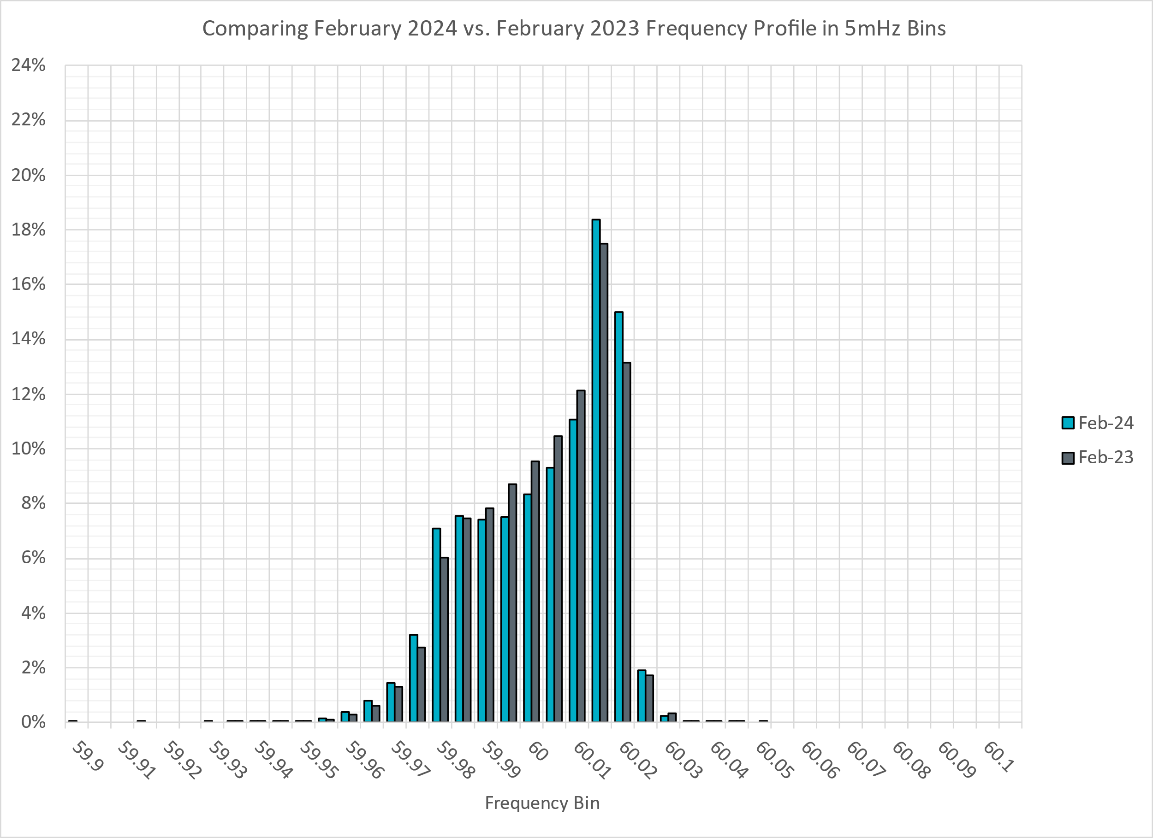
Frequency Profile Comparison
Notes:
Comparison of frequency profile between February 2023 and February 2024. Compared to last year, there are more instances of frequency hovering around the dead bands.

Slide 13
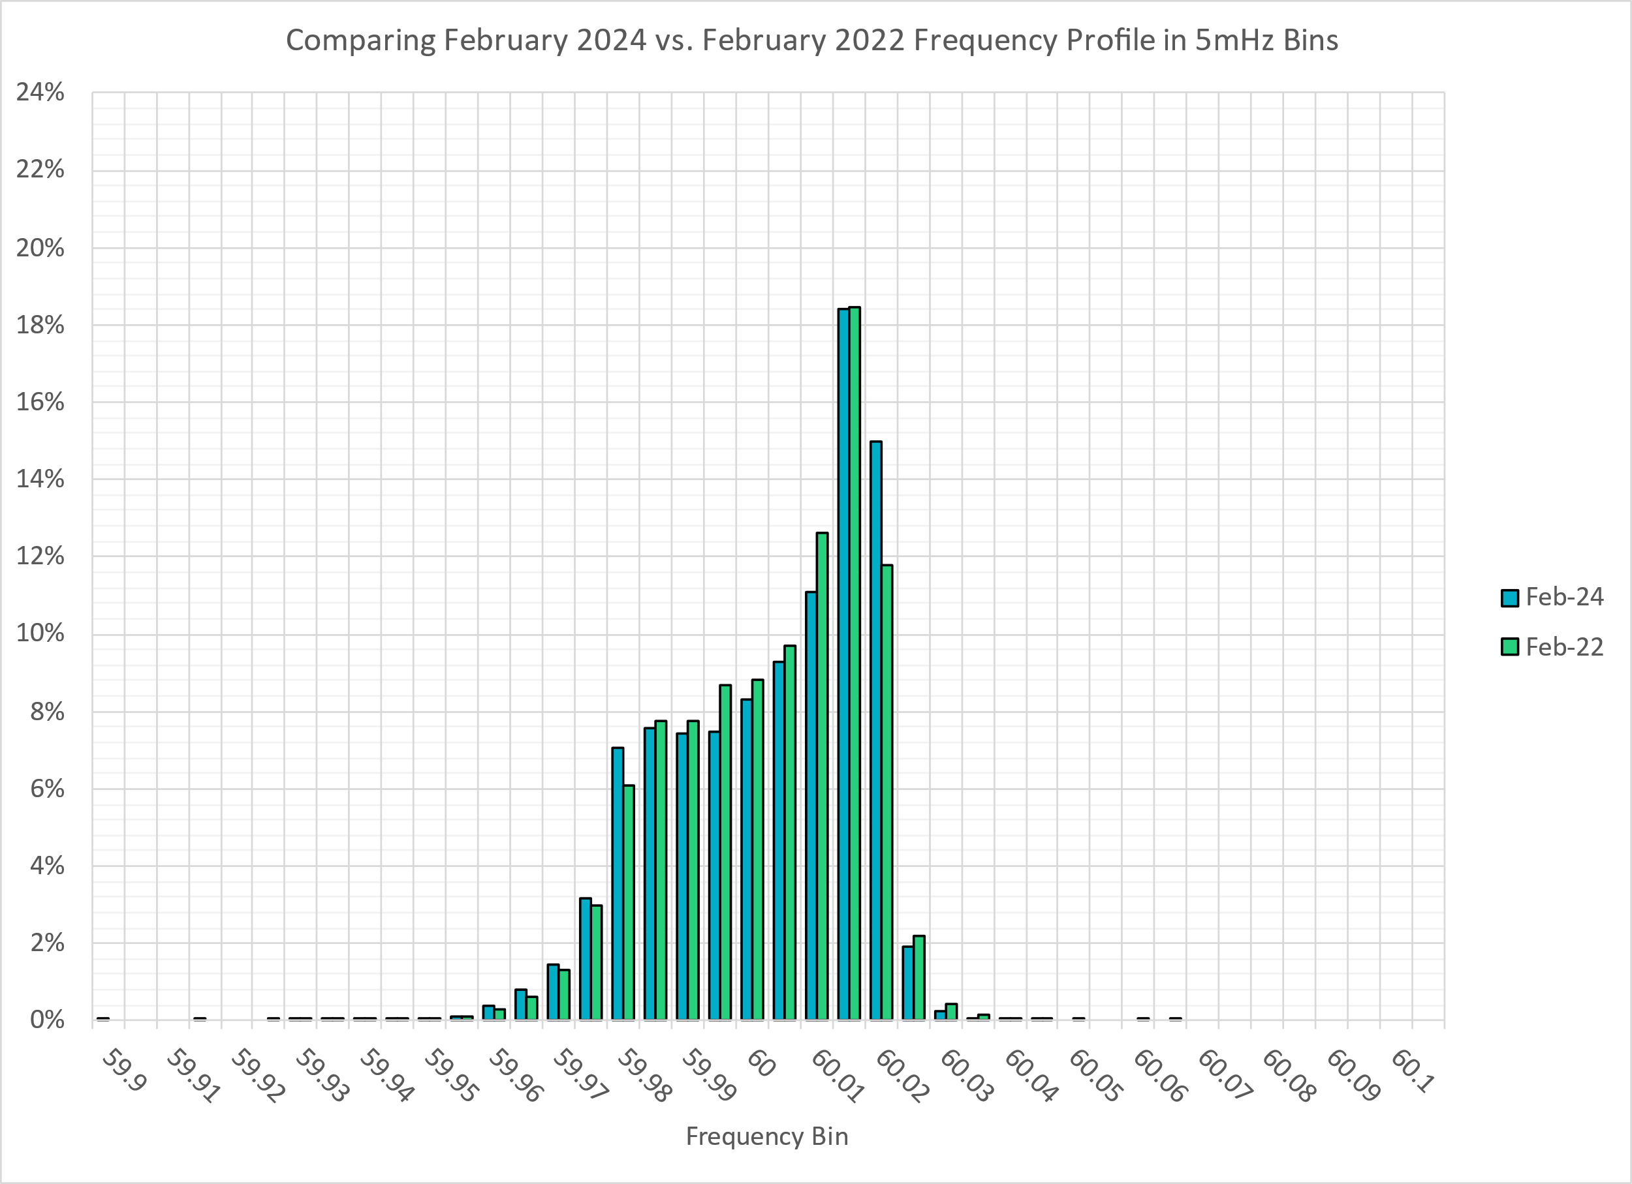
Frequency Profile Comparison
Notes:
Comparison of frequency profile between February 2022 and February 2024. Similar to the previous slide, compared to 2022, there are more instances of frequency hovering around the dead bands.

Slide 14
Time Error Correction

Slide 15
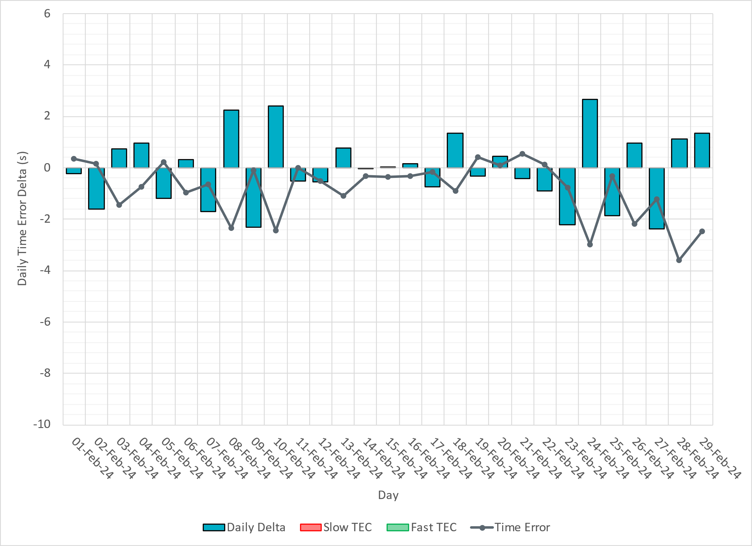
ERCOT Daily Time Error

Slide 16
Time Error Corrections Log Summary
There have been no time error corrections since December 2016

Slide 17
BAL-003 Performance

Slide 18
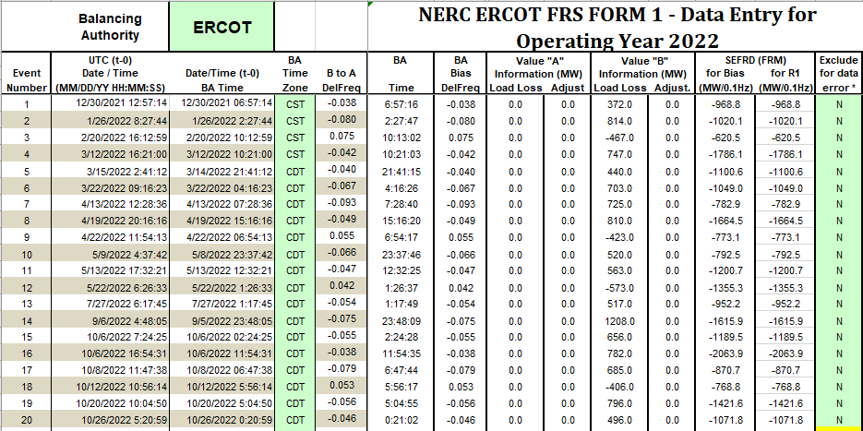
Op. Year 2022 BAL-003 Selected Events – Update
Notes:
BAL-003
These events will be selected and posted after April 1st, slide will be updated for upcoming PDCWG meetings.

Slide 19
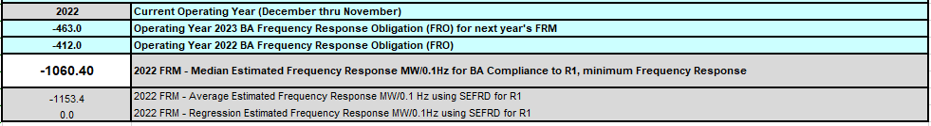
Op. Year 2022 BAL-003 FRM Performance - Update
Notes:
OP2018: FRO = -381.0, FRM_median = -843.17, FRM_average = -959.7
OP2019: FRO = -381.0, FRM_median = -811.14, FRM_average = -892.5
OP2020: FRO = -425.0, FRM median = -789.34, FRM average = -879.0
OP2021: FRO = -471.0, FRM median = -913.56, FRM average = -992.
OP2022: FRO = -463.0, FRM median = -1060.40, FRM average = -1153.4

Slide 20
ERCOT Energy Statistics

Slide 21
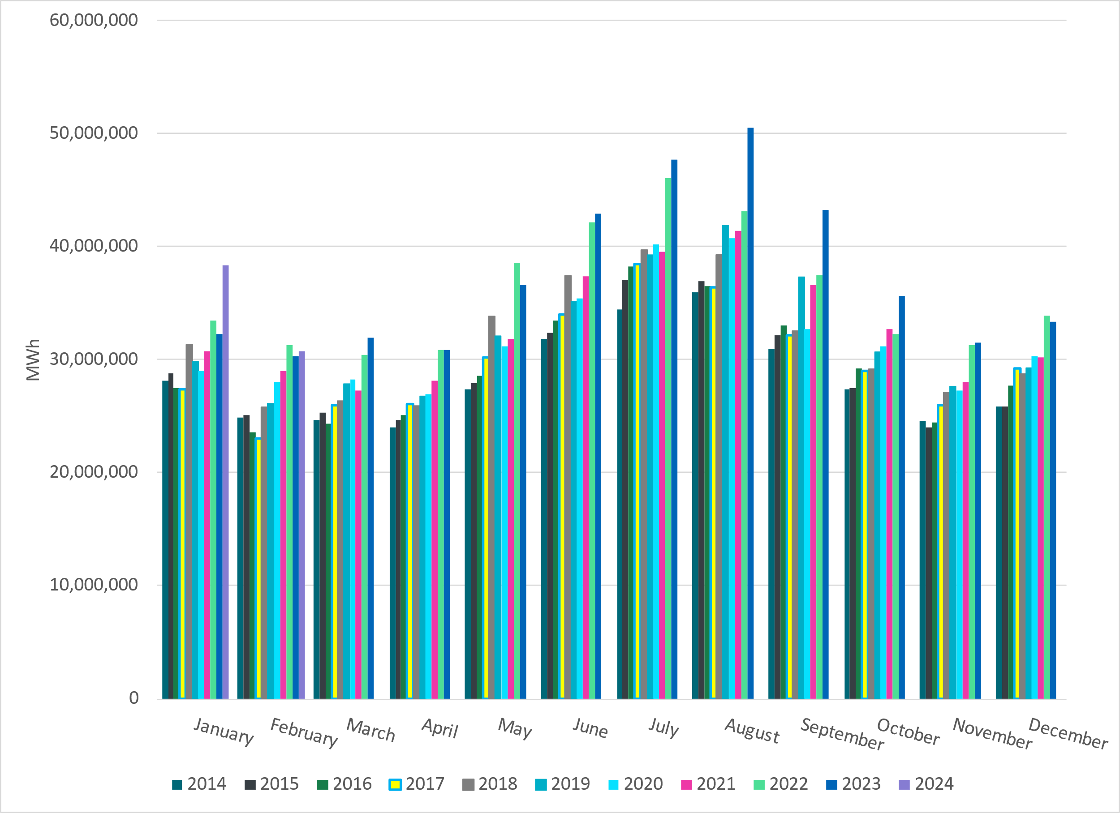
Total Energy
Notes:
30,761,552 MWh

Slide 22
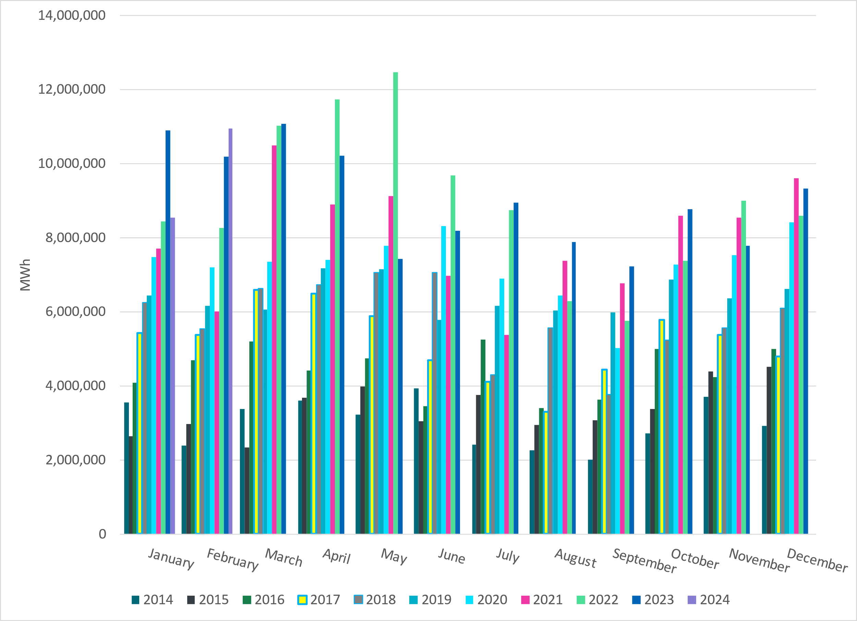
Total Energy from Wind Generation
Notes:
10,944,115 MWH ~

Slide 23
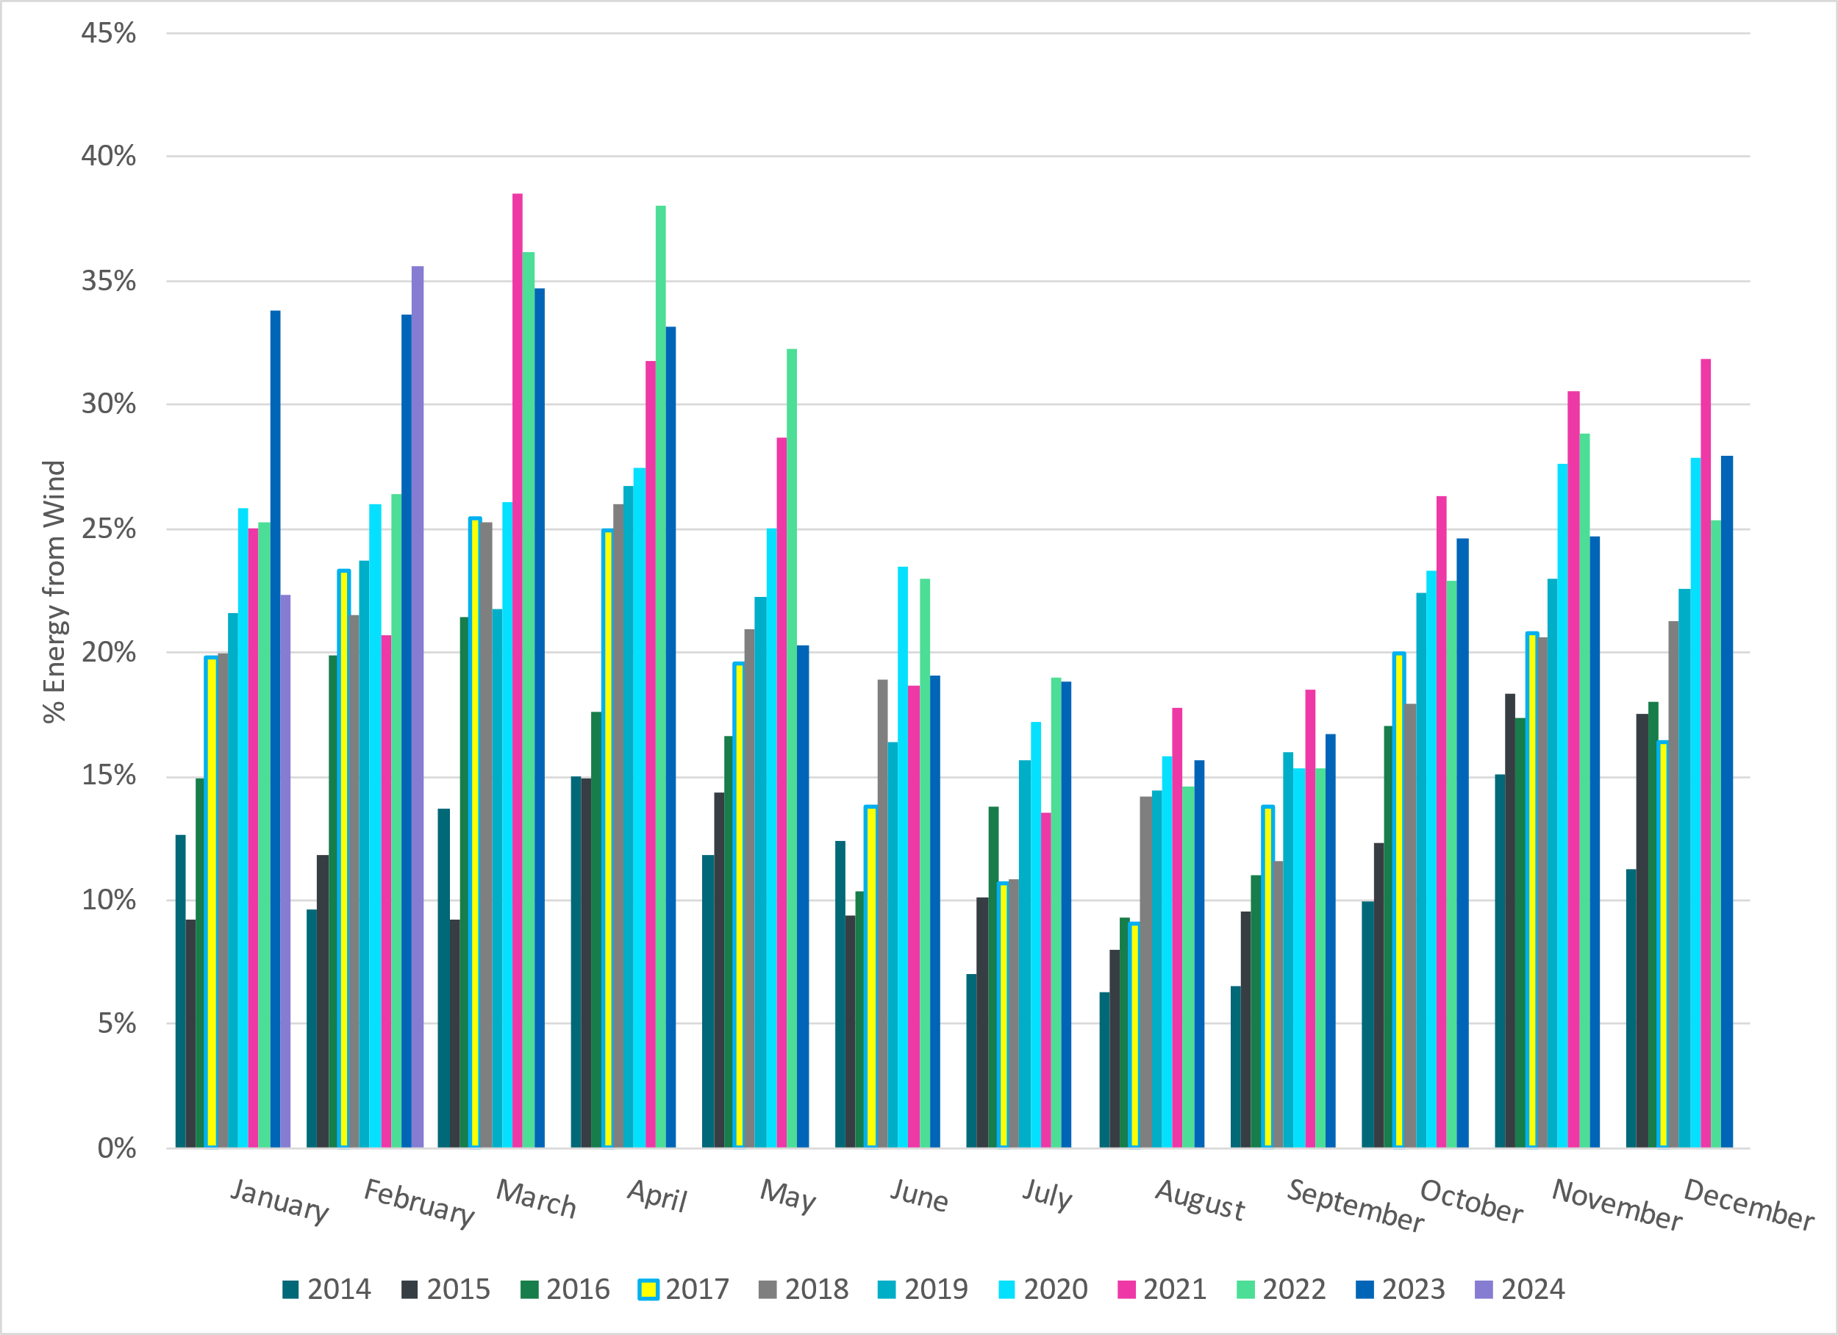
% Energy from Wind Generation
Notes:
35.58% of total energy was provided by wind generation

Slide 24
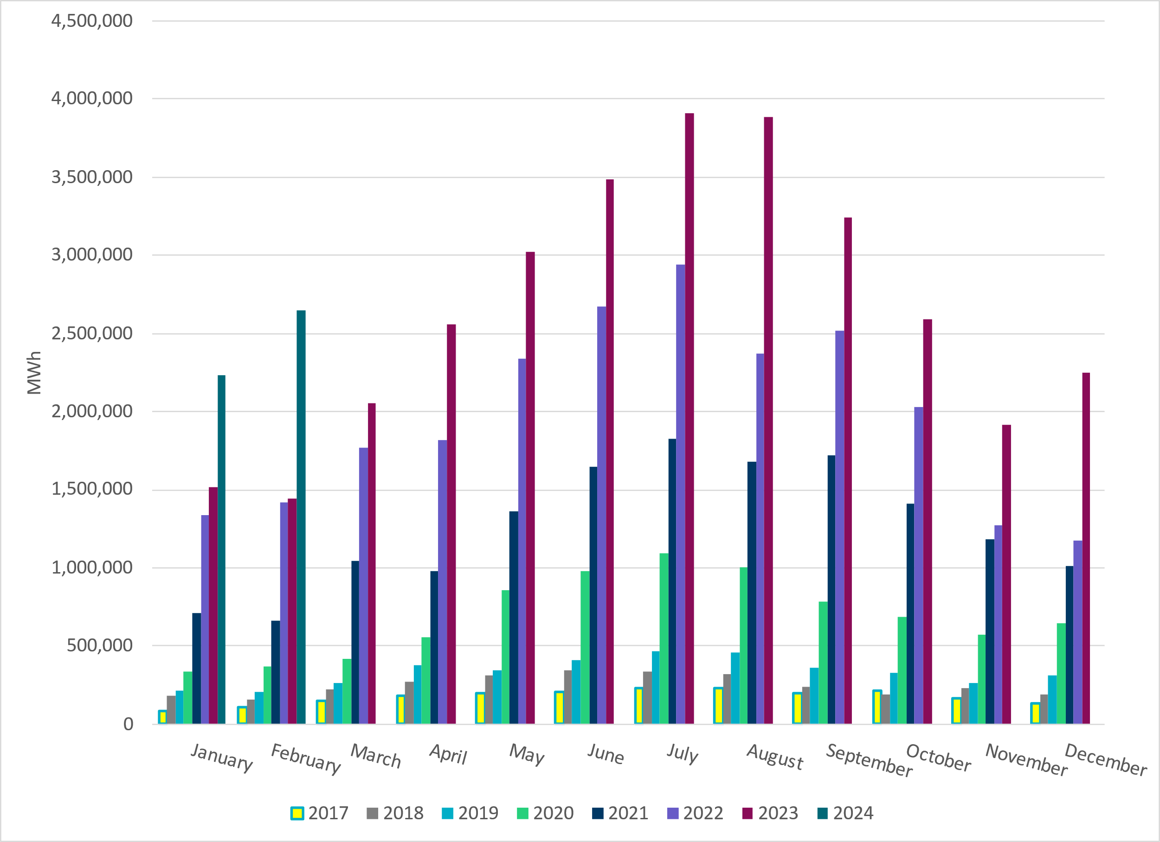
Total Energy From Solar Generation
Notes:
2,646,220 MWh ~ significant increase in solar from previous years.

Slide 25
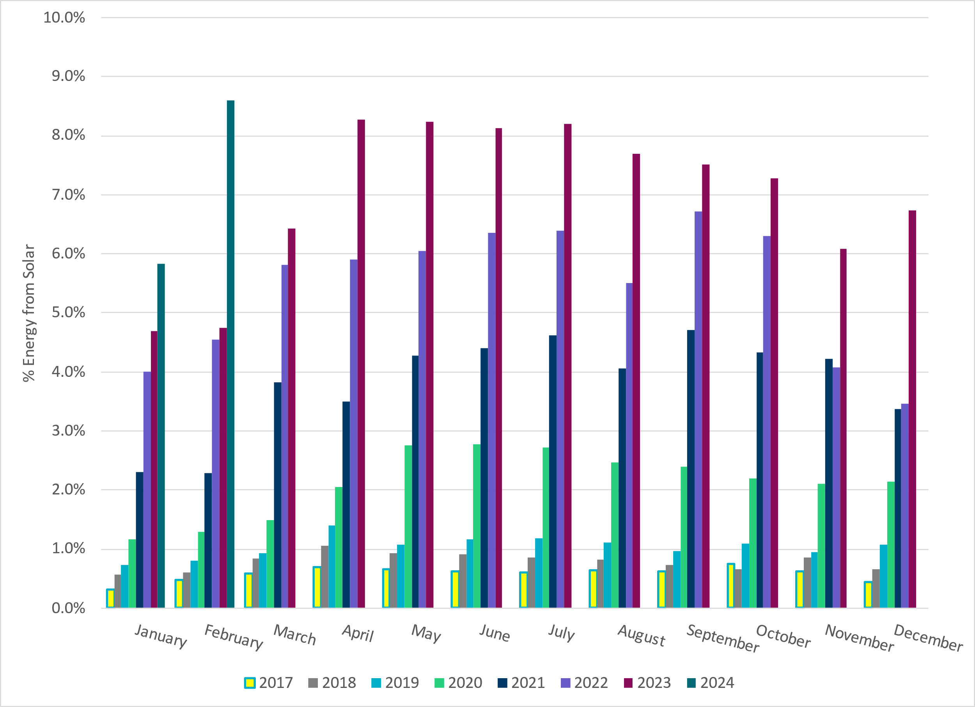
% Energy from Solar Generation
Notes:
8.60% of total energy was provided by solar generation

Slide 26
ERCOT System Inertia

Slide 27
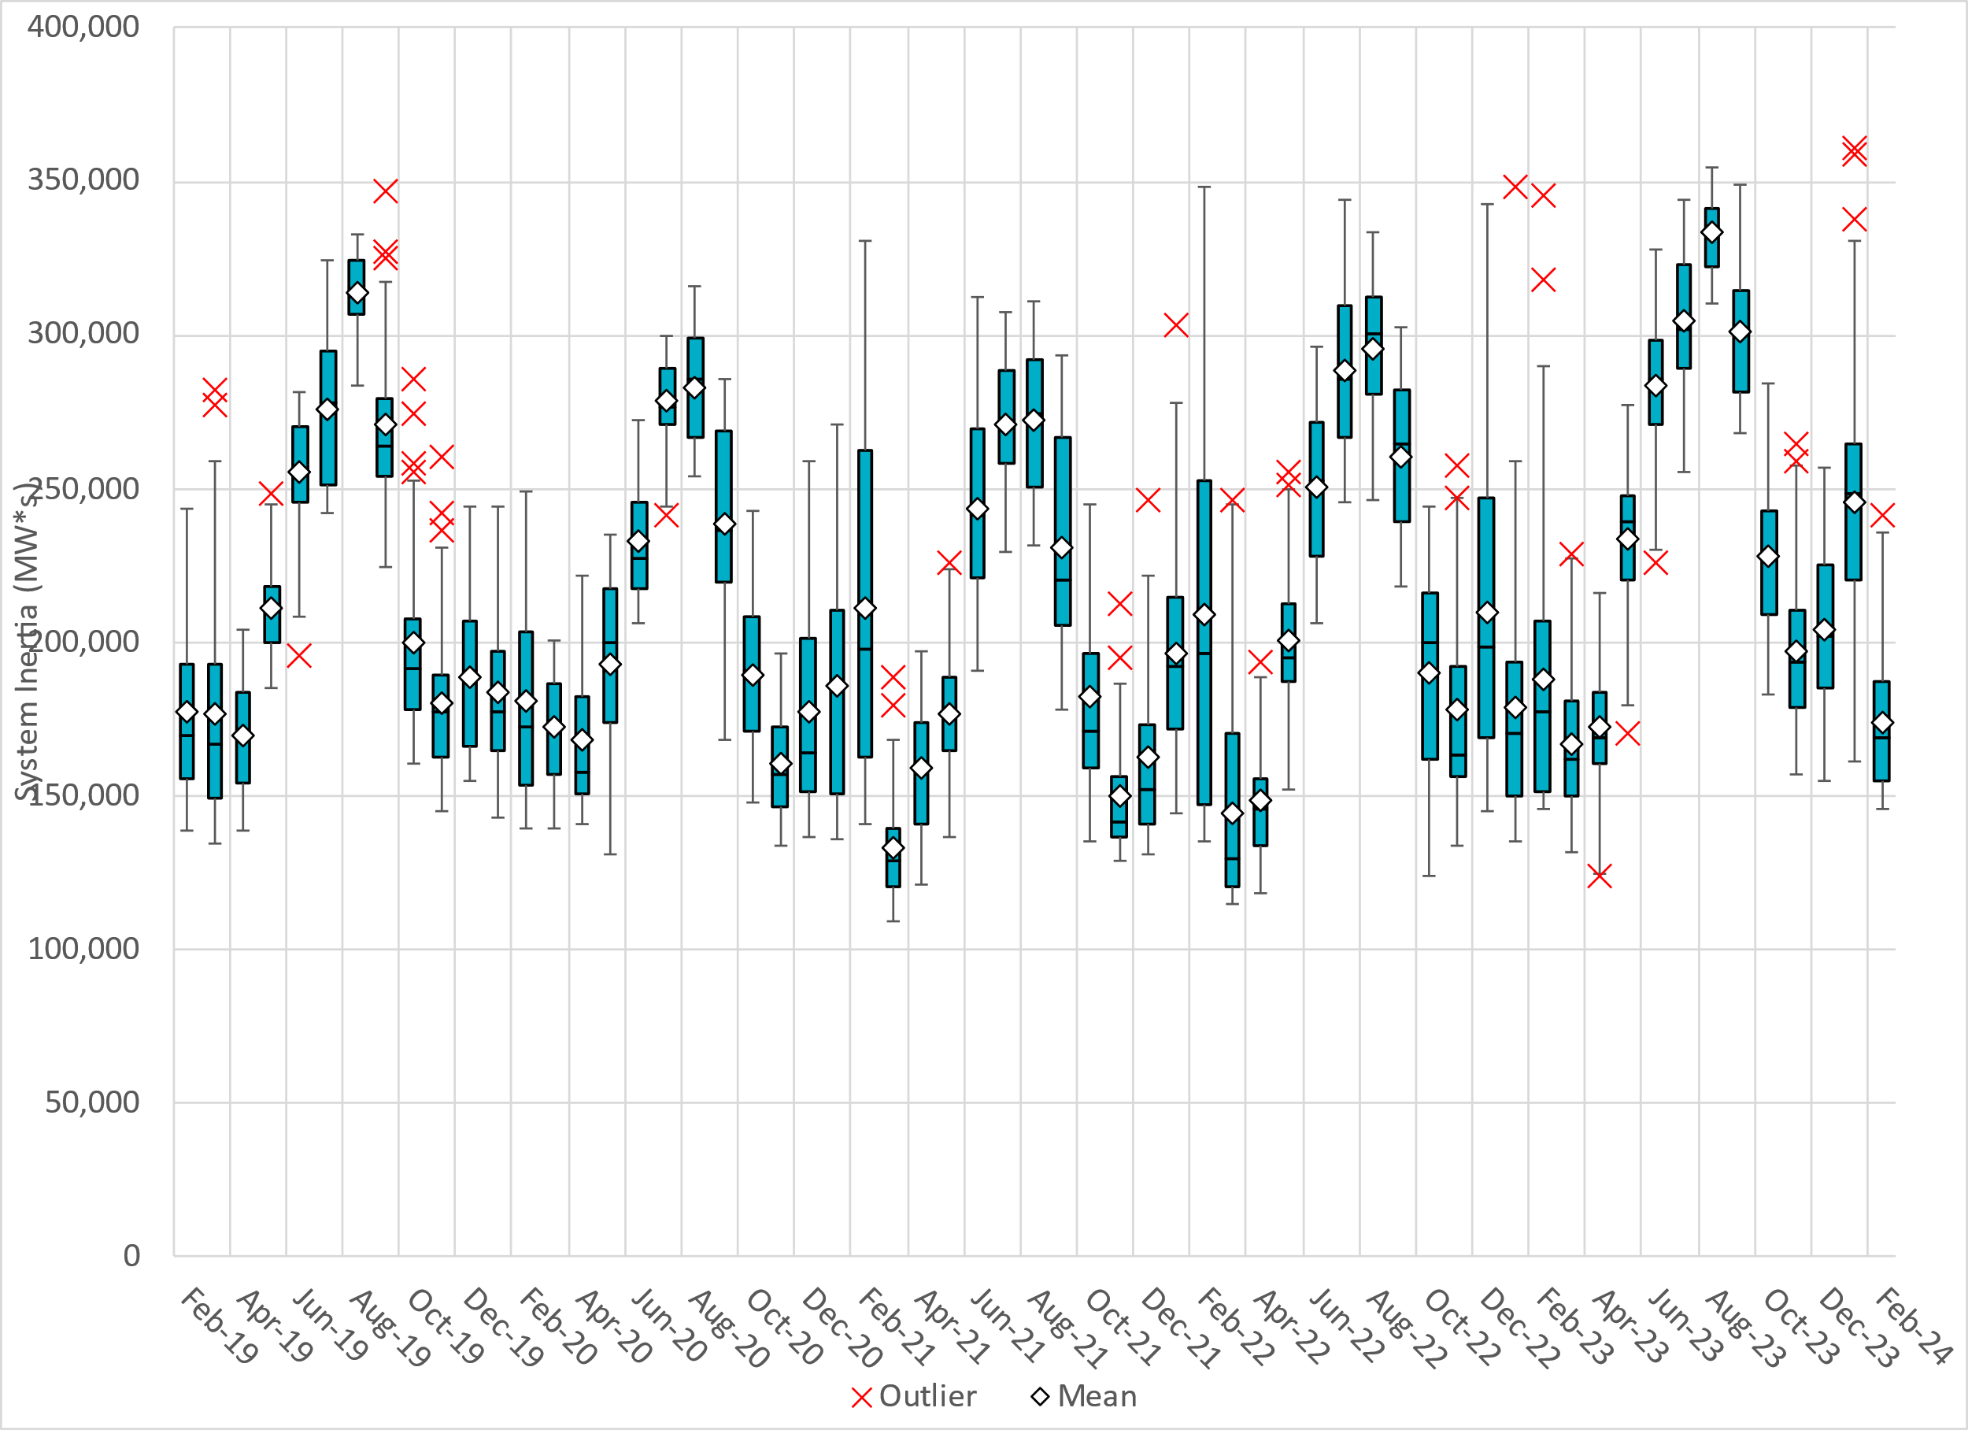
Daily Minimum System Inertia
Notes:
Minimum Inertia in February 2024 = 145,331 MW*s on 2/25/2024
Historical Overall Minimum was 109,029 MW*s on 3/22/2021
Data:
Mean: 173,614 MW*s
Max: 241,450 MW*s on February 29th
Min: 145,331 MW*s on February 25th

Slide 28
ERCOT Inertia 2013-2024
Date and Time | 2013 3/10 3:00 AM | 2014 3/30 3:00 AM | 2015 11/25 2:00 AM | 2016 4/10 2:00 AM | 2017 10/27 4:00 AM | 2018 11/03 3:30 AM | 2019 3/27 1:00 AM | 2020 05/01 2:00 AM | 2021 03/22 00:00 AM | 2022 03/21 01:00 AM | 2023 04/18 02:00 AM | 2024 02/25 03:00 AM
Min synch. Inertia (GW*s) | 132 | 135 | 152 | 143 | 130 | 128.8 | 134.5 | 131.1 | 109 | 115 | 124 | 145
System load at minimum synch. Inertia (MW) | 24,726 | 24,540 | 27,190 | 27,831 | 28,425 | 28,397 | 29,883 | 30,679 | 32,599 | 33,365 | 35,799 | 36,235
Non-synch. Gen. in % of System Load | 31 | 34 | 42 | 47 | 54 | 53 | 50 | 57 | 65 | 66 | 61 | 65
Notes:
Summary of ERCOT intertia for the previous 10 years. Lowest inertia this year was on February 25th.
For each box, the central mark (red line) is the median, the edges of the box (in blue) are the 25th and 75th percentiles, the whiskers correspond to +/- 2.7 sigma (i.e., represent 99.3% coverage, assuming the data are normally distributed. The corresponding lowest inertia in each year is given in the table.
The circle on each boxplot is showing inertia during time when highest portion of load was served by wind/solar generation in that year.

Slide 29
Questions?
Thank you!

