Slide 1
Operations Working Group Meeting Notes
Chair- Rickey Floyd
Vice-Chair- Tyler Springer
HITE List Sub-Chair – Pushkar Chhajed
03/13/2024

Slide 2
ERCOT Updates and System Operation Report
Unofficial Peaks Reported by ERCOT
February Peak Demand – 55,855 MW on 2/19 at 0800.
  Previous February Peak 63,508 MW
February Solar Penetration – 17,201 - New Record set on 2/19 at 1020
  Penetration record at 39.94 %
Renewable Penetration – 71.78 % – New Record set on 2/25

Slide 3
Texas Reliability Entity Report
NERC standards out for ballot.
  Updated glossary of terms term on what an IBR is.
  EOP-004 is out for comment on IBR for event reporting.
NERC has new process on prioritizing standard projects.
Industry Outreach
  Talk with TEXAS webinar 3/13/2024
  Week of 3/18 brief webex on Texas RE roll as interconnection model designee from NERC.
  April 24th spring standards and compliance workshop.

Slide 4
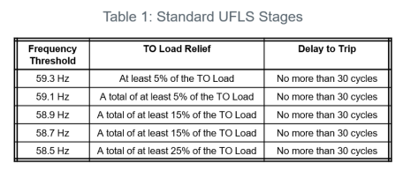
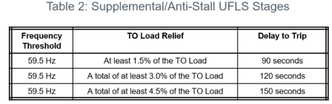
2024 UFLS Survey
  Partial implementation of NOGRR 247 modifies the automatic UFLS program by increasing the number of load shed stages from 3 to 5, and with uniform increments of 5%. With future required utilization of supplemental anti-stall UFLS Stages.
  Survey Activity Timeline
    March 13, Announcement of survey timeline to OWG.
    March 28, Market notice sent to Authorized TO Representatives.
    May 9 at 1100, Date and time of survey.
    July 12, Survey results due to ERCOT.
    August – September, Results reported to OWG, ROS, and TAC.

Slide 5
NPRR 1198 and NOGRR258 - Congestion Mitigation Using Topology Reconfigurations
Blake Holt provided update on LCRA comments
  Provided clarity on EAP’s prior to SCED, can be proposed for economic or reliability reasons.
  Changes to threshold
    5 million for 3 months within the past 36 months, the 3 months do not need to be consecutive.
    Reduced to 2% for 69kV
    Reduced to 1% for 115kV and above
  Market participant or ERCOT can propose an existing EAP be suspended.
Ready to move forward to ROS.

Slide 6
NPRR 1070 - Planning Criteria for GTC Exit Solutions
Remains Tabled, no update.

Slide 7
OTWG Update
ERCOT OTS starts next week, registrations still being processed as needed. Starts Monday at noon, please be on time!
GridGeo is on track for Black Start. Contingency plans available if not ready.
More details of the OTWG update can be found on the OWG February 20th meeting page.

Slide 8
Other Business
EOP 8 plans that are due this week send to supervisors@ercot.com

