Slide 1
ERCOT Frequency Events
February 2024
ERCOT
Operations Planning
PDCWG | Mar 20, 2024

Slide 2
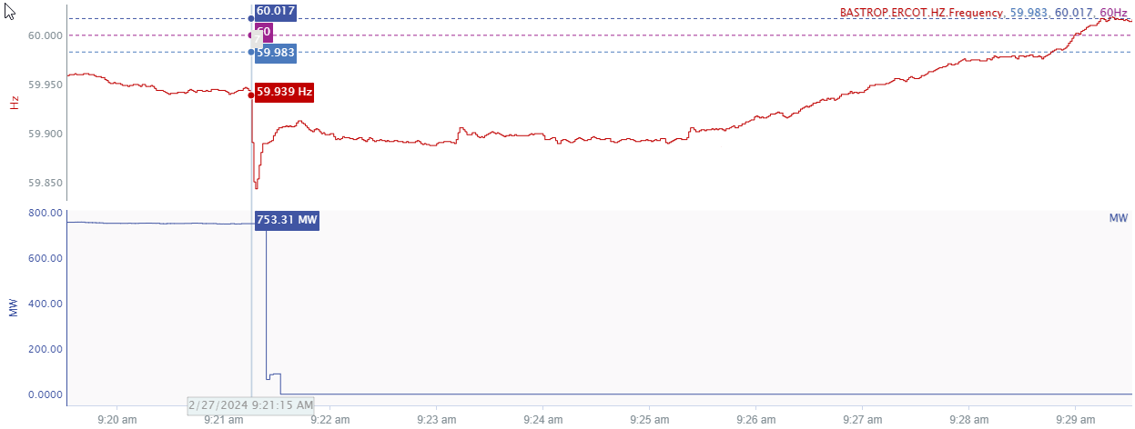
2/27/24 9:21:15 (Non-FME)
Notes:
The unit tripped offline for loss of approximately 754 MW
Starting Frequency: 59.939 Hz
Minimum Frequency: 59.844 Hz
A-C Time : 3 seconds
Recovery Time(back to deadband): 7 minutes 30 seconds
ECRS Released: 779 MW
Trip Reason: Bad outlet pressure
Contextual Information: A total of 395 MW of regulation Up was deployed and manual offset of 400 MW was applied during the event
No Selection Reason: Starting frequency below the lower deadband

Slide 3
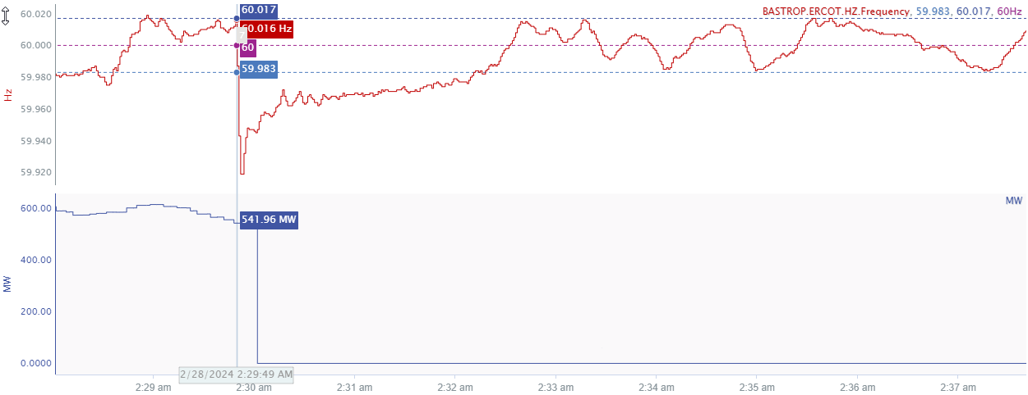
2/28/2023 2:29:49(FME)
Notes:
Thetripped offline while carrying approximately 539 MW gen
Starting Frequency: 60.016 Hz
Minimum Frequency: 59.919 Hz
A-C Time : 4 seconds
Recovery Time(back to deadband): 2 minutes 22 seconds
ECRS Released: 0 MW
Trip Reason: Bypass on the feedwater valve failed to open
Contextual Information: A total of 100 MW of regulation up was deployed during this time

Slide 4
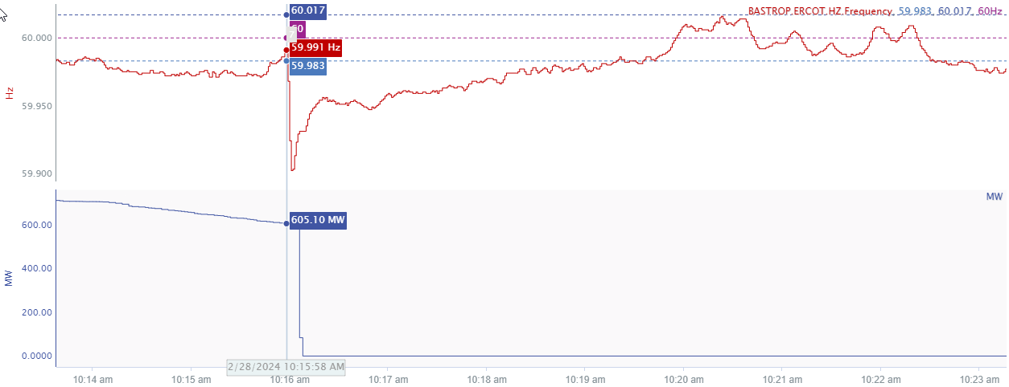
2/28/2023 10:15:58(Non-FME)
Notes:
The unit experienced a runback and tripped offline while carrying approximately 603 MW
Starting Frequency: 59.991 Hz
Minimum Frequency: 59.902 Hz
A-C Time : 3 seconds
Recovery Time(back to deadband): 3 minutes 22 seconds
ECRS Released: 329 MW
Trip Reason: high back pressure
Contextual Information: A total of 369 MW of regulation up was deployed during this time
No Selection Reason: The starting frequency is outside the low deadband for before the event.

Slide 5
Questions?
Thank you!

