Slide 1
ECRS Minimum Quantity Determination for 2024 And Deployment Triggers
ERCOT Staff
March 19, 2024
Workshop

Slide 2
Introduction
As part of the 2024 Ancillary Service (AS) Methodology discussion at the Technical Advisory Committee (TAC) and ERCOT Board (BoD), ERCOT was asked to review by April 30, 2024 the methodology used to compute ERCOT Contingency Reserve Service (ECRS) and potential alternate solutions, taking into account the analysis that the Independent Market Monitor (IMM) has conducted on the impact of ECRS.
This presentation will address the 2024 methodology for computing minimum ECRS requirements.
Further, recognizing that the approach used to release ECRS may also impact market outcomes, this presentation will also review the approach and triggers used to release ECRS.
Notes:
TAC Motion: To endorse the 2024 Ancillary Services Methodology as recommended by ERCOT on the commitment from ERCOT to bring the methodology back up for TAC review by April 30, 2024
Source: https://www.ercot.com/files/docs/2023/12/04/2023%20TAC%20AS%20Methodology%20Ballot%2020231204.xls
ERCOT BoD Slide #7
ERCOT has committed to TAC to perform additional assessment related to ECRS prior to April 30, 2024 which could result in an intra-year update to the methodology or deployment procedures related to ECRS.
Source: https://www.ercot.com/files/docs/2023/12/11/14.1%20ERCOT%20Recommendation%20regarding%202024%20ERCOT%20Methodologies%20for%20Determining%20Minimum%20Ancillary%20Service%20Requirements.pdf

Slide 3
Background
ERCOT Contingency Reserve Service (ECRS) is a service that is that is capable of being ramped to a specified output level within 10 minutes.
ECRS may be provided by
unloaded, On-Line Generation Resource capacity;
Quick Start Generation Resources (QSGRs);
Load Resources that may or may not be controlled by high-set, under-frequency relays;
Controllable Load Resources; and
Generation Resources operating in synchronous condenser fast-response mode, as defined in the Operating Guides.
ECRS may be deployed/released to
restore frequency within 10 minutes of a significant frequency deviation and recover deployed Regulation Service,
compensate for intra-hour net load forecast uncertainty and variability on days in which large amounts of online thermal ramping capability is not available, or
when there is a limited amount of capacity available for Security-Constrained Economic Dispatch (SCED).

Slide 4
ECRS Requirement Methodology
ECRS requirement is the sum of
capacity needed to recover frequency following a large unit trip and
capacity needed to cover for intra-hour net load (i.e., load – wind – solar) forecast errors.
The next few slides will review each of these components of the methodology in more detail.

Slide 5
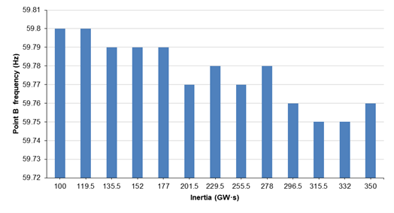
Method for Determining MWs needed for Frequency Recovery 2024
Summary of Study Methodology
Simulations/studies are run at varying inertia levels.
In every simulation, a single medium-size unit is tripped offline such that the frequency nadir stays just above 59.7 Hz* and B-point is recorded.
Capacity needed to recover frequency for each inertia level/study is determined.
*59.7Hz is the trigger frequency for Load Resources that are providing RRS using an under-frequency relay.
60 Hz
59.98 Hz
B-point
59.7 Hz
Recovery-MW_{inertia} = (59.98 Hz – Freq_{B-point}) * (1% load in MW/0.1 Hz) * 10

Slide 6
2024 Frequency Recovery Calculation Changes
2024 Methodology Updates
Use two years of historic information (as opposed to 3 years used in previous year);
Cover 60% of historic net load and inertia conditions (as opposed to 70% coverage used in previous year); and
Account for Regulation Up requirement in the hour.
Absent these changes, ECRS quantities would have been on average 447 MW higher in 2024.
Avg | 688 | MW
Min | 191 | MW
Max | 1613 | MW
Avg | 1135 | MW
Min | 588 | MW
Max | 1963 | MW

Slide 7
Method for Determining MWs needed for intra-hour net load forecast errors
Approach Summary:
Capacity needed to intra-hour net load forecast errors is computed using
85th to 95th percentile of 30-minute ahead intra-hour net load forecast errors for same hour same month of previous two years
The percentile associated with every hour is determined based on the risk of net load up ramp in the hour. Periods where the risk of net load ramp is highest will use 95th percentile and 85th percentile for periods with lowest risks.
An additional adjustment is included to account for the impact of increase in over-forecast error from expected growth in solar generation installed capacity.
2024 Methodology Updates
Adjust the risk coverage during sunset hours to be at least 90th percentile
Why 30 minute ahead Net Load forecast error?
When ECRS is released during events triggered by sudden, large, sustained under forecasts in net load, ECRS will be relied upon until the next offline Resource is online and ready for dispatch. During such conditions, typically units that are providing offline Non-Spin can have up to a 30 minute cold start time. Hence 30 minutes has been selected since it reflects the minimum amount of uncertainty that ECRS would be needed to cover when deployed.

Slide 8
Example Scenario
How to operate reliably on a day like this?
Release of ECRS and
Deploy offline Non-Spin
Highest 5-min Actual Net Load
Hourly Averaged Net Load Forecast & Generation Dispatch
Setting magnitude of ECRS to use 30 min out uncertainty ensures that ECRS is able to resolve any capacity needs until the offline Non-Spin unit comes on.
Move by dispatch
Offline Non-Spin 30 min out
Next RUC (i.e., Offline unit) 6 hours out
Actual Net Load
Adjustment period
Operating Hour
15:00
16:00
17:00
18:00
19:00

Slide 9
Cold Start-up Time of OFFNS Resources in 2023
Cold Start time of units that were providing Non-Spin using OFFNS status was analyzed at 5-min resolution.
80th Percentile | a. HE1-2 & HE23-24 | b. HE3-6 | c. HE7-10 | d. HE11-14 | e. HE15-18 | f. HE19-22
1 – Jan | 18 min | 18 min | 18 min | 18 min | 24 min | 18 min
2 – Feb | 18 min | 18 min | 18 min | 18 min | 24 min | 18 min
3 – Mar | 18 min | 18 min | 18 min | 18 min | 24 min | 18 min
4 – Apr | 18 min | 18 min | 24 min | 30 min | 30 min | 30 min
5 – May | 18 min | 18 min | 18 min | 18 min | 24 min | 24 min
6 – Jun | 18 min | 18 min | 18 min | 30 min | 30 min | 30 min
7 – Jul | 18 min | 18 min | 24 min | 30 min | 30 min | 30 min
8 – Aug | 15 min | 18 min | 18 min | 30 min | 30 min | 18 min
Aug 17, 25, 30 | 18 min | 18 min | 30 min | 30 min | 30 min | 30 min
95th Percentile | a. HE1-2 & HE23-24 | b. HE3-6 | c. HE7-10 | d. HE11-14 | e. HE15-18 | f. HE19-22
1 – Jan | 30 min | 30 min | 30min | 30 min | 30 min | 30 min
2 – Feb | 30 min | 30 min | 30min | 30 min | 30 min | 30 min
3 – Mar | 30 min | 30 min | 30min | 30 min | 30 min | 30 min
4 – Apr | 30 min | 30 min | 30min | 30 min | 30 min | 30 min
5 – May | 30 min | 30 min | 30min | 30 min | 30 min | 30 min
6 – Jun | 30 min | 30 min | 30min | 30 min | 30 min | 30 min
7 – Jul | 30 min | 30 min | 30min | 30 min | 30 min | 30 min
8 – Aug | 30 min | 30 min | 30min | 30 min | 30 min | 30 min
Aug 17, 25, 30 | 30 min | 30 min | 30min | 30 min | 30 min | 30 min
Notes:
Decker Removed

Slide 10
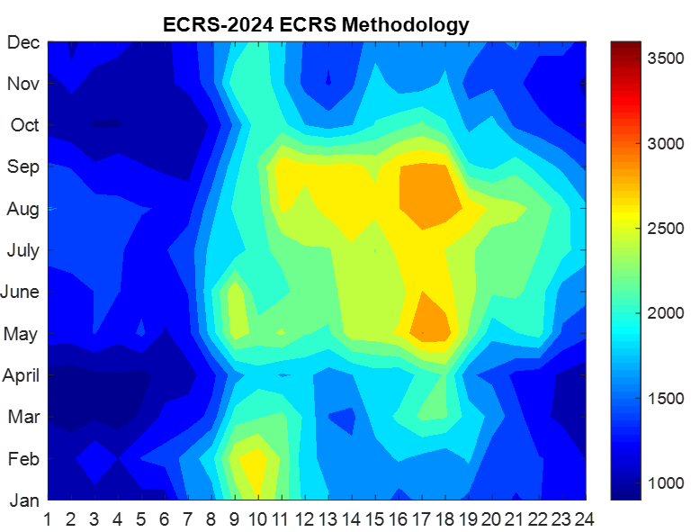
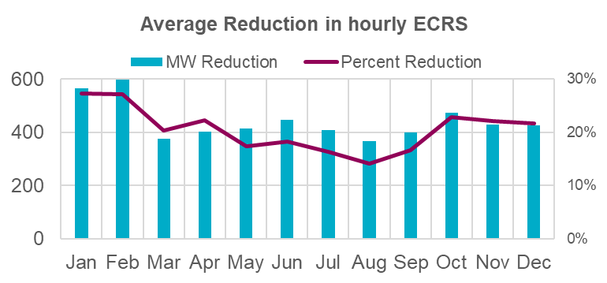
2024 vs 2023 ECRS Methodology
Avg | 1,752 | MW
Min | 889 | MW
Max | 3,007 | MW
Avg | 2,194 | MW
Min | 1,203 | MW
Max | 3,548 | MW
The changes made to the 2024 ECRS methodology resulted in reducing ECRS quantities.
On an average the ECRS quantity reduced by 442 MW in each hour (~21% reduction).

Slide 11
2024 ECRS Methodology - Summary
ERCOT is not proposing any further changes in the ECRS methodology for 2024.
The IMM continues to advocate that the methodology for computing minimum ECRS requirements be revisited.
ERCOT is open to continue discussing the IMM’s feedback on this as a part of the PUC AS study discussion.
Under the PUC AS study, ERCOT and the IMM can revisit the ECRS methodology to consider the various operating scenarios under which ECRS deployment may be needed and the probabilistic risk of these and other contingencies, with the aim to formulating an approach for computing ECRS quantities in future.

Slide 12
ECRS Deployment Introduction
ECRS can be released automatically and manually.
Automatic release of ECRS triggers during a unit-trip type event when frequency drops below 59.91 Hz.
Only SCED Dispatchable ECRS is released automatically.
Manual release triggers are currently based on the following two assessments of available dispatchable capacity to serve forecasted 10 minute ahead net load:
10-min Net Load Ramp Capability
10-min Remaining Ramping Capability minus 10-min Net Load Ramp Forecast
PRC Trigger
PRC – 3200 – (10-min Net Load Ramp Forecast) + QSGR
Some of the release of ECRS last summer occurred on scarcity days - i.e., days when the available dispatchable capacity was limited and the net load was extremely high. The manual ECRS triggers described above are not designed for these type of days. Arguably, on these days some portion of ECRS could have been released earlier.

Slide 13
Options for releasing ECRS earlier
The IMM shared the following ideas on potential concepts that could be considered for releasing ECRS (prior to RTC):
Option 1: Release chunks of ECRS manually at particular system lambda price triggers
Option 2: Release chunks of ECRS at particular amounts of undergeneration
Option 3: Standing deployment of some portion of ECRS at an Energy offer floor
ERCOT has reviewed these ideas and is agreeable to making Nodal Protocol changes to adopt a concept like the one described in Option 3. Since this concept may need some system changes (potentially both for systems in ERCOT and at Market Participant end), this option may not be feasible to implement by Summer 2024.
For Summer 2024, ERCOT has worked with the IMM to develop a concept for releasing ECRS using Option 2 above. The next few slides will delve into the details of this potential trigger for releasing ECRS.

Slide 14
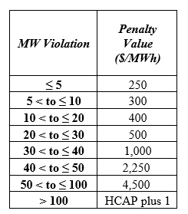
SCED Power Balance Penalty and Under-Generation
The Power Balance constraint is the balance between the ERCOT System Load and the amount of generation that is dispatched by SCED to meet that load.
The Power Balance Penalty curve reflects the penalty for violating the Power Balance constraint.
SCED/Solver will only allow such violations when it makes sense to incur the sharp penalty (i.e. there is no other economic option for dispatching energy).

Slide 15
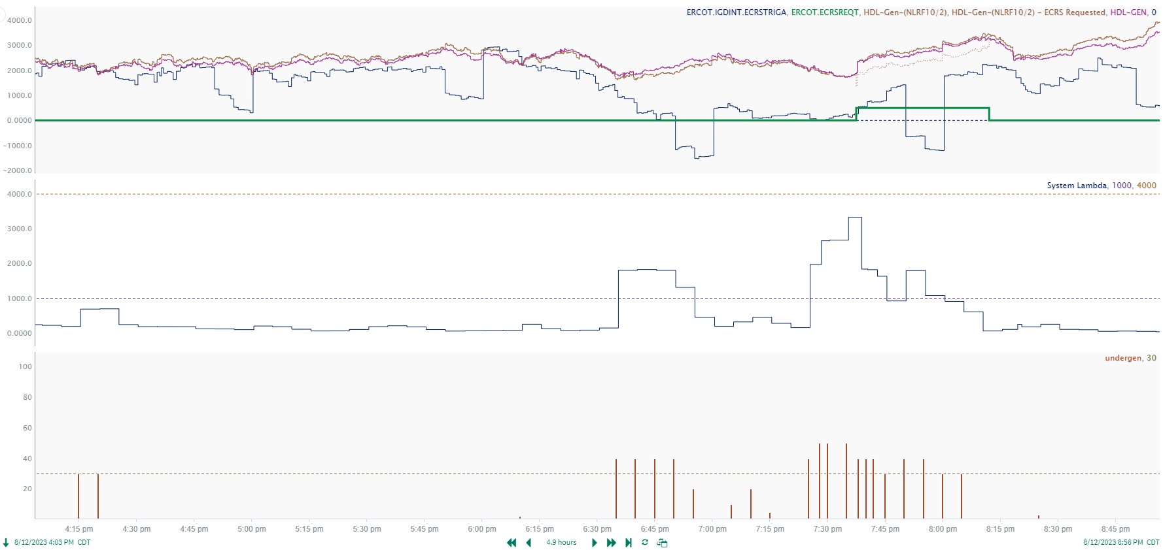
Example: 8/12/2023
Historical ECRS Release at: 7:37 PM
SCED Under-Generation
On this day SCED started violating the Power Balance constraint almost an hour prior to the time when ECRS released.

Slide 16
New Manual Trigger for deploying ECRS using Undergen
Concept: Release SCED dispatchable ECRS in blocks of 500 MW when in Real Time, SCED starts using Power Balance Penalty to forgo dispatching at least X MWs - i.e,. total SCED BPs is less than GTBD consistently for Y consecutive minutes.
This condition would be an indication that from SCED perspective it is more economic to rely on Regulation than deploy higher priced MWs.
Some portion of procured ECRS is to ensure that ERCOT has sufficient capacity that can respond and help recover frequency within NERC established requirements.
NERC’s BAL-002 requires frequency to be recovered within 15 minutes after a large unit trip.
Hence when manually deploying ECRS, ERCOT will preserve some SCED dispatchable ECRS capacity and release the remaining in small blocks of up to 500 MW when the ECRS manual deployment trigger is met.
The preserved SCED-dispatchable ECRS will be released based on existing automatic frequency-based triggers or manually when a “must-release” stage is reached.

Slide 17
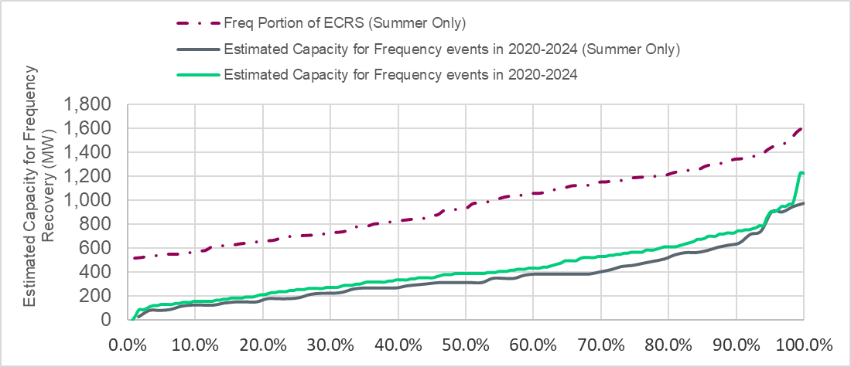
Capacity for Frequency Recovery
A review of historical frequency events between 2020 and 2024 was conducted to estimate the capacity needed for recovering frequency to 59.98 Hz in these events as
Recovery-MW = (59.98Hz – B_{point}) * 895 MW/0.1Hz * 10
Based on this analysis, approximately 900 MW of SCED-dispatchable ECRS capacity is needed to recover frequency during most of the unit trip events that are typically experienced.
Percentile | Est. Capacity (Summer) | Est. Capacity
50th | 313.3 MW | 384.8 MW
70th | 409.9 MW | 528.0 MW
90th | 640.8 MW | 737.5 MW
95th | 887.8 MW | 897.2 MW
Max | 958.4 MW | 1226.2 MW

Slide 18
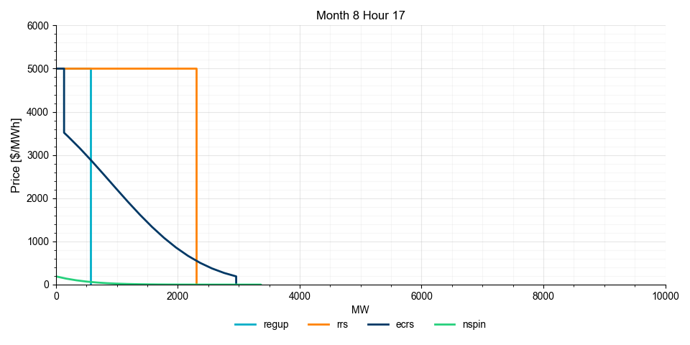
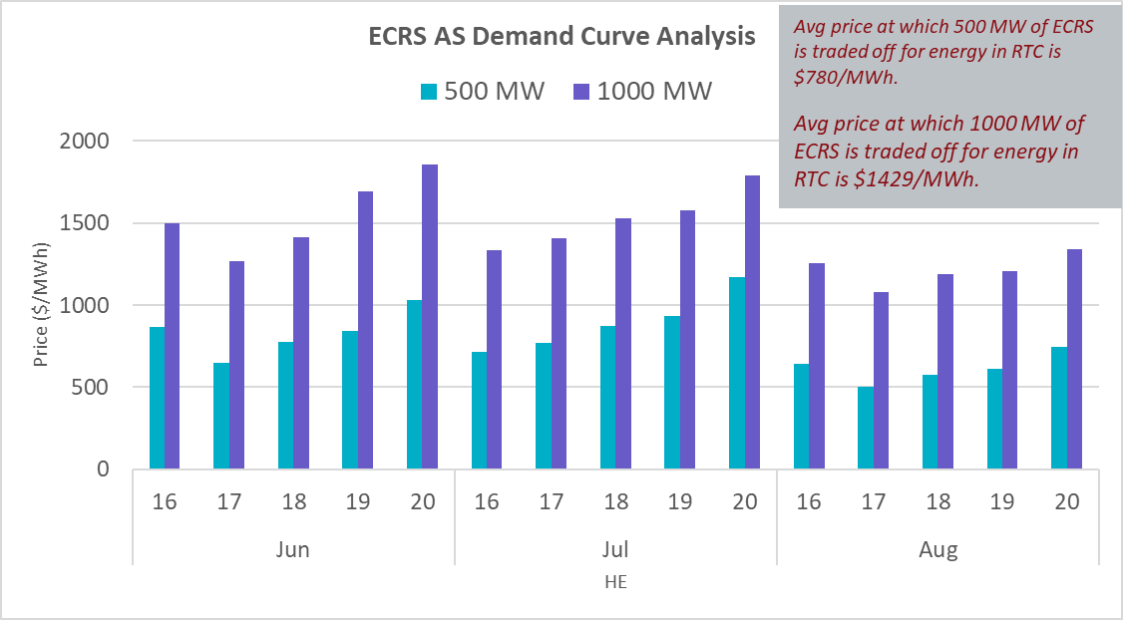
Quick Review of RTC AS Demand Curves
At its Feb 21, 2024 meeting, the RTC+B Task Force reviewed the policy that has been approved to build AS Demand Curves for RTC.
The ECRS AS Demand Curves that would be produced for HE16 to HE20 in June, July and August 2024 were reviewed specifically to understand the price point at which RTC SCED would start going short on ECRS procurement during these hours.
~500 MW trade off in ECRS procurement at price of $503/MWh
During peak summer hours, when prices reach approximately $780/MWh, it is expected that RTC SCED will be short at least 500 MW in ECRS procurement, effectively releasing 500 MW of capacity for the energy market.

Slide 19
New Manual Trigger: Parameter Selection
Concept: Release SCED dispatchable ECRS in blocks of 500 MW when in Real Time, SCED starts using Power Balance Penalty to forgo dispatching atleast X MWs - i.e., total SCED BPs is less than GTBD consistently for Y consecutive minutes.
This condition would be an indication that from SCED perspective it is more economic to rely on Regulation than deploy higher priced MWs.
A goal to select a value of X & Y can be such that the manual release of ECRS would closely mimic how the procurement of ECRS would work when RTC is implemented.
In reviewing the historic operations since implementation of ECRS, and the ASDC analysis, selection of X = 30 MW and Y = 10 minutes would result in the first 500 MW of ECRS being released when system lambda is likely around $500/MWh or higher.

Slide 20
Example: 8/12/2023
Historical ECRS Release at: 7:37 PM
SCED Under-Generation
Under-Generation >= 30 for 10 minutes
Trigger at: 6:45 PM
With X=30 and Y=10, this new trigger would recommend an earlier release of ECRS in this case.

Slide 21
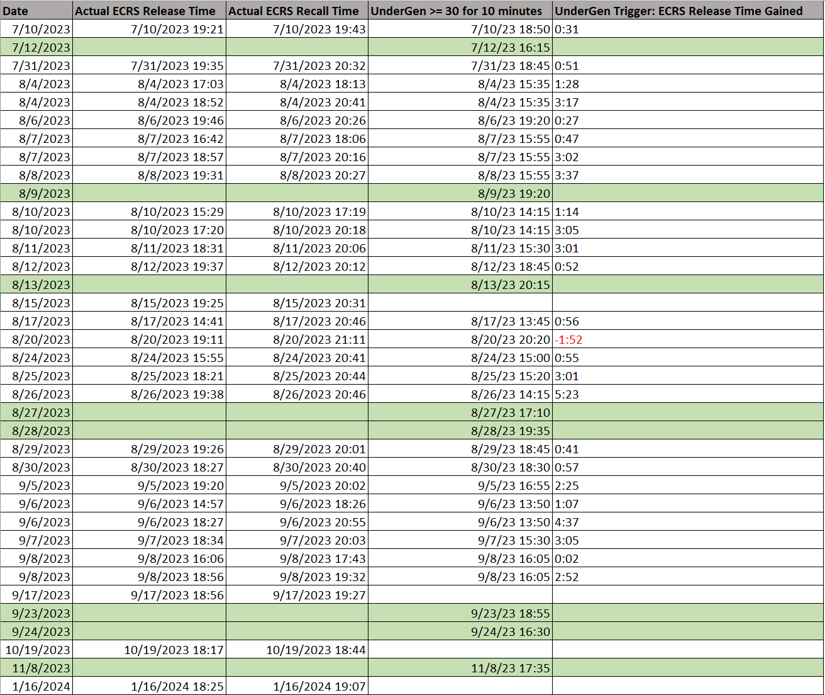
New Manual Trigger: Some Considerations
Using X=30, Y=10 on operation data since July 1, 2023 to test when the undergeneration based concept would trigger ECRS release, it was observed that the concept picked:
same days when ECRS was released but in many cases indicates the need to release ECRS earlier
new days when ECRS wasn’t released
days with high pricing due to high congestion costs
Green indicates a day with no historical ECRS Release

Slide 22
New Manual Trigger: Deployments and Recall
Release ECRS when in Real Time, SCED starts using Power Balance Penalty to forgo dispatching at least X MWs - i.e., total SCED BPs is less than GTBD consistently for Y consecutive minutes.
Deployment
When this trigger is met ECRS, ERCOT may release up to 500 MW of SCED Dispatchable ECRS capacity.
If after releasing ECRS, X MW or more of undergen continues to persists, ERCOT may further release ECRS in small blocks of up to 500 MW.
Note that when manually releasing ECRS, ERCOT plans to preserve 900 MW of SCED Dispatchable ECRS for frequency recovery. However, if undergen continues to persist and/or dispatchable headroom continues to decline releasing ECRS in small blocks is expected to continue till undergen reduces or all of SCED dispatchable ECRS is released.
Recall
ERCOT will recall ECRS using the following two approaches,
Monitor SCED undergeneration MW as well and may recall when under-gen is at 0 MW for more than 30 consecutive minutes OR
Recall ECRS deployment after sunset - i.e., after the need for ECRS has ended

Slide 23
Summary and Next Steps
ERCOT is not proposing any further changes to the methodology used for computing minimum ECRS quantities in 2024.
ERCOT is open to continue discussing the IMM’s feedback on this as a part of the PUC AS study and 2025 AS Methodology discussion.
ERCOT is agreeable to a new trigger to deploy SCED Dispatchable ECRS.
Parameters for this new trigger will need to be defined.
ERCOT will work with the IMM to refine the concept to release a portion of ECRS at a designated Energy Offer floor and will aim to publish an NPRR for consideration at the June 13, 2024 Protocols Revision Subcommittee (PRS) meeting.
ERCOT requests stakeholder feedback on ECRS release, including parameters for the new manual trigger. Email: nmago@ercot.com.
Timeline for Discussion
March 19, 2024 – Workshop
April 03, 2024 – WMS
April 04, 2024 – ROS
April 15, 2024 – TAC
April 23, 2024 – BoD

