Slide 1
ASDCs under RTC
Shams Siddiqi, Ph.D.
Hunt Energy Network (HEN)
(512) 619-3532
shams@crescentpower.net
RTCBTF Meeting
March 19, 2024

Slide 2
AS Products under RTC
RTC:
  VOLL = $5,000/MWh
  Energy Offer Cap = $2,000/MWh in RT (RTSWCAP), $5,000/MWh in DAM
  Energy Bid Cap = $2,000/MW in RT (?), $5,000/MWh in DAM (?)
  PBPC = $7,000.01/MWh = VOLL + RTSWCAP + $0.01/MWh in RT (N/A in DAM?)
  Energy Price Cap = $5,000/MWh (excluding congestion)
  Ancillary Service Offer Cap = $5,000/MWh in RT and DAM
Regulation Service remains the same under RTC – deployed by LFC. However, since ASDCs are capped at VOLL, Reg-Up capacity awarded may be less than AS Plan if LMP>ASDC
RRS should no longer be released to SCED under RTC and only auto-deployed based on frequency (manual deployment should be avoided). However, since ASDCs are capped at VOLL, RRS capacity awarded may be less than AS Plan if LMP>ASDC
ECRS (except NCLR?) becomes a “capacity” price product under RTC – never deployed but provides additional price support and commitment incentive for 10-minute ramp capable capacity – award level depends on ASDC
  No EOC floor
Non-Spin (except offline and NCLR?) becomes a “capacity” price product under RTC – never deployed but provides additional price support and commitment incentive for 30-minute ramp capable capacity – award level depends on ASDC
  No EOC floor

Slide 3
Grid Reliability under RTC
During severe scarcity under RTC:
  If EOC=$2,000/MWh and AS Offer=$5,000/MW, no AS may be awarded if ASDC<=$5,000/MW
Lessons learned from Uri: Grid needs to maintain at least 1,500MW of RRS to prevent total collapse from an additional 1,500MW of GR tripping even if it requires firm Load shed – this implies ASDC for first 1,500MW of RRS should be PBPC + Reg-Down ASDC
  Reflects opportunity cost of Energy at PBPC and Reg-Down at Reg-Down ASDC
Ideally, all critical reliability AS (RRS and Reg-Up) should have their AS Plan amount (these are minimum requirements) with ASDCs set at PBPC + Reg-Down ASDC
  Note: Reg-Down can have an ASDC lower than VOLL, say $2,000/MW, in which case the RRS and Reg-Up ASDC values would be lowered to $9,001/MWh
MCPC Cap = $5,000/MW – ensures RRS & Reg-Up are procured but MCPCs capped
  So, MCPCs during severe scarcity will remain the same with this change; however, critical AS would be procured
ECRS and Non-Spin under RTC are for sending capacity value prices similar to the ORDC. Thus, ECRS and Non-Spin ASDCs can be based on the ORDC after accounting for RRS and Reg-Up AS Plan amounts
  Note: Are 2 capacity price products needed particularly if DRRS eliminates the need for Non-Spin?
Duration limits amount of capacity eligible to provide ECRS and Non-Spin, but in RT under normal conditions, the opportunity cost of providing ECRS and Non-Spin will be minimal and result in lower MCPCs under RTC. DAM AS market, being financial, will tend to converge to RTM prices. RTC will result in significant loss of current price support for Resources.
Critically important that ASDCs are designed properly to not exacerbate that situation.

Slide 4
ORDC Design Elements
ORDC was designed to provide capacity (operating reserves) price signals for Online and Offline available capacity in a way such that energy prices would not exceed VOLL
  ORDC was not used to procure AS in DAM or RTM and thus did not have to account for opportunity cost in order to ensure adequate procurement of reliability AS products – AS procurement in DAM was based on penalty functions that were much higher than VOLL
Under RTC, ASDCs are used to procure AS products - some of which are essential for grid reliability
  Thus, AS products essential for reliability must take into account opportunity costs in order not be under-procured and expose the reliability of the grid
There is no separate ASDC for Offline AS products – thus, all AS products are based only on Online reserve value – e.g., offline Non-Spin receives the same clearing price as online Non-Spin
Current ORDC assumes Offline (30-min) capacity is deployed at the time of SCED run such that Offline capacity is available to offset loss of Load in 30-mins (2nd half of the next 1-hour) when in reality telemetered Offline capacity isn’t actually deployed at the time of SCED run and won’t be running in the second 30 minutes of the hour
  These assumptions were necessary to provide a capacity value to Offline capacity but also reduced the value of Online capacity
Also, current ORDC can significantly reduce in value during scarcity whereas ASDCs need to be higher during such intervals to ensure adequate AS is procured
Thus, ASDCs should be created from the ORDC with no reduction in VOLL for higher System Lambda and considering all AS capacity to be Online

Slide 5
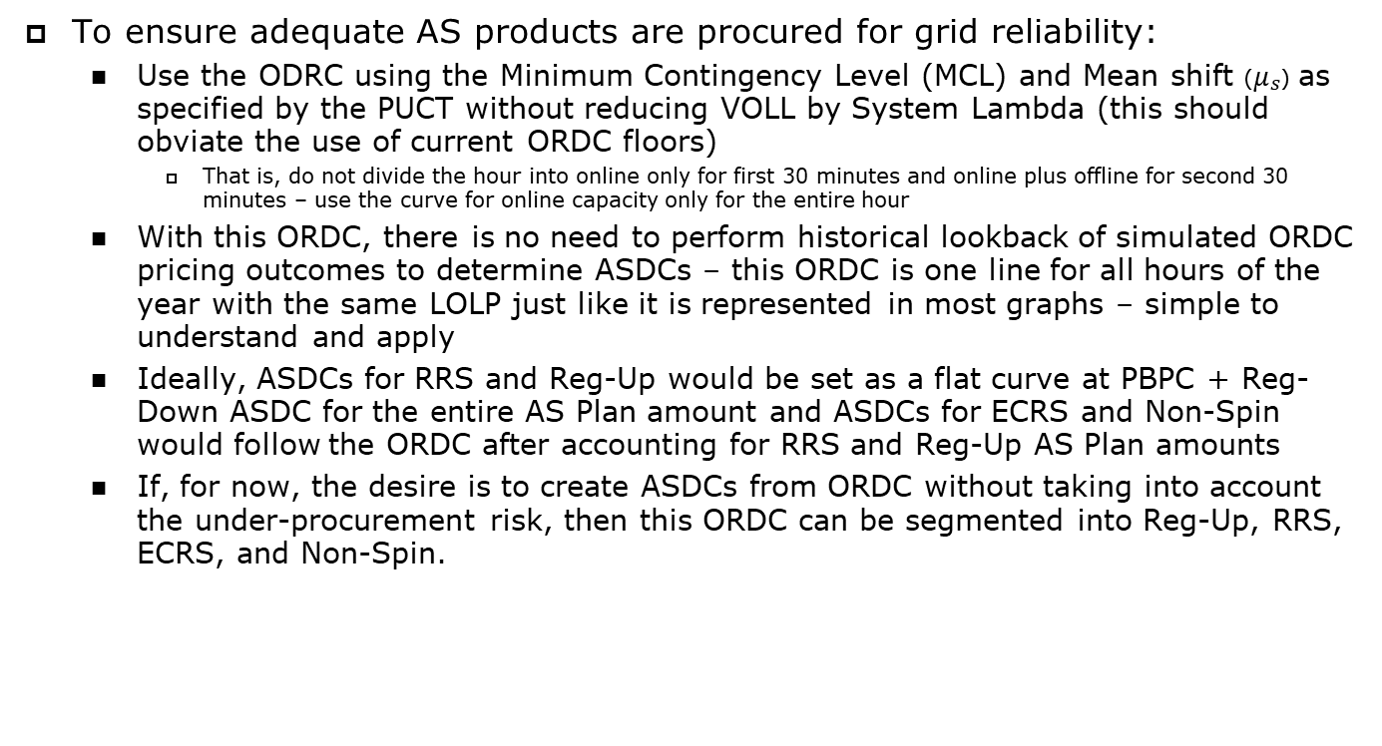
Proposed ASDC Design
To ensure adequate AS products are procured for grid reliability:
  Use the ODRC using the Minimum Contingency Level (MCL) and Mean shift ($μ_{s}$) as specified by the PUCT without reducing VOLL by System Lambda (this should obviate the use of current ORDC floors)
    That is, do not divide the hour into online only for first 30 minutes and online plus offline for second 30 minutes – use the curve for online capacity only for the entire hour
  With this ORDC, there is no need to perform historical lookback of simulated ORDC pricing outcomes to determine ASDCs – this ORDC is one line for all hours of the year with the same LOLP just like it is represented in most graphs – simple to understand and apply
  Ideally, ASDCs for RRS and Reg-Up would be set as a flat curve at PBPC + Reg-Down ASDC for the entire AS Plan amount and ASDCs for ECRS and Non-Spin would follow the ORDC after accounting for RRS and Reg-Up AS Plan amounts
  If, for now, the desire is to create ASDCs from ORDC without taking into account the under-procurement risk, then this ORDC can be segmented into Reg-Up, RRS, ECRS, and Non-Spin.

