Slide 1
ESR Mitigation
Recommendation Impacts
Market Analysis & Validation
CMWG
March 2024

Slide 2
Recap
Over the course of 2023, ERCOT began evaluating approaches for an enduring mitigation framework for Energy Storage Resources (ESRs)
Recommendation to TAC in December ‘23: work together to develop a fair, effective, and enduring… framework and provide another report and recommendation to TAC no later than December 31, 2024.

Slide 3
Frameworks Reviewed
ERCOT and CMWG stakeholders reviewed different frameworks to help inform the design of a future MOC.
CAISO Default Energy Bid
Use DAM prices x a scaling factor for opportunity cost. Most advanced market in terms of ESR participation and the most comprehensive MOC design elements
“Just-in-time” Framework
Review concepts around MOC contemplated for Reliability Must Run (RMR) Resources to determine what may be instructive for a MOC for ESRs, specifically the idea around using a constraint’s shadow price cap to dynamically determine a Resource’s MOC

Slide 4
Frameworks Reviewed
Next slides use a lookback of 2023 ERCOT market data to compare, contrast and understand the relative impact to ESRs had these different MOC frameworks been in place.

Slide 5
Mitigation Strategies
DAM x scalar
We find the highest price from the DAM for the relevant Settlement Point and multiply by a scalar (1.1 or 2).
The ESR MOC is lowered from the SWCAP to this value new value.
Just-in-time
We consider the constraints an ESR can help by at least -0.2 (those that have a more negative shift factor).
We find the highest contribution factor (-1 * max constraint shadow price * shift factor).
The ESR MOC is lowered from the SWCAP to the max contribution factor minus one cent.
Note that these MOC changes can only impact SCED results if the ESR is flagged in the SCED CCT process.

Slide 6
Analysis Methodology
The table shows how often each mitigation strategy would impact SCED
An interval is considered “impacted” if the dispatch differs by at least 0.1 MW between the original EOC and the EOC mitigated by the different proposals using the production LMP for both. This will tell us how often SCED would be impacted but would not show the correct dispatch.
We could only determine the actual MW dispatch difference by rerunning SCED.
The case studies involve SCED reruns

Slide 7
Impacts from different proposals
Proposal | Unique SCED intervals | Unique Resources | Resource-intervals | Mitigated over 1 hour | Greatest daily mitigation (hours)
DAM * 1.1 | 3,166 | 64 | 5,904 | 97 | 7.2
DAM * 2 | 1,115 | 51 | 2,130 | 32 | 2.7
Just-in-Time | 358 | 14 | 581 | 12 | 2.4
Notes:
An interval is considered “impacted” if the dispatch differs by at least 0.1 MW between the original EOC and the EOC mitigated by the different proposals using the production LMP for both. If we were to rerun, the difference in that specific resource may or may not exist, but there would be an impact to the objective function.
We could not tell the actual dispatch amount difference without rerunning SCED.
‘Mitgated over 1 hour’ looks at whether there is at least 1 hour of mitigation within a 2-hour period. There is a limit of 1 instance per resource per day.

Slide 8
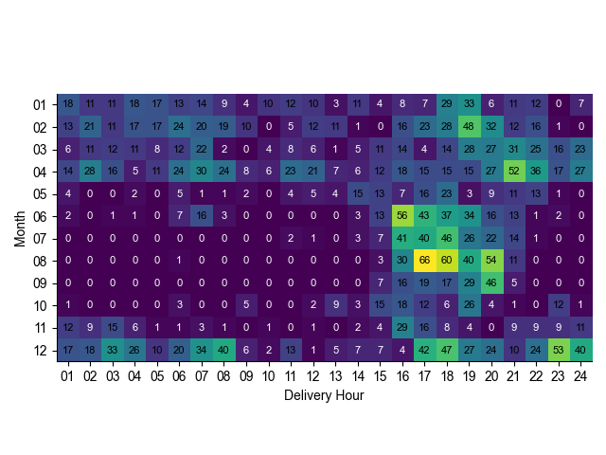
DAM x 1.1 - affected intervals by month and delivery hour

Slide 9
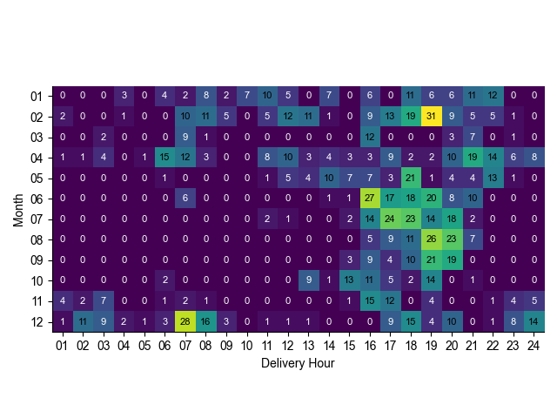
DAM x 2 - affected intervals by month and delivery hour

Slide 10
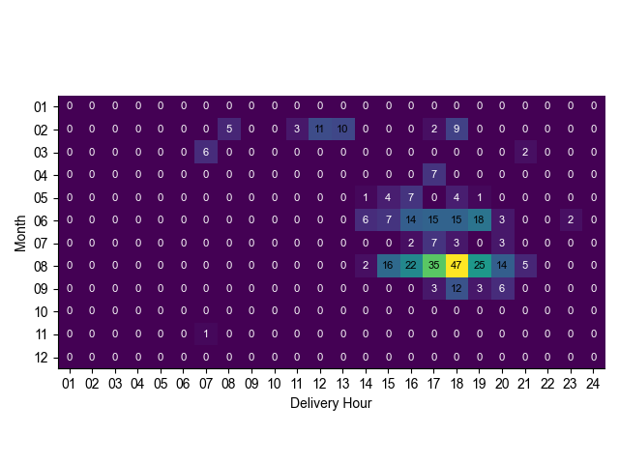
Just-in-time - affected intervals by month and delivery hour

Slide 11
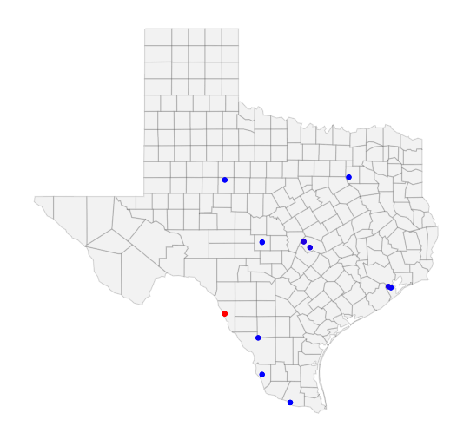
Just-in-time - mitigated intervals

Slide 12
Case Study: SCED interval 2023-03-25 20:05
BRP_PBL1_UNIT1 (and BRP_PBL2_UNIT1)
CROSSETT_BES1 (and CROSSETT_BES2)
CATARINA_BESS

Slide 13
Mitigation in SCED
$$MOC Curve=MAX(Mit Offer Floor,MIN\left(EOC, MAX\left(Mit Offer Cap, Ref LMP+0.01∗MOC at LSL\right)\right))$$
The mitigated offer cap will only be applicable if it is greater than the reference LMP. It will cap the energy offer curve at this value.

Slide 14
Case Study Just-in-time Mitigation Strategy

Slide 15
Just-in-time Mitigation Case Study: BRP_PBL1_UNIT1
Max contribution factor = 681.8
-0.243 shift factor on constraint with a max shadow price of $2,800/MWh
Notes:
Dispatch increases to help relieve congestion

Slide 16
Just-in-time Mitigation Case Study: CROSSETT_BES1
No mitigation. No shift factors met -0.2 threshold.
Notes:
Curve is unchanged

Slide 17
Just-in-time Mitigation Case Study: CATARINA_BESS
Max contribution factor = 960.1
-0.274 shift factor on constraint with a max shadow price of $3,500/MWh
Notes:
Dispatch remains unchanged. LMP increases due to co-optimization between this resource and BRP_PBL1_UNIT1

Slide 18
Case Study DAM x Scalar Mitigation Strategy

Slide 19
DAM Mitigation Case Study: BRP_PBL1_UNIT1
177.88 max DAM price
250.85 reference LMP
Reference LMP used for scalar of 1.1
at HDL

Slide 20
DAM Mitigation Case Study: CROSSETT_BES1
242.99 max DAM price
330.35 reference LMP
Reference LMP used for scalar of 1.1
at HDL

Slide 21
DAM Mitigation Case Study: CATARINA_BESS
153.14 max DAM price
Reference LMP lower than DAM for all values
at HDL

Slide 22
Case study comparison: SBE2ASH8 TURTLECK_WCRYS_1 impact
 | Original | DAM * 1.1 | DAM * 2 | Last-in-line
Shadow Price ($/MW) | 2,800 | 0 | 71 | 1,165
Violation (MW) | 0.93 | 0 | 0 | 0

Slide 23
Takeaways
Just-in-time
This strategy mitigates resources when the ability to abuse market power due to local market conditions exists. This is the goal of mitigation in ERCOT.
There were only two instances in 2023 when a resource was mitigated over 2 hours in a day using this strategy.
DAM x scalar
This strategy both over- and under-mitigates. Resources are often mitigated due to DA/RT price divergences.
Resources are marginal much more than the last-in-line strategy due to the severity of mitigation.

Slide 24
Discussion

