Slide 1
RTC+B Task Force
Update
Matt Mereness
RTCBTF
March 19, 2024

Slide 2
Outline
Brief Program update: RTC+B Program Update from Feb Board T&S
Reminder of RTCBTF Review Cycle
Review of Issues List
Today’s topics relate to Issues List:
  Issue 4 - Verifiable Cost Manual (Change for on-line hydro Resources per Key Principle 1.3(3))
    (Initial review)
  Issue 18 - Review of the AS Demand Curves in the context of current policy
    (ERCOT to answer any questions about current implementation)
  Issue 17 - RUC Capacity Short
    (ERCOT received no questions or alternative, prepared to walk through details from prior meeting or examples)
Multiple requests to complete by 1pm today

Slide 3
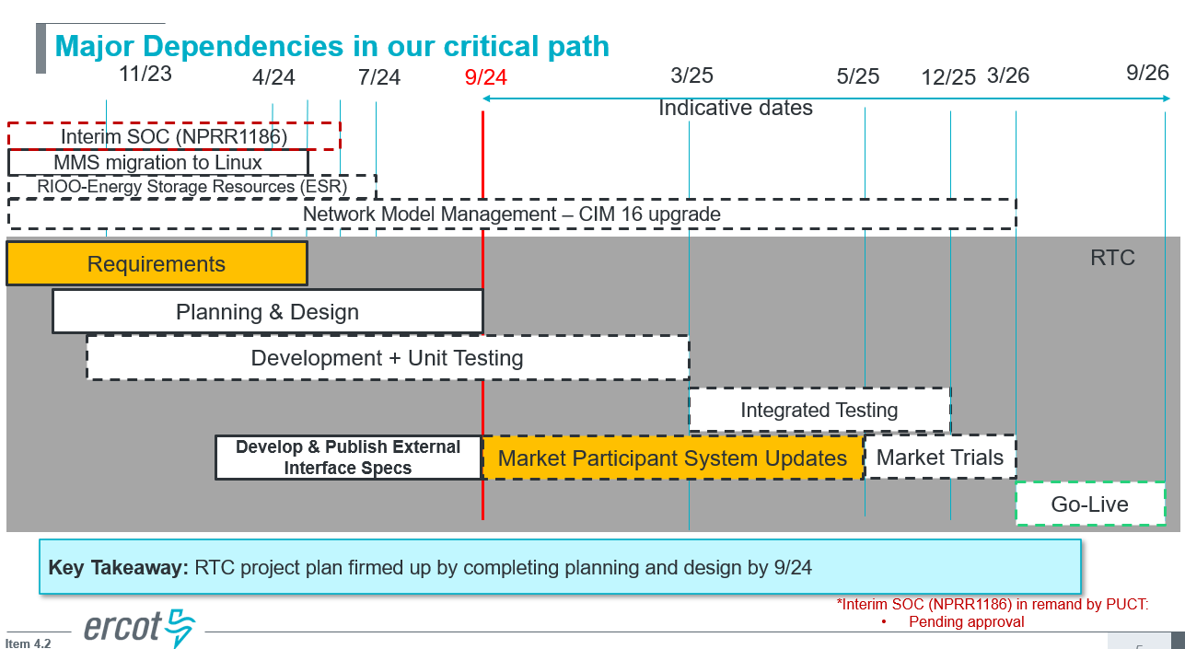
RTC+B Program Update
(excerpt from Feb Board T&S RTC Update)

Slide 4
Plans for Meetings and Review Cycles
Reminder of RTC+B Program Scope
  RTC Key Principles were approved to lay foundation of NPRR1007-1013
    Consolidated Key Principles: https://www.ercot.com/files/docs/2020/04/01/RTC_Key_Principle_Quick_Reference.docx
    Library of Key Principles: https://www.ercot.com/mktrules/puctDirectives/rtCoOptimization
  Battery Key Topic Concepts approved to lay foundation of NPRR1014
    https://www.ercot.com/mktrules/keypriorities/bes
  RTC State-of-Charge accounting in NPRR1204
Objective is to present concepts or issues that need to be resolved for an effective implementation.
  Coordinating timelines for interface requirements and testing,
  Providing the forum for any analysis or policy decisions (such as parameter values)
  Coordinating market readiness and cutover activities,
  Review draft Revision Requests or other artifacts necessary to successfully implement the program within the identified timeframes, and discussing other details as needed.
Lessons learned from RTCTF to avoid being delayed in decisions:
  Meeting #1: Initial concept presented by ERCOT staff
  Meeting #2: Comments and alternatives presented by MPs
  Meeting #3: RTCTF consensus achieved or escalated to TAC for a vote to decide the matter.

Slide 5
Current Issues List
Link to this issues on today’s meeting page

Slide 6
Proceed with rest of meeting
Any questions before we start today’s topics?
  Issue 4 - Verifiable Cost Manual (Change for on-line hydro Resources per Key Principle 1.3(3))
    (Initial review)
  Issue 18 - Review of the AS Demand Curves in the context of current policy
    (ERCOT to answer any questions about current implementation)
  Issue 17 - RUC Capacity Short
    (ERCOT received no questions or alternative, prepared to walk through details from prior meeting or examples)

