Slide 1
South Texas Wind Events
November 2023 – January 2024
Patrick Gravois
Operations Engineer – Operations Analysis
IBRWG Meeting
March 8, 2024

Slide 2
Overview of Events
Three events occurred on
  November 7, 2023, @ 14:01
  December 10, 2023, @ 01:04
  January 16, 2024, @ 03:45
All three events preceded by normally cleared faults followed by large temporary reduction of wind generation during fault and small post-disturbance loss of generation

Slide 3
November 7, 2023, Event
@ 14:00:50, fault occurred on 138 kV in South Texas followed by temporary reduction and post-disturbance MW losses shown below
All wind facilities, no significant reduction in solar
System frequency dropped 0.028 Hz and recovered in 5 seconds
Reclose attempt 30 seconds later, results below based on performance during original fault

Slide 4
November 7, 2023, Event
RFIs went out to facilities that did not return to near pre-disturbance output within 2 seconds (Plants F,G,L,M, and P).
Plants F,G,L, and M reported turbines tripping due to grid voltage disturbance and working with OEMs to review ride-through settings.
Plant P did not have turbines trip but had a slow recovery. Similar performance seen during Jan.16, 2024 event. RE currently investigating.
Plants D,E,K,N, and Q all have OEM4 turbines and had similar performance in which real power drops by ~1/2 and takes ~2 seconds to recover to pre-disturbance output.
ERCOT will evaluate with OEM4 to determine if this is expected performance and if improvements are feasible.

Slide 5
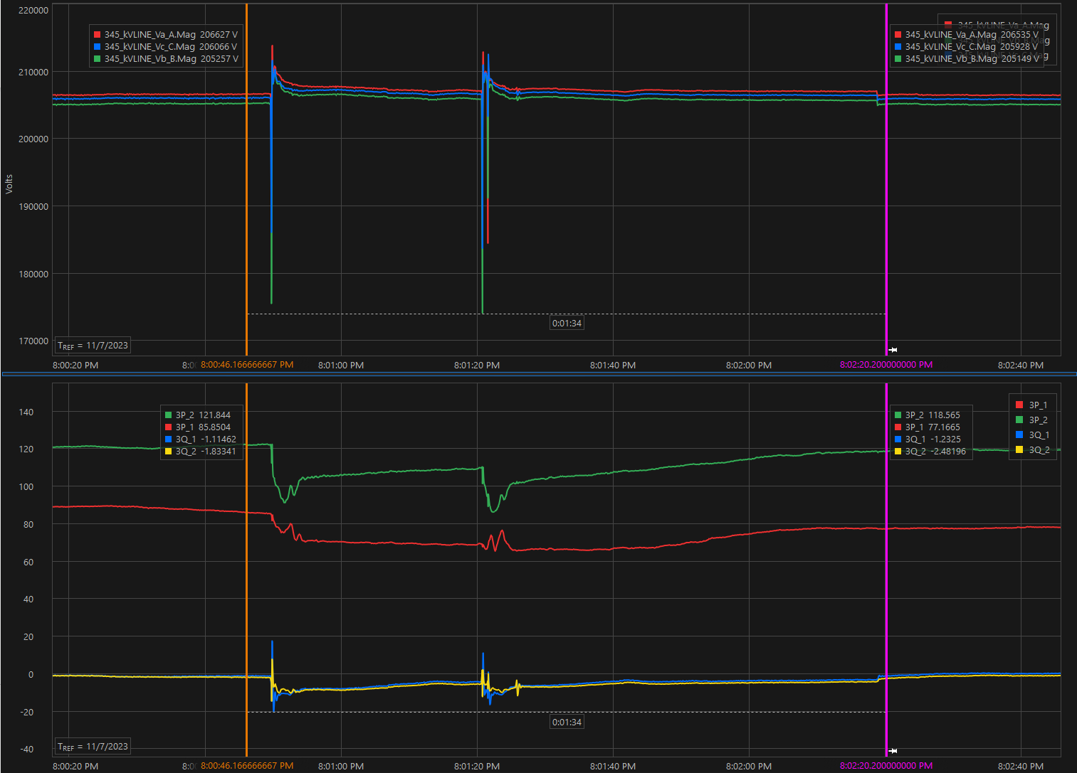
Plant P Performance for November 7, 2023, Event
C-phase voltage drops to 0.88pu and recovers in ~100 ms
Both units drop active power after voltage recovers and slowly begin to recover
2nd fault occurs 30 seconds later and active power drops again
Units recover to near pre-disturbance output ~1.5 minutes after original fault

Slide 6
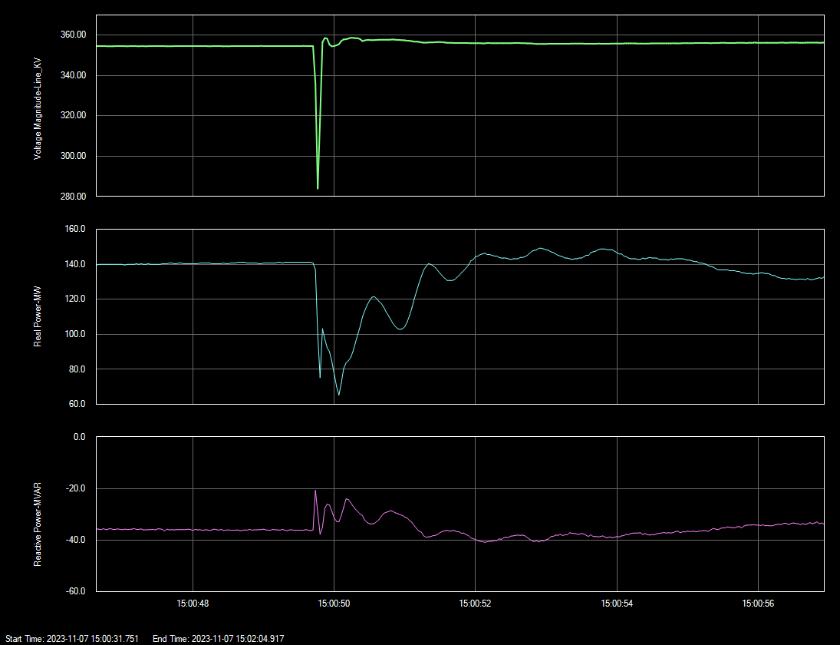
Plant Q Performance for November 7, 2023, Event
Positive sequence voltage drops to 0.82pu and recovers in 100 ms
Active power drops to ~1/2 pre-disturbance output and recovers in ~2 seconds
Similar performance for all facilities with OEM4 turbines

Slide 7
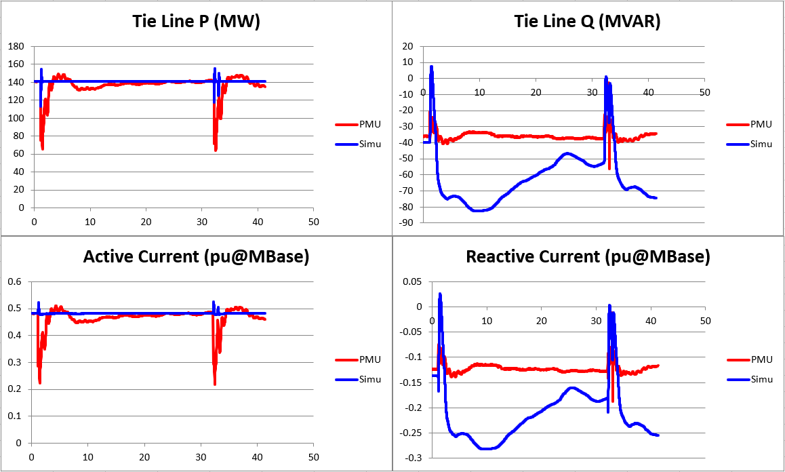
Plant Q Model Validation for Nov.7 Event

Slide 8
December 10, 2023, Event
@ 01:03:52, fault occurred on 138 kV in South Texas followed by temporary reduction and post- disturbance MW losses shown below
All wind facilities
System frequency dropped 0.063 Hz and recovered in 7 seconds

Slide 9
December 10, 2023, Event
No RFIs went out for this event. ERCOT did not identify and perform full analysis at time of event due to the small amount of post-disturbance MW loss.
Plant O had similar performance issues for Jan. 16, 2024, event and ERCOT has since sent RFI to this RE.
Other post-disturbance losses were quite small relative to pre-disturbance output (<5%).
Similar performance seen for facilities with OEM4 turbines, which accounted for 700 MW of temporary reduction during fault

Slide 10
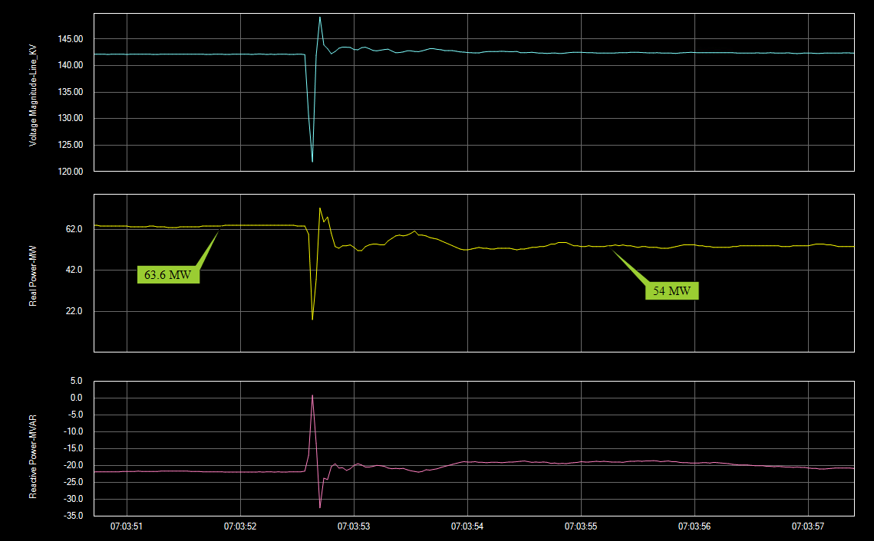
Plant O Performance for December 10, 2023, Event
Positive sequence voltage drops to 0.88pu and recovers in 100 ms
Positive sequence voltage overshoot reaches 1.08pu
Unit recovers to pre-disturbance output with voltage recovery then reduces ~10 MW
Similar performance during Jan. 16 event in which turbine tripping was reported

Slide 11
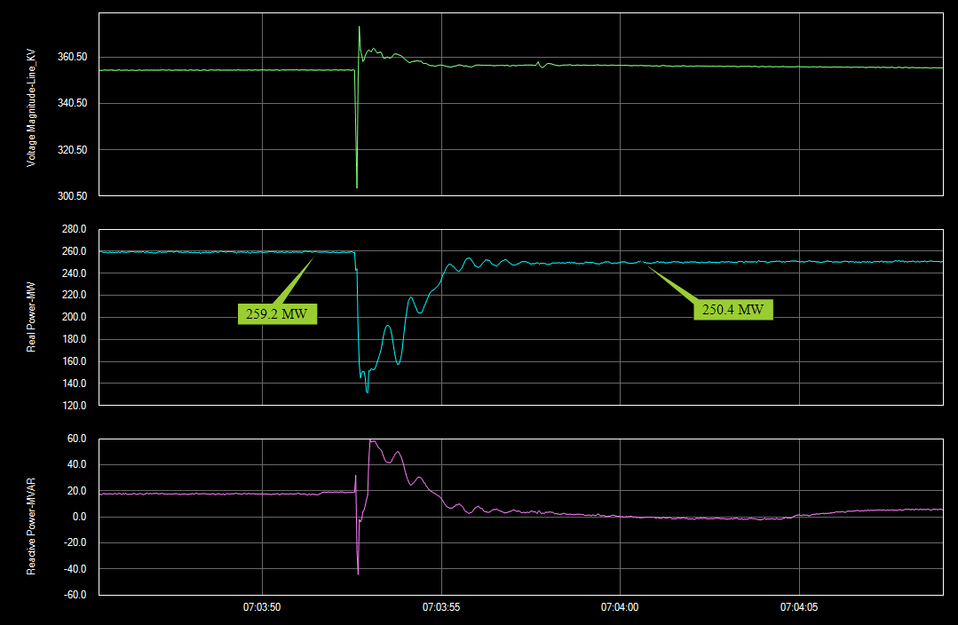
Plant E Performance for December 10, 2023, Event
Positive sequence voltage drops to 0.87pu and recovers in 100 ms
Active power drop to ~1/2 pre-disturbance output and recovers to near pre-disturbance output in ~2 seconds
Cause of plant not returning to full output undetermined
Similar performance for all facilities with OEM4 turbines

Slide 12
January 16, 2024, Event
@ 03:45:43, fault occurred on 138 kV in South Texas followed by temporary reduction and post-disturbance MW losses shown below
Reclose attempt and additional fault 2 seconds later; since units did not fully recover between original fault and reclose, there was an additional delay for unit recovery
All wind facilities
System frequency dropped 0.037 Hz and recovered in 9 seconds

Slide 13
January 16, 2024, Event
RFIs went out to facilities that did not return to near pre-disturbance output within 2 seconds after second fault (Plants B,L,M,O, and P).
Plant B investigating why active power dropped to 0 MW during faults and the root cause of any turbine trips.
Plant L/M reported 13 turbines between the two plants had crowbar failure, which causes turbines to disconnect when grid voltage is outside of 0.9pu to 1.1pu. Crowbar equipment has been replaced for 7 of the turbines and remaining 6 are in progress.
Plant O is still investigating the cause of turbine trips.
Plant P had same performance issues as Nov. 7 event in which active power drops after voltage recovers and return to pre-disturbance output takes up to 2 minutes. Still under investigation.

Slide 14
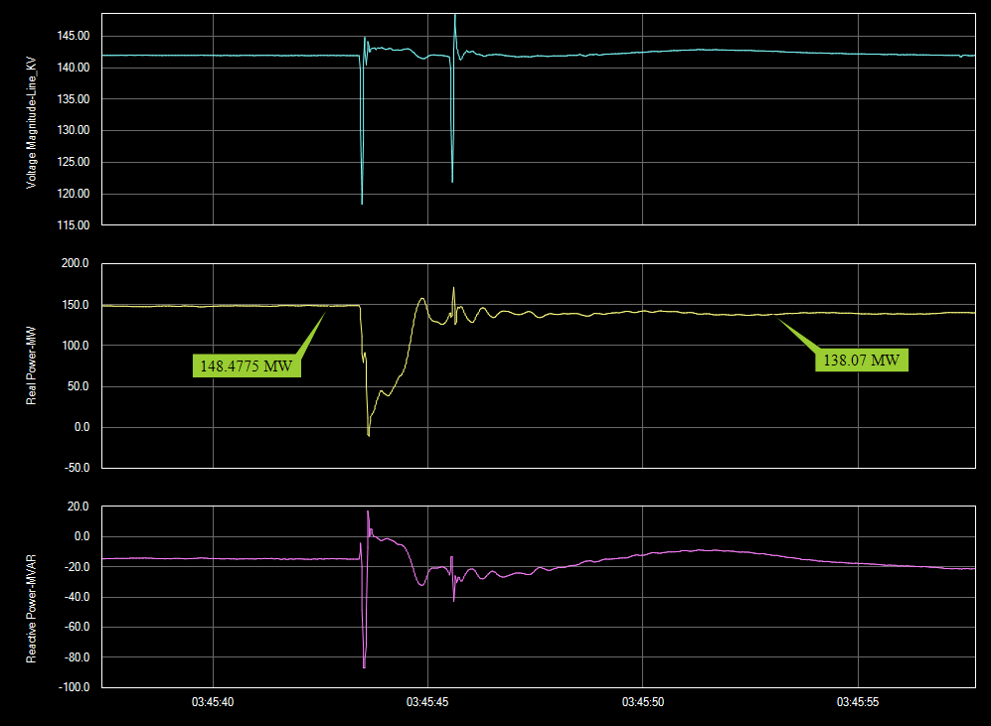
Plant B Performance for January 16, 2024, Event
Positive sequence voltage drops to 0.86pu and recovers in 100 ms
Active power drops to 0 MW during original fault and recovers to near pre-disturbance output within 2 seconds
Second fault occurs and plant reduces 10-11 MW.
Still under investigation if turbines tripped and reason why plant dropped to 0 MW during fault.

Slide 15
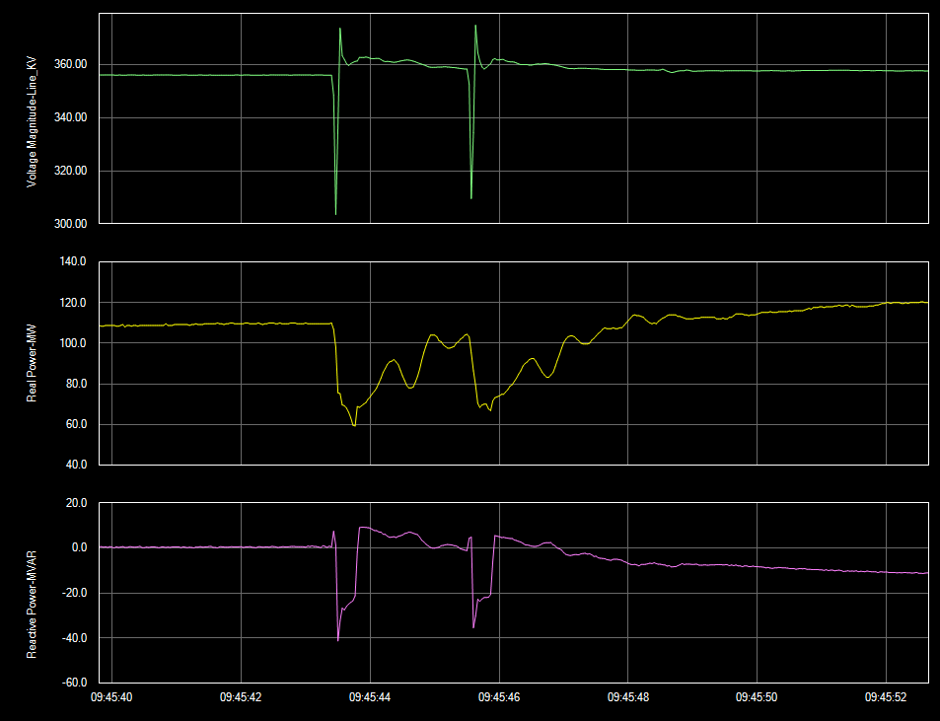
Plant D Performance for January 16, 2024, Event
Positive sequence voltage drops to 0.88pu and recovers in 100 ms
Active power drop to ~1/2 pre-disturbance output and mostly recovers before 2nd fault occurs 2 seconds later
Active power again drops by ~1/2 and recovers to pre-disturbance output 2 seconds later
Similar performance for all facilities with OEM4 turbines

Slide 16
Questions for OEMs and REs
Why is there such a large MW loss immediately after a shallow voltage dip fault?
What can be done to prevent such a large loss of active current immediately after the fault?
Is this expected performance based on your provided models?

Slide 17
Questions?

