Slide 1
Information Technology Report
Mick Hanna
Manager, Market Applications Services Support
ERCOT Public
March 2024

Slide 2
Incident Report Highlights
Service Availability – February 2024
  Retail Market IT systems did meet all SLA targets.
  Market Data Transparency IT systems met all SLA targets.
Retail Incidents & Maintenance – February 2024
  February 12 ERCOT experienced a degradation of outbound processing which began at 7:56 am to 8:57am on February 12, 2024. No data was lost but response times were adversely impacted.
  February 24-25 Retail Release.
Non-Retail Incidents & Maintenance –February 2024
  February 22 Planned Releases.
ListServ Incidents & Maintenance – February 2024
  No activities.
  SLA Documents and Incident Reporting
  https://www.ercot.com/services/sla/

Slide 3
MarkeTrak Performance
MarkeTrak
February 2024 | Availability (%) | Response Time (seconds) |  | SLO (seconds)
 |  | Monthly Average | 12 Month Average
API QueryDetail | 100.00 | .40 | .39 | 2
API QueryList | 100.00 | 1.94 | 2.67 | 10
API Update | 100.00 | .60 | .66 | 10
GUI | 99.96 | .99 | 1.61 | 10
Average | 99.99

Slide 4
February ListServ Stats
3496 Posts
325727 Recipients
RMS List Highlights
  57 Posts
  7 New Subscriptions
  5 Unsubscribes
TDTMS List Highlights
  6 Posts
  2 New Subscriptions
  0 Unsubscribe
  Weather Moratorium Actions
  No Auto Deletes
  No Sign Offs

Slide 5
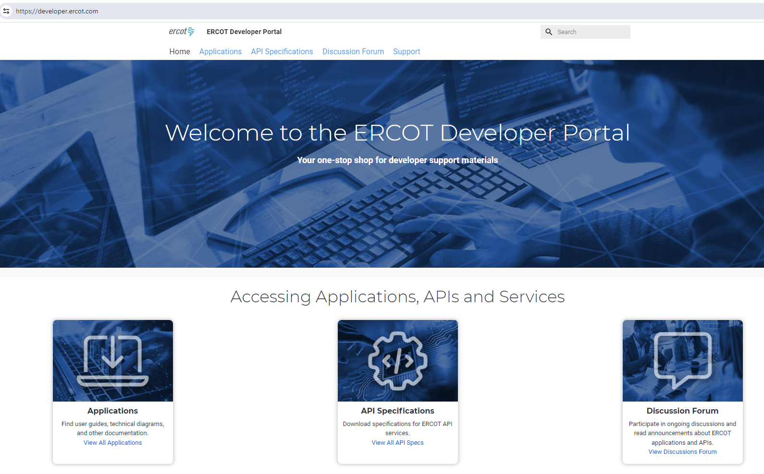
ERCOT Developer Portal

