Slide 1
Lubbock Retail Integration Task Force – LRITF march 5th, 2024
Chris Rowley Michael Winegeart Sheri Wiegand

Slide 2
Final Transition Timeline

Slide 3
LRITF meetings 2/6/24 2/20/24
The Task Force reviewed the following:
Customer Choice Transaction Status – with the impending start of the DREP Assignment period, choice transaction totals were been presented: 2/6 ~33,700 enrollments, 2/15 ~ 70,000 enrollments. DREP Assignments = 37,730 ESIs. As of 2/20 ~9500 CSA counts and growing rapidly.
DREP & Choice MVIs logic – stacking logic reviewed for DREP with MMRD and Choice transaction with MMRD+1 day post 2/15 for choice to trump DREP assignment.
Elimination of DG rate – LP&L have chosen to eliminate the residential and secondary < 10 kW Distributed Generation rate classes. All ESIs will move to the appropriate rate class via an 814_20 transaction.
Proration of Demand Charges – LP&L’s systems are not set up to prorate demand charges should a customer switch REPs mid-cycle. REPs may issue Usage & Billing MarkeTraks requesting corrections.
Various Updates: Shopping Fairs, Winter Storm Uri declaratory order, historical usage request formats, 867 IDR payloads, all bills paid apartments, DNPs, SMT update, transaction processing timing.

Slide 4
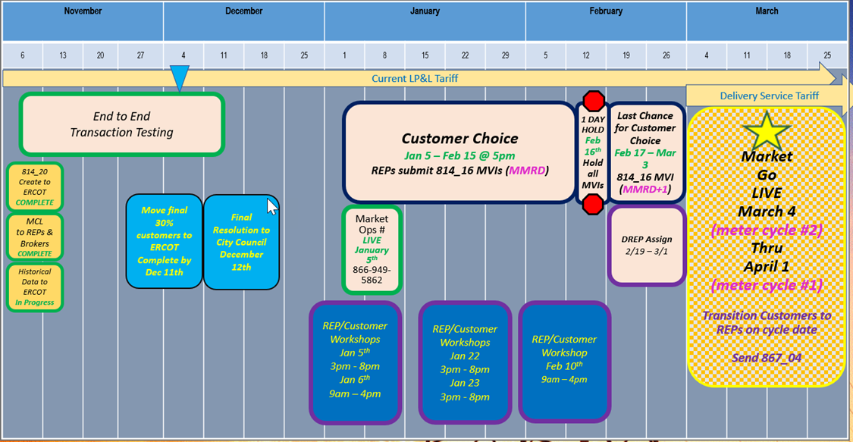
Completed Action Items Q&A
Transition to Competition
ERCOT/LP&L will begin accepting transactions 1/5/24 – 2/15/24 @ 5PM. On 1/5/24, transactions will be accepted at any time, however, LP&L will not begin processing transactions until after 5PM on 1/5/24. With the throttling of transactions to LP&L on 1/5 @ 5PM (by ESG), Not First In transactions (NFI) on 1/5 will be reviewed by LP&L and NFIs will be unexecuted if necessary with T025 codes “Competing Transaction Scheduled for the Same Date”. IMPORTANT: LP&L has asked REPs to hold transactions from 2/15/24 @ 5PM until Saturday, 2/17 @ 7AM to allow time for LP&L to perform queries for DREP assignments and modify systems to no longer automate the MVI date for the appropriate meter read cycle. DREP Assignment Period to commence 2/19/24 – 3/1/24 Transitioning of LP&L customers on March/early April meter read cycles (starting 3/4/24 – 4/1/24)

Slide 5
Completed Action Items Q&A
Transition to Competition - continued
Q: How will LP&L customers know they are assigned to a DREP? And to which DREP? A: LP&L sent postcards to customers who had not chosen by 2/15 @ 5:00 informing them of their assigned DREP. DREPs will also be sending out Welcome Kits and letters.
PUCT Requirements
Q: Will the Winter Storm Uri securitizations apply to LP&L customers post-transition? A: PUCT issued a declaratory order supporting LP&L’s position is that HB4492 and PUCT Dockets 52321 and 52322 (Securitizations M & N) excluded LP&L customers (post-transition) from securitization charges and REPs should not be charging customers for such charges. LP&L met with PUCT Staff and Executive Director to review. ERCOT agrees with LPL’s interpretation and intends to file two petitions (one for each subchapter of PURA 39.151 (j-1) addressing Securitizations M and N) for a clear written record of the PUCT’s interpretation of the above applicability. The goal of the procedural schedule is for the Commission to hear no later than the Feb 15th Open Meeting. Concurrently, ERCOT is working to operationalize excluding LP&L load from the calculations and expect the exclusions to be in place for the first initial settlement invoices (in March).

Slide 6
Completed Action Items Q&A
ERCOT Market Requirements
Q: Will LP&L submit LSE files to Smart Meter Texas for customer and REP access? A: LP&L is working with Smart Meter Texas to reach an agreement for utilization of the AMS data repository. It is expected LP&L will not integrate LSE files until at least Q2 of Q4 2024 after SMT has planned a version update (v3.0). As a workaround, REPs are encouraged to utilize ERCOT’s AMS Settlement extract to obtain daily interval data files (which is available at OD+4). With the delay of the transition, LP&L is hopeful an agreement is reached with SMT and REPs will be able to retrieve daily LSE files in the same manner as other TDUs. LP&L will continue to provide updates for SMT utilization when REPs will be able to retrieve daily LSE files in the same manner as other TDUs. Q: Has LP&L tested their daily LSE files with ERCOT for formatting and processing? What is LP&L’s level of confidence in the quality of the AMS data? A: LP&L does plan to tested their LSE file processing with ERCOT in August 2023 and will provide test files for interested REPs once all the LP&L ESIs have been created thus around mid to late October. Regarding the quality of the AMS data, LP&L is confident in their system and are currently fine tuning the Validating, Editing, and Estimating (VEE) process. LP&L reminded the market they have been deployed and operational with AMS meters for ~3 years.

Slide 7
Completed Action Items Q&A
ERCOT Market Requirements - continued
Q: Which SAC04 Codes do Lubbock plan to utilize for 810_02 invoices to REPs? A: LP&L will use the following existing SAC04 codes to represent the cost recovery components of their delivery charges: DIS001 – Delivery Service Charge (volumetric) MSC029 – Transition Charge (volumetric) BAS003 – Monthly DG Charge (fixed) Keep in mind for demand-based rate classifications, the SAC04 of DIS001 will appear twice in an 810_02 (once for kW and once for kWh volumes).
TDSP Specific Activities
Q: Does LP&L have any master metered apartments? A: LP&L does not currently have any have 3 master metered apartments and 5 “all bills paid” complexes. If a REP needs to make arrangements for a DNP/RNP, REPs should email marketops@mylubbock.us to confirm and coordinate as noted in Chapter 8 of the RMG.

Slide 8
Completed Action Items Q&A
LP&L Rates
LP&L’s street lighting rate was inadvertently assigned as $0.27 per kWh and will be revised to $0.17 per kWh. Upon final approval, rate is expected to effective prior to transition. Q: What is considered a normal 30 day billing cycle? A: Normal billing cycles range from 27 to 33 days. Q: Will LP&L consider proration of demand charges for billing periods outside of normal 30 day billing cycle? A: LP&L systems are not designed to adjust/prorate demand charges for billing periods outside of 30 days. For SWIs that result in the same customer receiving two split bills for one 30 day period, a REP(s) may submit a Usage & Billing – Dispute MarkeTrak to request demand charges be prorated for the shorter billing cycle. Q: Will LP&L have a discretionary Priority Move In Fee? A: At this time, LP&L will not implement a PMVI, however, may consider its addition at their annual rate review (mid to late summer).

Slide 9
TIMELINE of Actions
Pro Forma Tariff
Access Agreement
POLR Process
Safety Net Process
Q4 2022
ERCOT Activities: SAC04s, Load Profiles
TSDP Activities: Critical Care, DLFs, Solar/DG, Switch Hold Files, BUSIDDRQ, Call Center, OGFLT, Weather Moratoriums, Proration
LP&L Rates
Customer Enrollment Process – Detailed Timeline
PUCT Complaint Process / Application of PUCT Rules
Transaction Timelines / TXSET Timelines
CSA Process
Q1 2023
Q2 2023
ESI IDs in TDSP Extract
RMG Chapter 8 Revisions
Historical Usage Requests
TDSP AMS Data Practices
Mass Customer Lists
Power to Choose website
Customer Forums/Town Halls
Flight Testing / Bank Testing
Q3 2023
CBCI files
Default REP Selection Process
DNP Blackout Period
Market Operations Group Established
Tampering Information Process
Smart Meter Texas
Q4 2023
March 2024
GO LIVE – Transition to Competition
Completed
Q3 2023
Q4 2023
Q1 2024
Q4 2024

Slide 10
Lritf meeting 3/5/2024 @ 1:00PM following RMS
AGENDA ITEMS:
Customer Choice MVI Transaction Status Update–
MVI counts
CSA counts
DREP Process & Competitive MVIs
Rejections
Inadvertent Gain Process during Transition
Winter Storm Uri Securitization Exemption NPRR
Sample 867 IDR payload
Historical Usage Requests – LOA Form Change
Updated Tariff
Elimination of DG rates
Street Light Rate Change
Franchise Fee
EPS Meters
Open Discussion

