Slide 1
DRRS Design to Meet HB1500 Intent
Hunt Energy Network (HEN)
February 29, 2024

Slide 2
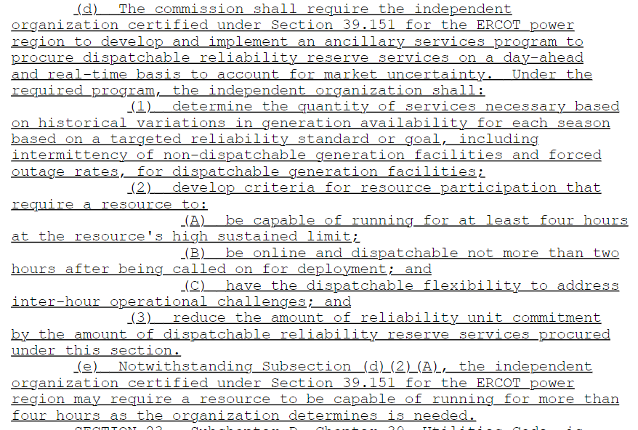
HB1500

Slide 3
Primary Goal of DRRS
HB1500: “determine the quantity of services necessary based on historical variations in generation availability for each season based on a targeted reliability standard or goal, including intermittency or non-dispatchable generation facilities and forced outage rates, for dispatchable generation facilities”
Any reliability standard ultimately adopted will likely require no more than 5-10 GW of firm Load shed that can be rotated during extreme events of significant duration
Severe winter storms of long duration, with little solar and wind support, are the most challenging for the ERCOT Grid – about 10 GW of additional dispatchable resources needed to meet any reasonable reliability standard
According to HB1500, DRRS should be designed to meet this reliability challenge

Slide 4
DRRS Design to Meet Goal
DRRS duration requirement should be 24 hours at least for the winter months and may be as low as 4 hours in all other months and must be available within 2 hours
DRRS Resources would have EOC Floor of $500/MWh with DRRS payment clawed back with possible penalties if not available during critical times
Online DRRS already considered available by RUC and offline DRRS will be available to RUC at significantly scaled down startup and min energy cost – no RUC makewhole payment to DRRS Resources
CLRs must consume at DRRS awarded capacity with CLR Energy Bid Floor at SWOC
Non-Spin would be repurposed for DRRS for quick implementation – Non-Spin ASDCs for non-winter months but much higher ASDC for winter reflecting enormous costs of long duration dispatchable capacity shortfall
Starting quantity ~6GW for winter (Non-Spin MWs for other seasons) with pre-specified growth to meet reliability standard based on VOLL and LOLP
DRRS allocated LRS and can be self-arranged and traded
Commitment of offline DRRS accounted for in RDPA

Slide 5
DRRS Implementation
Non-Spin would be repurposed for DRRS for quick implementation and to minimize cost impact on Load
Starting quantity ~6GW with pre-specified quantities over future years to meet reliability standard at the earliest possible considering time needed to build new dispatchable resources with predefined adjustments for retiring dispatchable resources
DRRS is procured in DAM and co-optimized with Energy/AS and can be bilaterally traded but represents a physical commitment hours ahead since RUC looks hours ahead
Since DRRS quantities and prices would be significantly higher in winter months, DRRS is targeted to longer-duration dispatchable resources
Seasonal DRRS ASDCs reflecting varying DRRS seasonal quantity needs would be used to procure DRRS (DRRS ASDC is not tied to segmented ORDC for winter)

Slide 6
Proposed DRRS Implications
ERCOT Grid needs long-duration dispatchable resources to meet any reasonable reliability standard – proposed DRRS design would incentivize such resources and thus better meet the stated goal of HB1500
Non-performance clawback and possible penalties will encourage high availability during scarcity events and the development of firmer fuel supply
During non-winter months, solar ramp hours are relatively easy to forecast and load forecast errors are known at least a few hour ahead – thus, DRRS can meet those needs making Non-Spin redundant (online Non-Spin provides little reliability benefit anyway)
Proposed DRRS would incentivize newer longer-duration dispatchable resources that thrive on capturing high prices in an IRR saturated market
With EOC Floor of $500/MWh, proposed DRRS provides some price support to other resources during most hours while moderating extreme events by being dispatched when prices exceed submitted EOC

