Slide 1
TDTMS Update
RMS
March 5th, 2024

Slide 2
TDTMS
ERCOT Reporting
Listserv Activity – Update to listserv lag in emails sent on 1/12: a throttle was removed, and performance returned to as expected. The lag was due to the growth in the TXANS distribution reported last month from 20K to 26K subscribers.
SCR817 – ERCOT currently working on the Inadvertent Gain revisions for the User’s Guide which may impact a few other areas of the RMG. The group decided to preserve all RMG revisions until SCR817 business requirements and user’s guides drafts have been reviewed in order to submit only one RMGRR.
MIS API project update – Released weekend of 12/9 – 12/10 and is reportedly functioning well. A couple of follow up issues reported, one being missing ‘key date’ requested for initiating transactions if the viewer is not the submitter. A few defects were found in the first round of corrective testing; therefore, a second round of testing is being performed.
Retail Incident 2/12 – ERCOT was unable to send transactions for ~1hour from 7:56AM-8:57AM as well as reporting was affected. Issue triggered by a known bug which a new data center and storage refresh in 3-4 weeks may correct. Two market notices were sent to notice_extracts_retail@lists.ercot.com and notice_operations_retail@lists.ercot.com.

Slide 3
TDTMS
RMGRR177 – Switch Hold Removal Clarification
Switch Hold Removal Clarification RMGRR was approved with one abstention at RMS on 2/6. During RMS conversation, a question was posed if PUCT Staff will be made aware of the changes.
Update: ERCOT staff met with PUCT Staff and PUCT Staff was comfortable with the proposed language and did not request changes.

Slide 4
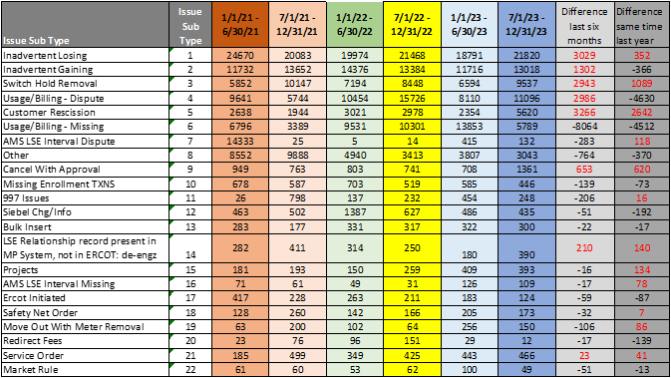
TDTMS
MarkeTrak Subtype Volume Analysis – End of Year 2023

Slide 5
TDTMS
MarkeTrak Subtype Volume Analysis – End of Year 2023
Inadvertent Losing subtype continues to be elevated.
Observations:
Inadvertent Gaining subtype counts appear seasonal in nature and consistent in the latter halves of the years.
Switch-hold Removal subtype has grown with higher counts reflected in the second half of the year; likely due to extreme heat weather moratoriums.
Rescission subtype spiked in the last six months of 2023 which will be reviewed for opportunities.
Cancel with Approvals also spiked in the last six months of 2023 and will be reviewed to see if REPs are inadvertently sending same-day requests.
Two others of note were the DEV and Service Order subtypes which saw an increase.

Slide 6
TDTMS
Next Meeting – March 12th
DRAFT Agenda:
System Instances & MT Performance
Listserv
ERCOT Reports
MIS API update – update on ‘key dates’ populating
SCR817 Business Requirements
MarkeTrak Subtypes Volume Analysis 2023 – Further Analysis
Review of User’s Guide drafts - Inadvertent Gains and any other clarifications
Data/Talking Points for Client Services on MarkeTrak analysis - update
Tuesday, March 12th - 9:30 AM WebEx only
RMGRR177 Switch Hold Removal Clarification – status of progress
IAG Report – Quarterly Review

