Slide 1
Standalone DRRS Workshop 1
Concept Draft Proposal
February 29, 2024

Slide 2
Agenda
Background
Overview of DRRS
Qualification
Process for Procurement
Deployment
Real-Time Reliability Deployment Price Adder Changes
Settlement Processes
Q&A

Slide 3
Tentative Timeline
February 29
Present concept
Take stakeholder feedback
March 27
Present draft NPRR
Take stakeholder feedback
April
Post NPRR
Begin stakeholder process
Late 2024/ Early 2025
Board endorsement of NPRR
PUCT approval of NPRR
TBD
Implementation

Slide 4
Background
Section 22 of House Bill 1500, passed by the 88th Texas Legislature, orders the implementation of DRRS in the ERCOT Market.
ERCOT previously filed Nodal Protocol Revision Request (NPRR) 1203, Implementation of Dispatchable Reliability Reserve Service, to address this requirement by establishing DRRS as a subtype of Non-Spinning Reserve Service.
After receiving feedback from state leadership and the Public Utility Commission of Texas, ERCOT withdrew NPRR1203 in order to develop DRRS as a standalone Ancillary Service.

Slide 5
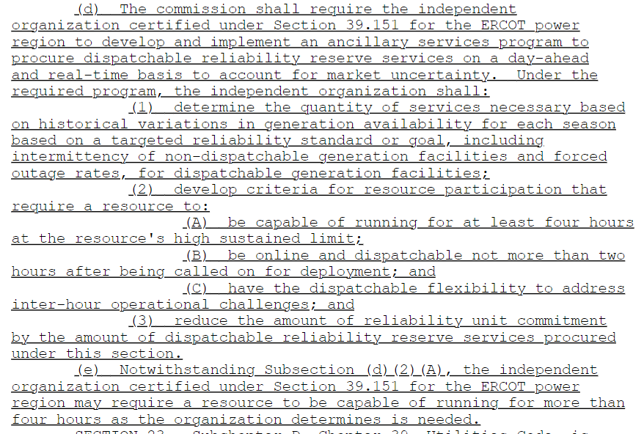
HB 1500 Language

Slide 6
Standalone DRRS Concept Overview
To satisfy the requirements of HB 1500, ERCOT proposes to create a new standalone Dispatchable Reliability Reserve Service (DRRS) that:
Can be provided by off-line Generation Resources with a 2 hour or less start time, on-line Generation Resources, Energy Storage Resources (ESRs), and/ or Controllable Load Resources (CLRs);
Requires Resources be able to provide the service for 4 consecutive hours from a qualification perspective;
Is procured in the Day-Ahead Market (DAM);
Is not co-optimized with energy or other Ancillary Services in the Real-Time Market (RTM);
Is primary deployed through Reliability Unit Commitment (RUC) processes; and
Will be implemented either simultaneous with or after RTC (i.e., 2026 or 2027).

Slide 7
Qualification
Off-line Generation Resources
With startup time <= 2 hours
On-line Generation Resources
ESRs
Limited to 4-hour capability
CLRs
Non-CLRs
Does not meet “dispatchable flexibility” criterion in statute
Goal: Qualify as many types of Resources as possible to meet reliability objective as efficiently as possible.
Tradeoff: More types of Resources means more implementation complexity.

Slide 8
Qualification - ESRs
Based on the statutory language, qualification is limited to Resources with 4-hour capability. Due to ESRs’ duration limitations, their qualification will be limited to their 4-hour MW and MWh capabilities.
Additionally, ESR provision of DRRS will need to consider State of Charge (SOC).
Failure to provide rules and requirements will generally exist for all Resource types.
SOC requirement will be for ESR to maintain sufficient SOC to provide DRRS capacity for 4 hours, less Base Point and Primary Frequency Response deployment.
ESRs with durations less than 4 hours and providing DRRS will need to adjust their High Sustained Limits (HSLs) to address:
“be capable of running for at least four hours at the resource’s high sustained limit”.
ESRs
Limited to 4-hour capability
Example: 100 MW, 200 MWh ESR can provide 50 MW of DRRS. SOC requirement is 200 MWh less BP and PFR deployments.

Slide 9
DRRS Quantities
DRRS quantities will be determined during the annual Ancillary Service Methodology process.
Methodology will include consideration of forecast and outage risks in the +2 hour ahead timeframe.
The overall Ancillary Service Methodology will be reviewed to assess if changes are warranted in light of DRRS procurement.

Slide 10
Process for Procurement
DRRS will be co-optimized with other Ancillary Services in the DAM.
DRRS can be offered from either on-line or off-line Resources.
There will not be Ancillary Only Offers for DRRS.
No specific proposal today on the Ancillary Service Demand Curve (ASDC) for DRRS but expect that the max. price on the ASDC for DRRS to be less than the max. price on the ASDC for Non-Spinning Reserve (Non-Spin) . As an initial reference, this may mean a max. price in the range of $150/MWh - $200/MWh (although this is based on current 2024 Ancillary Service quantities).
A QSE may self-arrange DRRS.
QSEs may trade DRRS and there will be no trade limitations based on the manner in which DRRS is being provided (on-line vs. off-line).

Slide 11
Process for Procurement
Generation Resources providing off-line DRRS cannot simultaneously be providing off-line Non-Spin because there is not a way to account for what portion of the capacity is being deployed/held back for each service.
Deploying one service effectively means a deployment of the other.
DRRS will not be co-optimized in the RTM
DRRS is intended to be used in lieu of RUC instructions. The Operator needs to know which Resources are providing DRRS, if they need to deploy it instead of issuing a RUC.
Unlike other Ancillary Services, the triggering conditions for deployment are not based on Real-Time conditions. They are based on forecasted system conditions at the time RUC is executing. Even manual Non-Spin deployments are based on what the Operator is seeing during the Operating Hour.
Because DRRS is not co-optimized in the RTM and given that DRRS is intended to be used in lieu of RUC instructions, RUC will also not co-optimize DRRS.
More discussion on proposed RUC changes later.

Slide 12
Deployment of Off-Line DRRS
The Ancillary Service Manager application is not directly connected to RUC processes. To simplify processes for the Operator and to ensure DRRS is being considered before issuing RUC instructions, DRRS deployment of off-line Generation Resources will be an inherent part of the RUC process.
For off-line Generation Resources, DRRS will be deployed via the commitment of the Resource through the RUC process.
For hours in which the Resource is providing DRRS (based on data in the Current Operating Plan (COP)), the startup and min. gen. cost of the Resource will be scaled down so that RUC “prefers” the Resource over the commitment of other Resources.
The commitment decision will account for the Resource’s startup time and may be less than 2 hours.
The RUC engine will respect the Resource’s min and max runtime.
The hours of commitment may include hours in which the Resource is not scheduled to provide DRRS. Those hours will generally be treated as self-commitment where the Resource’s Startup Costs will not be included in the calculation of RUC Guarantee.

Slide 13
Deployment of On-Line DRRS
For on-line Resources, DRRS capacity will be required to be offered behind an offer (or bid, as applicable) floor for both energy and Ancillary Services.
The offer floor will need to be set such that it is high enough to allow non-DRRS capacity to provide energy and Ancillary Services but not too high to result in other Ancillary Services being deployed before DRRS.

Slide 14
RUC Changes Associated with the DRRS Deployment Processes
The RUC engine will be modified to:
Consider DRRS capacity as available to meet committed capacity margin deficiencies;
Prioritize the use of off-line DRRS over committing other off-line Generation Resources;
Assign the lowest penalty price for DRRS capacity provided by on-line Generation Resources, ESRs, and CLRs, relative to other Ancillary Services. Coordinate this penalty with scaled off-line DRRS costs as much as possible to first utilize on-line DRRS.
Reg Up + RRS + ECRS + Non-Spin
DRRS
Reg Up + RRS + ECRS + Non-Spin
Committed Capacity
DRRS
RUC Recommendation = No additional capacity needed, beyond the deployment of DRRS
Committed Capacity
RUC Recommendation = Additional capacity needed beyond deploying DRRS (both off-line and on-line DRRS)
Load Forecast
Load Forecast

Slide 15
Real-Time Reliability Deployment Price Adder Changes
ERCOT-directed deployment of off-line DRRS will be considered in the determination of the Real-Time Reliability Deployment Price Adder for Energy, and the Real-Time Reliability Deployment Price Adders for Ancillary Services.
The off-line DRRS deployment will look like a RUC instruction for purposes of the price adder process.
The deployed off-Line DRRS Resources will be adjusted as following in the SCED Pricing Run process:
(i) Set the LSL and LDL to zero;
(ii) Remove all Ancillary Service Offers; and
(iii) For the first step of SCED, administratively set the Energy Offer Curve for the Resources at a value equal to the power balance price for all capacity between 0 MW and the HSL of the Resource.

Slide 16
Settlement
Propose DAM Settlement for DRRS to be the same as all other Ancillary Services under Real-time Co-optimization (RTC).
Payments are based on awards and charges are based on Day-Ahead Obligation.
Day-Ahead Charges are re-allocated based on actual Hourly Load Ratio Share in the same manner as all other Ancillary Services under RTC.
The one exception is that there are no virtual awards.

Slide 17
Settlement
Propose Real-Time Settlement to include
RUC Make-Whole Cost allocation based on DRRS shortfall
DRRS shortfall allocation based on DRRS Awards, Self-Arranged, Trades and what is reflected in the COP at the time of the RUC commitment
DRRS shortfall allocation will be capped in a manner similar to how the Capacity Short allocation is capped today. Current cap is based on 2 times the MW shortage
Amounts not allocated to the DRRS shortfall will be allocated to RUC Capacity Short QSEs and then Load Ratio Share, like it is today
Failed quantity charge and payment
QSE will be charged for failure to provide DRRS responsibility
Charged the Day-Ahead DRRS clearing price times the failed amount
Failed amount is based on telemetered responsibility
Failed quantity charge is distributed to Hourly Load Ratio Share

Slide 18
Next Steps
Please send comments to jbillo@ercot.com.
ERCOT plans to post draft NPRR language to workshop #2 calendar page by March 20.
DRRS workshop #2 on March 27 following TAC (but no earlier than 1:00).
Post DRRS NPRR.

Slide 19
Questions/ Comments

