Slide 1
NPRR1186 Update
Nitika Mago/Sreenivas Badri
February 22, 2024

Slide 2
NPRR1186 Status
Objective of this NPRR is to implement improvements prior to the RTC+B project for better ESR State of Charge Awareness, Accounting, and Monitoring.
NPRR Status
On 1/18/2024, PUCT remanded this NPRR to the ERCOT Board.
Suggested modifications to section 8.1
ERCOT submitted comments to remove the revisions to Protocols Section 8.1
Pending ERCOT Board & PUCT approval

Slide 3
ERCOT System Changes
New ICCP Telemetry points for ESR additions

Slide 4
ERCOT System Changes
External Specs/xsd changes
3 new fields are being added to COP submissions
Max SOC
Min SOC
TargetBeginSOC
Changes are backward compatible for Non-ESRs and ESRs
Changes are in the ErcotTransactionTypes.xsd

Slide 5
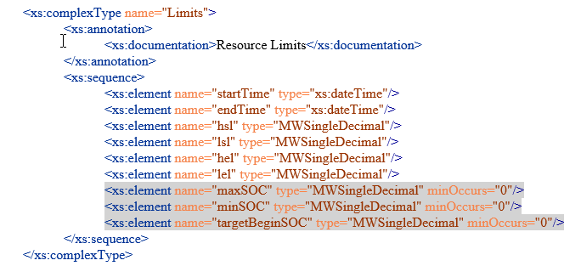
ERCOT System Changes
External Specification changes
The gray highlighted elements below were added for this NPRR

Slide 6
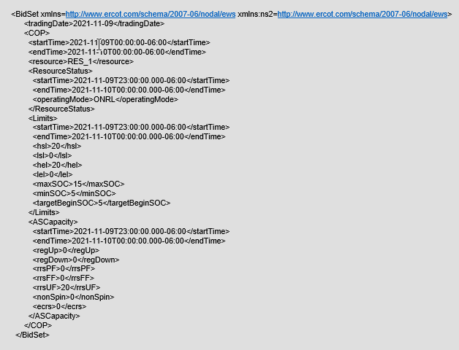
ERCOT System Changes
External Specification changes
COP submission xml example with SOC changes

Slide 7
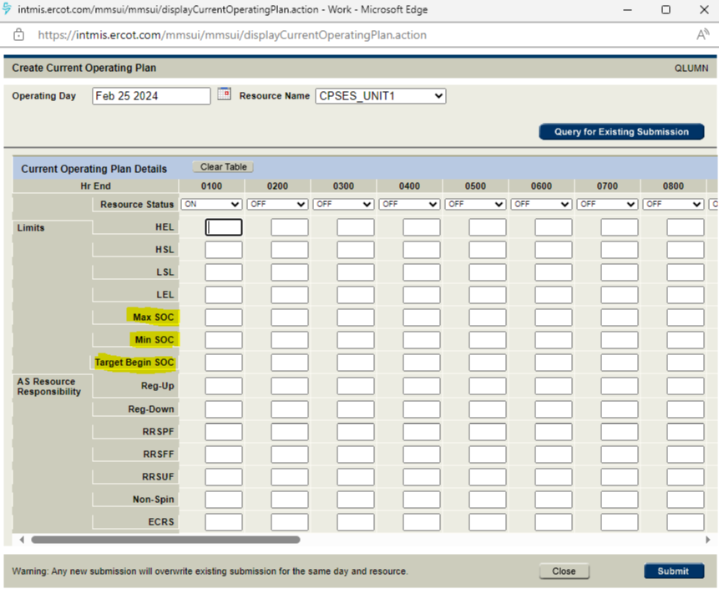
ERCOT System Changes
Market Manager UI changes
COP Submission with SOC changes

Slide 8
Timelines
Plan to make draft version of ICCP Handbook and External Specs (XSD) changes available in ercot.com by March 1st week after Board approval.
Release Timelines (subject to change based on Board/PUCT decision)
MOTE Testing to start from 05/16/2024
Go live date - 06/13/2024

