Slide 1

NERC EMSWG Update
Wei Qiu, NERC EA
ERCOT TWG Conference Call
February 22, 2024

Slide 2
2024 Monitoring and Situational Awareness Technical Conference
Location: ReliabilityFirst in Cleveland, OH
Date and Time:
  Tuesday, October 8, 2024
  Wednesday, October 9, 2024
Theme: TBD

Slide 3
NERC EMSWG Workplan 2024
2024 Monitoring and Situational Awareness Technical Conference - (in person)
Risk and Mitigations for Losing EMS Functions Reference Document v4 (biennial) 2024 Q3
More discussions
    Renewable resources
    EMS in Cloud Computing
    Lessons Learned
    EMS best practice

Slide 4
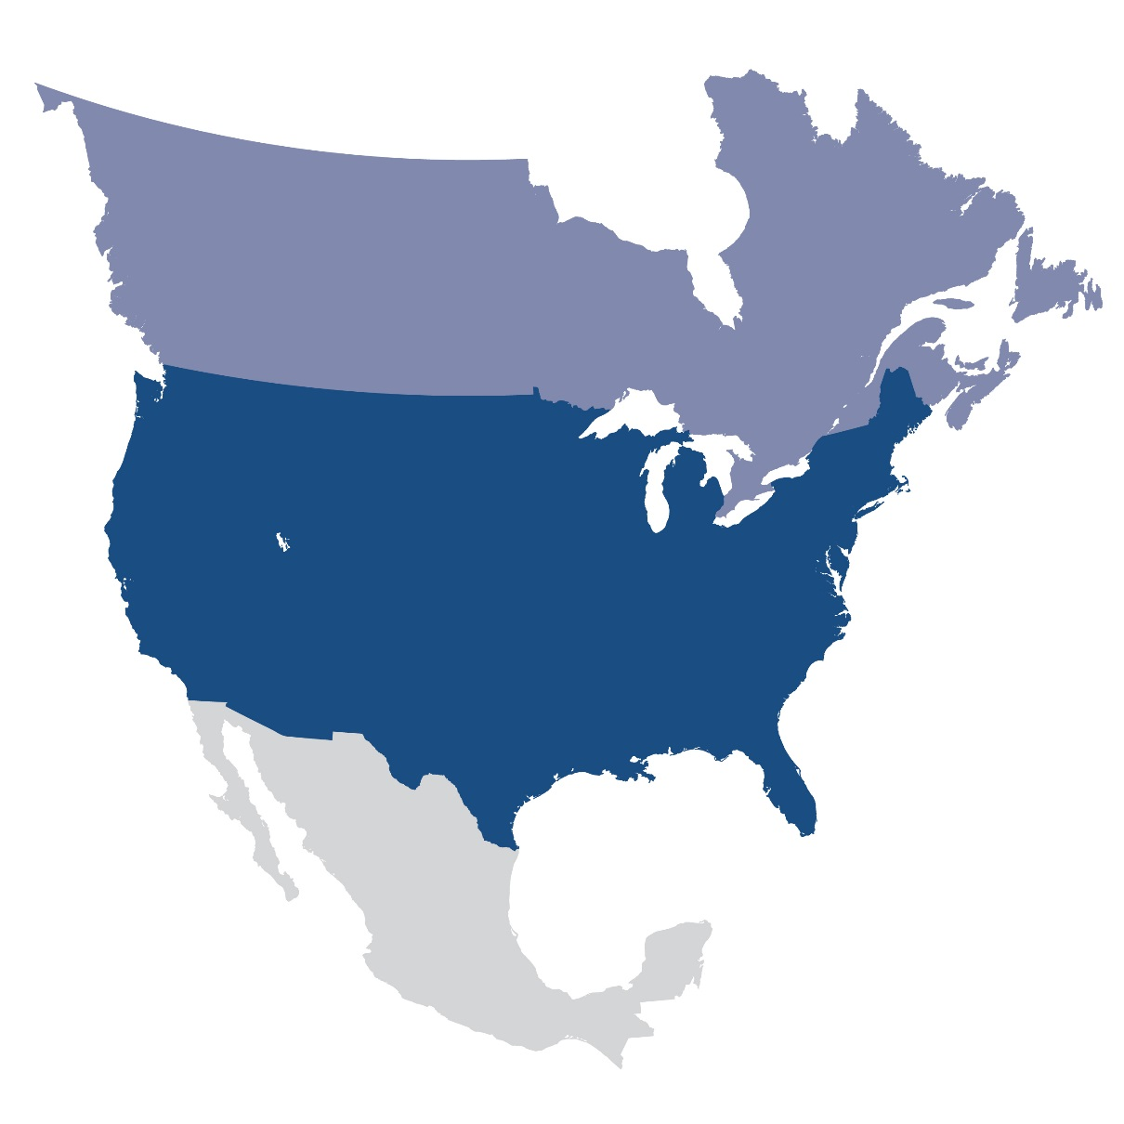
Questions and Answers
Contact Information:
wei.qiu@nerc.net

